Slide 1
Skin Condition: Part II
Assist . Lect: Rasha Saadi Abbas

Slide 2
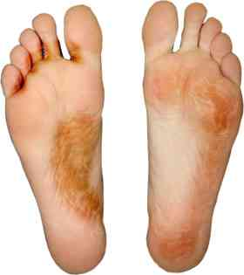
Athletes Foot

Slide 3
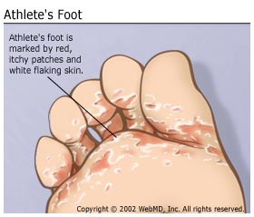

Slide 4
Treatment with Topical Antifungals
Imidazole (Clotrimazole, Miconazole, Ketoconazole)
Terbinafine
Griseofulvin
Undecenoates
Tolnaftate

Slide 5
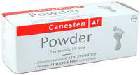
Imidazole/ Clotrimazole

Slide 6
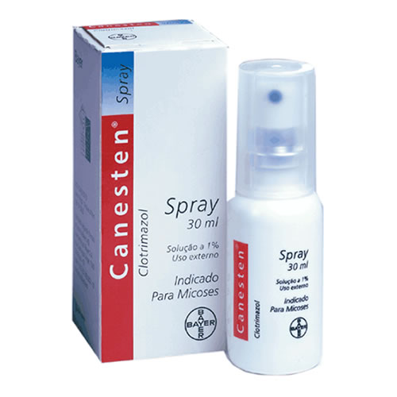
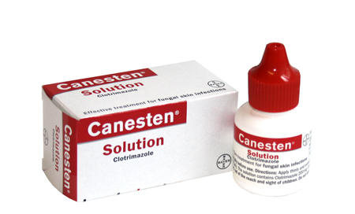

Slide 7
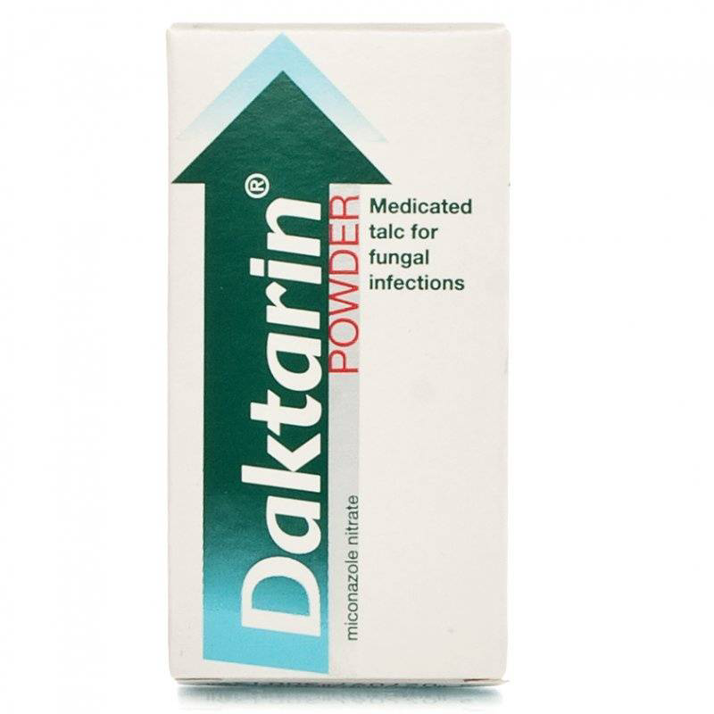
Miconazole

Slide 8
Ketoconazole

Slide 9
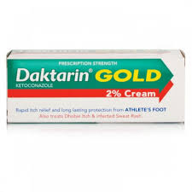
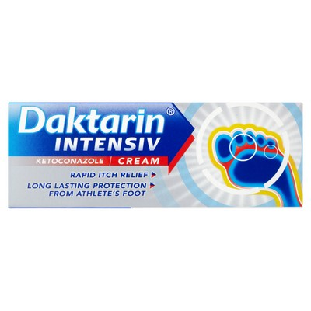

Slide 10
Terbinafin

Slide 11
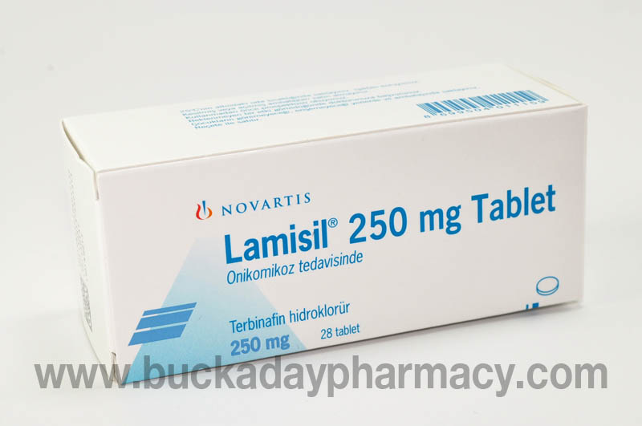

Slide 12
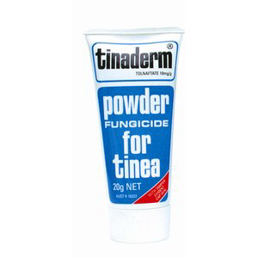
Tolnaftate

Slide 13
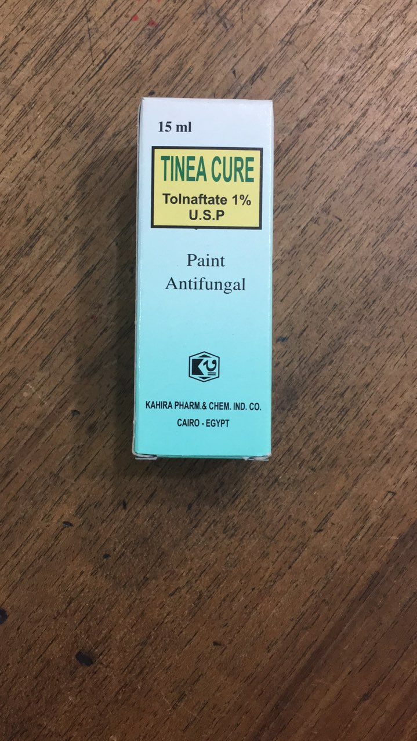

Slide 14
Griseofulvin

Slide 15
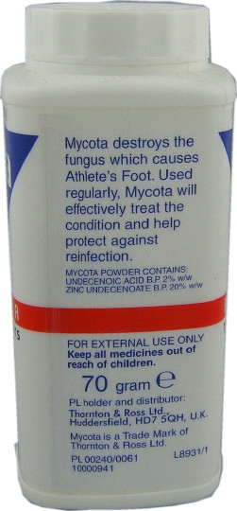
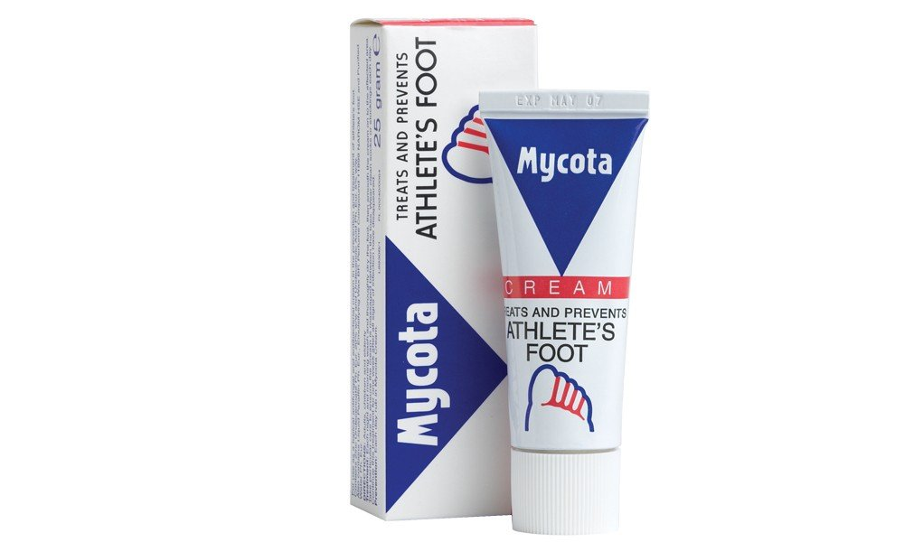
Antiseptic and Disinfectant/ Undecenoic acid with zinc undecenoate

Slide 16
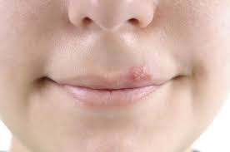
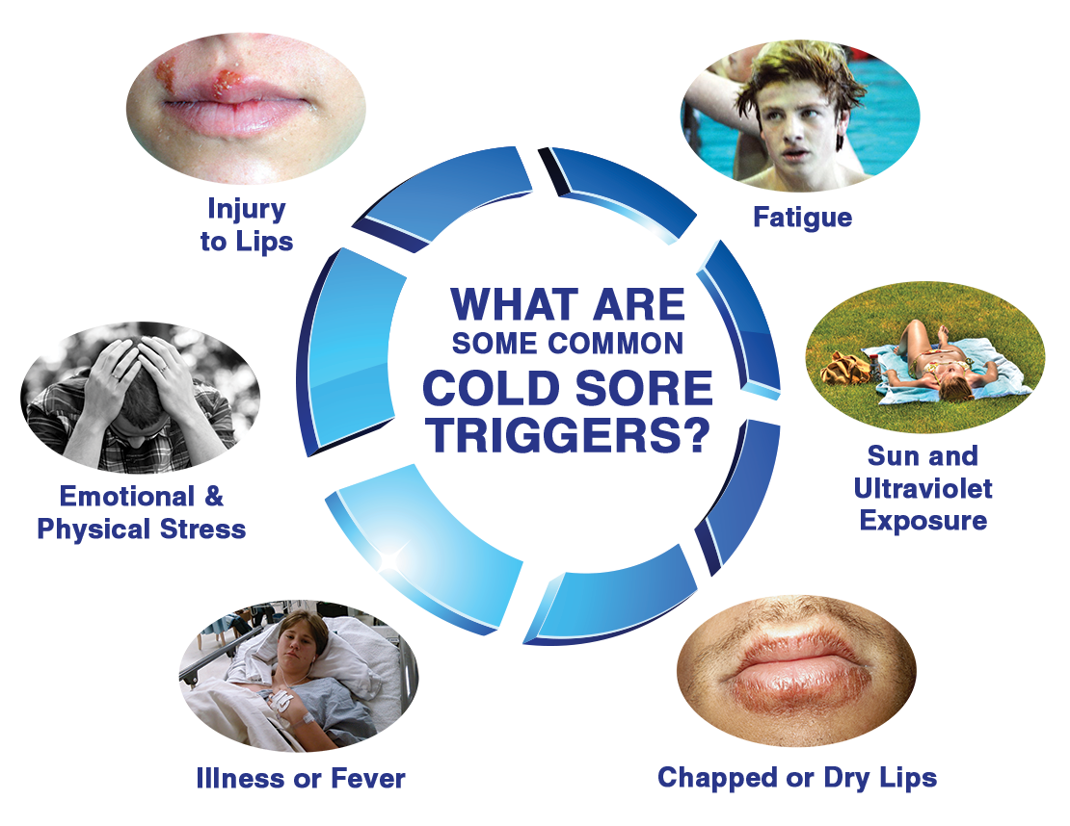
Cold Sore

Slide 17
Aciclovir (Acyclovir)

Slide 18
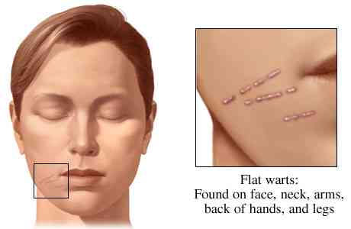
Warts

Slide 19
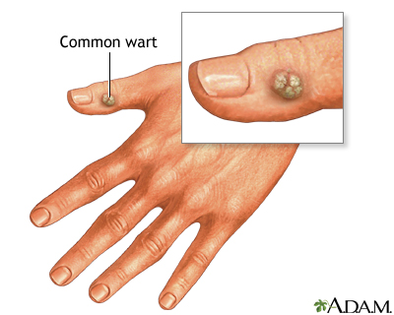
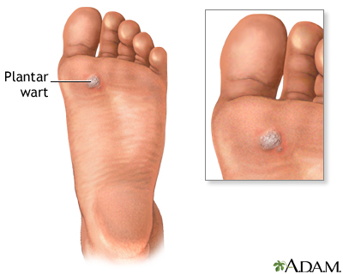

Slide 20
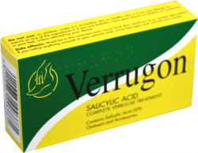
Salicylic acid

Slide 21
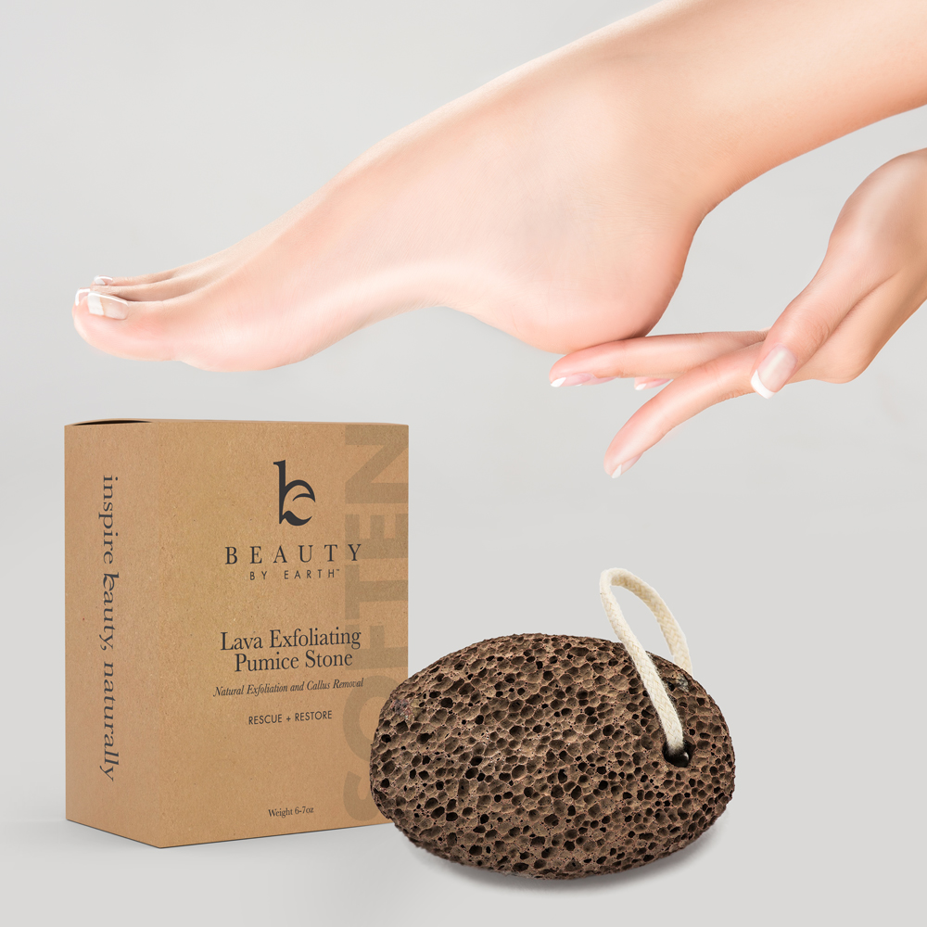

Slide 22
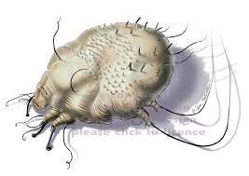
Scabies

Slide 23
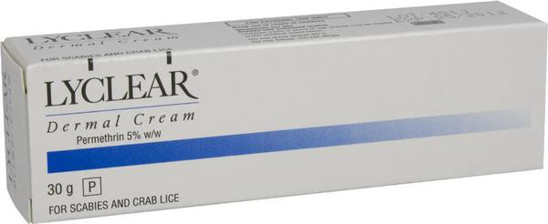
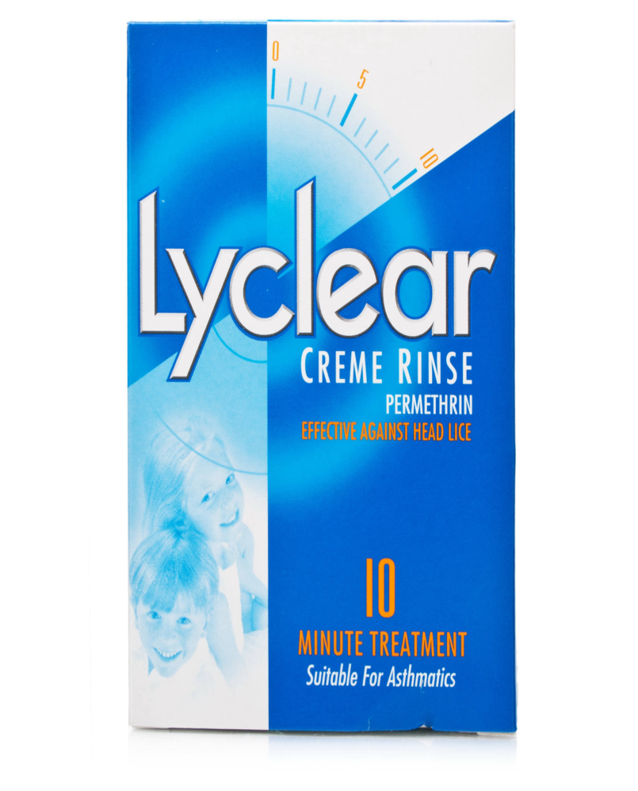

Slide 24
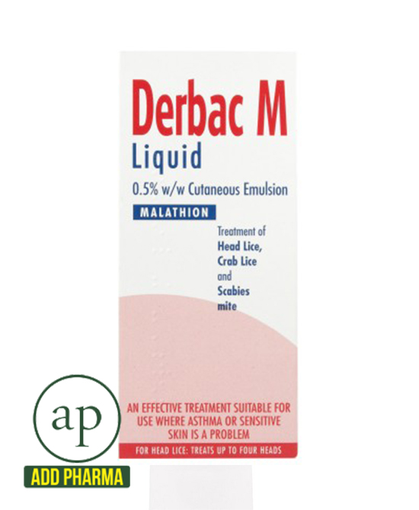

Slide 25
