Slide 1
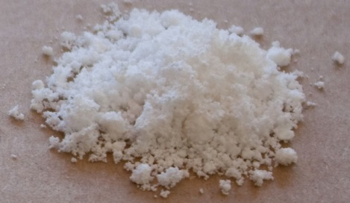
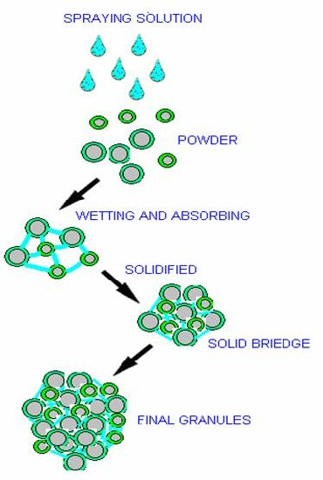
Wet Granulation

Slide 2
Wet Granulation
The wet granulation technique uses the same preparatory and finishing steps of direct compression and dry granulation (dry screening and mixing); it also involve additional steps of wet massing, wet screening and drying.

Slide 3
Steps of Wet Granulation
1.Mixing (blending) of the drug, diluent and disintegrant.
2.Wet massing by addition of binder or adhesive or called granulation agent.
3.Granulation by sieving (wet screening).
4.Drying.
5.Homogenizing by second sieving (dry screening).
6.Mixing (blending) by addition of glidant and lubricant.

Slide 4
Mixing
Wet Massing
Drying
Wet Screening
Dry Screening
Mixing

Slide 5
1- Mixing
Mixing starts with adding drug then excipients. The mixing process depends on the properties of the drug and excipients.
  If the drug is soluble in water and excipients are little; so we start to add binder solution to the drug to be distributed uniformly then excipients that have little solubility in water (e.g. starch), it is possible to be added extragranularly [as a whole] or [divided and added as one half intragranulary and the other extragranulary to avoid getting friable tablets].
Total amount of disintegrant is not always added completely to the powder–diluent mixture (intragranulary), some other portion might be added with lubricants (extragranulary) in the final step prior to compression (double disintegration)

Slide 6
2- Wet Massing
Adhesive (binder) is most commonly employed as solution, suspension, slurry, or used as a dry powder.
Method of introducing the binder depends on its solubility and on the components of the mixture (wettability).
In the wet massing step the binder solution will distribute and filling the spaces between particles.
The primary force of granulation act as a bridge and is obtained from surface tension and capillary force or pressure of the liquid (binder solution) between particles.

Slide 7
Once the liquid is added, mixing is continued until we get a uniform dispersion of the adhesive within the whole system.
The length off wetting time depends on the wetting property of the powder mix. and the granulating fluid, and on the efficiency of the mixer.
The end point can be determined by the press mass test (ball test) as the mass must be moisten rather than pasty or wet, it is done by pressing a portion of the mass in the palm if the ball crumbles under a moderate pressure, the mixture is ready for the next step (wet screening).

Slide 8
Over wetting causes:
1.Hard aggregates of powder during milling process.
2. Some of the material may block the sieve or screen(sticky).
3. Slow drying process.
Note: If the material to be granulated is water sensitive a great care should be considered by the use of organic solvents (e.g PVP in isopropyl alcohol as a binder) because it is flammable, expensive, not easily handled.

Slide 9
3- Wet Screening (granulation)
Granulation is performed to obtain a discrete granules and further consolidate the granules by increasing the particles contact points, and also to increase surface area to facilitate the drying process.
4- Drying
After drying step the granules should contain some degree of humidity to act as a binder (not be 100% free of humidity) as over drying may leads to weak force and friable granules.

Slide 10
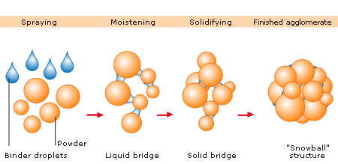
The final cohesive force obtained after drying stage when evaporation of solvent occur as a result of fusion, recrystalization and curing of the binding agent with Van der Waals forces playing a significant role.

Slide 11
5- Dry screening
After drying; then dry screening is performed to get a homogenized granules with uniform size and shape.
6- Mixing
By addition of lubricants and glidants.
Therefore, the granules will posses good compressibility (good cohesive forces once applying punch forming solid impact tab.), good flowability (spherical shape that is the ideal physical form in providing smoothness and size uniformity to the particles which is easily flow).

Slide 12
Advantages of wet granulation method:
1.Improve flowability, cohesiveness and compressibility of the powder, so the powder is easily compressed with lower binder concentration (due to the stick of powder particles together that are surrounded by layer of a binder) in addition to the low pressure and low energy comparing to dry granulation (prolong machine age).
2. Can be used for high dose drug with weak compressibility that is not affected by heat and moisture.
3. Maintaining uniform distribution for low dose drug and water soluble dyes (coloring agent).

Slide 13
4.Improve the dissolution rate of hydrophobic drug because of the presence of moisture of the already used water.
5. Maintaining good content uniformity due to prevention of particle segregation since all the granules will have the same density (same constituent of the powder mixture).

Slide 14
Disadvantages of wet granulation method
1.cost-time consumer
2. Personal and environmental hazards upon using organic solvents represented by the flammability and toxicity of these solvents after evaporation during drying, handling or storage.
3. Stability problem because of the presence of moisture speeds up the reaction between active ingredients and the additives and the additives itself.

Slide 15
Preparation of Sulfadiazine (sulfa drug) by wet granulation
Organoleptic properties: White crystalline or white yellowish fine crystals or powder form, tasteless or slightly bitter taste.
Solubility: Practically insoluble in water, chloroform, and ether; very slightly soluble in ethanol; soluble 1 in 300 of acetone; soluble in dilute mineral acids and in solutions of alkali hydroxides and carbonates.
Absorption: it is weak acid (pKa=6.36), so they are well absorbed from GIT, mainly in stomach because are present in undissociated form.

Slide 16
Stability: Stable in dry air and not affected by moisture and heat, slowly darken and decompose, so should be protected from light should be kept in dark closed container (opaque containers).
Sulfadiazine is prepared by wet granulation method for the following reasons:
1.They are not affected by moisture and heat.
2.Large doses
3.Present in powder form as fine crystals.

Slide 17
Sulfa drug are not prepared by direct compression because:
1.They had bad flowability because they present as fine powder or fine crystals
2.They are used in large doses and direct compression is only used for intermediate doses.

Slide 18
Example
Sulfadiazine 250 mg (active ingredient)
Ca carbonate 250 mg (diluent)
Explotab 50 mg (disintegrant)
Zn stearate 10 mg (lubricant)
Acacia mucilage 20%(w/v) q.s. (binder)
prepare 50 tablets

Slide 19
Answer
Mix all ingredients except lubricant and binder.
Add the binder drop by drop (ball test).
Calculate the weight of acacia in each tablet
(If we use for example 5 ml of (20%w/v) acacia mucilage for 50 tab.)
20 gm 100 ml
x 5ml
= 1 gm of acacia for 50 tab
1gm/50 *1000= 20 mg of acacia per tab.

Slide 20
Calculate the theoretical wt. of one tablet (without lubricant)
250 mg+250 mg+50 mg+10 mg =560 mg wt. of one
tablet without lubricant
Weigh the prepared granules (actual wt. of tablets without lubricant)
for example it was found to be 22800 mg
Find the real no. of tablets
Real no. of tab. = actual wt./theoretical wt.
=22800 / 570
=40 tablets

Slide 21
Calculate the actual amount of lubricant to be added:
amount of lubricant =10 mg * Real no. of tab.
=10 * 40
=400mg of lubricant added

Slide 22
Question
Na2CO3 125mg
Lactose 100mg
Starch 10mg
Acacia mucilage 20%(w/v)q.s.
Zn stearate 0.5mg
Prepare 20 tablet

Slide 23


