Slide 1
Lecture-9-10 Pharmaceutical Biotechnology
Elimination of Protein Therapeutics

Slide 2
Protein-based therapeutics are generally subject to the same catabolic pathways as endogenous or dietetic proteins:
The end products of protein metabolism are thus amino acids that are reutilized in the endogenous amino acid pool for the de novo biosynthesis of structural or functional proteins in the human body.
Non-metabolic elimination pathways (renal or biliary excretion) are negligible for most proteins.
Example: If biliary excretion occurs, however, it is generally followed by subsequent metabolic degradation of the compound in the gastrointestinal tract.

Slide 3
Proteolysis
The metabolic rate for protein degradation increases with:
Decreasing molecular weight from large to small proteins and peptides as shown in(Table 1)
Also dependent on other factors such as size, charge, lipophilicity, functional groups, and glycosylation pattern as well as secondary and tertiary structure.

Slide 4
Table 1. Molecular weight as major determinant of the elimination mechanisms of peptides and proteins
Major determinant | Predominant elimination mechanisms | Elimination site | Molecular weight
Structure, lipophilicity | 1.Extracellular hydrolysis 2.Passive lipoid diffusion | Blood, liver | < 500
Structure, lipophilicity | 1.Carrier-mediated uptake 2.Passive lipoid diffusion | Liver | 500-1,000
Molecular weight | Glomerular filtration and subsequent degradation process | kidney | 1,000-50,000
Sugar, charge | Receptor mediated endocytosis | Kidney, liver | 50,000-200,000
α2-macroglobulin, IgG | Opsonisation |  | 200,000-400,000
Particle aggregation | Phagocytosis |  | > 400,000

Slide 5
About Table 1
Notes:
The molecular weight is the major determinant of the elimination mechanisms of peptides and proteins.
Other determining factors are size, charge, lipophilicity, functional groups, sugar recognition, vulnerability or susceptibility for proteases, aggregation to particles, formation of complexes with opsonization factors (is a process of coating with opsonin, marking out for destruction by the immune system. Once it has been marked, thus it is killed via one of two mechanisms: it may be ingested and killed by an immune cell or killed directly without ingestion), etc.
Mechanisms may overlap and endocytosis may occur at any molecular weight range.

Slide 6
The clearance of a peptide or protein (irreversible removal of active substance from the vascular space, which includes metabolism & cellular uptake).
Proteolytic degradation of proteins (unspecific) occur everywhere in the body or can be limited to a specific organ or tissue.
some proteins already in blood as well as potential active cellular uptake, the clearance of protein drugs can exceed cardiac output, i.e., > 5L/ min for blood clearance and > 3L/min for plasma clearance.

Slide 7
General notes:
Molecular weight determines:
1. the major metabolism site
2. the predominant degradation process.
Proteolytic enzymes such as proteases and peptidases are ubiquitous (everywhere) throughout the body.
Sites capable of extensive peptide and protein metabolism are not only limited to the liver, kidneys, and gastrointestinal tissue, but also include blood and vascular endothelium as well as other organs and tissues.

Slide 8
Important notes:
As proteases and peptidases are located within cells, intracellular uptake is more as elimination rather than a distribution process.
While peptidases and proteases in the GIT and in lysosomes (unspecific).
soluble peptidases in the interstitial space and exopeptidases on the cell surface (higher selectivity and determine the specific metabolism pattern of an organ).
Example: The proteolytic activity of SC tissue results in a partial loss of activity of SC compared to IV administrated interferon-γ

Slide 9
Gastrointestinal Protein Metabolism
GIT is the major site of protein metabolism (with high proteolytic enzyme activity) due to its primary function to digest dietary protein.
limiting systemic bioavailability of orally administered protein drugs.
Note:
The metabolic activity of GIT is not limited to orally administered peptides and proteins.
Parenterally administered peptides and proteins may also be metabolised in the intestinal mucosa following intestinal secretion.
For Example: At least 20% of the degradation of endogenous albumin has been take place in the GIT.

Slide 10
Renal Protein Metabolism and Excretion
Size selectivity: The kidneys are a major site of protein metabolism (for smaller sized proteins that undergo glomerular filtration).
The size-selective cut-off for glomerular filtration (60 kDa), although the effective molecule radius based on molecular weight and conformation is probably the limiting factor.
Glomerular filtration is most efficient for proteins smaller than 30 kDa.
Peptides and small proteins (<5kDa) are filtered very efficiently, and their glomerular filtration clearance approaches the glomerular filtration rate (GFR,$\sim$120 mL/ min in humans).
For molecular weight exceeding 30 kDa, the filtration rate falls off sharply.
charge selectivity observed for glomerular filtration where anionic macromolecules pass through the capillary wall < neutral macromolecules < cationic macromolecules.

Slide 11
Renal metabolism of peptides and small proteins is mediated through three highly effective processes:
Only minuscule amounts of intact protein are detected in urine.
The first mechanism
Involves glomerular filtration of larger, complex peptides and proteins followed by reabsorption into endocytic vesicles in the proximal tubule and subsequent hydrolysis into small peptide fragments and amino acids.
Example: This mechanism of elimination has been described for IL-2, IL-11, growth hormone, and insulin.

Slide 12
The second mechanism
Needs glomerular filtration followed by intraluminal metabolism, predominantly by exopeptidases in the luminal brush border membrane of the proximal tubule. The resulting peptide fragments and amino acids are reabsorbed into systemic circulation.
Example: This route of disposition applies to small linear peptides such as glucagon and LH-RH.
Note:
Recent studies implicate the proton driven peptide transporters PEPT1 and especially PEPT2 (the main route of cellular uptake of small peptides and peptide-like drugs from the glomerular filtrates).
These high-affinity transport proteins exhibit selective uptake of di- and tripeptides, which implicates their role in renal amino acid homeostasis.

Slide 13
For both mechanisms, glomerular filtration is the dominant, rate-limiting step as subsequent degradation process are not saturable under physiologic conditions.
Due to this limitation of renal elimination, the renal contribution to the overall elimination of proteins is dependent on the proteolytic activity for these proteins in other body organs:
If metabolic activity for these proteins is high in other body regions, there is only minor renal contribution to total clearance, and it becomes negligible in the presence of unspecific degradation throughout the body.
If metabolic activity is low in other tissues or if distribution to the extravascular space is limited, however, the renal contribution to total clearance may approach 100%.
Example: Recombinant human interleukin-10 (rhIL-10), for which clearance correlation closely with GFR, making dose adjustments necessary in patient with impaired renal function.

Slide 14
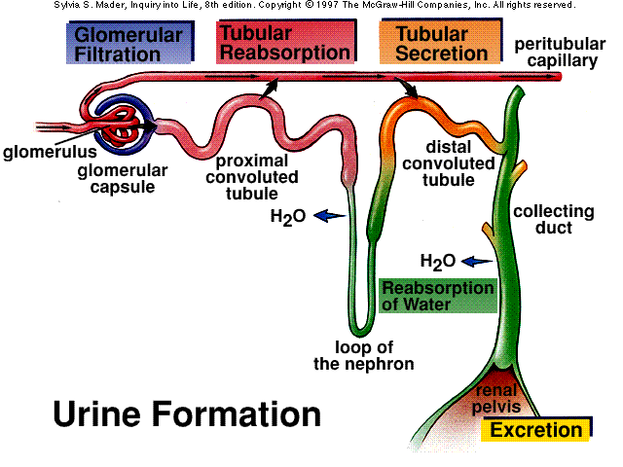
The third mechanism
Renal metabolism in peritubular extraction of peptides and proteins from post-glomerular capillaries with subsequent intracellular metabolism.

Slide 15
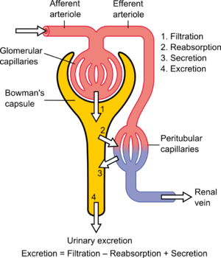

Slide 16
Hepatic Protein Metabolism
Aside from renal and gastrointestinal metabolism, the liver play a major role in the metabolism of protein therapeutics.
Exogenous + endogenous proteins undergo proteolytic degradation to dipeptides and amino acids that are reused for endogenous protein synthesis.
Proteolysis starts with endopeptidases that attack (middle part of the protein), and the resulting oligopeptides are then further degraded by exopeptidases.
The rate of hepatic metabolism is largely dependent on the specific amino acid sequence of the protein.

Slide 17
A prerequisite for protein metabolism is the uptake of proteins into the hepatocytes:
Small peptides may cross the hepatocyte membrane via simple passive diffusion if they have sufficient hydrophobicity.
Example: Peptides of this nature include the cyclosporine (cyclic peptides).
Other cyclic and linear peptides of small size (<1.4 kDa) and hydrophobic nature (containing aromatic amino acids), such as cholecystokinin-8 (CCK-8; 8 aminoacids) are taken up by the hepatocytes by a carrier-mediated transport, in this case of CCK-8 by the organic anion transporting polypeptide OATP-8 (SLCOIB3)

Slide 18
After internalization into the cytosol, these peptides are usually metabolized by microsomal enzymes (cytochrom P-450 3A for cyclosporine A) or cytosolic peptidases (CCK-8).
Then typically excreted into the bile by active export transporters.
These hepatic clearance pathways are identical to those known for most small hydrophobic drug molecules.

Slide 19
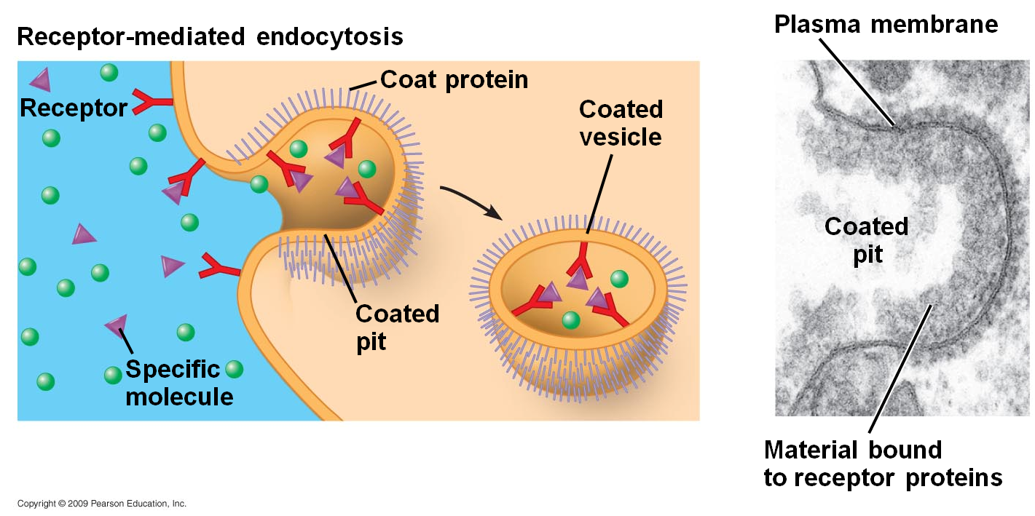
Uptake of larger peptides and proteins is facilitated via various carrier-mediated, energy-dependent transport processes.
One of the possibilities is receptor-mediated endocytosis: such as for insulin and epidermal growth factor.
In Receptor-mediated endocytosis, circulating proteins are recognized by specific hepatic receptor proteins.

Slide 20
Steps of protein metabolism in liver:
The receptors (integral membrane glycoproteins with an exposed binding domain on the extracellular side of cell membrane).
After the binding of the circulating protein to the receptor, the complex is already present or moves in coated pit regions, and the membrane invaginates and pinches off to form an endocytotic coated vesicle that contains the receptor and ligand (internalization).
The vesicle coat consists of proteins (clathrin, adaptin, and others), which are then removed by an uncoating adenosine triphosphatase (ATPase).
The vesicle parts (the receptor and the ligand) dissociate and are targeted to various intracellular locations.

Slide 21
Some receptors, such as the low-density lipoprotein (LDL), asialoglycoprotein and transferrin receptors, are known to undergo recycling.
Other receptors, such as the interferon receptor, undergo degradation.
Decrease in the concentration of receptors on the cell surface (receptor down-regulation).
Others, such as insulin receptors, for example, undergo both recycling and degradation.

Slide 22
For glycoproteins, if a critical number of exposed sugar groups (mannose, galactose, fucose, N-acetylglucosamine, N-acetylgalactosamine, or glucose) is exceeded, receptor-mediated endocytosis through sugar-recognizing receptors, is an efficient hepatic uptake mechanism.
Important carbohydrate receptors in the liver are the asialoglycoprotein receptor and the mannose receptor in Kupffer and liver endothelial cells.
The high-mannose glycans in the first kringle domain of t-PA, for example, have been implicated in its hapatic clearance.

Slide 23
Low density lipoprotein receptor-related protein (LRP)
Is a member of the low-density lipoprotein (LDL) receptor family responsible for endocytosis of several important lipoproteins, protease, and protease-inhibitor complexes in the liver and other tissues.
Uptake of proteins by liver cells is followed by transport to an intracellular compartment for metabolism.
Protein internalized into vesicles via an endocytotic mechanism (undergo intracellular transport towards the lysosomal compartment near the center of the cell)
There, the endocytotic vehicles fuse with or mature into lysosome (specialized acidic vesicles that contain a wide variety of hydrolases capable of degrading all biological macromolecules).
Proteolysis is started by endopeptidases (mainly cathepsin D) that act on the middle part of the proteins. Oligopeptides-as the result of the first step-are further degraded by exopeptidases.
The resulting amino acids and dipeptidases reenter the metabolic pool of the cell.

Slide 24
The hepatic metabolism of glycoproteins (occur more slowly than the naked protein) because [protecting oligosaccharide chains need to be removed first].
Metabolised protein and peptides (in lysosomes from hepatocytes, hepatic sinusoidal cells and kupffer cells) may be released into blood or delivered to the bile canaliculus and excreted by exocytosis.
Note: The receptor-mediated uptake of protein drugs by hepatocytes, followed by intracellular metabolism (causes dose-dependent plasma disposition curves) [due to the saturation of the active uptake mechanism at higher doses].

Slide 25
Direct shuttle or transcytotic pathway
A second intracellular pathway for proteins is the direct shuttle or transcytotic pathway.
A- The endocytotic vesicle formed at the cell surface
B- traverses the cell to the peribiliary space,
C- fuses with the bile canalicular membrane,
D- releasing its content by exocytosis into bile.
Examples: This pathway, described for polymeric immunoglobulin A, bypasses the lysosomal compartment completely.

Slide 26
Receptor-Mediated Protein Metabolism
Substantial elimination pathway for those protein therapeutics that bind with high affinity to membrane-associated receptors on the cell surface.
The interaction of the protein therapeutic with the membrane receptor is frequently part of pharmacologic effect of the drug, i.e., the receptor is the target structure the protein therapeutic is directed at.
This binding can lead to receptor-mediated uptake by endocytosis and subsequent intracellular lysosomal metabolism.

Slide 27
Questions
Chapter-4
How does one sterilize biotech products for parenteral administration?
Answer: through aseptic manufacturing protocols. Final filtration through 0,2 0r 0.22 μm pore filters into the vials/ syringes further reduces the chances of contamination of the protein solutions.
A pharmaceutical protein, which is poorly water soluble around its pI, has to be formulated as an injection. What conditions would one select to produce a water soluble, injectable solution?
Answer: as the aqueous solubility is probably pH dependent, information on the preferred pH ranges should be collected. If necessary, solubility enhancers (e.g., lysine, arginine and/ or surfactants) and stabilizers against adsorption/ aggregation should be added. “As a last resort,” one might consider carriers such as liposomes.
Why are most of the biotech proteins to be used in the clinic formulated in freeze-dried form?
Answer: chemical and physical instability of proteins in aqueous media is usually the reason to dry the protein solution. Freeze drying is then preferred technology, as other drying techniques do not give rapid reconstitutable dry forms for the formulation, and/ or because elevated temperatures necessary for drying jeopardize the integrity of the protein. The glass tranition/ eutectic temperature should not be exceeded as otherwise collapse of the cake can be observed. Collapse slows down the drying process rate and collapsed material does not rapidly dissolve upon adding water for reconstitution.

Slide 28
4. why are (with the exception of oral vaccines) no oral delivery systems available for protein?
Answer: because of the hostile environment in the GI tract regarding protein stability and the poor absorption characteristics of protein (high molecular weight/ often hydrophilic).
What alternative route of administration to the parenteral route would be the first to look into if one dose not wish to exploit absorption enhancing technologies?
Answer: the pulmonary route.
If one considers using the iontophoretic transport route for protein deliver, what are the variables to be considered?
Answer: physical characteristics of the protein and medium, such as a molecular weight, pI, ionic strength, and pH . And, in addition, electrical current options (pulsed, permanent, wave shape) and desired dose level/ pattern (pulsed/ constant, variable).
Chapter 5
How do the sugar groups on glycoproteins influence hepatic elimination of these glycoproteins?
Answer: in some cases, the sugar groups are recognized by hepatic receptors (galactose receptor, for example), facilitating receptor-mediated uptake and metabolism. In other cases, sugar groups (terminal sialic acid residues, for example) may shield the protein from binding to receptors and hepatic uptake.
Why protein therapeutics generally not active upon oral administration?
Answer: the gastrointestinal mucosa is a major absorption barrier for hydrophilic macromolecule such as proteins. In addition, peptide and protein therapeutics are degraded by the extensive peptidase and protease activity in the gastrointestinal tract. Both processes minimize the oral bioavailability of protein therapeutics.

