Slide 1
Eye problems
The red eye
The dry eye

Slide 2
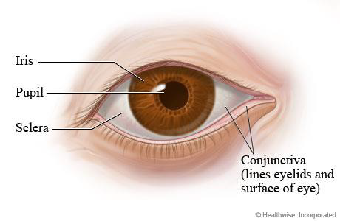

Slide 3
What you should know
Painless red eye:
Painful red eye:
One or both eyes affected?
Duration of symptoms
What is the appearance of the eye?
Pain, gritty feeling, photophobia?
Is vision affected?
Any discharge from the eye(s) – purulent, watery?
Does the patient wear contact lenses?

Slide 4
Painless red eye
Infective conjunctivitis
Allergic conjunctivitis
Blepharitis
Subconjunctival haemorrhage

Slide 7
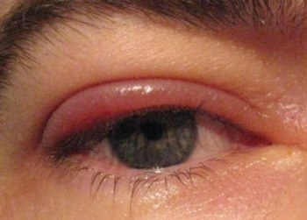
Blepharitis

Slide 8
Subconjunctival haemorrhage

Slide 9
Painful eye conditions Referal
Corneal ulcers, keratitis
Uveitis (iritis)
Glaucoma
Contact lenses

Slide 10
The dry eye

Slide 12
What you should know
What are the symptoms – pain, gritty feeling, photophobia?
Is vision affected?
Does the patient wear contact lenses?

Slide 13
Causes of dry eye
Environment
Medical conditions
Medication

Slide 19
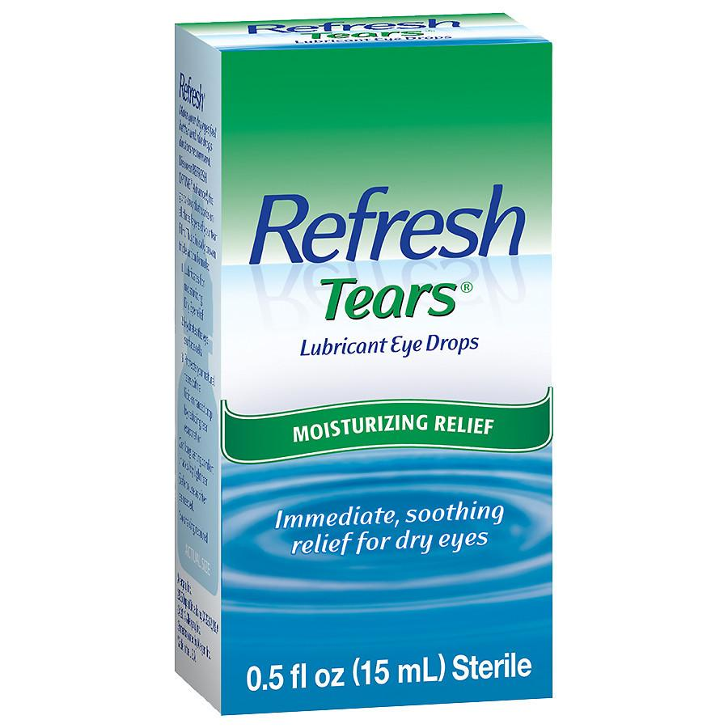
Management

Slide 20
Practical advice
Using a humidifier at home and work, Opening windows can help keep the air moist.
Avoiding tobacco smoke and smoking.
Avoid drugs known to aggravate the condition.
Wearing sunglasses outside will protect the eyes from the drying effects of sun and wind.
If using a computer for long periods, ensure that the monitor is at or below eye level, avoid staring at the screen, and take frequent breaks to close/blink eyes.

Slide 21
Recommended treatments for dry eye
Recommend artificial tears and ointments in people with dry eyes where Practical advice is insufficient. The severity of the condition and the person’s preference should guide choice:
For people with mild or moderate symptoms, artificial tears alone are usually sufficient.
Eye ointments containing paraffin may be uncomfortable and blur vision, so they should usually only be used at night and never with contact lenses.

Slide 22
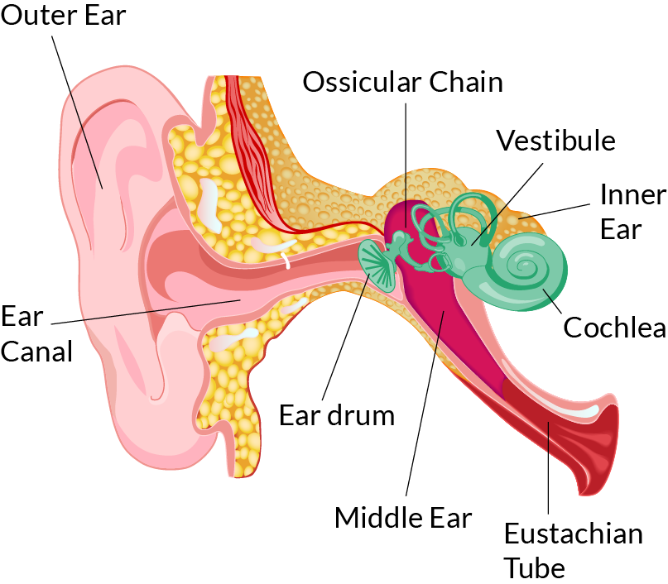
Common Ear problems

Slide 24
Normal ear vs. Ear wax

Slide 25
Cotton wool puds….

Slide 26
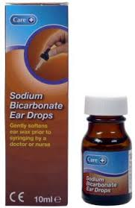
Ear Drops

Slide 27
Uppermost position (stay 2-3 min)

Slide 28
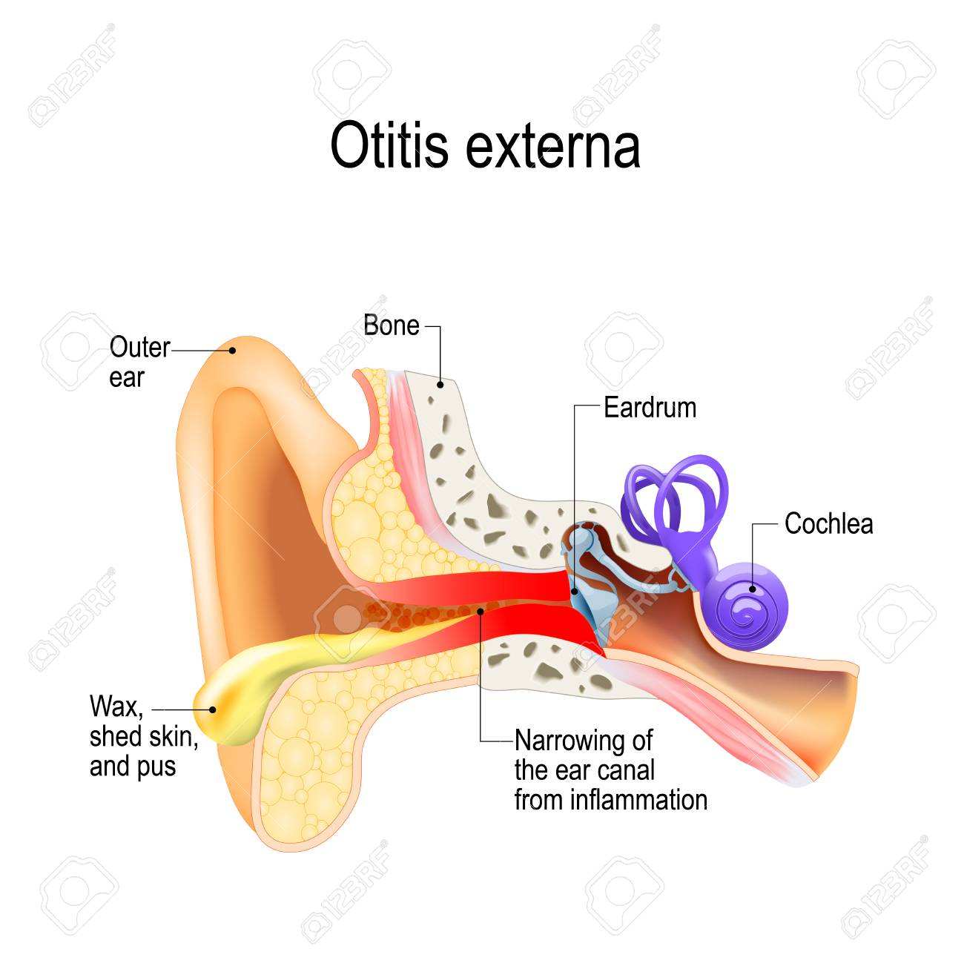

Slide 29
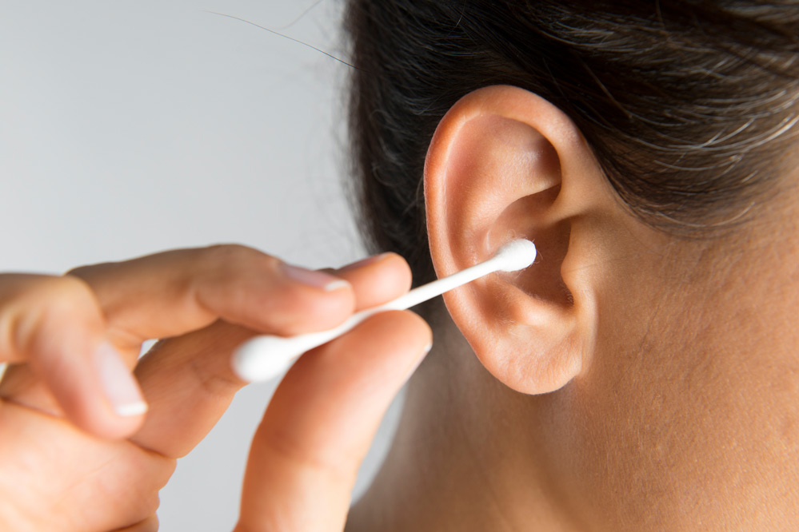
Causes

Slide 33
Oral ulcers result from damage to the mucosa of the mouth, both the epithelium, and the lamina propria
Mouth Ulcer

Slide 35
Causes
Family history
Trauma like biting the cheeks
Fitting dentures
Hormonal
Stress and emotional
Deficiency of iron, folate, zinc or vit. B12
Medications

Slide 36
Referal
Duration of longer than 3 weeks (without treatment) and 1 week (with treatment)
Associated weight loss
Ulcer suggestive of cancer
Involvement of other mucous membranes or eyes
Rash
Suspected adverse drug reaction
Diarrhoea

Slide 37
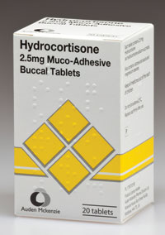
Management

Slide 38
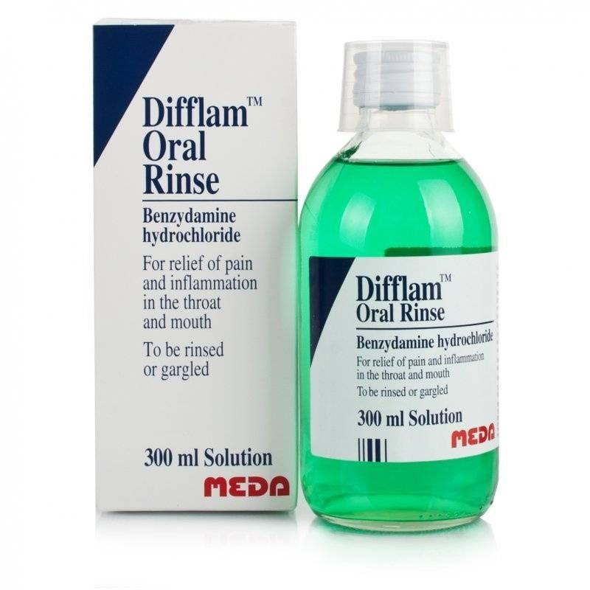
Local Analgesics
Local Anaesthetics

Slide 39
Good Luck

