Slide 1
Medical Microbiology
Asst. Prof. Dr. Dalya Basil Hanna

Slide 2
In This Lecture….
Opportunistic mycoses
Mycotoxins
Antifungal chemotherapy

Slide 3
Opportunistic mycoses
Patients with compromised host defenses are susceptible to ubiquitous fungi to which healthy people are exposed but usually resistant.
As members of the normal microbial flora, Candida and related yeasts are endogenous opportunists. Other opportunistic mycoses are caused by exogenous fungi that are globally present in soil, water, and air.

Slide 4
Candidiasis
Several species of the yeast genus Candida are capable of causing candidiasis. They are members of the normal flora of the skin, mucous membranes, and gastrointestinal tract. Candida species colonize the mucosal surfaces of all humans during or soon after birth, and the risk of endogenous infection is ever-present.
Candidiasis is the most common systemic mycosis, and the most common agents are C albicans, C tropicalis, C parapsilosis, C glabrata, C guilliermondii, and C dubliniensis. The widespread use of fluconazole has precipitated the emergence of more azole-resistant species, such as C krusei and C lusitaniae.

Slide 5
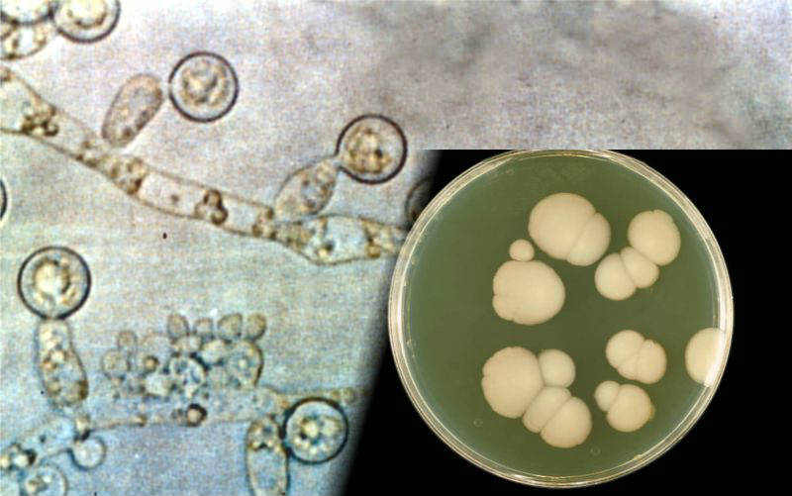
Candidiasis
Morphology & Identification: In culture or tissue, Candida species grow as oval, budding yeast cells, they also form pseudohyphae when the buds continue to grow but fail to detach, producing chains of elongated cells that are pinched or constricted at the septations between cells. Unlike other species of Candida, C albicans is dimorphic; in addition to yeasts and pseudohyphae, it can also produce true hyphae.

Slide 6
Pathogenesis & Pathology
Superficial (cutaneous or mucosal) candidiasis is established by an increase in the local census of Candida and damage to the skin or epithelium that permits local invasion by the yeasts and pseudohyphae. Systemic candidiasis occurs when Candida enters the bloodstream and the phagocytic host defenses are inadequate to contain the growth and dissemination of the yeasts. From the circulation, Candida can infect the kidneys, attach to prosthetic heart valves, or produce candidal infections almost anywhere (eg, arthritis, meningitis, endophthalmitis). The lesions contain abundant budding yeast cells and pseudohyphae. Large increases of Candida in the intestinal tract often follow the administration of oral antibacterial antibiotics, and the yeasts can enter the circulation by crossing the intestinal mucosa.

Slide 7
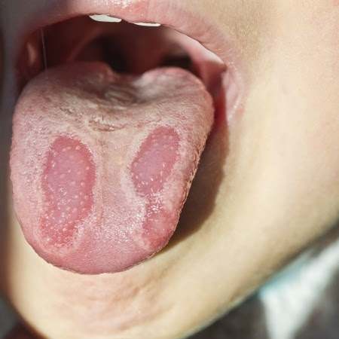
Clinical Findings
1- Cutaneous & Mucosal Candidiasis: The risk factors associated with superficial candidiasis include AIDS, pregnancy, diabetes, young or old age and trauma (burns, maceration of the skin). Thrush can occur on the tongue, lips, gums, or palate. It is a patchy to confluent, whitish pseudomembranous lesion composed of epithelial cells, yeasts, and pseudohyphae.
Yeast invasion of the vaginal mucosa leads to vulvovaginitis, characterized by irritation, pruritus, and vaginal discharge. This condition is often preceded by factors such as diabetes, pregnancy, or antibacterial drugs that alter the microbial flora, local acidity, or secretions.

Slide 8
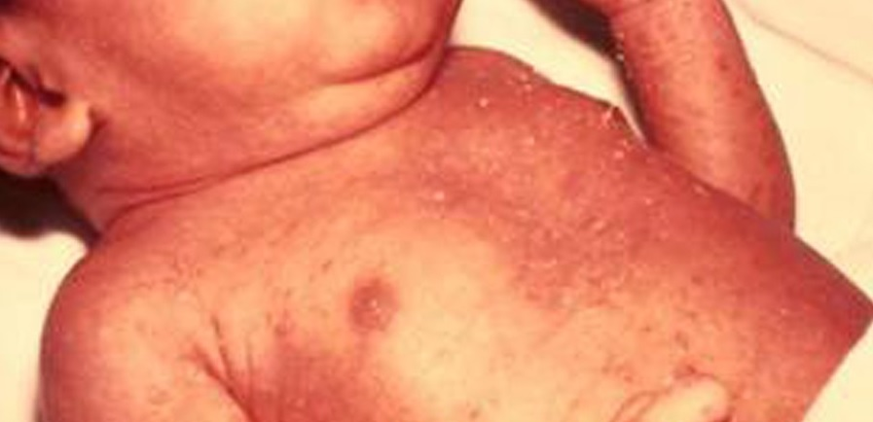
Clinical Findings
2- Systemic Candidiasis: Candidemia can be caused by indwelling catheters, surgery, intravenous drug abuse, or damage to the skin or gastrointestinal tract. In most patients with normal host defenses, the yeasts are eliminated and candidemia is transient. However, patients with compromised innate phagocytic defenses may develop lesions anywhere, especially the kidney, skin (maculonodular lesions), eye, heart, and meninges. Systemic candidiasis is most often associated with chronic administration of corticosteroids or other immunosuppressive agents; with hematologic diseases such as leukemia, lymphoma, and aplastic anemia; or with chronic granulomatous disease.

Slide 9
Diagnostic Laboratory Tests
Specimens: Include swabs and scrapings from superficial lesions, blood, spinal fluid, tissue biopsies, urine, exudates, and material from removed intravenous catheters.
Microscopic Examination: Tissue biopsies, centrifuged spinal fluid, and other specimens may be examined in Gram-stained smears or histopathological slides for pseudohyphae and budding cells. Skin or nail scrapings are first placed in a drop of 10% potassium hydroxide (KOH) and calcofluor white (a special fluorescent stain).

Slide 10
Diagnostic Laboratory Tests
Culture: All specimens are cultured on fungal or bacteriologic media at room temperature or at 37°C. Yeast colonies are examined for the presence of pseudohyphae. The diagnostic value of a quantitative urine culture depends on the integrity of the specimen and the yeast census. Positive blood cultures may reflect systemic candidiasis or transient candidemia due to a contaminated intravenous line. Sputum cultures have no value because Candida species are part of the oral flora. Cultures of skin lesions are confirmatory.
Treatment: Thrush and other mucocutaneous forms of candidiasis are usually treated with topical nystatin or oral ketoconazole or fluconazole. Systemic candidiasis is treated with amphotericin B, sometimes in conjunction with oral flucytosine, or fluconazole. The clearing of cutaneous lesions is accelerated by eliminating contributing factors such as excessive moisture or antibacterial drugs.

Slide 11
Cryptococcosis
Cryptococcus neoformans and C gattii are yeasts with large polysaccharide capsules. C neoformans occurs worldwide in nature and is isolated readily from dry pigeon feces. C gattii is less common and typically associated with trees in tropical areas. Both species cause cryptococcosis, which follows inhalation. From the lungs, these neurotropic yeasts typically migrate to the central nervous system where they cause meningoencephalitis. However, they also have the capacity to infect many other organs (eg, skin, eyes, prostate). C neoformans occurs in immunocompetent persons but more often in patients with HIV/AIDS, hematogenous malignancies, and other immunosuppressive conditions.

Slide 12
Pathogenesis
Infection is initiated by inhalation of the yeast cells, which in nature are dry, minimally encapsulated, and easily aerosolized. The primary pulmonary infection may be asymptomatic or may mimic an influenza-like respiratory infection, often resolving spontaneously. In patients who are compromised, the yeasts may multiply and disseminate to other parts of the body but preferentially to the central nervous system, causing cryptococcal meningoencephalitis. Other common sites of dissemination include the skin, adrenals, bone, eye, and prostate gland. The inflammatory reaction is usually minimal or granulomatous.

Slide 13

Clinical Findings
The major clinical manifestation is chronic meningitis, which can resemble a brain tumor, brain abscess, degenerative central nervous system disease, or any mycobacterial or fungal meningitis. Cerebrospinal fluid pressure and protein may be increased and the cell count elevated, whereas the glucose is normal or low. Patients may complain of headache, neck stiffness, and disorientation. In addition, there may be lesions in skin, lungs, or other organs.

Slide 14
Treatment
Combination therapy of amphotericin B and flucytosine has been considered the standard treatment for cryptococcal meningitis, though the benefit from adding flucytosine remains controversial. Amphotericin B (with or without flucytosine) is curative in most patients. Since AIDS patients with cryptococcosis will almost always relapse when amphotericin B is withdrawn, they require suppressive therapy with fluconazole.

Slide 15
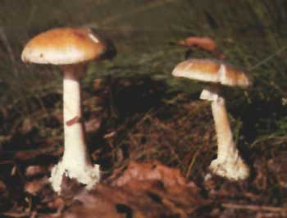
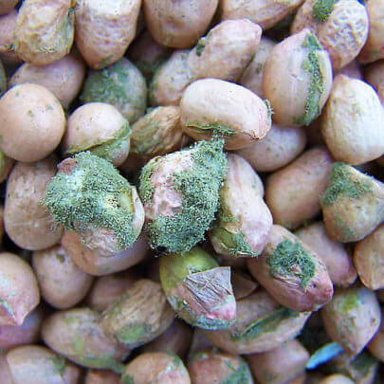
Mycotoxins
Many fungi produce poisonous substances called mycotoxins that can cause acute or chronic intoxication and damage. A variety of mycotoxins are produced by mushrooms (eg, Amanita species), and their ingestion results in a dose-related disease called mycetismus. Cooking has little effect on the potency of these toxins, which may cause severe or fatal damage to the liver and kidney.
Other fungi produce mutagenic and carcinogenic compounds that can be extremely toxic for experimental animals. One of the most potent is aflatoxin, which is elaborated by Aspergillus flavus and related molds and is a frequent contaminant of peanuts, corn, grains, and other foods.

Slide 16
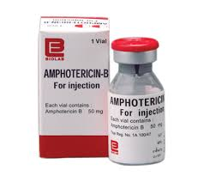
Antifungal Chemotherapy
1- Amphotericin B: The major polyene antibiotic is amphotericin B, a metabolite of streptomyces. Amphotericin B is the most effective drug for severe systemic mycoses. It has a broad spectrum, and the development of resistance is rare. The mechanism of action of the polyenes involves the formation of complexes with ergosterol in fungal cell membranes, resulting in membrane damage and leakage. Amphotericin B has greater affinity for ergosterol than cholesterol, the predominant sterol in mammalian cell membranes.

Slide 17
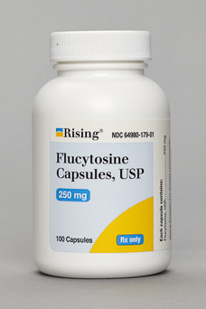
Antifungal Chemotherapy
2- Flucytosine: Flucytosine (5-fluorocytosine) is a fluorinated derivative of cytosine. It is an oral antifungal compound used primarily in conjunction with amphotericin B to treat cryptococcosis or candidiasis. It penetrates well into all tissues, including cerebrospinal fluid.
Flucytosine is used mainly in conjunction with amphotericin B for treatment of cryptococcosis and candidiasis. In vitro, it acts synergistically with amphotericin B against these organisms, and clinical trials suggest a beneficial effect of the combination, particularly in cryptococcal meningitis. The combination has also been shown to delay or limit the emergence of flucytosine-resistant mutants. By itself, flucytosine is effective against chromoblastomycosis and other dematiaceous fungal infections.

Slide 18
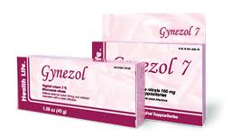
Antifungal Chemotherapy
3- Azoles: The antifungal imidazoles (eg, ketoconazole) and the triazoles (fluconazole, voriconazole, and itraconazole) are oral drugs used to treat a wide range of systemic and localized fungal infections. The indications for their use are still being evaluated, but they have already replaced amphotericin B in many less severe mycoses because they can be administered orally and are less toxic.

Slide 19
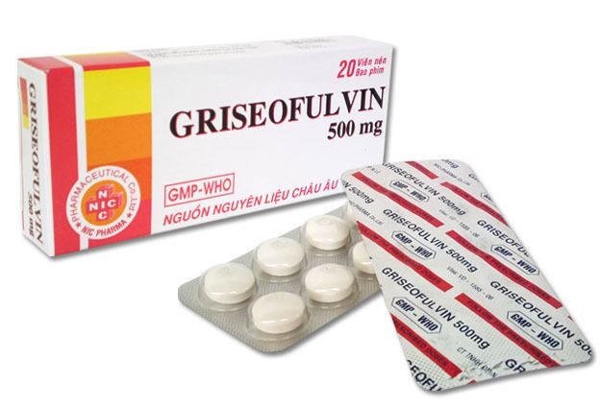
Antifungal Chemotherapy
4- Griseofulvin: Griseofulvin is an orally administered antibiotic derived from a species of penicillium. It is used to treat dermatophytoses and must be given for long periods. Griseofulvin is poorly absorbed and concentrated in the stratum corneum, where it inhibits hyphal growth. It has no effect on other fungi.
After oral administration, griseofulvin is distributed throughout the body but accumulates in the keratinized tissues. Within the fungus, griseofulvin interacts with microtubules and disrupts mitotic spindle function, resulting in inhibition of growth. Only actively growing hyphae are affected. Griseofulvin is clinically useful for the treatment of dermatophyte infections of the skin, hair, and nails.

Slide 20
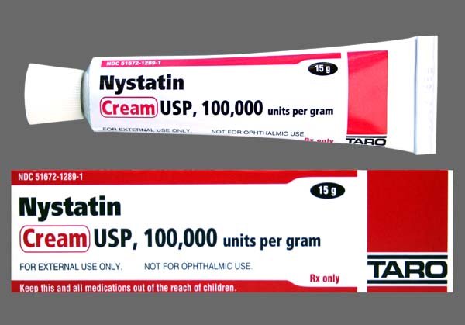
Antifungal Chemotherapy
5- Topical Antifungal Agents:
a- Nystatin: Nystatin is a polyene antibiotic, structurally related to amphotericin B and having a similar mode of action. It can be used to treat local candidal infections of the mouth and vagina. Nystatin may also suppress subclinical esophageal candidiasis and gastrointestinal over-growth of candida. No systemic absorption occurs, and there are no side effects.
b- Clotrimazole, Miconazole, & Other Azoles: A variety of antifungal azoles too toxic for systemic use are available for topical administration. Clotrimazole and miconazole are available in several formulations. Econazole, butaconazole, tioconazole, and terconazole are also available.
Topical azoles have a broad spectrum of activity. Tinea pedis, tinea corporis, tinea cruris, tinea versicolor, and cutaneous candidiasis respond well to local application of creams or powders. Vulvovaginal candidiasis can be treated with vaginal suppositories or creams.

Slide 21

Thank you

