Slide 1
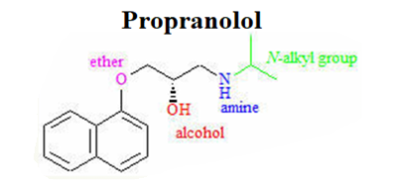
Pharmaceutical
chemistry
Analgesics
Assist . Prof . Karima F. Ali
AL-Mustansiriyah university
College of pharmacy

Slide 2
Analgesics
The opioids (or narcotic analgesics), which play a major role in the relief of acute pain and in the management of moderate to severe chronic pain;
The NSAIDs and acetaminophen, which are the most widely used analgesic drugs for relieving mild to moderate pain and reducing fever;
The triptans (the antimigraine medications), which are specifically designed and targeted for acute and abortive treatment of migraine and cluster headaches
Analgesic adjuvants that include tricyclic antidepressants such as amitriptyline, anticonvulsants such as gabapentin and pregabalin, and topical analgesics such as lidocaine patches that can be used to treat neuropathic pains.

Slide 3
Origin of Pain
Physiological (nociceptive): is the most common and is often caused by an injury to body organs or tissues. It is further categorized, according to the source of the pain, into cutaneous pains (skin and surface tissues), somatic pains (ligaments, tendons, bones, blood vessels), and visceral pains (body organs and internal cavities).
Inflammatory: originates from an infection or inflammation as a result of the initial tissue or organ damage.
Neuropathic: Neuropathic pain is a very complex, chronic pain, resulting from injury of the nervous systems.

Slide 4
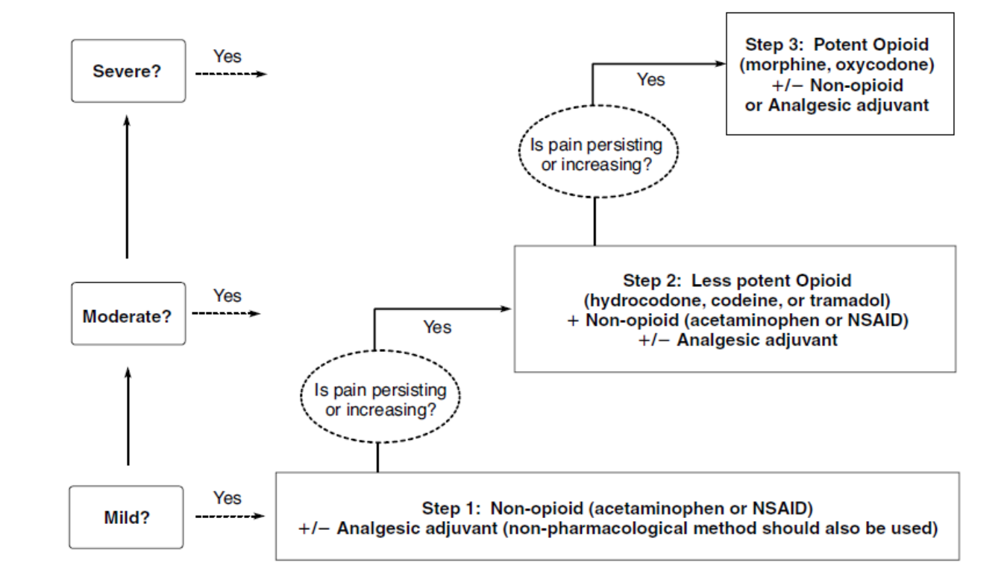
Three-step analgesic ladder

Slide 5
OPIOIDS
Opioid Receptor Discovery and Endogenous Ligands:
The first endogenous peptide was termed enkephalin, which was found to be a mixture of the two pentapeptides that only differ in their terminal amino acid (Met-enkephalin) and (Leu-enkephalin).
The transient nature of the enkephalins’ actions correlated with the rapid degradation of the enkephalin Tyr-Gly bond by aminopeptidases.
Much synthetic work has been done in an attempt to increase the duration of action of the opioid peptides and maintain their analgesic effect.

Slide 6
SARs of Enkephalins
The first amino acid of the pentapeptide shows a distinct preference for tyrosine.
Most changes to this amino acid, either by substituting with other amino acids or masking the phenolic hydroxyl (OH) or amino function, produce an inactive or weakly active peptide.

Slide 7
GLY2
Replacing the naturally occurring L-Gly with various D-amino acids produces a peptide that is resistant to peptide cleavage by aminopeptidases.
Replacement with D-Ser is the most effective replacement, and all L-amino acid analogs had low activities.
Substituting D-amino acids for L-amino acids produces stable peptides, and the stereochemical change may give the peptide access to additional binding sites on the receptors
Replacing the Gly2 with D-Ala2 while simultaneously replacing the L-Leu5 with D-Leu5 produces the peptide known as D-Ala2, D-Leu5 enkephalin (DADLE), which is commonly used as a selective δ-agonist

Slide 8
GLY3
Almost all changes to this amino acid result in a drop in potency, unless they are also accompanied by another change such as replacing the Gly2 with D-Ala2 .
PHE4
The aromatic nature of the fourth residue is required for high activity.
When combined with the D-Ala2 replacement, the addition of an electron withdrawing, lipophilic substituent (e.g., NO2, Cl, and Br) in the para position of Phe4 greatly increases activity.
Para substitutions with electron donating, hydrophilic functional groups (e.g., NH2 and OH) abolish activity.
MET5/LEU5
Position 5 appears to tolerate more residue changes than the other positions.
Many amino acid substitutions at this position maintain activity (e.g., Ala, Gly, Phe, Pro).

Slide 9
The pituitary gland, hypothalamus, and the adrenal medulla all produce various opioid peptides.
Many of these materials were found to be fragments of β lipotropin (β - LPT) a 91 amino acid peptide.
The fraction containing amino acids 61–91 is designated β -endorphin
It is much more potent than the enkephalins in both in vivo and in vitro tests.
Some examples of endogenous opioid peptides:
β Endorphin, Endomorphin-1, Endomorphin-2, Dynorphin, α-Neoendorphin, β-Neoendorphin, Nociceptin, and Orphanin FQ.

Slide 10
Opioid Receptors
Opioid receptors are distributed throughout the brain, spinal cord, and peripheral tissues (µ, δ, and k)
THE µ-RECEPTOR
Endogenous peptides for the µ-receptor include endomorphin-1, endomorphin-2, and β-endorphin.
Exogenous agonists for the µ-receptor include drugs from the five structural classes (4,5-epoxymorphinan, morphinan, benzomorphan, 4-phenyl/4-anilido piperidines, and the diphenylheptanes)
In general, agonists at the µ -receptor produce analgesia, respiratory depression, decreased gastrointestinal (GI) motility, euphoria, feeding, and the release of hormones.
Agonists are also responsible for the addictive effects of the opioid analgesics.
Most clinically used opioid drugs bind to the µ -opioid receptor.

Slide 11
THE δ-RECEPTOR
The amide nitrogen appears to be the most sensitive to modifications and may play an important role in δ-receptor selectivity.
The “address–message” concept proposes that one part of the molecule may act as an “address,” essentially directing the chemical to the correct receptor by binding specifically to that receptor, and another part of the molecule acts as the “message,” which gives the compound the biological action.

Slide 12
THE k-RECEPTOR
Kappa receptors are primarily found in the limbic, brain stem, and spinal cord.
TRK-820 is a k-agonist displaying approximately 15 times selectivity toward k-receptors versus µ-receptors.
The 4,5-epoxymorphinan structure of TRK-820 is proposed to mimic the tyrosine–glycine moiety of endogenous opioid peptides, in effect the agonist message.
The additional 6β-substituent constitutes the address directing the compound to the k-receptor.
SARs on this class of compounds revealed that methyl-substituted nitrogen amides, a methylene spacer between the amide and the aromatic ring and the (-) isomer were all required for k- activity.

Slide 13
THE ORPHANIN RECEPTOR/FQ/NOP₁
The traditional opioid peptides do not elicit any biological effect at the orphanin receptor.
An endogenous peptide for the orphanin receptor has been found and termed orphanin FQ or nociceptin .
This 17 amino acid peptide can reverse the analgesic effects of morphine thus is antiopioid.
This receptor is a target for the design of novel peripherally acting antitussive agents.

Slide 14
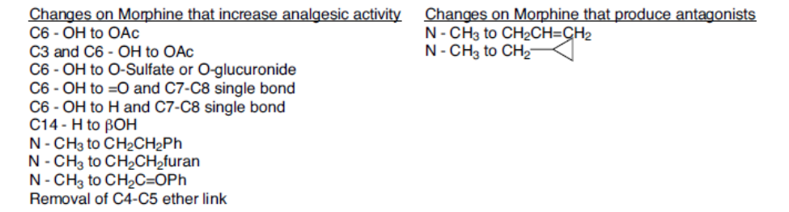
STRUCTURE–ACTIVITY RELATIONSHIPS

Slide 15
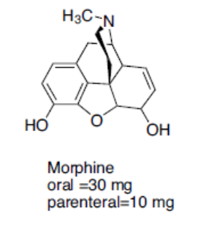
Drug classes
1. 4,5-Epoxymorphinans:
MORPHINE
The prototype ligand for the µ-receptor is morphine.
Morphine contains 5 chiral centers and has 16 optical isomers (not 32 because of the restriction of C-9 to C-13 ethanamino bridge).
The naturally occurring, active form of morphine is the levorotatory enantiomorph with the stereochemistry 5(R), 6(S), 9(R), 13(S), and 14 (R).

Slide 16
Morphine was isolated from opium.
The first mention of the opium poppy was found in Iraq on clay tablets inscribed in cuneiform script in about 3000 BC.
Opium is isolated from the opium poppy, Papaver somniferum
Opium contains over 40 different alkaloids with most alkaloids represented in the following five structures: morphine , codeine , thebaine , papaverine , and noscapine.
Morphine is the drug to which all other µ-agonists are compared, it is used as analgesic agent.

Slide 17
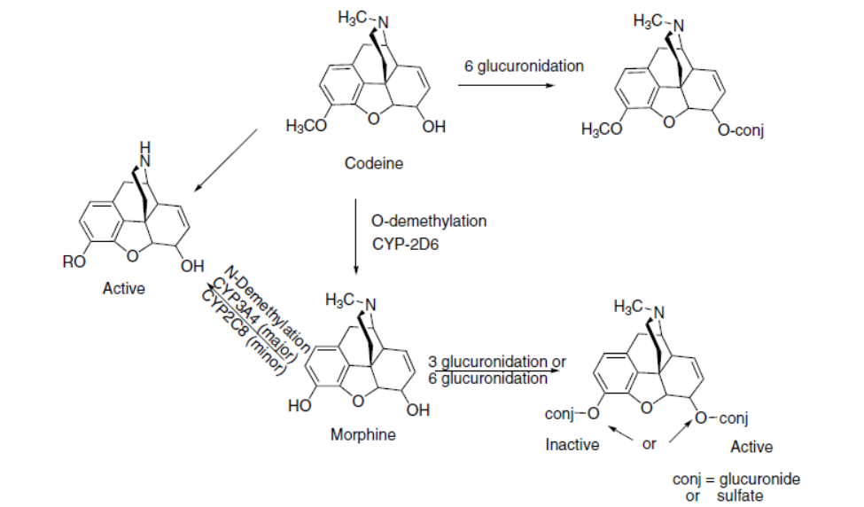
Metabolism of morphine and codeine

Slide 18
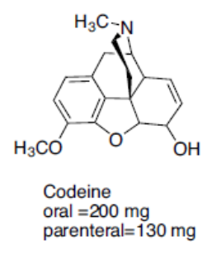
CODEINE
It is used to a limited extent in cough preparations.
Approximately 5% of codeine is metabolized to morphine via O-demethylation.
The analgesic component of codeine has long been assumed to be the O demethylated metabolite, morphine.

Slide 19
HEROIN
Heroin is the 3,6 diacetylated form of morphine.
Heroin can pass through the blood-brain barrier quicker than morphine and lead to the euphoric “rush”.

Slide 20
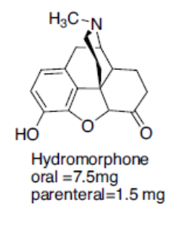
HYDROMORPHONE:
Hydromorphone, is a synthetic derivative of morphine.
Reducing the 7,8 double bond of morphine increased the flexibility of the molecule and resulted in a compound with slightly enhanced binding and increased potency (approximately 5 times as potent as morphine).

Slide 21
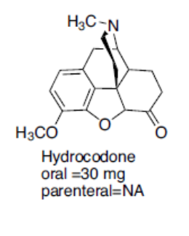
HYDROCODONE
The protected 3-position has better brain penetration, and the 7,8-dihydro-6-keto C ring contributes to the increased binding of the compound to the µ-receptor.
It is marketed as an antitussive agent, also marketed in combination with acetaminophen or aspirin for the treatment of pain.

Slide 22
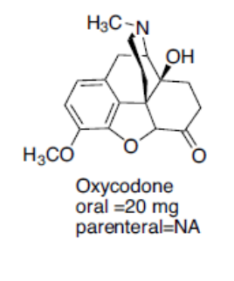
OXYCODONE
Oxycodone is the 14 beta-hydroxyl version of hydrocodone.
This additional functional group gives oxycodone greater potency (1.5 times orally) than hydrocodone presumably by increasing receptor affinity.
Oxycodone is marketed in combination with acetaminophen, aspirin, and ibuprofen.

Slide 23
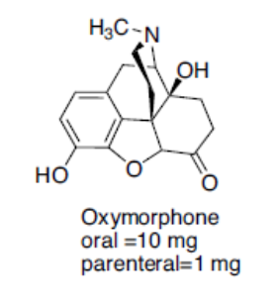
OXYMORPHONE
Oxymorphone is the 14 beta-hydroxyl version of hydromorphone.
The addition of the OH group does increase its binding affinity at the receptor.

Slide 24
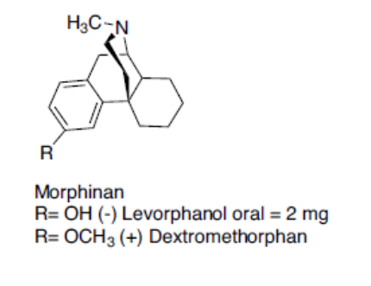
2. Morphinans
The morphinans were made by removing the E ring of morphine ( the 4,5-ether bridge)

Slide 25
LEVORPHANOL:
The loss of the 4,5-epoxide and the 7,8-double bond allows levorphanol greater flexibility and leads to the increased binding affinity at all opioid receptors.
It is the levorotatory form of methorphan and is approximately 7.5 times more potent than morphine as analgesic agent.
DEXTROMETHORPHAN:
It is the dextrorotatory form of levorphanol with a methoxy group on the 3 position.
It is available in a lot of OTC cough and cold preparations.
Many cases were reported involving abuse of this drug.

Slide 26
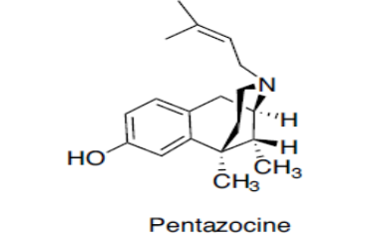
3. Benzomorphans
Removing the C ring of the morphinan structure, yields the benzomorphans. It is also referred to as the benzazocines
Pentazocine
The only benzomorphan in clinical use is pentazocine, which is prepared as the 2(R), 6(R), 11(R) enantiomer;
it is a mixed agonist/antagonist agent.
At the µ-receptor, pentazocine is a partial agonist and a weak antagonist; it is also an agonist at the k-receptor.

Slide 27
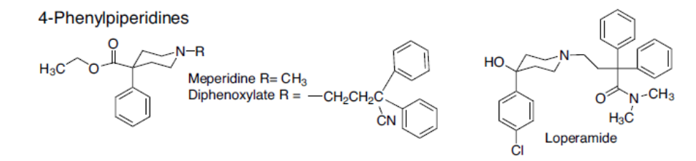
4. (4-Phenylpiperidines and 4-Anilidopiperidines)
Removal of the B ring of the benzomorphans yields the 4-substituted piperidines.
The A ring is in an axial position relative to the piperidine (D) ring, the A ring can exist in either an axial or an equatorial position.

Slide 28
MEPERIDINE:
Meperidine is an agonist at the µ-receptor.
The 4-ethyl ester was found to be the optimal length for analgesic potency.
Structural changes that increase the potency of meperidine include the introduction of a m-hydroxyl on the phenyl ring, substituting the methyl on the N for a phenylethyl or a p-aminophenylethyl.
Meperidine is metabolized to normeperidine by the liver enzymes CYP3A4 and CYP2C18 and in the brain by CYP2B6.
Meperidine and normeperidine are also metabolized by liver carboxylesterases.

Slide 29
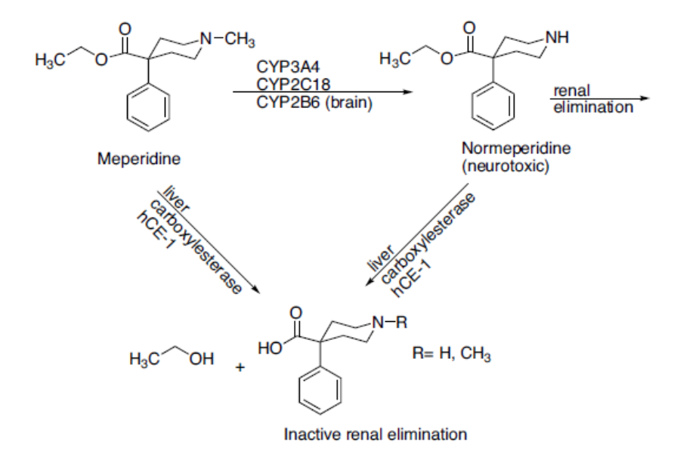
The use of meperidine should be limited to those patients that have true allergies to the morphine-type opioids, and patients should be monitored for toxicity.

Slide 30
DIPHENOXYLATE:
Diphenoxylate is a weak opioid agonist and is available combined with atropine (Lomotil) for use as an antidiarrheal agent.
LOPERAMIDE:
Loperamide (Imodium) is a 4-phenylypiperidine with a methadone-like structure attached to the piperidine nitrogen.
It acts as an antidiarrheal by directly binding to the opiate receptors in the gut wall.

Slide 31
4-Anilidopiperidines:
When the 4-phenyl substituent of meperidine was replaced with a 4-aniline with a nitrogen connection, the potency increased.
This led to the development of the 4-anilidopiperidine series of compounds (fentanyl, alfentanil, sufentanil, remifentanil).

Slide 32
Fentanyl was the first compound marketed .
The high lipophilicity of fentanyl gave it a quick onset, and the quick metabolism led to a short duration of action.
The combination of potency, quick onset, and quick recovery led to the use of fentanyl as an adjunct anesthetic.
The SAR studies of the 4-phenylpiperidine analgesics found that the propionamide is the optimal chain length.
Adding polar groups to the 4-piperidine carbon (CH2OCH3 in sufentanil and alfentanil, COOCH3 in remifentanil) increases potency.
The piperidine nitrogen of fentanyl contains a phenethyl substituent that appears to be the correct chain length for optimal potency.

Slide 33
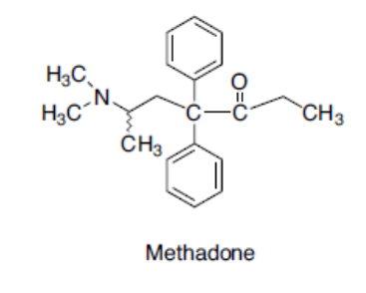
5. Diphenylheptanes
METHADONE
Methadone is a synthetic opioid approved for analgesic therapy and for the maintenance and treatment of opioid addiction.
Methadone is marketed as the racemate, although the opioid activity resides in the R-enantiomer (7–50 times more potent than the S-enantiomer).
Methadone is a µ-receptor agonist.

Slide 34
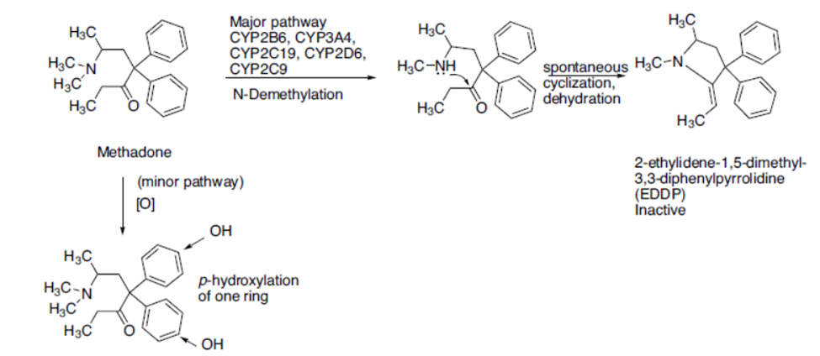
The major metabolic pathway of methadone metabolism is via N-demethylation to an unstable product that spontaneously cyclizes to form the inactive 2-ethylidene-1,5-dimethyl-3,3- diphenylpyrrolidine (EDDP).

Slide 35
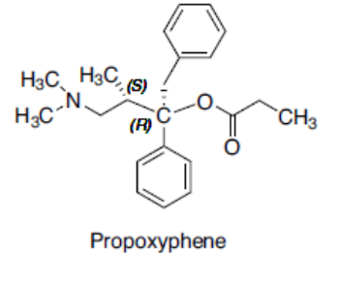
PROPOXYPHENE
Propoxyphene is a derivative of methadone .
It is only about 1/10th as potent as morphine as an analgesic yet retains all the same opioid adverse effects.

Slide 36
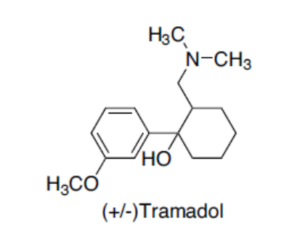
Miscellaneous
TRAMADOL
Tramadol is an analgesic agent.
It is a weak µ-agonist.
Structurally, tramadol resembles codeine with the B, D, and E ring removed.
Tramadol is synthesized and marketed as the racemic mixture of two (the [2S, 3S] [-] and the [2R, 3R] [+]) of the four possible enantiomers.
The (+) enantiomer is about 30 times more potent than the (-) enantiomer.

Slide 37
Opioid Antagonists
NALTREXONE:
Naltrexone is a pure opioid antagonist at all opioid receptor subtypes with the highest affinity for the µ-receptor.
Theoretically, it should work well to treat opioid dependence but in clinical practice, patients have shown poor compliance and high relapse rates.
Naltrexone has also been studied to treat alcohol dependence with mixed results.
NALOXONE:
Naloxone is a pure antagonist at all opioid receptor subtypes. Structurally, it resembles oxymorphone except that the methyl group on the nitrogen is replaced by an allyl group. It is used to reverse the respiratory depressant effects of opioid overdoses.

Slide 38
NALMEFENE:
It is a pure opioid antagonist that is the 6-methylene analog of naltrexone.
It is available to reverse the effects of opioids after general anesthesia and in the treatment of overdose.
METHYLNALTREXONE:
It is the methylated, quaternary form of naltrexone.
The permanently charged nitrogen prevents the drug from crossing the blood-brain barrier. Thus, it only acts as an antagonist at peripheral opioid receptors.

