Slide 1
Pharmaceutical Chemistry
Drugs Anticonvulsant
By
Assist. Prof. Karima Fadhil Ali
Al mustansiriyah university
College of pharmacy

Slide 2
:Anticonvulsant Drugs (AEDs)
Epilepsy is not a disease. It is the most prevalent neurological disorder affecting more than 0.5% of the world’s population. It is characterized by recurrent seizures.
Seizures, on the other hand, are symptoms of disturbed electrical activity in the brain characterized by episodes of abnormal, excessive, and synchronous discharge of a group of neurons within the brain that cause involuntary movement, sensation, or thought.

Slide 3
It is generally agreed that seizures may result from primary or acquired neurological disturbances of brain function as a result of an imbalance between excitatory and inhibitory processes in the brain.
There are many possible causes of seizure including brain tumors or infections, head trauma, neurological diseases, systemic or metabolic disorders, alcohol abuse, drug overdose, or toxicities.

Slide 4
Classification of Epileptic Seizures and Recommended Initial Drug Therapy
Seizures are classified, based on their initial signs and symptoms and the pattern seen on the electro-encephalogram (EEG), into two broad categories:
Primary generalized seizures
Two major types of generalized seizures are the primarily generalized tonic–clonic seizures (grand mal) and the absence (petit mal) seizures.
Partial seizures
Major types of partial seizure are simple partial seizures (focal) and complex partial seizures (temporal lobe or psychomotor).

Slide 5
Mechanisms of action of anticonvulsants
(A) Modulation of voltage-gated ion channels (Na, Ca2, and K).
(B) Enhancement of γ- amino butyric acid (GABA)-mediated inhibitory neurotransmission.
(C) Attenuation of excitatory (particularly glutamate-mediated) neurotransmission in the brain.
Many of AEDs, especially the newer drugs, work by more than one of the above mechanisms of actions, therefore possessing a broader spectrum of antiepileptic action.

Slide 6
GABA A Receptors as Targets for Anticonvulsants
It is now well recognized that cellular excitability leading to convulsive seizures can be attenuated by GABA ergic stimulation in the brain. The GABAA receptor is one of two ligand-gated ion channels responsible for mediating the effects of GABA, the major inhibitory neurotransmitter in the brain.
Activation of the GABAA/benzodiazepine (BZD) receptors/chloride channel complex allows increased chloride conductance, thereby preventing the spread of neuronal excitations.

Slide 7
The potential targets for AED’s action on the GABA ergic inhibitory synapses include:
(a)Drugs that enhance the biosynthesis of GABA(gabapentin, pregabalin, and VPA),
(b) Drugs that inhibit GABA degradation (vigabatrin).
(c) Drugs that inhibit the reuptake of GABA (tiagabine).
(d) Drugs that bind to an allosteric site on the postsynaptic GABAA receptor complex that increase chloride conductance (barbiturates, BZDs).

Slide 8
Phenobarbital and Primidone (Mysoline)
Although sedative–hypnotic barbiturates commonly display anticonvulsant properties, only phenobarbital display enough anticonvulsant selectivity for use as antiepileptics.

Slide 9
Primidone (Mysoline)
Is metabolized by CPY2C9/19 to phenobarbital and phenylethylmalonamide (PEMA)
Both of these metabolites have anticonvulsant activities.
However, it is generally believed that the pharmacological
action of primidone is mainly a result of the minor metabolite, phenobarbital.
Thus, primidone is much less potent/toxic than phenobarbital, because most of the drug is rapidly degraded to the less potent metabolite, PEMA.

Slide 10
Metabolic biotransformation of primidone.

Slide 11
Hydantoins

Slide 12
Hydantoin Drugs

Slide 13
Biotransformation of fosphenytoin to phenytoin.

Slide 14
Oxazolidinediones

Slide 15
Carbamazepine (Tegretol)
The two phenyls substituted on the urea nitrogen fit the pharmacophore pattern suggested for binding to the VGSC. Like phenytoin, CBZ is useful in generalized tonic– clonic and partial seizures. Carbamazepine stabilizes the inactivated state of voltage-gated sodium channels, making fewer of these channels available to subsequently open. This leaves the affected cells less excitable until the drug dissociates. Carbamazepine is also a GABA receptor agonist, as it has also been shown to potentiate GABA receptors made up of alpha1, beta2, and gamma2 subunits
Oxcarbazepine (Trileptal) (OXC) is a newer AED with a similar mechanism of action to CBZ except for its metabolic inactivation pathway.

Slide 16
Metabolism of Carbamazepine and Oxcarbazepine

Slide 17
Drugs that enhance the biosynthesis of GABA
GABA, the major inhibitory neurotransmitter in the brain, is biosynthesized at the GABA ergic neurons by the decarboxylation of the amino acid, L-glutamic acid (itself an excitatory amino acid neurotransmitter in the brain). The rate-limiting enzyme that catalyzes this conversion is L-glutamic acid decarboxylase (GAD). A 3-substituted GABA, gabapentin and especially pregabalin, may have the ability to activate GAD, Both of these drugs are weak activators of GAD.

Slide 18
Gabapentin and its closely related analog pregabalin, (S)-3-isobutyl-GABA are broad-spectrum anti consultants. with multiple mechanisms of action.
In addition to modulating calcium influx and stimulate GABA biosynthesis, they also compete for the biosynthesis of L-glutamic acid because of their structural similarity to L-leucine.

Slide 19
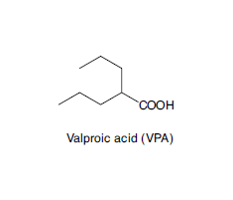
Valproic Acids (VPA), also elevates brain levels of GABA in patients with epilepsy. It is generally agreed that VPA inhibits SSADH, the enzyme responsible for conversion of SSA to succinic acid. The exact mechanism of action of how this inhibition enhances GABA levels in the brain is still the subject of much debate (i.e., from an indirect stimulation of GAD to an inhibition of GABA-T).

Slide 20
Biosynthesis and metabolism of GABA.

Slide 21
Drugs that inhibit GABA degradation
Vigabatrin (-vinyl-GABA) is an irreversible inhibitor of GABA-T, rationally designed based on the biochemical mechanism of transamination reaction. Briefly, vigabatrin, because of its structural similarity, competes with GABA for binding to GABA-T and forms a Schiff base intermediate with the cofactor, pyridoxal phosphate similar to GABA.

Slide 22
However, unlike its substrate GABA, during the process of transferring the amino group to the pyridoxal phosphate, a reactive intermediate is formed with vigabatrin that immediately attaches itself to the active site of the enzyme, thereby irreversibly inhibiting GABA-T and increasing GABA levels in the brain. , It is marketed as an adjunctive treatment of patients with partial seizures.

Slide 23
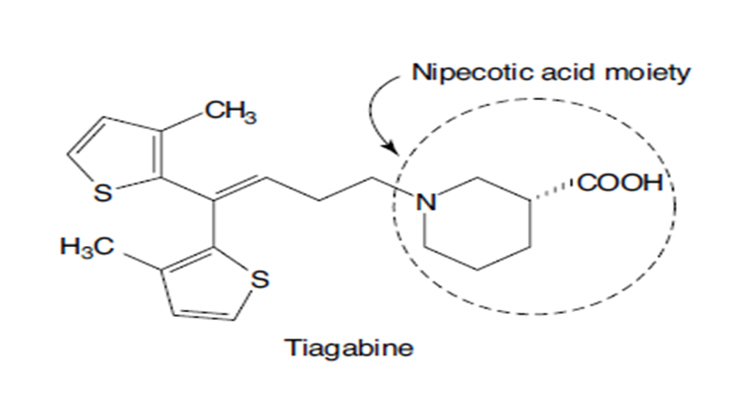
Drugs that inhibit reuptake of GABA
Tigabine: An uptake inhibitor. it blocks GABA reuptake as a major mode of its anticonvulsant activity. Its use is against partial seizures. Inhibitors of GABA transporter-1(GAT-1 inhibitors) increase extracellular GABA concentration in the hippocampus, striatum, and cortex, thereby prolonging the inhibitory action of GABA released synaptically.

Slide 24
Ethosuximide (zarontin) and Methsuximide (celontin)
Ethosuximide is considered the prototypical anticonvulsant needed for treating patients with absence seizures.
Ethosuximide and the N- dealkylated active metabolite of methsuximide work by blocking the low threshold T-type calcium channels, thereby reducing the hyper excitability of thalamic neurons that is specifically associated with absence seizure.

Slide 25
Benzodiazepines (acts on a selective molecular target)
Clonazepam: is useful in absence seizures and in myoclonic seizures. Tolerance to the anticonvulsant effect of the clonazepam often developed rather quickly, and it is a common problem with the BZDs.
Diazepam: is given orally (Valium) or rectally (Diastat) as an adjunctive treatment in patients with generalized tonic–clonic status epilepticus.

