Slide 1
Pharmaceutical chemistry
Cholinergic Drugs
Assist . Prof . Karima F. Ali
AL-Mustansiriyah university
College of pharmacy

Slide 2
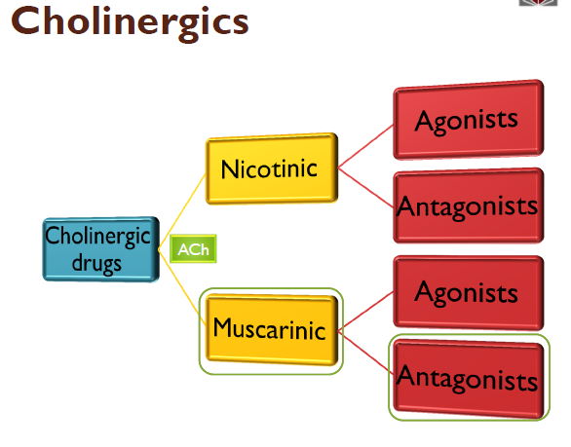

Slide 3
Neurotransmitters (NT)
Neurotransmitters (NT) are endogenous (produced by body) chemicals that transmit signals across a synapse from sending presynaptic neuron to the target postsynaptic neuron
They are synthesized and stored in neuron itself
There are many NTs eg: Acetylcholine, Adrenaline, serotonin, dopamine, GABA
The process of transmission of signal along a neuron and over the synapse is called neurotransmission. Signal can pass over the synapse by either chemically or electrically
One neurons interacts with many other neurons in all possible directions.

Slide 4
Cholinergic Drugs and Related Agent
The peripheral nervous system consists of those nerves outside the cerebrospinal axis and includes :
Somatic motor nerves system
Autonomic motor nervous system.
The somatic nerves are made up of a sensory (afferent) nerve and a motor (efferent) nerve. The motor nerves arise from the spinal cord and project uninterrupted throughout the body to all skeletal muscle. ACh mediates transmission of impulses from the motor nerve to skeletal muscle.

Slide 5
Cholinergic Drugs and Related Agents
Autonomic motor NS:
  Carry messages from the CNS to smooth muscle, cardiac muscle and adrenal medulla.
  Two subsystems:
  1. Parasympathetic nerves:
  From CNS to smooth muscles. Acetylcholine is the N.T.
      2.Sympathetic nerves:
      To the cardiac muscles and most of internal organs
      Using Noradrenalin and Acetylcholine as N.T
Drugs and chemicals that cause the parasympathetic division to react are termed parasympathomimetic, whereas those blocking the actions are called parasympatholytic.

Slide 6
Agents that mimic the sympathetic division are sympathomimetic, and those that block the actions are sympatholytic.
3. Enteric NS:
  Located in the wall of intestine. Use serotonin, neuropeptide, Acetylcholine and Dopamine are among many other neurotransmitters take part in this system
.

Slide 7
Cholinergic receptors
There are two distinct receptor types for ACh that differ in composition, location, and pharmacological function and have specific agonists and antagonists. Cholinergic receptors have been characterized as nicotinic and muscarinic on the basis of their ability to be bound by the naturally occurring alkaloids nicotine and muscarine, respectively.
Receptor subtypes that differ in location and specificity to agonists and antagonists have been identified for both the nicotinic and muscarinic receptors.

Slide 8
Cholinergic receptors
Nicotinic Receptors
Nicotinic receptors are coupled directly to ion channels and, when activated by Ach, mediate very rapid responses. Ion channels are responsible for the electrical excitability of nerve and muscle cells and for the sensitivity of sensory cells. When the neurotransmitter ACh binds to the nicotinic receptor, it causes a change in the permeability of the membrane to allow passage of small cations Ca2, Na, and K.
The physiological effect is to temporarily depolarize the end plate. They are agonized by nicotine.

Slide 9
This depolarization results in muscular contraction at
a neuromuscular junction or, as occurs in autonomic ganglia, continuation of the nerve impulse.
Neuromuscular nicotinic ACh receptors are of interest as targets for autoimmune antibodies in myasthenia gravis and for muscle relaxants used during the course of surgical procedures.
Nicotinic receptors in autonomic ganglia, when blocked by drugs, can play a role in the control of hypertension.

Slide 10
Nicotinic receptor subtypes
Nicotinic receptors located in the neuromuscular junction differ from those on neurons, such as those in the CNS and autonomic ganglia, in that they have different ligand specificities.
Nicotinic receptors at the neuromuscular junction (N1) are blocked by succinylcholine, d-tubocurarine, and Decamethonium and stimulated by phenyltrimethyl -ammonium. N2-nicotinic receptors are found in autonomic ganglia.
They are blocked by hexamethonium and trimethaphan
but stimulated by tetramethylammonium and dimethyl-4-
phenylpiperazinium (DMPP).

Slide 11
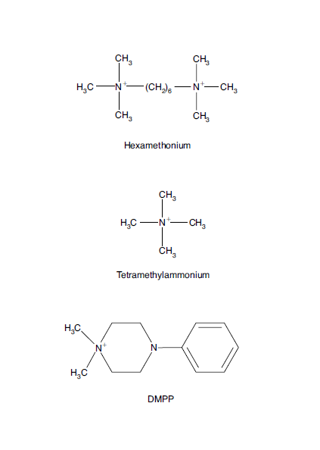
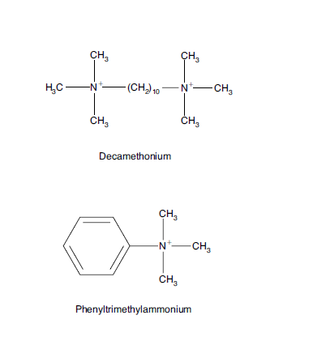

Slide 12
Muscarinic receptors
Muscarinic receptors play an essential role in regulating the functions of organs innervated by the autonomic nervous system to maintain homeostasis of the organism.
The action of ACh on muscarinic receptors can result in stimulation or inhibition of the organ system affected.
ACh stimulates secretions from salivary and sweat glands, secretions and contraction of the gut, and constriction of the airways of the respiratory tract. It inhibits contraction of the heart and relaxes smooth muscle of blood vessels

Slide 13
Muscarinic receptor subtypes
Evidence from both pharmacological and biochemical studies shows that subtypes of muscarinic receptors are located in the CNS and peripheral nervous system. Molecular cloning studies have revealed the existence of five different molecular mammalian muscarinic receptor proteins.
The cloned receptors have been identified as M1 to M5.

Slide 14
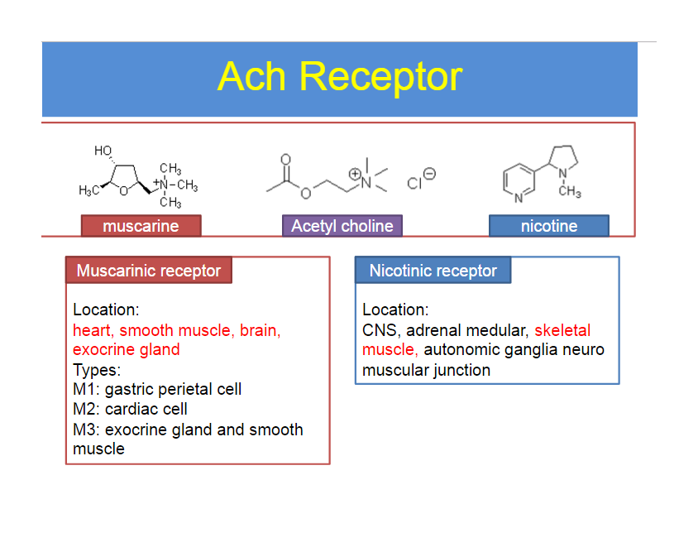
ACH Receptors

Slide 15
Cholinergic neurochemistry
Cholinergic neurons synthesize, store, and release ACh .
The neurons also form choline acetyl transferase
(ChAT) and acetyl choline esterase AChE.
The synthesis of ACh from choline and acetyl-CoA is catalyzed by ChAT. Choline is the limiting substrate for the synthesis of ACh.
ACh is prepared in the nerve ending by the transfer of an acetyl group from acetyl-coenzyme A (CoA) to choline. The reaction is catalyzed by ChAT.

Slide 16
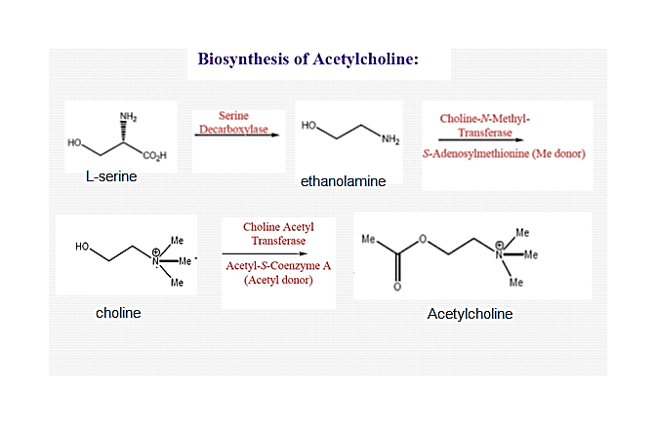

Slide 17
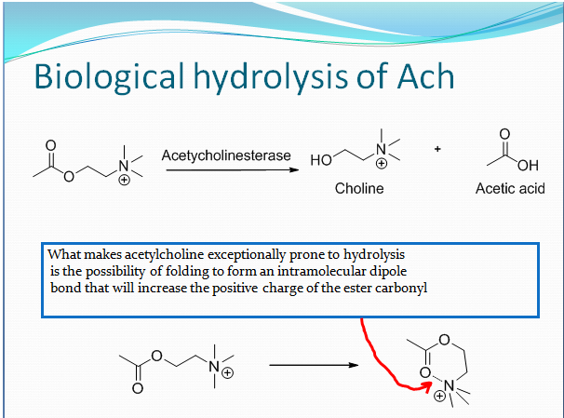

Slide 18
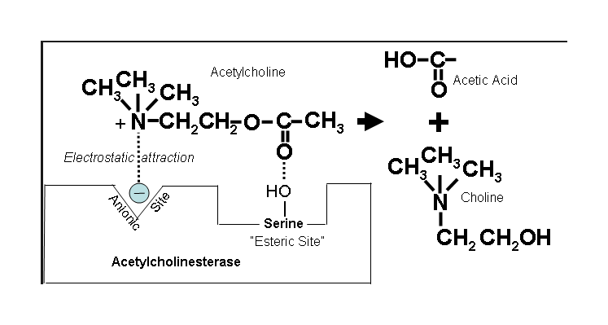

Slide 19
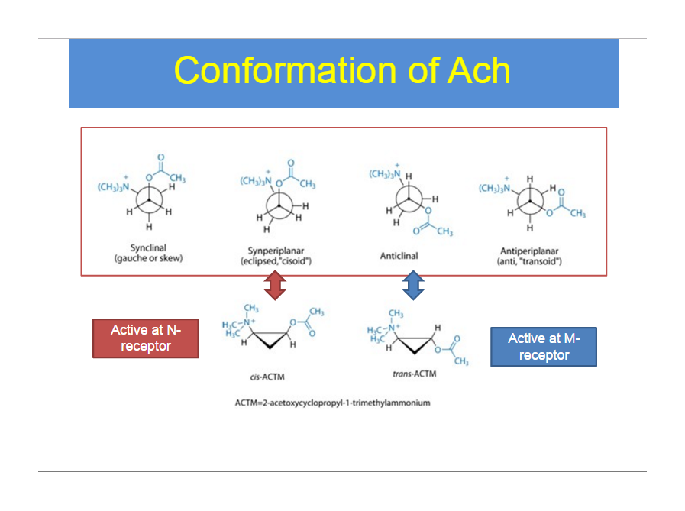

Slide 20
Physio-Chemical property of Ach
1. It is ester of acetic acid and choline
2. It is soluble in water due to salt form at Nitrogen
3. In solid form it is stable but in solution, the ester group gets hydrolyzed (ie ester group turns into acid and alcohol).
4. If acid or base is present, as in stomach, then rate of hydrolysis is so fast that it prevents oral dosing of Ach
5. Even if we prepare it’s solution in neutral water and inject in blood so as to bypass the acidic stomach, an ester hydrolyzing enzyme called butryl cholinesterase significantly degrades it that the pharmacological response is very weak.

Slide 21
Even if it was administered in stable form, It’s ionic ammonium group prevents good penetration across the lipophillic cell wall .
This chemical property makes it a weak agonist plus since it is non-selective agonist of Muscarinic and Nicotinic
(Thus having no ester group and no ionic amine is an approach for making more stable and strong Ach agonist. However selectivity is a different issue).
2 problems prevent it from being a good drug Unselective Unstable (Easy to hydrolyze)
Solution:
Ethylene group control selectivity
Acyloxy group controls stability

Slide 22
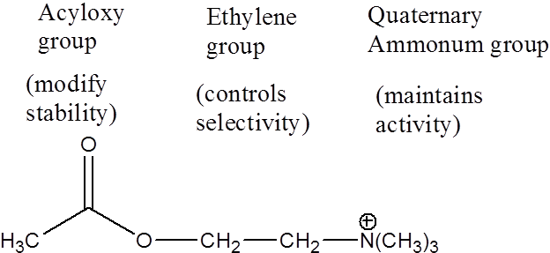
Acetylcholine

Slide 23
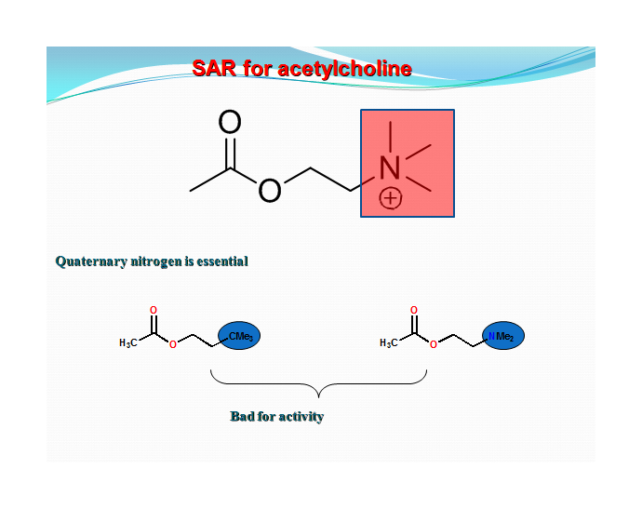

Slide 24
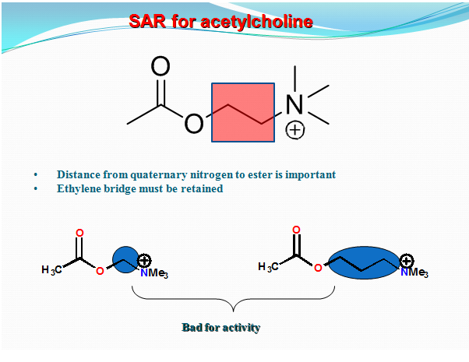

Slide 25
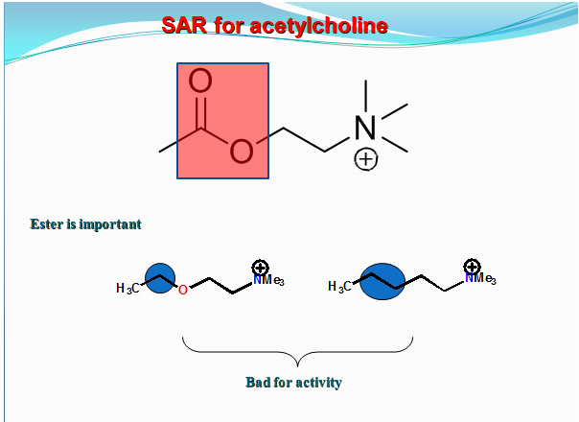

Slide 26
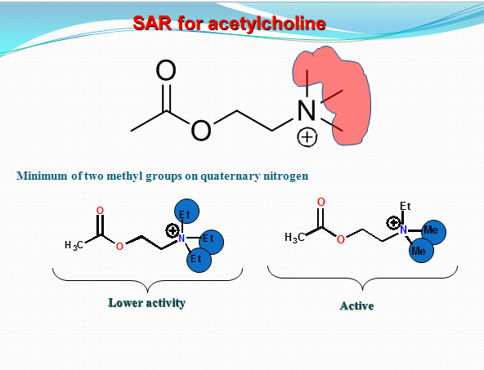

Slide 27
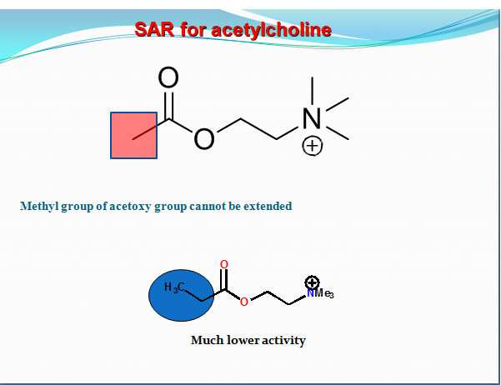

Slide 28
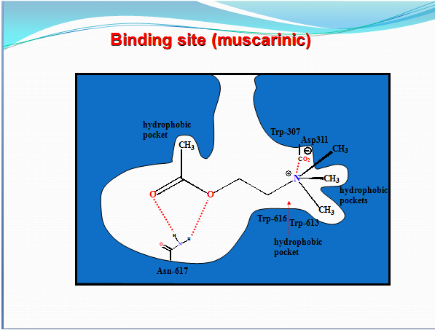

Slide 29


Slide 30
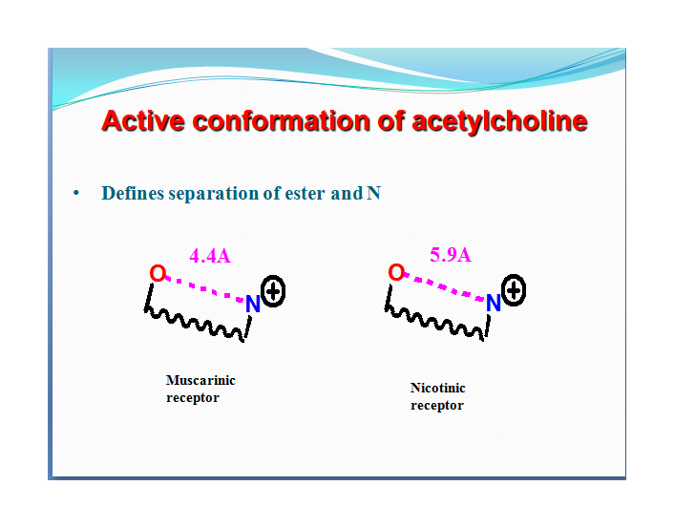
Study have shown that the separation between the ester group and the quaternary nitrogen is important for binding. This distance differ for the muscarinic and the nicotinic receptors.

Slide 31
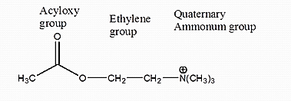
SAR of cholinergics as Muscarinic agonist
Based on above informations we can make simple changes to Ach hopefully design derivatives to improve stability and cell penetration.
Cholinergic drugs mimic action of Ach on Muscarinic or nicotinic receptors and produce the same effect as Ach but in greater magnitude. A general strategy of making an agonist is to use the original compound, in this case Ach, as a framework
1. Modification of quaternary Ammonium group

Slide 32
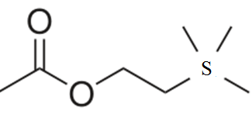
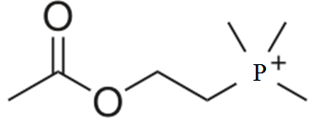
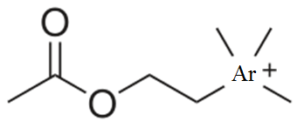
Replacement with sulphur removes the +ve charge and causes reduced activity
Replacement with Arsenic or Phosphorous maintains + charge but still reduces activity
Conclusion
1) positive charge needed
2) Positive charge should be on Nitrogen only
3) Charge on Nitrogen only possible when it bonded to 4 atoms ie quaternary form needed

Slide 33
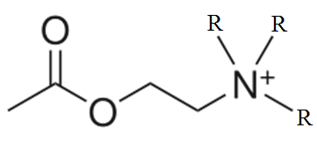
If R = methyl,(CH3) --> active
If R = ethyl (C2H5) --> antagonist!
If R = propyl (C3H9) and higher alkyls --> inactive
If only one of the R = ethyl or propyl active but less potent than Ach
If any or all R = H activity goes on decreasing

Slide 34
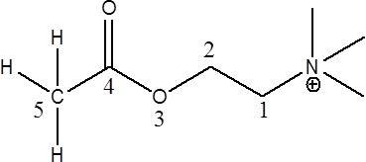
2. Change in the ethylene group
A “rule of five” idea states that there should be no more than 5 atoms between the Nitrogen and the terminal Hydrogen
As the chain length increased from two, activity
is rapidly lost. This tells us about the relative size of binding site

Slide 35
*For maximal muscarinic activity, the quaternary ammonium group should be followed by a chain of five atoms; this has been referred to as the five-atom rule.
*Shortening or lengthening the chain of atoms that
separates the ester group from the onium moiety reduces muscarinic activity.
An α- substitution on the choline moiety decreases both nicotinic and muscarinic activity, but muscarinic activity is decreased to a greater extent.
Substitution on the β-carbon nicotinic activity is decreased to a greater degree

Slide 36
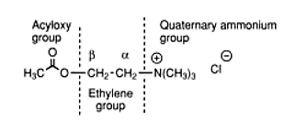
*Hydrolysis by AChE is more affected by substitutions on the β- than the α-carbon.
The hydrolysis rate of racemic acetyl β -methyl acetylcholine is about 50% of that of ACh; racemic acetyl α-ACh is hydrolyzed about 90% as fast.

Slide 37
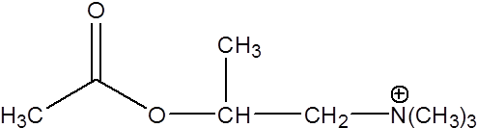
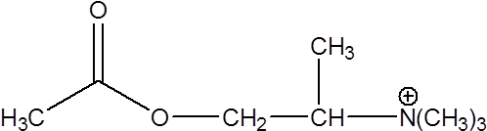
Methacholine
Methyl group in Beta carbon
As potent as Ach
Selective to Muscarinic receptor
Used clinically
Methyl group in alpha carbon
Not As potent as Ach
Selective to Nicotinic receptor
Not Used clinically

Slide 38
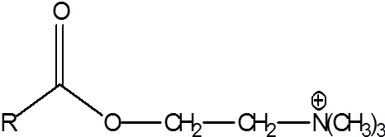
3. Modifications to the Acetoxy group
Substituting the Acetyl with higher homologous group such as propionyl or butyryl reduces activity. The ester group isn’t mandatory as quanternary amine group but an oxygen atom is required in this region
Since ester group makes it liable to hydrolysis, alternate groups were included and found that replacing the ester with carbamate, ether or ketone function resists hydrolysis while maintaining activity.

Slide 39
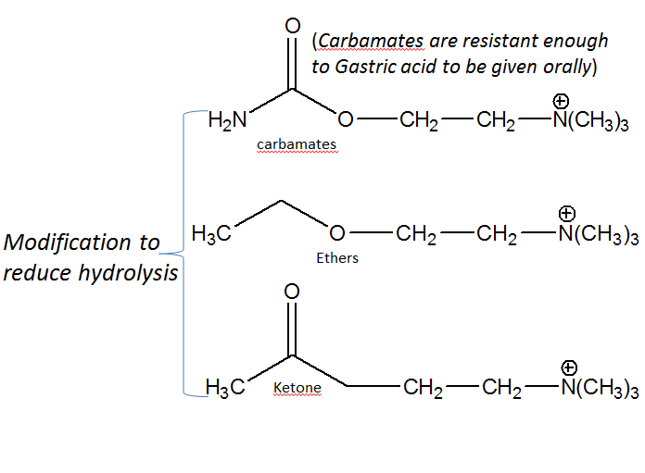

Slide 40
Uses of cholinergic agonists
Nicotinic selective agonists
Treatment of myasthenia gravis
- lack of acetylcholine at skeletal muscle causing weakness
Muscarinic selective agonists
Treatment of glaucoma
Switching on GIT and urinary tract after surgery
Treatment of certain heart defects. Decreases heart muscle activity and decreases heart rate

Slide 41
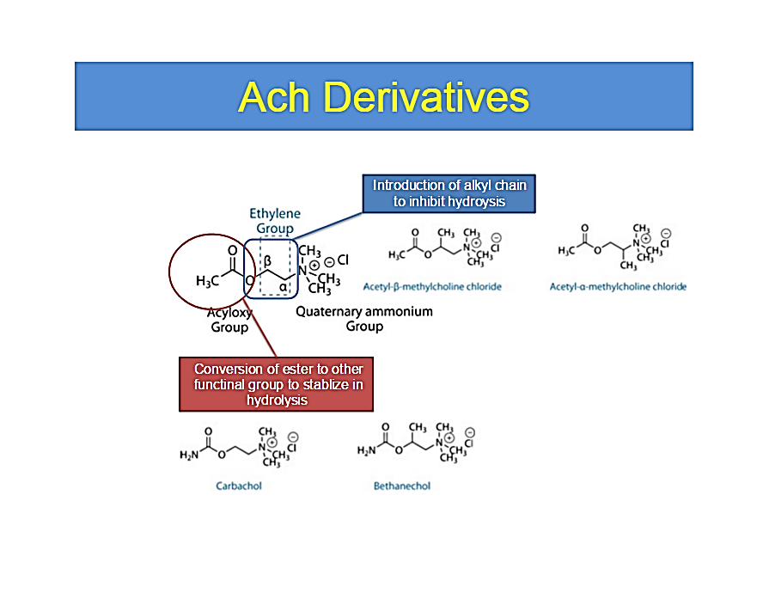
Ach Derivatives

Slide 42
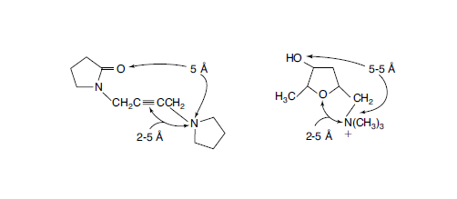
(Muscarinic agonists)
Oxotremorine
Has been regarded as a CNS muscarinic stimulant. It increases ACh brain levels in rats up to 40% and has been studied as a drug in the treatment of Alzheimer disease.
Comparison of the geometries of oxotremorine and muscarine shown below:

Slide 43
Acetylcholine Chloride
A powerful stimulant effect on the parasympathetic nervous system.
Attempts have been made to use it as a cholinergic agent,
but its duration of action is too short for sustained effects,
because of rapid hydrolysis by esterases and lack of specificity when administered for systemic effects.

Slide 44
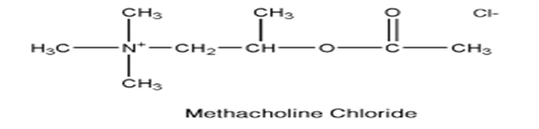
Methacholine chloride
Methacholine chloride acetyl β-methyl chloride or (2-hydroxy propyl) trimethylammonium chloride acetate, is the acetyl ester of β- methylcholine. It is a muscarinic selective cholinergic agonist.
Unlike ACh, Methacholine has sufficient stability in the body to give sustained parasympathetic stimulation. Methacholine can exist as (S) and (R) enantiomers. Although the chemical is used as the racemic mixture, its muscarinic activity resides principally in the (S)-isomer. The (S)/(R) ratio of muscarinic potency for these enantiomers is 240:1.
(+)-Acetyl-(S)-β-methylcholine is hydrolyzed by AChE, whereas the (R)(-)-isomer is not.

Slide 45
Carbachol.
Choline chloride carbamate is not selective to muscarinic or nicotinic receptor, non specific in its action on muscarinic receptor subtypes.
The pharmacological activity of carbachol is similar to that of ACh. It is an ester of choline and thus possesses both muscarinic and nicotinic properties by cholinergic receptor stimulation. It can also act a- indirectly by promoting release of ACh and b-by its weak anti cholinesterase activity. Carbachol forms a carbamyl ester in the active site of AChE, which is hydrolyzed more slowly than an acetyl ester.

Slide 46
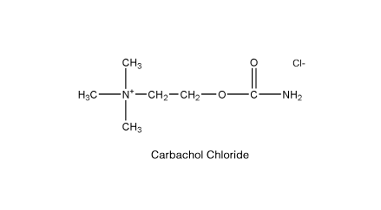
*Carbachol differs chemically from ACh in its stability to hydrolysis. The carbamyl group of carbachol decreases the electrophilicity of the carbonyl and, thus, can form resonance structures more easily than ACh can.
The result is that carbachol is less susceptible to hydrolysis and, therefore, more stable in aqueous solutions.

Slide 47
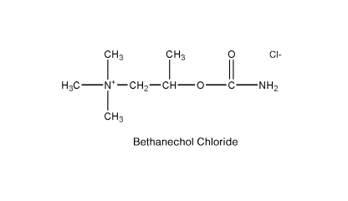
Bethanechol Chloride
(Urecholine), is selective to muscarine nonspecific in its action on muscarinic receptor subtypes but appears to be more effective at eliciting pharmacological action of M3 receptors. It has pharmacological properties similar to those of methacholine.
Both are esters of β -methylcholine and have feeble nicotinic activity. Bethanechol is inactivated more slowly by AChE in vivo than is methacholine. It is a carbamyl ester and is expected to have stability in aqueous solutions similar
to that of carbachol.

Slide 48
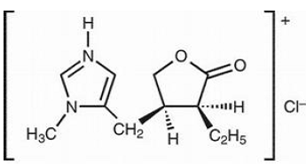
Pilocarpine Hydrochloride
It is a plant derived alkaloid whose structure does not match the established SAR but still acts like an cholinomimetic
It is not selective to muscarine. Unlike other muscarine agonists, it can penetrate the eye well following topical application

Slide 49
Anticholinesterase
Acetyl cholinesterase (AchE) is a enzyme that hydrolyzes Ach into Acetic acid and Choline.
Anticholinesterase drugs work by inhibiting the enzyme Acetyl cholinesterase which prevents hydrolysis of Ach thus increasing their concentration in the synapse which promotes more Ach action.
Since they promote Ach activity without binding to any receptor they are also called indirectly acting cholinergic agonists.
Applications:
Improve muscle strength in Myasthenia gravis
Glaucoma ,Alzheimer's, Insecticides ,Chemical weapon (serine gas)
There are two types: Reversible and Irreversible

Slide 50
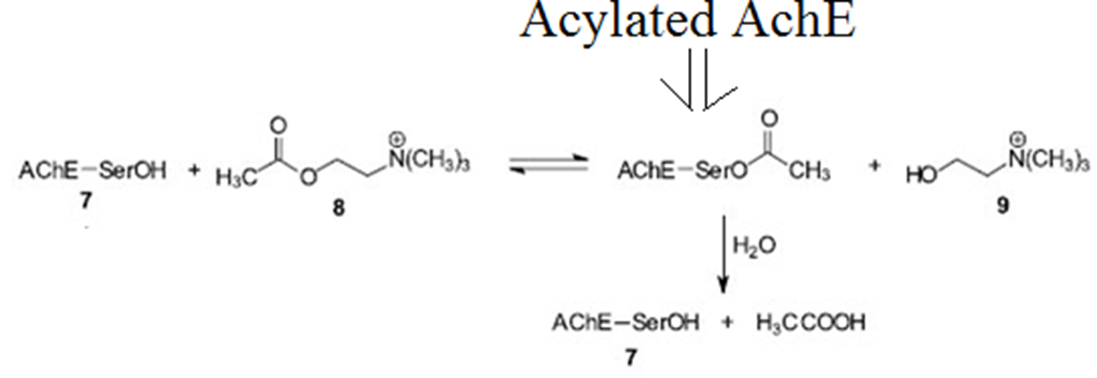
Theory of AchE inhibitors
During hydrolysis of Ach, the AchE gets acylated.
It needs to be hydrolyzed by water to be regenerated in free from or else it can’t function again.

Slide 51
AChE attacks the ester substrate through a serine hydroxyl, forming a covalent acyl-enzyme complex. The serine is activated as a nucleophile by the glutamic acid and histidine residues that serve as the proton sink to attack the carbonyl carbon of ACh. Choline is released, leaving the acetylated serine residue on the enzyme.
The acetyl-enzyme intermediate is cleaved by a general base catalysis mechanism to regenerate the free enzyme.
If instead of acetyl group there is carbamate group then hydrolysis will be resisted.
The AchE which is not hydrolyzed cannot be used again. Thus goal of AchE inhibitor is to provide such hydrolysis resistant functional group such as carbamates or phosphate ester.

Slide 52
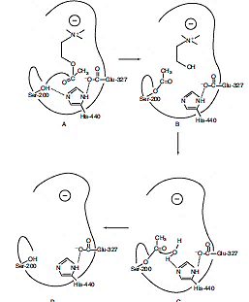
Mechanism of hydrolysis
of ACh by AChE.
A. ACh–AChE reversible complex.
B. Acetylation of esteratic site.
C. General base-catalyzed hydrolysis of acetylated enzyme.
D. Free enzyme.

Slide 53
Reversible Anticholinesterase
These are compounds can act by two ways:
They bind but don’t react with AchE with greater affinity than Ach like Ach does
These compounds that bind and react with AchE to form acylate AchE which is more stable form but still capable of being easily hydrolyzed
Reversible means that they inhibit AchE for short time (only few mins)
These compounds have more therapeutic uses than irreversible ones like Physostigmine and Neostigmine

Slide 54
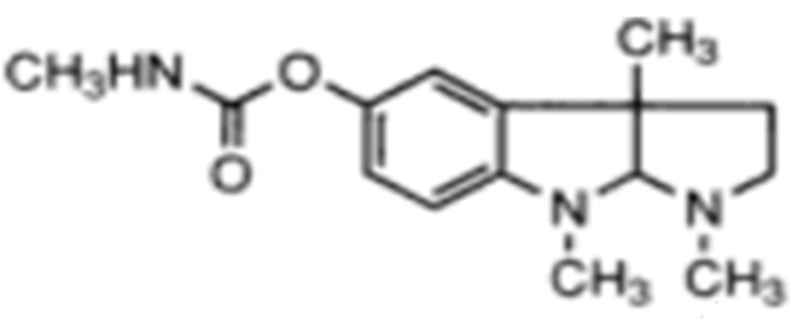
Physostigmine
It is an alkaloid type anticholinesterase obtained from the seeds of calabar beans
It has no charged amine and is more lipophillic and can thus penetrate the blood brain barrier
It has very great affinity for AchE but that can only in charged form. Thus there is pH limitation in it’s activity. Inhibition of cholinesterase is greater in acid media.
Physostigmine is a relatively poor carbamylating agent of AChE and is often considered a reversible inhibitor of the enzyme.

Slide 55
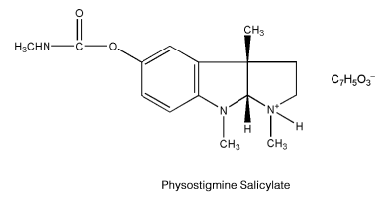
Uses : Glaucoma
Counter CNS poisoning by atropine and tricyclic depressents
MOA – It inhibits AchE by binding and reacting to it and carbamylating it.
This carbamylated enzyme is slow to hydrolysis

Slide 56
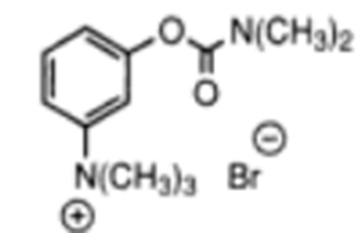
Neostigmine
It is a synthetic anticholinesterase based on Physostigmine.
It resembles the aromatic features of physostigmine and also the distance between the ester and ammonium is same but since it has charge on Nitrogen, it cannot cross the CNS like physostigmine does
Also its half life is shorter than physostigmine
Uses:
Myasthenia gravis
To counter Urinary retention
MOA – It inhibits AchE by binding and reacting to it and carbamylating it. This carbamylated enzyme is slow to hydrolysis

Slide 57
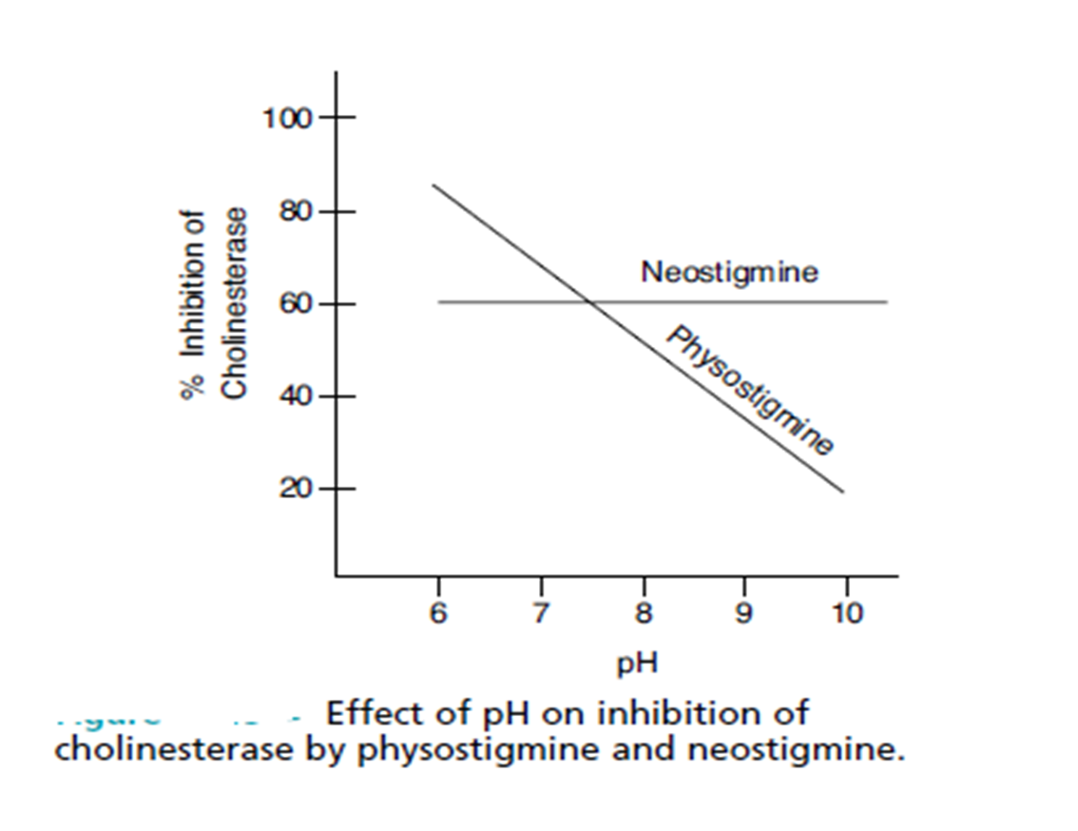

Slide 58
Ambenonium Chloride.
Ambenonium chloride is used for the treatment of myasthenia gravis in patients who do not respond satisfactorily to neostigmine or pyridostigmine.
This drug acts by suppressing the activity of AChE.
It possesses a relatively prolonged duration of action and causes fewer side effects in the GI tract than the other anticholinesterase agents. Because of its quaternary ammonium structure, ambenonium chloride is absorbed poorly from the GI tract.

Slide 59
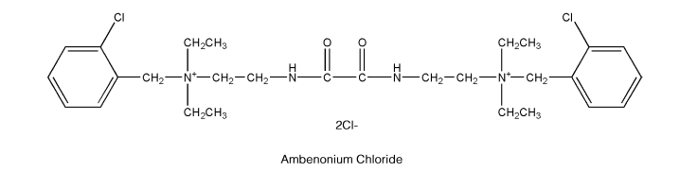
In moderate doses, the drug does not cross the blood-brain barrier. Ambenonium chloride is not hydrolyzed by cholinesterases.
Ambenonium chloride

Slide 60
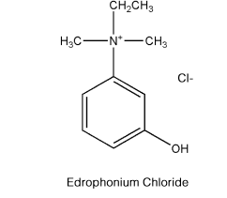
Edrophonium Chloride
Edrophonium Chloride ethyl (hydroxyphenyl) dimethylammonium chloride (Tensilon), is
a reversible anticholinesterase agent.
It is bitter and very soluble in water and alcohol. Edrophonium has a more rapid onset and shorter duration of action than neostigmine, pyridostigmine, or ambenonium.
It is a specific anticurare agent and acts within
1 minute to alleviate overdose of d-tubocurarine, dimethyl d -tubocurarine, or gallamine triethiodide.

Slide 61
Irreversible Anticholinesterase
These compounds act by only one way: that bind and react with AchE to AchE with greater affinity than Ach to form acylated enzyme which strongly resist hydrolysis
Irreversible means that they inhibit AchE for very long time(many hours)
These compounds have less therapeutic uses than reversible ones.
Serine gas and organophosphate insecticides are based on this concept.
They cause cholinergic crisis
Their common structural feature is the presence of Phosphate ester bond which strongly resist hydrolysis

Slide 62
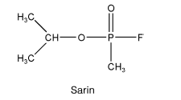
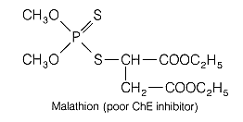
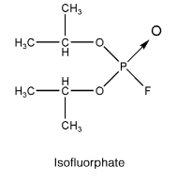
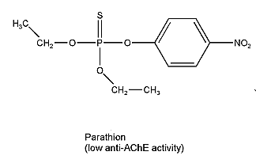
The compounds belong to a class of organophosphorous esters. A general formula for such compounds follows:

Slide 63
Cholinergic crisis
A cholinergic crisis is an over-stimulation at a neuromuscular junction due to an excess of acetylcholine (ACh). This happens due to inactivity (perhaps even inhibition) of the AChE enzyme, which normally breaks down acetylcholine. This is a consequence of some types of nerve gas, (e.g. sarin gas) or insecticides.
It causes muscle paralysis and respiratory failure

Slide 64

Aging
Irreversible Anticholinesterase containing Phosphate ester
resist hydrolysis very strongly.
They also undergo a feature called aging which increases this resistance even more.
When AchE becomes acylated for a long time with, one of the ester bond is broken. This creates a negative charge that oppose nucleophillic attack on phosphorous and in this state it resists hydrolysis even more.
At this stage antidotes against Irreversible anticholinesterase such as PAM doesn’t work.
Thus regeneration of AchE is blocked for even longer periods
leading to cholinergic crisis

Slide 65
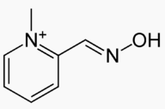
Antidote to insecticides (Pralidoxime)
Because insecticides can lead to cholinergic crisis, antidotes were designed to hydrolyze the acylated AchE.
A successful antidote was PAM
It has a quaternary ammonium and a very strong nucleophile called oxime group and both work together to free AchE from the phosphate ester compounds
Anti-dote PAM

Slide 66
Organophosphate poisoning
  Most insecticides use concept of irreversible AchE
inhibition to kill pesticides. These compounds contain Phosphate ester bond that strongly resist hydrolysis. They are very lipophillic and volatile also. They can quickly enter the blood stream and inhibit AchE for a many hours. This promotes Ach
activity in the synapse which leads to ‘cholinergic
crisis’. When this happens muscles stop responding
to Ach causing paralysis and respiratory failure
(death)

Slide 67
How PAM reverses poisoning by organophosphate or serine gas ?
There are two sites in the binding pocket of AchE. One is a anionic site which is empty and other is the Esteric site where the phosphate compound sits. 3 event follows:
First :the charged ammonium of PAM binds to the anionic site. From there PAM’s strong nucleophillic oxime group can be in close distance to attack the ester bond between Phosphorous and serine amino acid of AchE.
Second: 2-PAM bound to organophosphate
Third : organophosphate bond to serine is broken
This form free AchE and phosphorylated PAM

Slide 68
Limitation: For PAM to work, it must be used immediately following exposure to insecticides or serine gas or no more than 36 hrs of exposure or else aging will occur and it wont be able to dislocate the
phosphate form the receptor

Slide 69
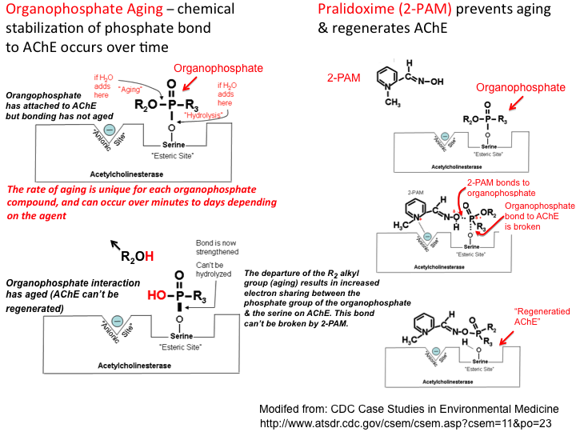

Slide 70
Cholinergic receptor antagonists
Anticholinergic action by drugs and chemicals apparently depends on their ability to reduce the number of free receptors that can interact with ACh.
A blocking agent that has high affinity for the receptor may decrease the number of available free receptors and the efficiency of the endogenous neurotransmitter
What is muscarinic antagonist ?
- An agent that have high binding affinity for the muscarinic receptor but have no intrinsic activity.
- They are competitive (reversible) antagonists of acetylcholine
- Their pharmacological actions are opposite to that of the muscarinic agonists

Slide 71
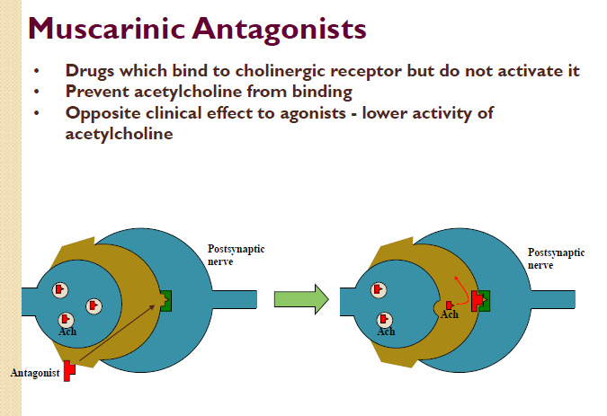

Slide 72
Muscarinic Antagonists
Clinical Effects
• Decrease of saliva and gastric secretions
• Relaxation of smooth muscle
• Decrease in motility of GIT and urinary tract
• Dilation of pupils
Uses
• Shutting down digestion for surgery
• Ophthalmic examinations
• Relief of peptic ulcers
• Treatment of Parkinson’s Disease
• Anticholinesterase poisoning
• Motion sickness

Slide 73
A wide variety of compounds possess anticholinergic activity.
The development of such compounds has been largely
empiric and based principally on atropine as the prototype.
Nevertheless, structural permutations have resulted in compounds
that do not have obvious relationships to the parent
molecule. The following classification delineates the major
chemical types encountered:
• Solanaceous alkaloids and synthetic analogs
• Synthetic aminoalcohol esters
• Aminoalcohol ethers
• Aminoalcohols
• Aminoamides
• Miscellaneous
• Papaveraceous

Slide 74
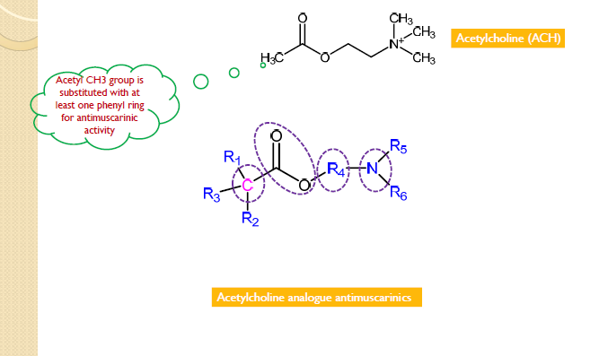
Structure Activity Relationship (SAR) Studies

Slide 75
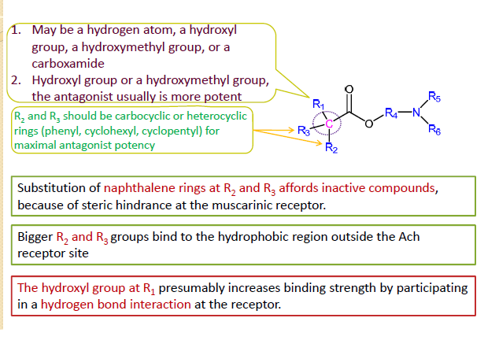
Substitutions at α-carbon with respect to ester group

Slide 76

Changes at ester group

Slide 77


Slide 78


Slide 79


Slide 80


Slide 81





Slide 82


Slide 83

Specific anti muscarinic drugs

Slide 84


Slide 85

Anti muscarinic drugs used in the treatment of urinary incontinence

Slide 86


Slide 87


Slide 88


Slide 89
Anti muscarinic drugs used in the treatment of bronchial asthma
*Ipratropium Hydrobromide
* Tiotropium bromide
M3 receptors: Bronchiole constriction
Therapeutic use: block cholinergic bronchiole constriction
(anti cholinergics) and allow adrenergic bronchiole dilation to help overcome the pulmonary constriction associated with asthmatic attack.

Slide 90

Ipratropium Hydrobromide (Atrovent®)

Slide 91

Tiotropium Bromide (Spiriva®)

Slide 92
Nicotinic Antagonists
Compounds that bind to cholinergic nicotinic receptors
with no intrinsic efficacy (competitive antagonists with
Ach)
Two subclasses of nicotinic antagonists
◦ Skeletal neuromuscular blocking agents
◦ Ganglionic blocking agents.
DONOT confuse with skeletal muscle relaxants that
produce their effects through the CNS

Slide 93

Events and sites of drug action at a nicotinic cholinergic synapse

Slide 94

Tubocurarine – the first neuromuscular blocker
The neuromuscular
blocking effects of extracts
of curare were first reported
as early as 1510
It was demonstrated that
curare extracts prevented
skeletal muscle contractions
by an effect at the
neuromuscular junction

Slide 95

Tubocurarine structure

Slide 96
Rationale for designing new compounds
Bis‐quaternary ammonium compound having two quaternary ammonium salts separated by 10 to 12 carbon atoms (similar to the distance between the nitrogen atoms in tubocurarine) was a requirement for neuromuscular blocking activity
The rationale for this structural requirement was that nicotinic receptors possessed two anionic‐binding sites, both of which had to be occupied for a neuromuscular blocking effect.
Nicotinic antagonist may be :
◦ Depolarizing neuromuscular blocker
◦ Non‐depolarizing neuromuscular blocker

Slide 97

Depolarizing agents

Slide 98

Decamethonium Bromide

Slide 99


Slide 100


Slide 101


Slide 102


Amino steroid NM blocking agents

Slide 103


Slide 104


Slide 105

Pancuronium Bromide (Pavulon)

Slide 106

Tetrahydroisoquinolines

Slide 107

Tetrahydroisoquinolines

Slide 108

Structure Activity Relationships

