Slide 1
Antifungal agents
Pharmaceutical chemistry
AL-Mustansiriyah university
college of pharmacy

Slide 2
Antifungal drugs
Fungi are traditionally important in plant pathology.
They have gained much importance for causing serious human diseases, mainly due to indiscriminate use of suppressive immunotherapy.
So development of antifungal is gaining importance.
Fungal infections are usually more difficult to treat than bacterial infections, because fungal organisms grow slowly and because fungal infections often occur in tissues that are poorly penetrated by antimicrobial agents (e.g., devitalized or a vascular tissues).
Therapy of fungal infections usually requires prolonged treatment.

Slide 3
Biochemical targets for antifungal chemotherapy
There are three general mechanisms of action for the antifungal agents:
Cell membrane disruption.
inhibition of cell division .
inhibition of cell wall formation.

Slide 4
Classification of antifungal drugs
I. Anti fungals damaging permeability of the cell membrane
Imidazoles: Bifonazole, Clotrimazole, Econazole,
Ketoconazole, Miconazole
Triazoles: Fluconazole, Itraconazole, Voriconazole
Allylamines: Terbinafine, Naftifine
Thiocarbamates: Tolciclate, Tolnaftate
Substituted pyridones: Ciclopirox
Polyene antibiotics: Amphotericin B, Nystatin

Slide 5
II. Antifungals inhibiting chitin synthesis in the cell wall
Caspofungin, Griseofulvin
III. Antifungals inhibiting synthesis of nucleic acids
Flucytosine

Slide 6
Antifungal azoles
Antifungal Azoles are synthetic drugs with broad-spectrum fungistatic activity.
Azoles can be divided into two groups: the older imidazole agents
(clotrimazole, ketoconazole, miconazole) in which
the ﬁve-member azole nucleus contains two nitrogens
and the newer triazole compounds
(ﬂuconazole, itraconazole, and voriconazole),
in which the azole nucleus contains three nitrogens.
The azoles tend to be effective against most fungi that cause superficial infections of the skin and mucous membranes.

Slide 7
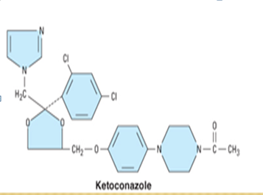
imidazole agents

Slide 8
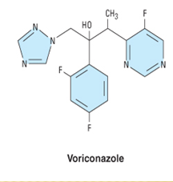
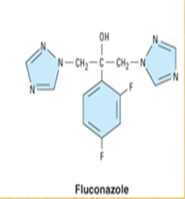
Triazole compounds

Slide 10
All azoles exert antifungal activity by inhibiting cytochrome P450 enzymes responsible for the demethylation of lanosterol to ergosterol.
Reduced fungal membrane ergosterol concen-
trations result in damaged, leaky cell membranes.
The toxicity of these drugs depends on their relative affinities for mammalian and fungal cytochrome P450 enzymes.

Slide 11
Cytochrome P450-class enzyme, lanosterol 14-demethylase, is the likely target for the azoles.
P450 possesses a heme moiety as part of its structure and the basic electron pairs of the azole rings can occupy a binding site on P450, preventing the enzyme from turning over. The function of lanosterol 14-demethylase is to oxidatively remove a methyl group from lanosterol during ergosterol biosynthesis.

Slide 13
Structure–activity relationships
1.The basic structural requirement for members of the azole class is a weakly basic imidazole or 1,2,4-triazole ring (pKa of 6.5–6.8) bonded by a nitrogen–carbon linkage to the rest of the structure.
2. At the molecular level, the amidine nitrogen atom (N-3 in the imidazoles, N-4 in the triazoles) is believed
to bind to the heme iron of enzyme-bound cytochrome P450 to inhibit activation of molecular oxygen and prevent oxidation of steroidal substrates by the enzyme.

Slide 14
3.The most potent antifungal azoles possess two or three aromatic rings, at least one of which is halogen substituted (e.g., 2,4-dichlorophenyl, 4-chlorophenyl, 2,4-difluorophenyl), and other non polar functional groups. Only 2, and/or 2,4 substitution yields effective azole compounds.
4.The halogen atom that yields the most potent compounds is fluorine, although functional groups such as sulfonic acids have been shown to do the same.
5.Substitution at other positions of the ring yields
inactive compounds.

Slide 15
The triazoles tend to have fewer side effects, better absorption, better drug distribution in body tissues, and fewer drug interactions.
Fluconazole does not require an acidic environment, as does ketoconazole, for GI absorption.
Itraconazole is lipophilic and water insoluble and requires a low gastric pH for absorption.
Ketoconazole can be absorbed orally, but it requires an acidic gastric environment.
Clotrimazole is a broad-spectrum fungistatic imidazole drug used in the topical treatment of oral, skin, and vaginal infections with C. albicans.

Slide 16
Allylamines
Reversible noncompetitive inhibitors of the fungal enzyme squalene monooxygenase, which converts squalene to lanosterol.( first step in ergosterol biosynthesis).
With a decrease in lanosterol production, ergosterol
production is also diminished, affecting fungal cell
membrane synthesis and function.
Notes:
first step in ergosterol biosynthesis

Slide 18
Naftiﬁne is available for topical use only in the treatment of cutaneous dermatophyte and Candida infections.

Slide 19
Terbinaﬁne (Lamisil®) is available for topical and systemic use (oral tablet) in the treatment of dermatophyte skin and nail infections.

Slide 20
Thiocarbamates:
Tolnaftate has been shown to act as an inhibitor of squalene epoxidase 44 in susceptible fungi, so it is classified with the allylamine antimycotics. Tolnaftate is formulated into preparations intended to be used with artificial fingernails to counteract the increased chance of ringworm of the nail beds.

Slide 21
Other antifungals affecting cell membrane stability
Ciclopirox is a topical solution used to treat fungal infections of the nails and hair. It is a broad-spectrum antifungal medication that also has antibacterial and anti-inflammatory properties.

Slide 22
Ciclopirox
Mechanism of Action: Its main mode of action is thought to be its high affinity for trivalent cations, which inhibit essential co-factors in enzymes.
Ciclopirox is thought to act through the chelation of polyvalent metal cations, such as Fe³⁺ andAl³⁺ . These cations inhibit many enzymes, including cytochromes, possibly disrupting the biosynthesis of ergosterol.

Slide 23
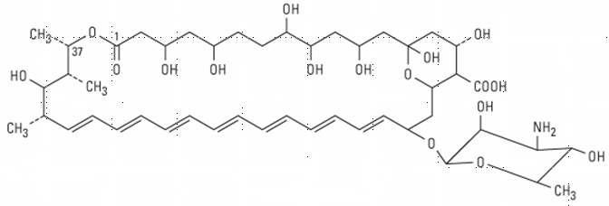
polyene antifungal agents
Amphotericin B and Nystatin bind to the fungal
cell membrane component ergosterol, leading to
increased fungal cell membrane permeability and
the loss of intracellular constituents.

Slide 24
Amp. B is indicated for treatment of severe, potentially life threatening fungal infections. Unfortunately, it must be given IV and is toxic (due to nonselective action on
cholesterol in mammalian cell membranes). Serious fungal infections involve long therapy.

Slide 25
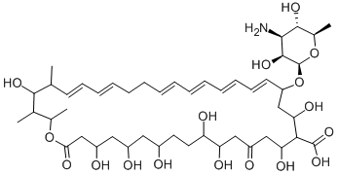
Nystatin is a polyene antifungal drug with a ring structure and a mechanism of action similar to that of amphotericin B. Too toxic for systemic use, nystatin is limited to the topical treatment of superﬁcial infections caused by C. albicans

Slide 26
Inhibitors of cell division
Flucytosine (5-ﬂucytosine, 5-FC) is an analogue of cytosine that was originally synthesized for possible use as an antineoplastic agent. 5-FC is converted to 5-ﬂuorouracil inside the cell by the fungal enzyme cytosine deaminase. The active metabolite 5-ﬂuorouracil interferes with fungal DNA synthesis by inhibiting thymidylate synthetase.
Incorporation of these metabolites into fungal RNA
inhibits protein synthesis.

Slide 27
Flucytosine has a significant antifungal activity against Candida spp. and the fungal organisms responsible for chromomycosis.

Slide 28
Cell wall inhibitors Griseofulvin
Griseofulvin is an antifungal produced from penicillium griseofulvin. therapy must continue until new tissue replaces old diseased tissue. when given orally, plasma-borne griseofulvin becomes incorporated into keratin precursor cells and ultimately into keratin that cannot support fungal growth.
Mechanism of action: griseofulvin inhibits microtubule polymerization thus inhibiting the
formation of the mitotic spindle.

Slide 29
Griseofulvin is an oral fungistatic agent used
in the long-term treatment of dermatophyte infections
caused by Epidermophyton, Microsporum, and
Trichophyton spp.

Slide 30
Caspofungin acetate is an parenteral injection used in the treatment of invasive aspergillosis in patients refractory to or intolerant of other antifungal therapies. Studies have shown caspofungin to be effective against invasive candidaisis. It is a semisynthetic lipopeptide(echinocandin) derived from a fermentation product of Glarea lozoyensis.
Mechanism of Action: Caspofungin is a (1,3)-D-glucan synthesis inhibitor, thus disrupting the formation of β-glucan in the cell walls. β-glucan is essential to the structural integrity of the cell wall.

Slide 31
Caspofungin

