Slide 1
NSAIDs 4th stage students
Prepared by:
Assist. Lec.Ola Ali Nasser
Assist. Lec.Lubab Tarek Nafea

Slide 2
Non-steroidal anti-inflammatory drugs

Slide 3
Mechanism of action
NSAIDs reduce the production of prostaglandins by inhibiting the enzyme cyclo-oxygenase.
They vary in their selectivity for inhibiting different types of cyclooxygenase; selective inhibition of cyclo-oxygenase-2 reduces gastro-intestinal intolerance.

Slide 4
Clinical uses
In single doses non-steroidal anti-inflammatory drugs (NSAIDs) have analgesic activity comparable to that of paracetamol
In regular full dosage NSAIDs have both a lasting analgesic and an anti-inflammatory effect which makes them particularly useful for the treatment of continuous or regular pain associated with inflammation.
Therefore, although paracetamol often gives adequate pain control in osteoarthritis,
NSAIDs are more appropriate than paracetamol or the opioid analgesics in the inflammatory arthritides (e.g. rheumatoid arthritis) and in some cases of advanced osteoarthritis.
NSAIDs can also be of benefit in the less well defined conditions of back pain and soft-tissue disorders.

Slide 5
Cautions and contra-indications
NSAIDs should be used with caution in the elderly (risk of serious side effects and fatalities),
In allergic disorders (they are contra-indicated in patients with a history of hypersensitivity to aspirin or any other NSAID—which includes those in whom attacks of asthma, angioedema, urticaria or rhinitis have been precipitated by aspirin or any other NSAID).
During pregnancy and breast-feeding .
In coagulation defects.
Long-term use of some NSAIDs is associated with reduced female fertility, which is reversible on stopping treatment.
In patients with renal, cardiac, or hepatic impairment caution is required since NSAIDs may impair renal function ,the dose should be kept as low as possible and renal function should be monitored.
All NSAIDs are contra-indicated in severe heart failure.
The selective inhibitors of cyclo-oxygenase-2 (celecoxib, etoricoxib, and parecoxib) are contra-indicated in ischaemic heart disease, cerebrovascular disease, peripheral arterial disease, and moderate or severe heart failure.
The selective inhibitors of cyclo-oxygenase-2 should be used with caution in patients with a history of cardiac failure, left ventricular dysfunction, hypertension, in patients with oedema for any other reason, and in patients with risk factors for heart disease.

Slide 6
Side-effects
Gastro-intestinal discomfort, nausea, diarrhoea, and occasionally bleeding and ulceration occur. Systemic as well as local effects of NSAIDs contribute to gastro-intestinal damage; taking oral formulations with milk or food, or using enteric-coated formulations, or changing the route of administration may only partially reduce symptoms such as dyspepsia. Those at risk of duodenal or gastric ulceration (including the elderly) who need to continue NSAID treatment should receive either a selective inhibitor of cyclo-oxygenase-2 alone, or a non-selective NSAID with gastroprotective treatment.
hypersensitivity reactions (particularly rashes, angioedema, and bronchospasm, headache, dizziness, nervousness, depression, drowsiness, insomnia, vertigo, hearing disturbances such as tinnitus, photosensitivity, and haematuria.
Blood disorders have also occurred.
Fluid retention may occur (rarely precipitating congestive heart failure); blood pressure may be raised.
Renal failure may be provoked by NSAIDs, especially in patients with renal impairment. Rarely, papillary necrosis or interstitial fibrosis associated with NSAIDs can lead to renal failure.
Hepatic damage, alveolitis, pulmonary eosinophilia, pancreatitis, eye changes, Stevens-Johnson syndrome and toxic epidermal necrolysis are other rare sideeffects.
Induction of or exacerbation of colitis has been reported.
Aseptic meningitis has been reported rarely with NSAIDs;
patients with connective-tissue disorders such as systemic lupus erythematosus may be especially susceptible.

Slide 7
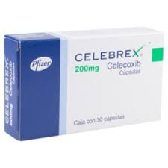
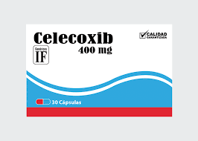

Slide 8
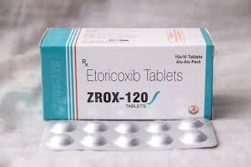
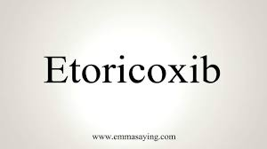
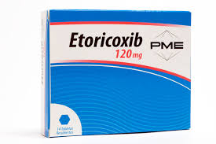

Slide 9
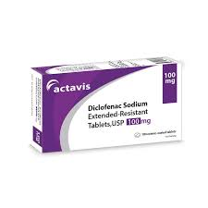
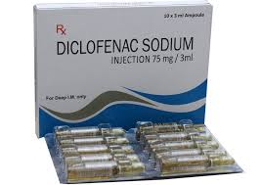

Slide 10
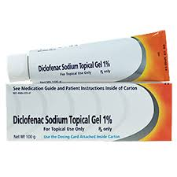
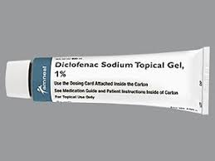
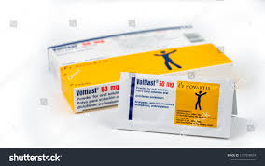

Slide 11
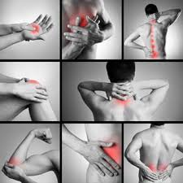
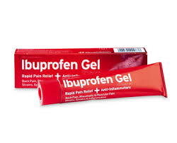
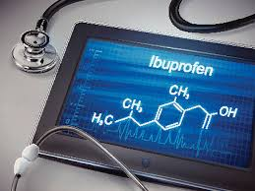

Slide 12
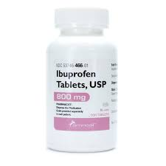
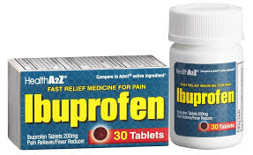
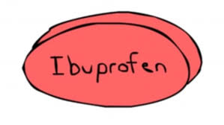

Slide 13
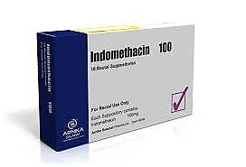
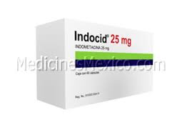
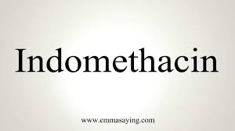
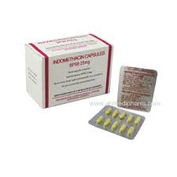

Slide 14
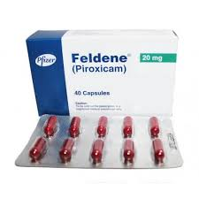
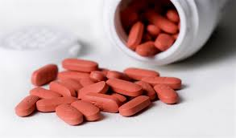

Slide 15
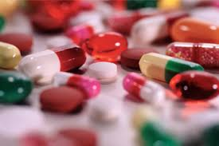
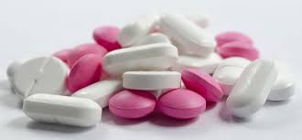
Thank you

