Slide 1
CNS fourth stage students
Prepared by:
Assist. Lect.Lubab Tarek Nafea
Assist. Lect.Shymaa Hasan Abbas

Slide 2
Motion Sickness

Slide 3

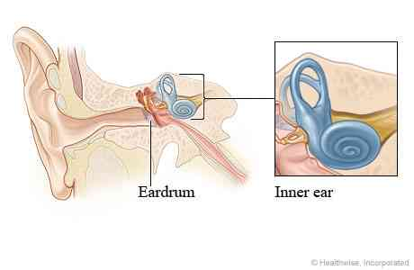

Slide 4
Motion sickness is caused by a conflict of messages to the brain, where the vomiting center receives information from the eyes, the GI tract and the vestibular system in the ear.
Patient assessment
Symptoms :nausea, sometimes vomiting, pallor and cold sweats.
Age
It is common in young children.
Babies and very young children up to 2 years seem to only rarely suffer from the problem and therefore do not usually require treatment.
The incidence of motion sickness seems to greatly reduce with age
Previous history
members of the family have history motion sickness and for whom treatment will be needed.
Mode of travel/length of journey
The estimated length of time to be spent travelling will help in the selection of prophylactic treatment, since the length of action of available drugs varies. Once vomiting starts there is little that can be done, so any medicine recommended must be taken in good time before the journey if it is to be effective. If it is a long journey, it may be necessary to repeat the dose while travelling and the recommended dosage interval should be stressed.
Children are less likely to feel or be sick if they can see out of the car, so appropriate seats can be used to elevate the seating position of small children. For any method of travel, children are less likely to experience symptoms if they are kept occupied by playing games as they are therefore concentrating on something else.

Slide 5
Antihistamine and Anticholinergic drugs

Slide 6
Management :
1.Antihistamines
They include cinnarizine, meclozine and promethazine. Anticholinergic effects are thought to be responsible for the effectiveness of antihistamines in the prophylaxis of motion sickness. All have the potential to cause drowsiness and promethazine appears to be the most sedative.
Meclozine and promethazine theoclate have long durations of action and are useful for long journeys since they need to be taken only once daily.
Cinnarizine and promethazine theoclate are not recommended for children younger than 5 years, whereas meclozine can be given to those over 2 years.
These drugs are best avoided during pregnancy.

Slide 7


This for motion sickness and vestibular disease
THIS FOR PERIPHERAL VASCULAR DISEASE

Slide 8
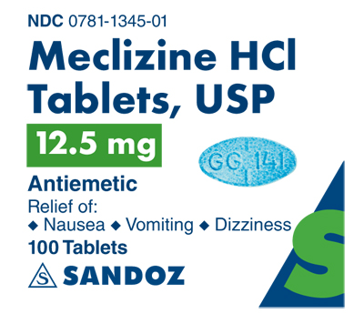

Slide 9
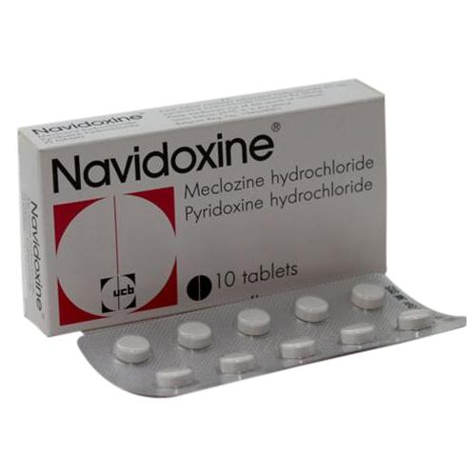

Slide 10
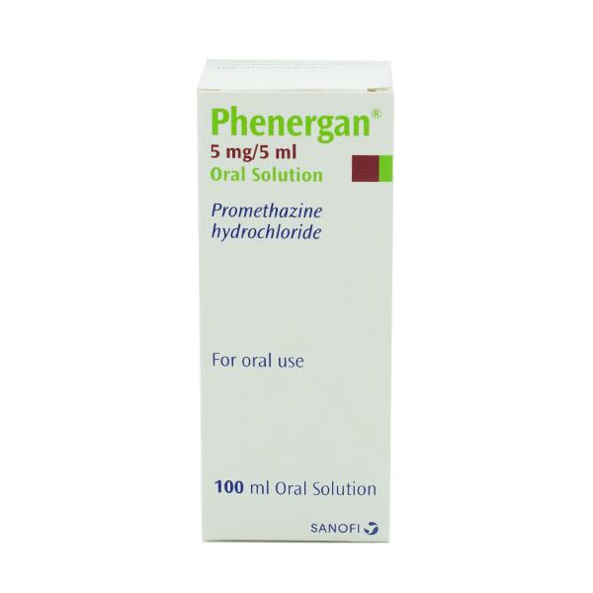
Promethazine

Slide 11
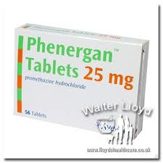
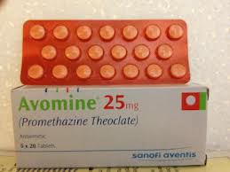

Slide 12

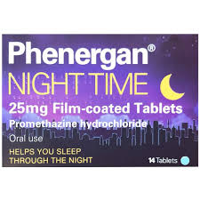

Slide 13


Slide 14

Scopolamine
(Hyoscine hydrobromide)

Slide 15
2. Anticholinergic agents
Hyoscine hydrobromide is the only anticholinergic used widely in the prevention of motion sickness which can be given to children over 3 years.
Anticholinergic drugs can cause drowsiness, blurred vision, dry mouth, constipation and urinary retention as side-effects, although they are unlikely at the doses used in OTC formulations for motion sickness. Children could be given sweets to suck to counteract any drying of the mouth.
Hyoscine has a short duration of action (from 1 to 3 h). It is therefore suitable for shorter journeys and should be given 20 min before the start of the journey.
Anticholinergic drugs and antihistamines with anticholinergic effects are best avoided in patients with prostatic hypertrophy because of the possibility of urinary retention and in glaucoma because the intraocular pressure might be increased.
side-effects from anticholinergic agents are additive and may be increased in patients already taking drugs with anticholinergic effects, such as tricyclic antidepressants (e.g. amitriptyline), butyrophenones (e.g. haloperidol) and phenothiazines (e.g. chlorpromazine).
3.Alternative approaches to motion sickness (Ginger)
It has been suggested that ginger acts on the GI tract itself rather than on the vomiting centre in the brain or on the vestibular system. No official dosage level has been suggested. Ginger would be worth trying for a driver who suffered from motion sickness, since it does not cause drowsiness, and might be worth considering for use in pregnant women, for whom other antiemetics such as anticholinergics and antihistamines are not recommended.

Slide 16
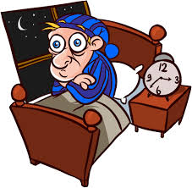
INSOMNIA

Slide 17
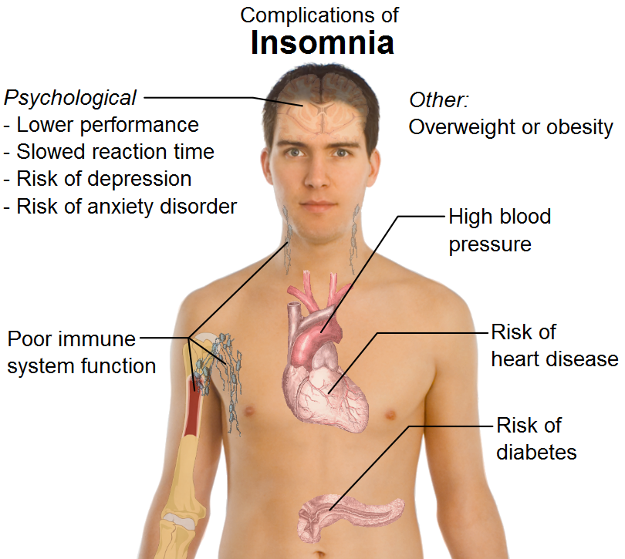

Slide 18
Patient assessment
Age
In elderly people the total duration of sleep is shorter .Nocturnal waking is more likely because sleep is generally more shallow. Elderly people may nap during the day and this reduces their sleep need at night even further.
Many babies, toddlers and infants have poor sleep patterns so referral can be helpful.
2.Symptoms
It is important to distinguish between the different types of sleep problems:
Difficulty in falling asleep (sleep latency insomnia)
Waking during the night
Early morning waking
Poor sleep quality
Snoring.
Depression is an important cause of insomnia. Early morning waking is a classic symptom of depression. Here the patient may describe no problems in getting to sleep but waking in the early hours and not being able to get back to sleep. This pattern requires referral .The onset of symptoms of bipolar disorder may be associated with lack of sleep. It is possible that insufficient sleep may actually trigger an episode of mania in bipolar disorder. Anxiety can also cause insomnia. This is usually associated with difficulty in getting off to sleep because of an overactive mind.

Slide 19
3.Duration
Sleep disorders are classified as follows:
Transient (days)
Short term (up to 3 weeks)
Chronic (longer than 3 weeks).
All chronic cases should be referred to the doctor.
4.Previous history
Where there is a previous history, it is helpful to know what treatments have been tried. It is also useful to be aware of a history of depression or anxiety or some other mental health problem.
5.Contributory factors
Shift work with changing shifts is a classic cause of sleep problems. Those who work away from home may experience difficulty in getting a good night’s sleep because of the combination of travelling and staying in unfamiliar places.
Alcohol – while one or two drinks can help by decreasing sleep latency, the sleep cycle is disturbed by heavy or continuous alcohol consumption.
Life changes can cause disrupted sleep, e.g. change or loss of job, moving house, bereavement, loss or separation or the change of life (i.e. menopause).
Other stressful life events might include examinations, job interviews,
celebrations (e.g. Christmas) and relationship difficulties.
Obesity can be associated with sleep apnea and snoring, both of which can interrupt sleeping.

Slide 20
6.Medication
Some drugs can cause or contribute to insomnia, including decongestants, fluoxetine, monoamine oxidase inhibitors, corticosteroids, appetite suppressants, phenytoin and theophylline.
Medical problems can be associated with insomnia through pain (e.g. angina, arthritis, cancer and gastro-oesophageal reflux) or breathing difficulties (e.g. heart failure, chronic obstructive airways disease and asthma). Other medical
conditions such as hyperthyroidism and Parkinson’s disease can also cause insomnia.
Treatment timescale: There should be an improvement within days: refer after 1 week if the problem is not resolved.
Practical points:-
Sleep hygiene /Key points are as follows:
• Establish a regular bedtime and waking time
• Consciously create a relaxation period before bedtime
• No meals just before bedtime
• No naps during the daytime
• No caffeine after early afternoon
• Reduce extraneous noise (use earplugs if necessary)
• Get up if you can’t sleep – go back to bed when you feel ‘sleepy, tired’
• Restrict alcohol intake to 1–2 units a day or less
• Restrict nicotine intake immediately before bedtime

Slide 21
Management
1.Antihistamines (diphenhydramine and promethazine)
•They reduce sleep latency (the time taken to fall asleep) and also reduce nocturnal waking. They should be taken 20–30 min before bedtime and can be recommended for adults and children over 16 years. Tolerance to their effects can develop and they should not be used for longer than 7–10 consecutive nights.
•Diphenhydramine has a shorter half-life than promethazine (5–8 h compared with 8–12 h). Following a 50-mg dose of diphenhydramine there is significant drowsiness for 3–6 h.
•These antihistamines have anticholinergic sideeffects, including dry mouth and throat, constipation, blurred vision and tinnitus. These effects will be enhanced if the patient is taking another drug with anticholinergic effects (e.g. tricyclic antidepressants and phenothiazines) but patients taking these drugs would be better referred anyway. Prostatic hypertrophy and closed-angle glaucoma are contraindications to the use of diphenhydramine and promethazine.
•Diphenhydramine and promethazine should not be recommended for pregnant or breastfeeding women.

Slide 22
2.Benzodiazepines
these drugs are for short-term use only and should not be used for longer than 3 weeks, pharmacists are well aware that patients continue to be on these drugs
for long periods of time.
3.Aromatherapy
Lavender oil has been shown to induce a sense of relaxation, as has camomile. One or two drops of the essential oil sprinkled on a pillow or three or four drops in a warm (not hot) bath can be recommended.
4.Melatonin
Melatonin is currently available only as prescription-only medicine. Melatonin is produced by the body’s pineal gland during darkness and is thought to regulate sleep. Melatonin levels are lower in the elderly. Supplementation with melatonin can raise levels and help to restore the sleep pattern. Melatonin has a short half-life (2–3 h) and is subject to first-pass metabolism. Sublingual, controlled release products are available.
5.St John’s wort (hypericum)

Slide 23
ANTIHESTAMINE
&
BENZODIAZEPINE

Slide 24
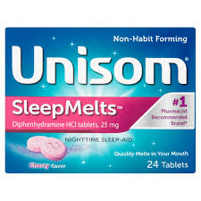
diphenhydramine

Slide 25
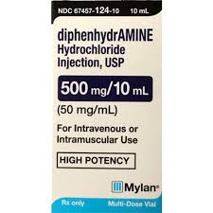

Slide 26


Slide 27
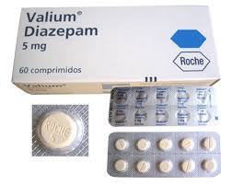
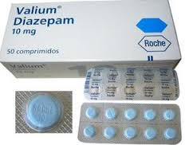

Slide 28
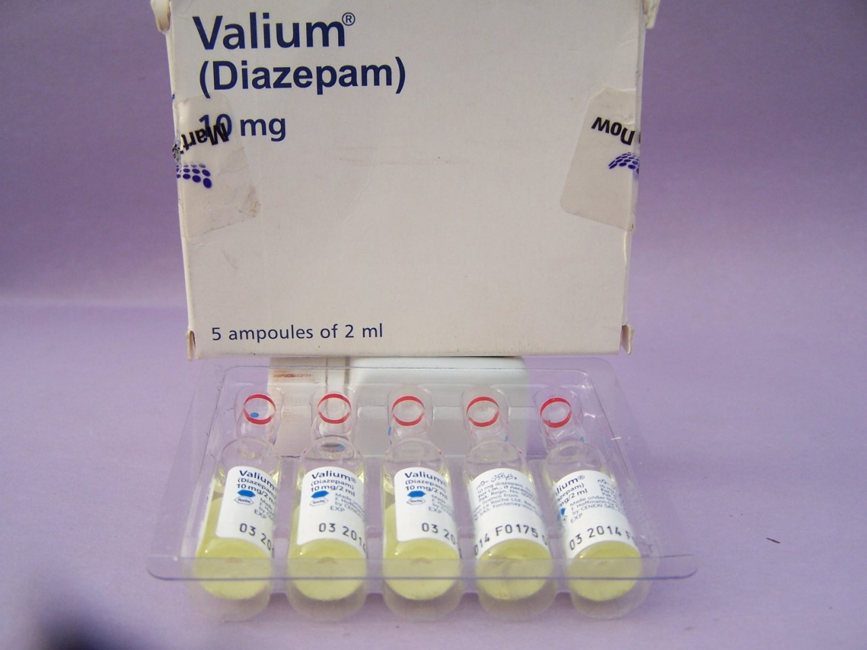

Slide 29
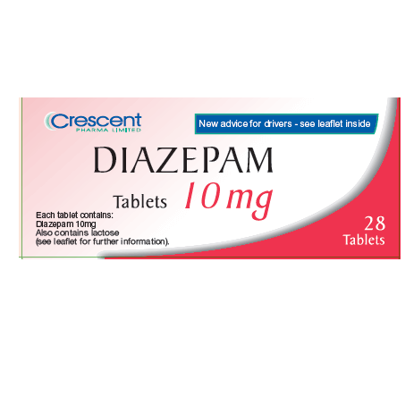

Slide 30
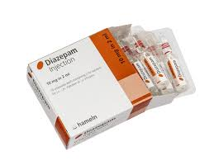

Slide 31
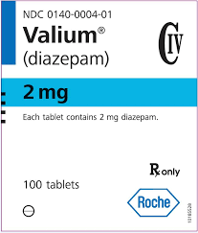

Slide 32
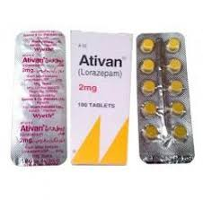
Lorazepam (Ativan®)

Slide 33
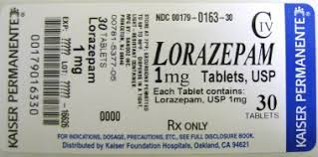

Slide 34


Slide 35
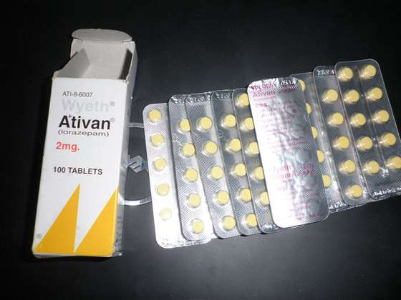

Slide 36
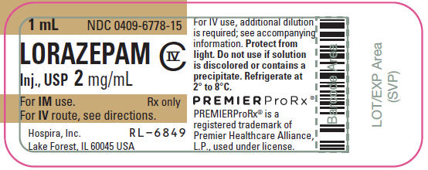

Slide 37
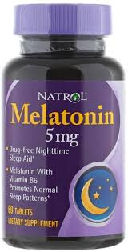
Melatonin

Slide 38
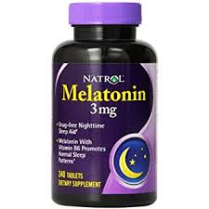

Slide 39
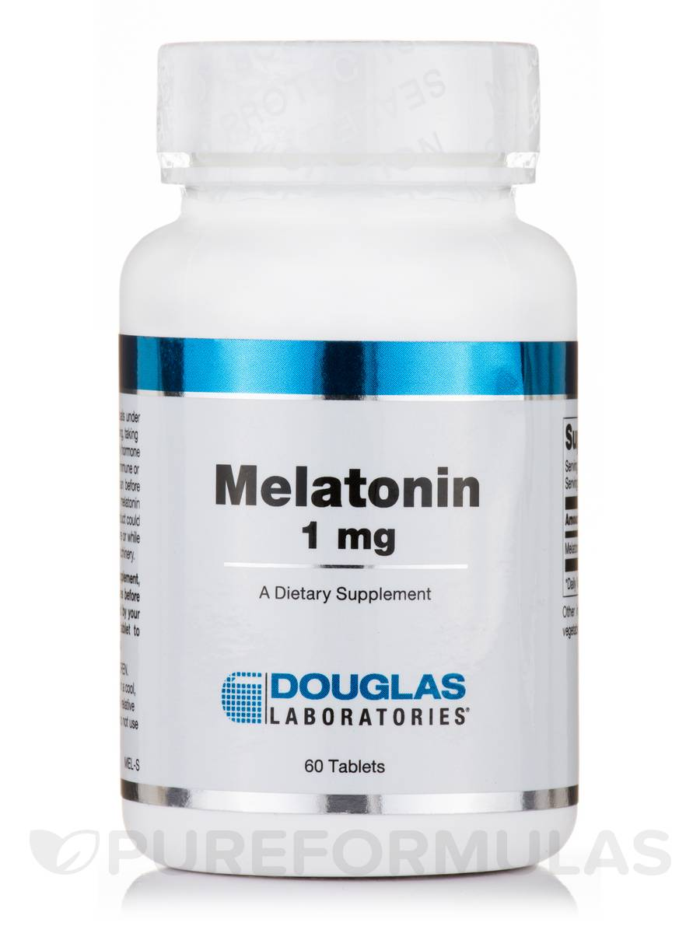

Slide 40
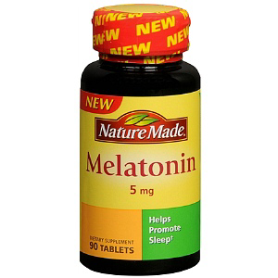

Slide 41
St John’s wort (hypericum)
St. John's wort is a plant with yellow, star-shaped flowers and five petals that grows in Europe, North and South America, Australia, New Zealand, and Eastern Asia. The plant grows in sunny, well-drained areas. It grows to be 50-100 cm tall.
St. John's wort might cause serious interactions with some medications. Because of this, France has banned the use of St. John's wort in products. In other countries St. John's wort is only available with a prescription.
St. John's wort is most commonly used for "the blues" or depression and symptoms that sometimes go along with mood such as nervousness, tiredness, poor appetite, and trouble sleeping. There is some strong scientific evidence that it is effective for mild to moderate depression.
St. John's wort is also used for symptoms of menopause such as hot flashes and mood changes

Slide 42
Aromatherapy
Aromatherapy uses aromatic essential oils medicinally to improve the health of the body, mind, and spirit. It enhances both physical and emotional health.

Slide 43

THANK YOU

