Slide 1
Monoclonal antibody drugs
Pharmaceutical chemistry
Assist . Prof . Karima F. Ali
Al-mustansiriyah university
college of pharmacy

Slide 2
Monoclonal Antibodies
Monoclonal antibodies (mAb or moAb) are monospecific antibodies that are made by identical immune cells that are all clones of a unique parent cell, in contrast to polyclonal antibodies which are made from several different immune cells. Monoclonal antibodies have monovalent affinity, in that they bind to the same epitope

Slide 3
Therapeutic treatment
Therapeutic monoclonal antibodies describe one example of plant derived anticancer compound and explain its mechanism of action.
Act through a number of mechanisms, such as blocking of targeted molecule functions, inducing apoptosis of cells which express the target, or by modulating signalling pathways
Cancer treatment: One possible treatment for cancer involves monoclonal antibodies that bind only to cancer cell-specific antigens and induce an immunological response against the target cancer cell.

Slide 4
Autoimmune Diseases:
    Monoclonal antibodies used for autoimmune diseases include:
    a. infliximab and adalimumab, which are effective in rheumatoid arthritis, Crohn's disease, ulcerative Colitis and ankylosing spondylitis by their ability to bind to and inhibit TNF-α
    b. Basiliximab and daclizumab inhibit IL-2 on activated T cells and thereby help prevent acute rejection of kidney transplants
    c. Omalizumab inhibits human immunoglobulin E (IgE) and is useful in moderate-to-severe allergic asthma.

Slide 5
Monoclonal antibodies are typically made by fusing myeloma cells with the spleen cells from a mouse that has been immunized with the desired antigen. However, recent advances have allowed the use of rabbit B-cells to form a rabbit hybridoma.
Polyethylene glycol is used to fuse adjacent plasma membranes, but the success rate is low so a selective medium in which only fused cells can grow is used.

Slide 6
The selective culture medium is called HAT medium because it contains hypoxanthine, aminopterin, and thymidine. This medium is selective for fused (hybridoma) cells.

Slide 7
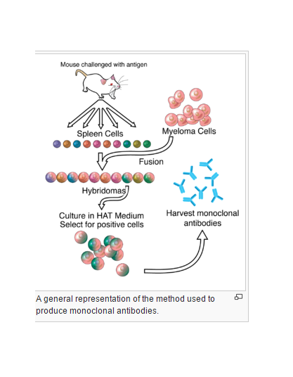

Slide 8
Monoclonal Antibody Drugs:
Rituximab:
(Rituxan, Chimeric) is an Mab directed against the CD20 antigen expressed on the surfaces of normal and malignant B lymphocytes.
Rituximab is indicated for the treatment of patients with relapsed or refractory, low-grade or follicular, CD20 B-cell non-Hodgkin lymphoma. CD20 is a protein of 35 to 37 k Da, and it may play a role in B cell activation and regulation and may be a calcium ion channel.

Slide 9
Alemtuzumab:
(Campath) is humanized MAb (Campath-1H) that is directed against the 21- to 28-k Da cell surface glycoprotein CD 52.
CD 52 is expressed on the surface of normal
and malignant B and T lymphocytes, monocytes, macrophages, and tissues of the male reproductive system.
Alemtuzumab is indicated for the treatment of B-cell chronic lymphocytic leukemia in patients who have been treated with alkylating agents and who have failed on this therapy.

Slide 10
Monoclonal Antibody RadionuclideTest Kits
A rcitumomab, nofetumomab merpentan ,
satumomab pendetide, imciromab pentetate
Nofetumomab merpentan (Verluma Kit) is the Fab fragment derived from the murine MAb NR-LU-10. The product is a protein, IgG2b, monoclonal that has been fragmented from NR-LU-10. Nofetumomab possesses only the Fab portion. NR-LU-10 and nofetumomab are directed against a 40-kDa protein antigen that is expressed in various cancers and some normal tissues..

Slide 11
Nofetumomab is indicated for the detection and evaluation of extensive-stage disease in patients with biopsy-confirmed, previously untreated small cell lung cancer by bone scan, CT scan (head, chest, abdomen), or chest x-ray.
Nofetumomab merpentan possesses a linker and a chelator that binds the technetium to the peptide.
This is a phenthioate ligand, 2,3,5,6tetrafluorophenyl-4,5-bis-S-[1 ethoxyethyl] - thioacetoamidopentanoate, hence the name merpentan

Slide 12
In-Home Test Kits
There are various MAb-based in-home test kits that are designed to detect pregnancy and ovulation. For example, a pregnancy test kit targets the antigen human chorionic gonadotropin and displays a certain sign if the test is positive.
The other type of test kit predicts ovulation by targeting LH in the urine. Just before ovulation, LH surges. The test kit is designed to detect and signal the time of ovulation. These test kits, based on the complex techniques of MAbs, are designed to be as simple and error-free as possible for patients.

Slide 13
Gene Therapy
Gene therapy arguably represents the ultimate application of rDNA (Recombinant DNA) technology to the treatment of disease. There are two ways to envision gene therapy:
(a) the replacement of a defective gene with a normal gene
(b) the addition of a gene whose product can help fight a disease such as a viral infection or cancer.
In the former case, replacement of a defective gene, an actual cure can be effected instead of just treating the symptoms.

Slide 14
It is possible that replacement of the defective gene with a corrected one could produce a cure.
Similar possibilities exist for other inherited
genetic disorders such as insulin-dependent diabetes, growth hormone deficiency, hemophilia, and sickle cell anemia.
The ability to transfer genes into other organisms has other important applications, including the heterologous production of recombinant proteins and the development of animal models for the study of human diseases.

Slide 15
Another area of exploration is the introduction of recombinant genes as biological response modifiers, for example, in preventing rejection following organ transplantation. An opposite strategy might be considered for the treatment of cancer, whereby transplanted cells could be used
to target cancer cells, increasing local cell-mediated immune responses.

Slide 16


