Slide 1
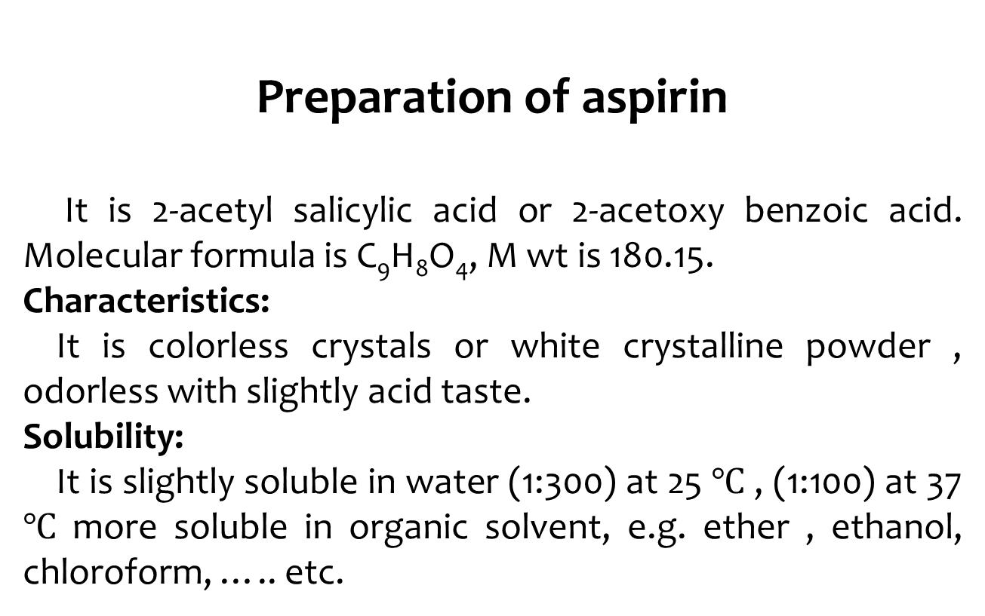
Preparation of aspirin
It is 2-acetyl salicylic acid or 2-acetoxy benzoic acid. Molecular formula is C₉H₈O₄, M wt is 180.15.
Characteristics:
It is colorless crystals or white crystalline powder , odorless with slightly acid taste.
Solubility:
It is slightly soluble in water (1:300) at 25 $℃$ , (1:100) at 37 $℃$ more soluble in organic solvent, e.g. ether , ethanol, chloroform, ….. etc.

Slide 2
Stability:
In the form of crystals or powder, ASA is stable in dry air , but in contact with moisture, it degrades by hydrolysis to both SA and acetic acid (HAc), through base catalysis of the attack of water molecule by carboxylate anion.
Mechanism:

Slide 3
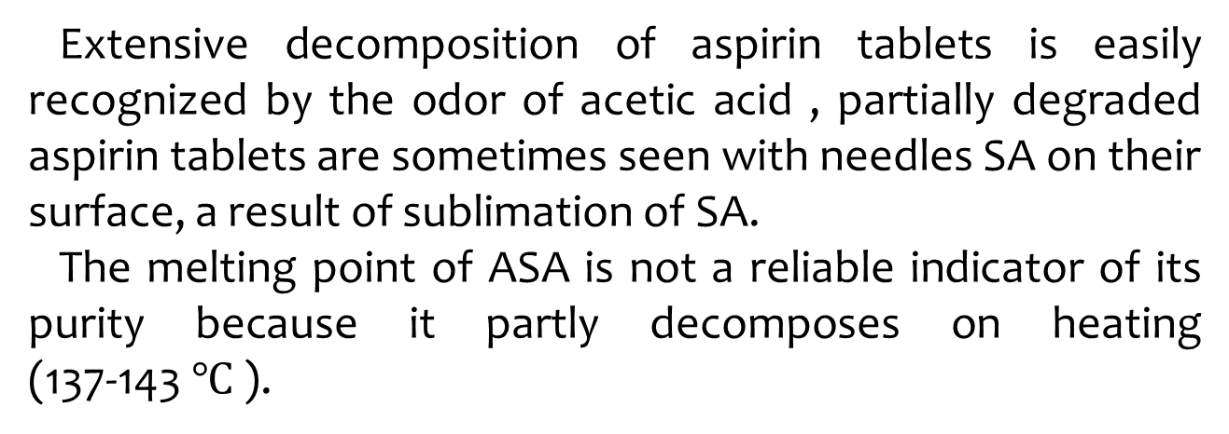
Extensive decomposition of aspirin tablets is easily recognized by the odor of acetic acid , partially degraded aspirin tablets are sometimes seen with needles SA on their surface, a result of sublimation of SA.
The melting point of ASA is not a reliable indicator of its purity because it partly decomposes on heating (137-143 $℃$ ).

Slide 4
Synthesis of aspirin:
Method 1:

Slide 5
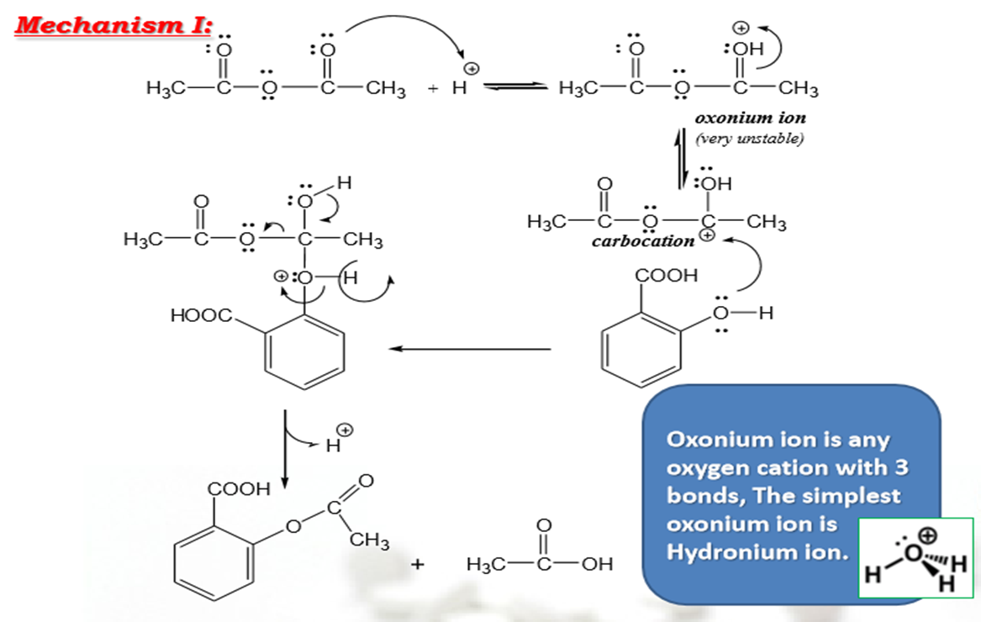
Mechanism of reaction:
1- Protonation of the oxygen of carbonyl group:

Slide 6
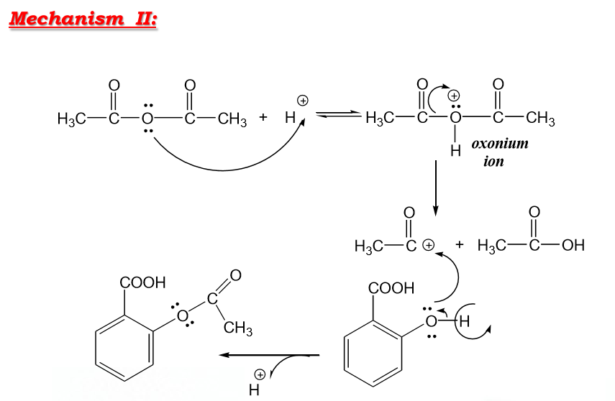
2- Protonation of central oxygen to give oxonium ion

Slide 7
Method 2:

Slide 8
Notes:
Method 1 is used mostly because acetic anhydride is cheap, readily available, easily handled and doesn't form corrosive HCl gas.
The reaction of acetylation is in the following order:
Acetyl chloride > acetic anhydride > acetic acid
On the other hand, acetylation of SA using acetyl chloride is very vigorous and will produce HCl gas which is corrosive to the respiratory tract.
In this method, pyridine base is used because the unshared pair of electrons on the N will react with HCl and form pyridine chloride. On the other hand , pyridine base is teratogenic agent and air pollutant; therefore, we avoid this method of preparation.

