Slide 1
API 20 E System
&
Antibiotic susceptibility test

Slide 2
API 20 E System
The API 20E strip, for identification of the Enterobacteriaceae and other gram negative rods.
These tests are inoculated with a bacterial suspension that reconstitute the media
Test stripe consists of microtubes (cupules) containing dehydrated substrates to detect the ;
enzymatic activity
fermentation of sugars
During incubation , metabolism produces colour changes.
When the carbohydrates are fermented , the pH with in the cupules changes and is shown by an indicator.

Slide 3
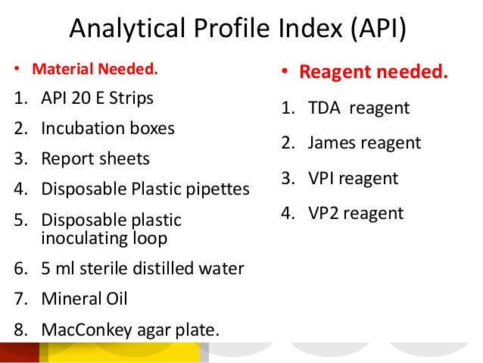
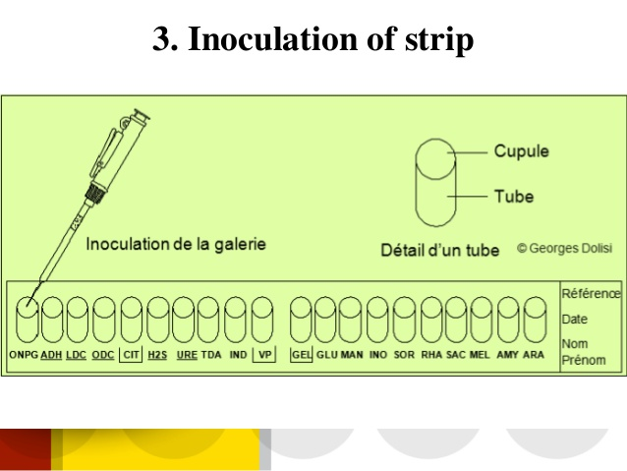

Slide 4
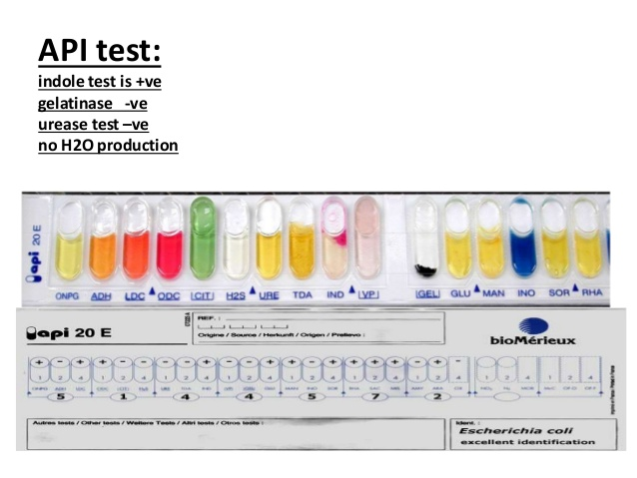

Slide 5
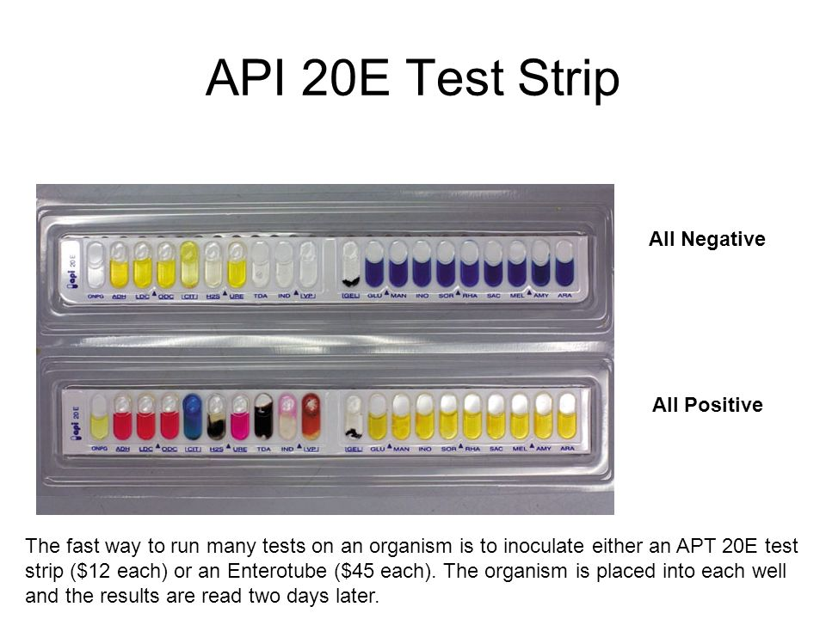

Slide 6
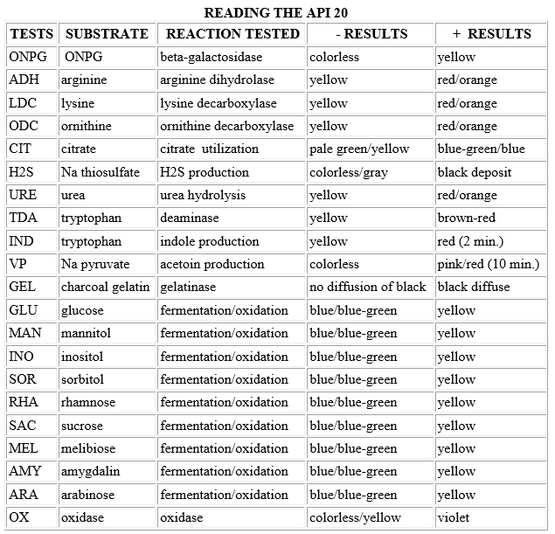

Slide 7
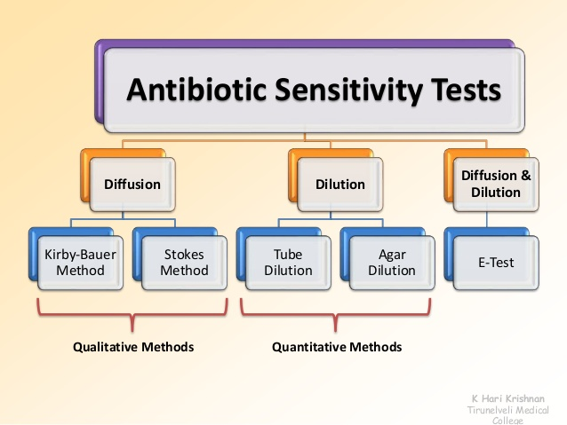
Antibiotic susceptibility test
A laboratory test which determine how effective antibiotic therapy is against bacterial infections.

Slide 8
Kirby – Bauer method
The purpose of Kirby-Bauer disk diffusion susceptibility test is to determine the sensitivity or resistance of pathogenic aerobic and facultative an aerobic bacteria to various antimicrobial compounds .
The pathogenic organisms grown on Muller-Hinton agar in the presence of various antimicrobial impregnated filter discs .
The presences or absence of growth around the disk is indirect measure of the ability of the compound to inhibit that organism .

Slide 9
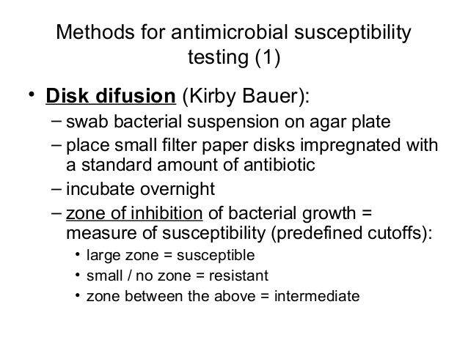

Slide 10
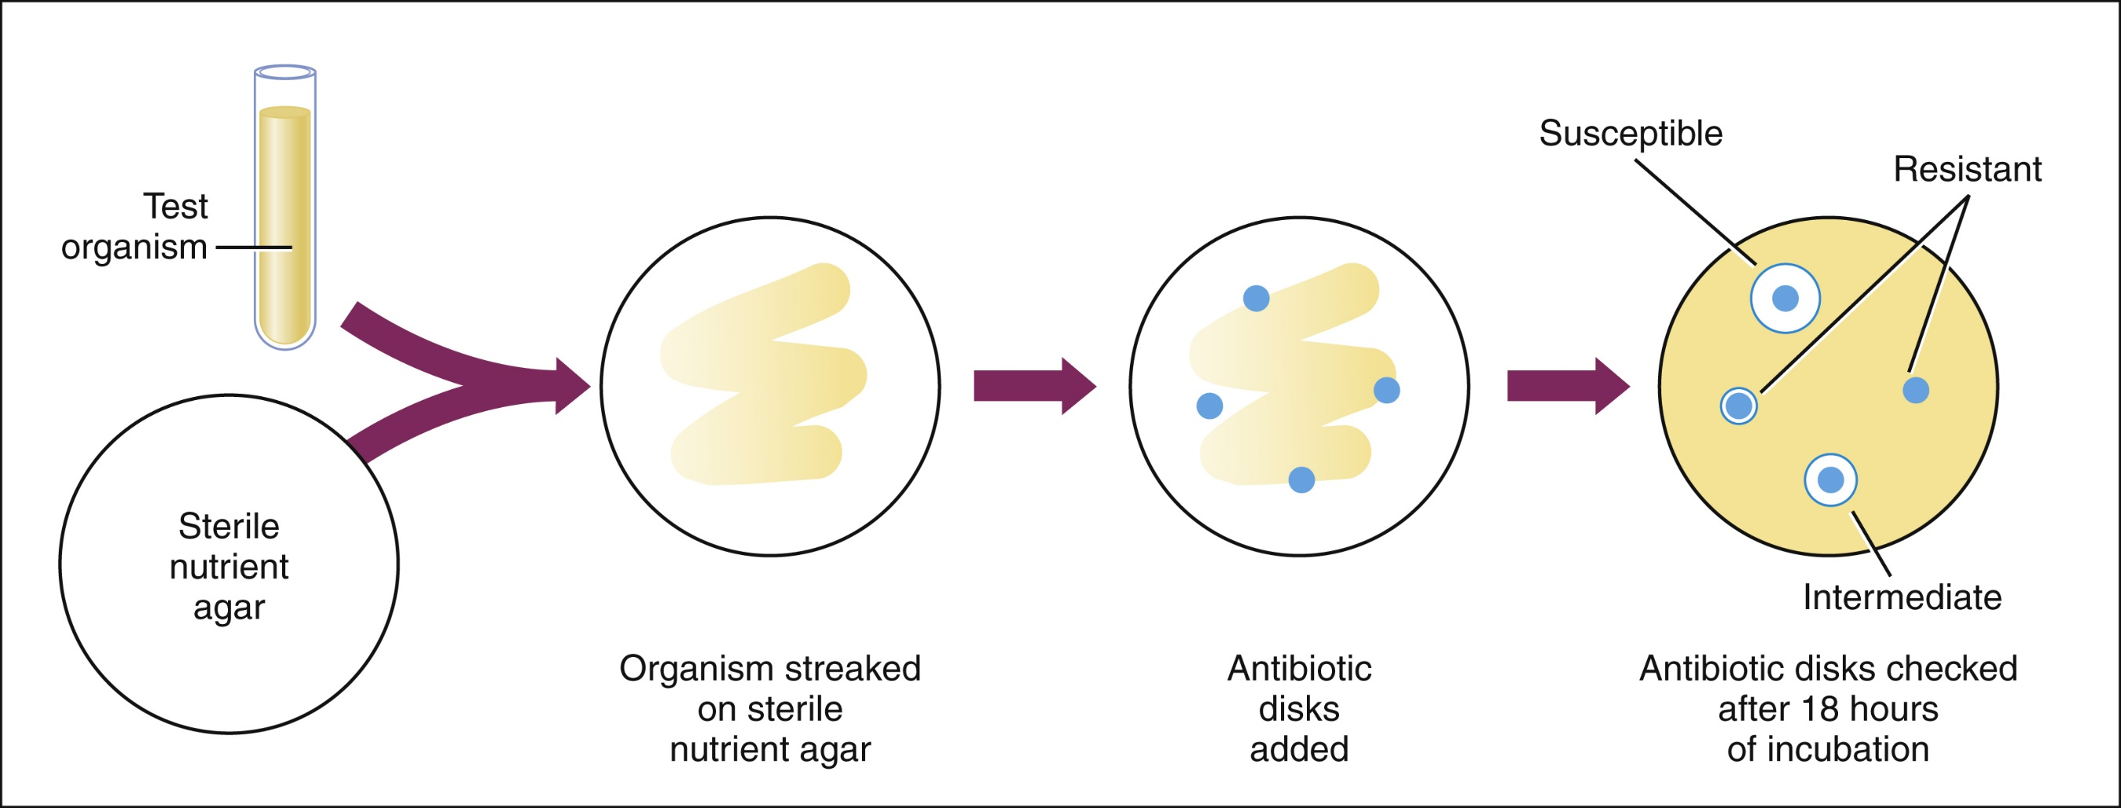

Slide 11
