Slide 1
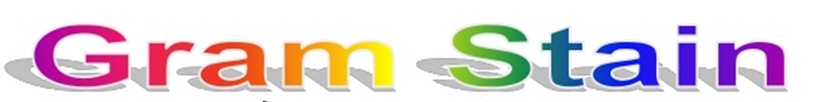
Medical Microbiology
Lab. 3
By
Assistant lecturer
Zainab farooq shafeeq

Slide 2
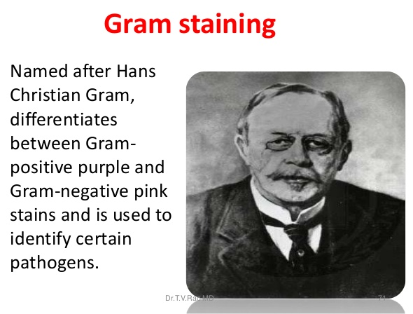

Slide 3
Principle
The Gram stain is the most useful and widely employed differential stain in bacteriology.
It divides bacteria in to two groups (Gram positive and Gram negative bacteria.
The primary stain is crystal violet. It is followed by treatment with an iodine solution , which function as a mordant , that is , it increase the interaction between the bacterial cell and the dye .

Slide 4
The smear than decolorized by washing with an agent such as 95% ethanol.
Gram positive bacteria retain the crystal violet-iodine complex when washed with the decolorizer where as gram negative bacteria lose their crystal violet-iodine complex and become colorless.
Finally , the smear is counter stianed with a basic dye, different in color than crystal violet.
This is safranin, the safranin will stain the colorless gram negative bacteria pink but does not alter the dark purple color of gram positive bacteria.

Slide 5
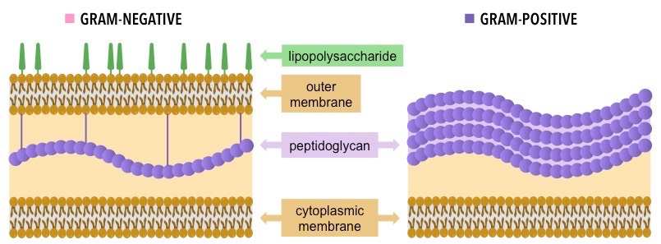

Slide 6
Difference between Gram positive and Gram negative bacteria
Gram positive bacteria | Gram negative bacteria
Simple cell wall | More complex cell wall
Thick peptidoglycan cell wall layer | Thin peptidoglycan cell wall layer
No outer lipopolysaccharide wall layer | outer lipopolysaccharide wall layer
Retain crystal violat/iodine | Retain safranin
Appear (Blue/Purple) | Appear (Pink/Red)

Slide 7
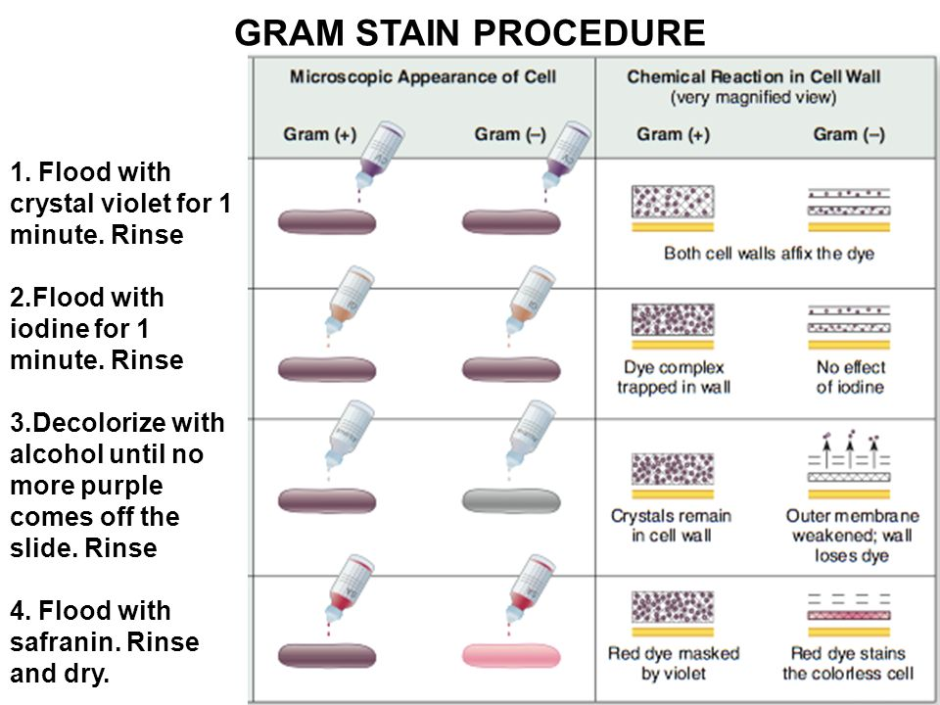

Slide 8
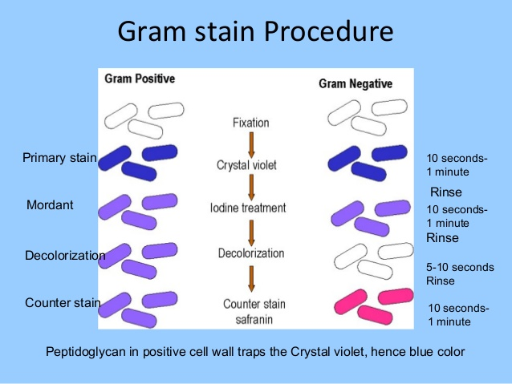

Slide 9
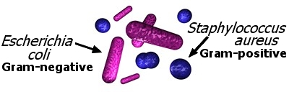
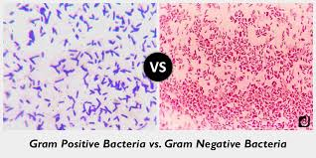
Staphylococcus aureus
Escherichia coli

Slide 10
