Slide 1
Biochemical Tests
Medical Microbiology
Lab. 6

Slide 2
Oxidase Test
Also known as the cytochrome oxidase Test
Oxidase enzymes play an important role in the operation of the electron transport system during aerobic respiration.
Cytochrome oxaidase uses O2 as an electron acceptor during the oxidation of reduced cytochrome to form water and oxidized cytochrome .
The oxidase test is for determining the production of cytochrome c oxidases by a bacteria.
You can differentiate bacteria species as aerobes and anaerobes.

Slide 3
This test is a useful procedure in clinical laboratory because of some gram negative pathogenic bacteria are oxidase positive (Pseudomonas aeruginosa and Neisseria spp.) Enterobacteriaceae family are oxidase negative.
Procedure
Put loopful of bacteria on oxidase test paper - redox indicator.
Observe the color.
Oxidase reagent(1%solution of dimethyl - p – phenylene- diaminehydrochlorid).
The reagent turns (dark blue to purple) when oxidized (oxidase - positive ) the reagent is colorless when reduced (oxidase – negative).

Slide 4
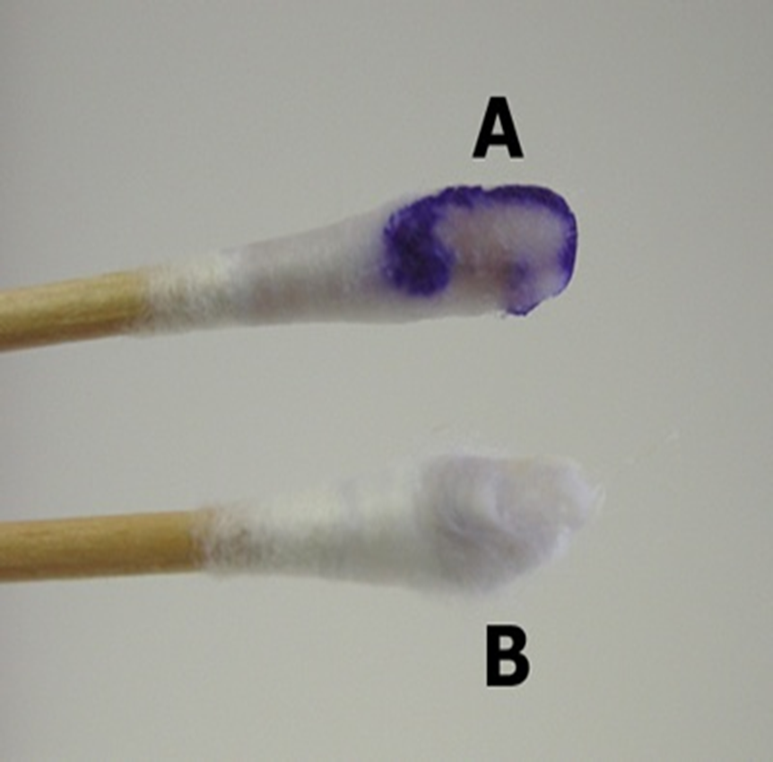
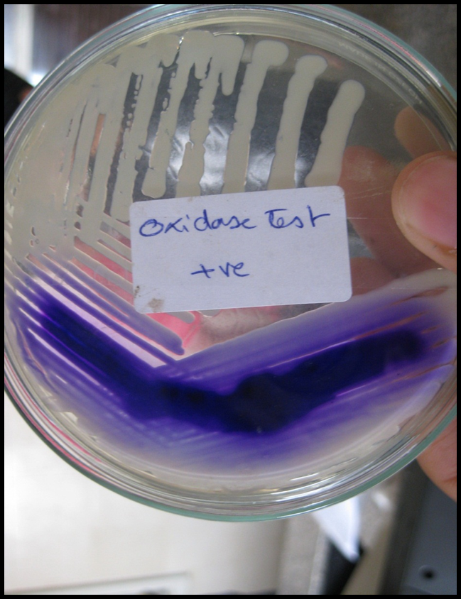
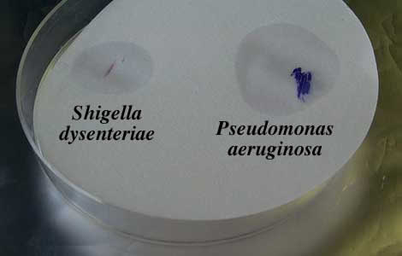
Swab method
Direct plate method
Filer paper method

Slide 5
Catalase test
Catalase production
Enzyme name \ catalase
Substrate name \ hydrogen peroxide
Enzyme action \ breakdown the toxic H2O2 producing oxygen gas and water
2H2O2 --------------► 2H2O + O2↑
Catalase
Hydrogen peroxide produce due to the aerobic respiration of the cells and have to be breakdown to prevent it’s toxic action on DNA and cell membrane

Slide 6
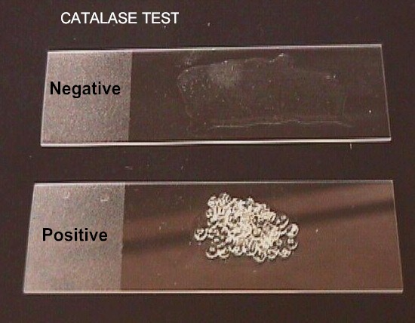
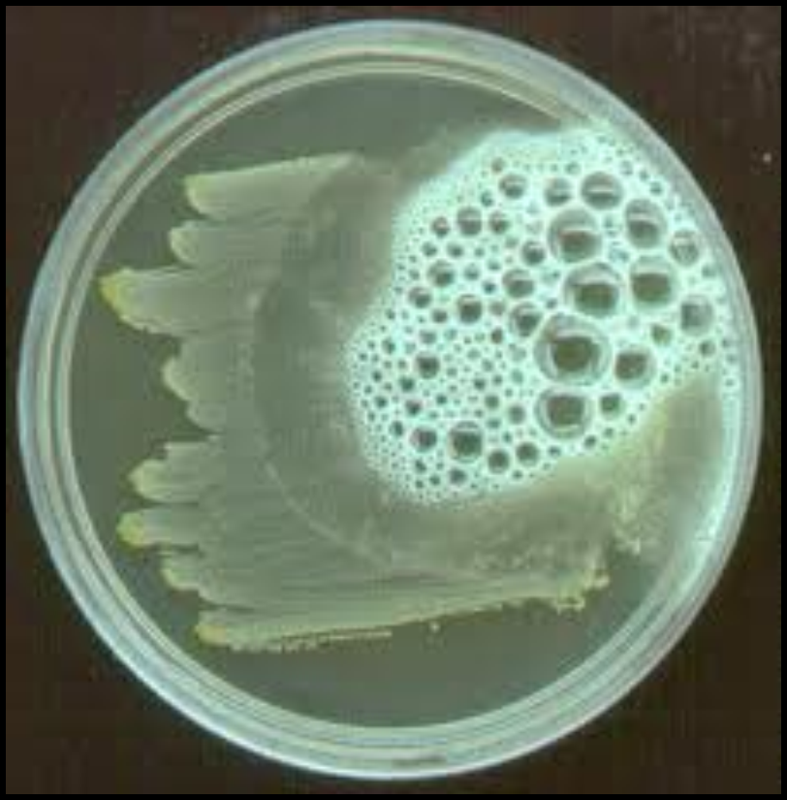
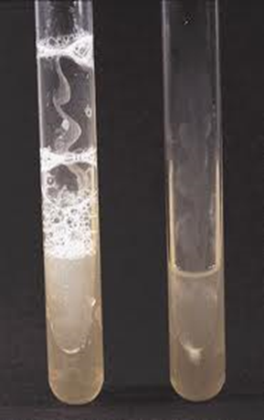
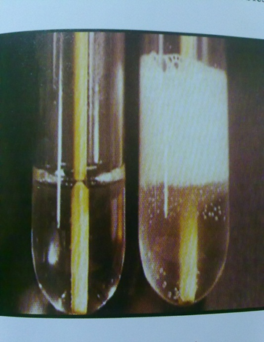
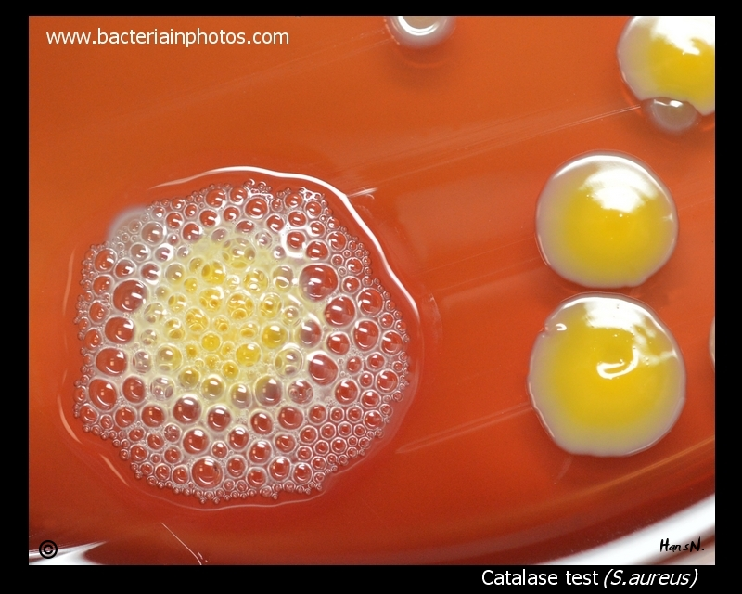

Slide 7
Coagulase Test
Coagulase test is one of the biochemical tests.
It is very important test in the microbiology.
The coagulase test identifies whether an organism produces the exoenzyme coagulase, which causes the fibrin of blood plasma to clot.
Organisms that produce Coagulase can form protective barriers of fibrin around themselves, making themselves highly resistant to phagocytosis, other immune responses, and some other antimicrobial agents.

Slide 8
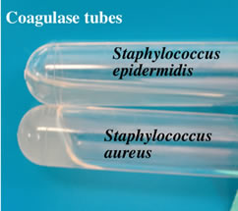
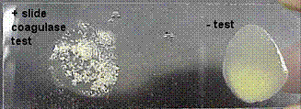

Slide 9
Certain bacteria are able to hydrolyze gelatin by secreting a proteolytic enzyme called gelatinase .
The resulting amino acids can then be used as a nutrients by the bacteria .
The ability of some bacteria to digest gelatin is an important characteristic in their differentiation .
Gelatin liquefaction can be tested by stabbing nutrient gelatin deep tubes following incubation , the cultures are placed in refrigerator at 4C until the bottom are solidifies .

Slide 10
If gelatin has been hydrolyzed , the medium will remain liquid after refrigeration.
If gelatin has not been hydrolyzed , the medium will be solidfy during the time it is in refrigerator

Slide 11
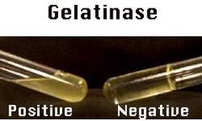
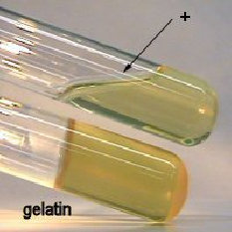
Proteus vulgaris
Escherichia coli

Slide 12
Urease hydrolysis
Urease activity (the urease test) is detected by growing bacteria in medium containing urea and using a pH indicator such as phenol red.
When urea is hydrolyzed, ammonia accumulates in the medium and makes it alkaline.
This increase in pH causes the indicator to change from orange-red to deep pink or purplish red and is a positive test for urea hydrolysis.
This test is particularly useful in distinguishing the genus Proteus from other enteric bacteria

Slide 13
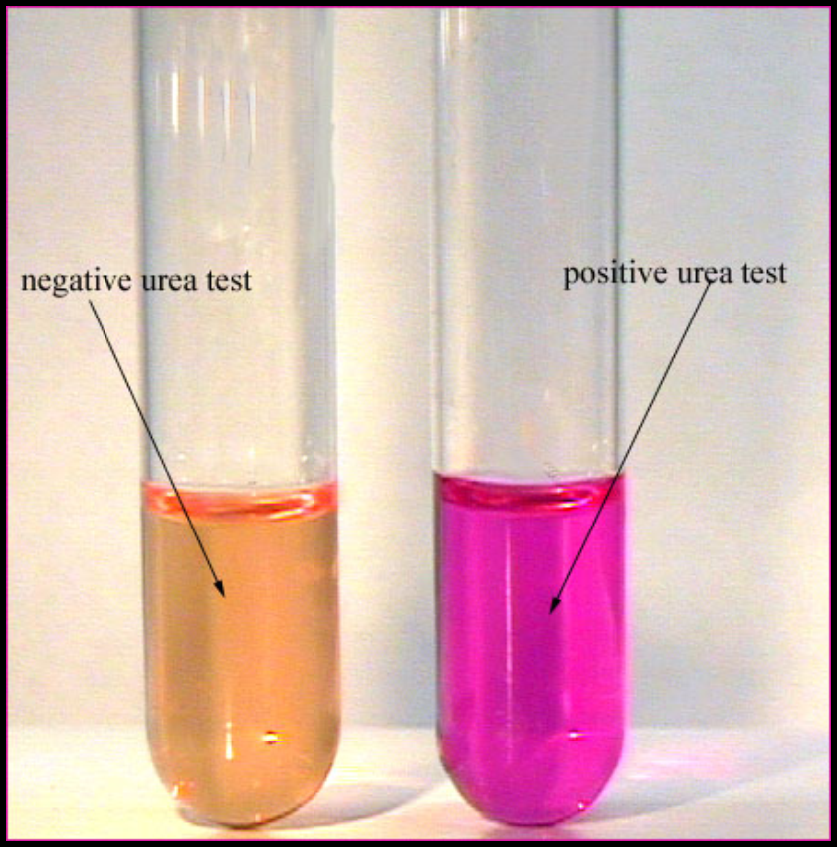
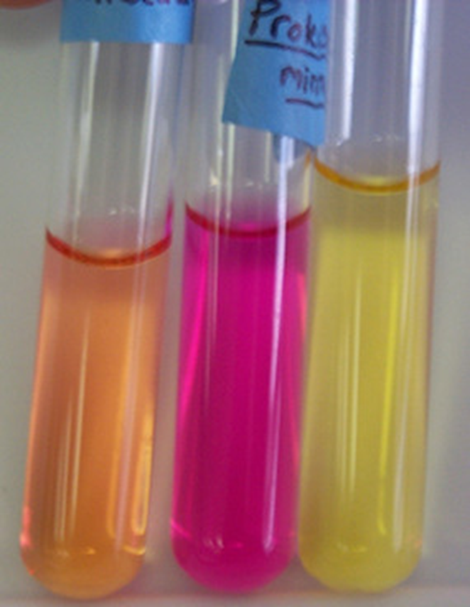

Slide 14
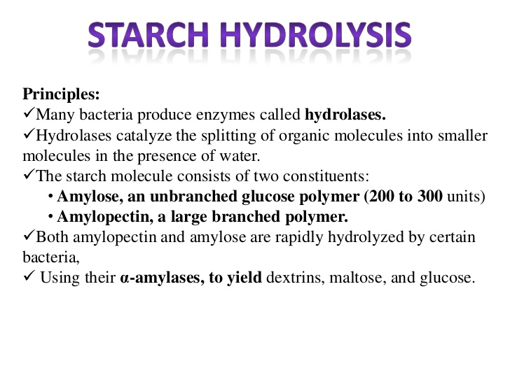
  Starch hydrolysis

Slide 15
