Slide 1
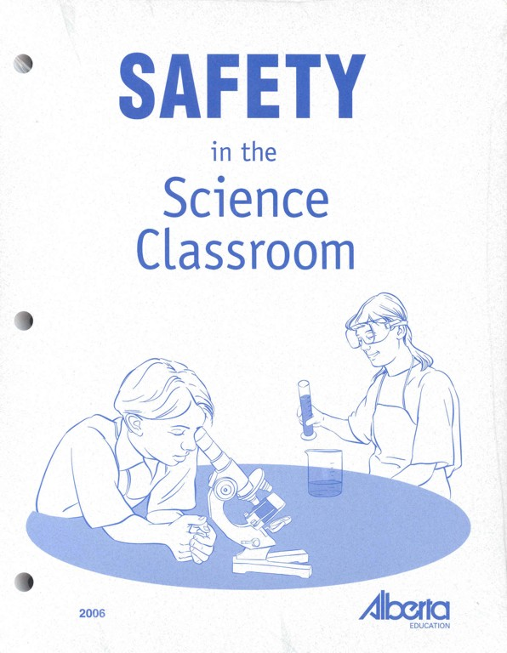

Safety and Rules of the Lab
Notes:
http://images.google.com/imgres?imgurl=http://68.90.81.6/ScienceTAKS/Integration/Science%2520TAKS%2520Objective%25201/safety4.jpg&imgrefurl=http://68.90.81.6/ScienceTAKS/Integration/Science%2520TAKS%2520Objective%25201/safetysymbols.htm&h=95&w=93&sz=3&hl=en&start=32&um=1&tbnid=AOIrcMWCY6-NPM:&tbnh=80&tbnw=78&prev=/images%3Fq%3DLab%2BSafety%2BSymbols%26start%3D20%26ndsp%3D20%26svnum%3D10%26um%3D1%26hl%3Den%26rls%3DGGLB,GGLB:1969-53,GGLB:en%26sa%3DN

Slide 2
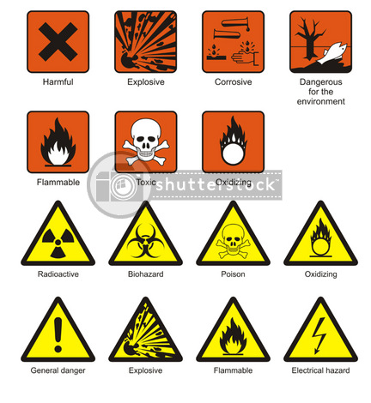
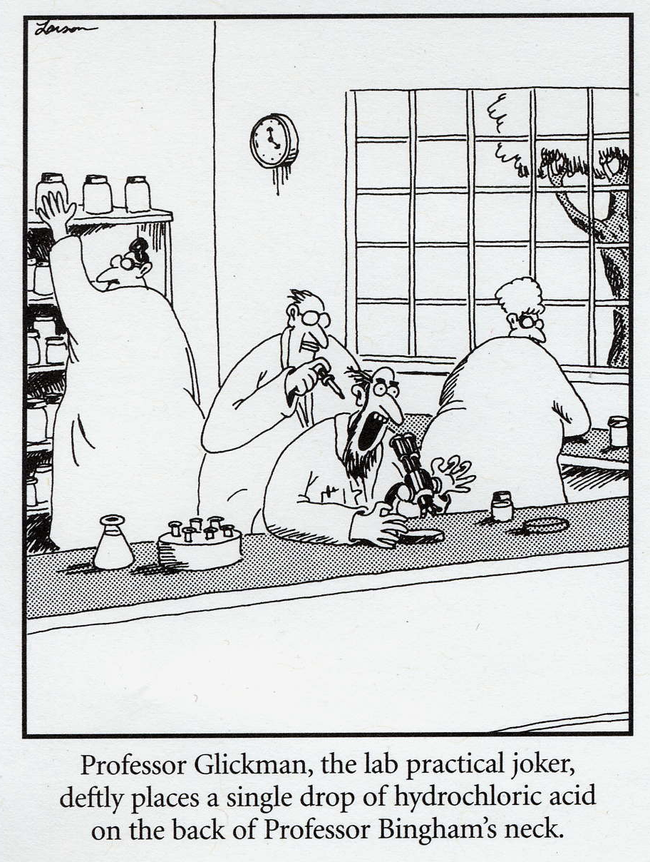

Use Your Head
Exercise Caution and Good Judgment
Follow all instructions given by the teacher
Notify the teacher immediately regarding any accident or unsafe areas

Slide 3
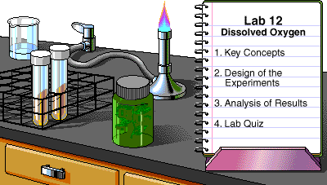
Use Your Head
Read lab instructions ahead of time
Always follow lab procedures exactly
Never do an unauthorized experiment

Slide 4


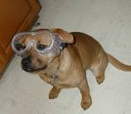
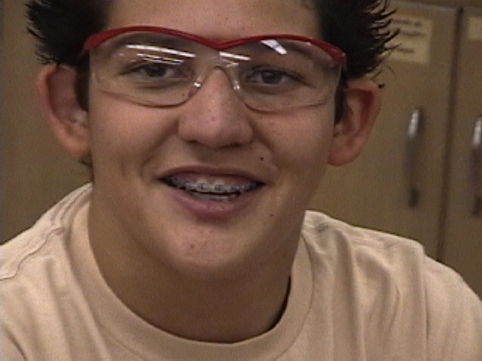
Protect Yourself
Eye Safety
Wear safety goggles when working with chemicals, flames, or heating devices
or if possibility of flying debris
If you wear contact lenses let your teacher know

Slide 5

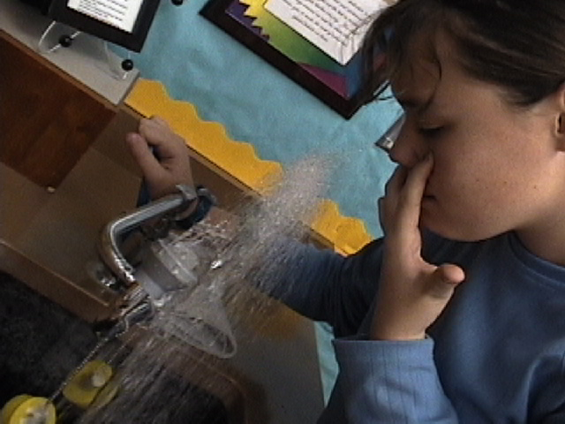
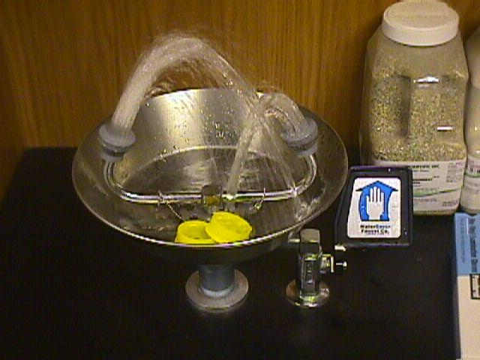
Protect Yourself
Eye Safety
Flush in water for 15 mins. and notify the teacher
In case of emergency in which a chemical goes into one’s eye, use the eyewash station

Slide 6


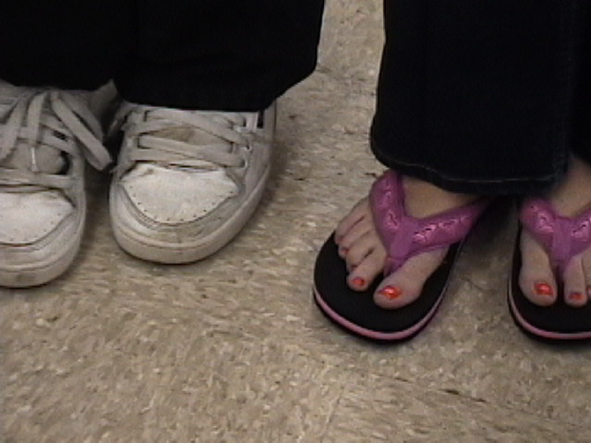
Protect Yourself
Proper Attire
Keep all long hair
tied back
Do not wear loose clothing that could catch on fire
Foot wear that completely covers the foot is required

Slide 7


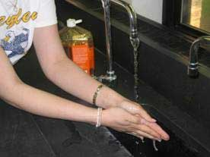
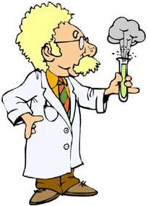
Protect Yourself
Hand Safety
If a chemical spills on your skin, notify the teacher and rinse with water for 15 minutes
Wash hands after every lab
Handle glassware, sharp tools and heated containers carefully

Slide 8
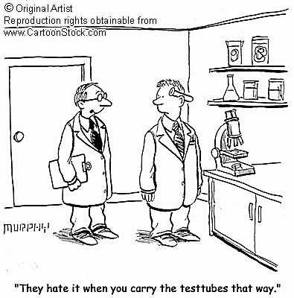
Protect Yourself
Hand Safety

Slide 9


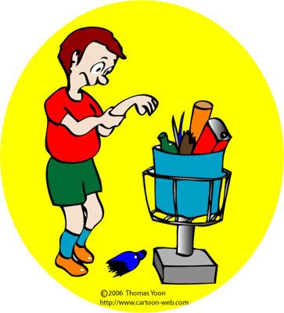
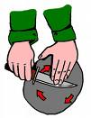
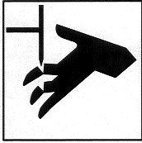
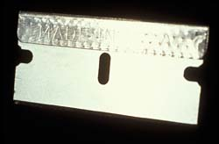
Sharp Objects
Notify teacher if you get cut
Broken glass and sharp objects do not go in trash cans
Teacher will clean up
broken glass

Slide 10

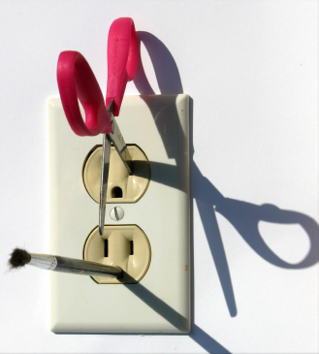
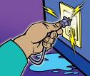

Electrical Safety
Only electrical plugs are to be placed into an electrical outlet
Unplug electrical equipment after use
Keep all electrical cords, wires, and appliances
away from
water

Slide 11

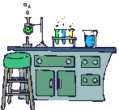
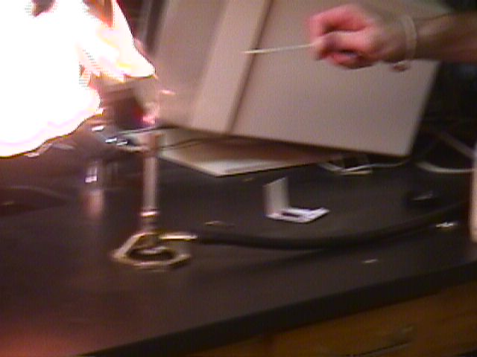
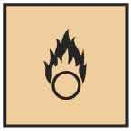
Heating Safety
Tie back hair and loose
clothes when working
with open flames
Never look into a
container as you
are heating it
Never point the end of
a test tube being heated
at yourself or others
Never heat in a closed container

Slide 12
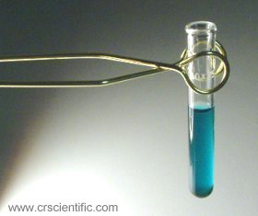
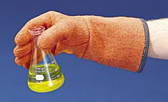
Heating Safety
Never leave a heat source unattended
Heated metal and glass looks
cool, use tongs or gloves
before handling
Do not place hot glassware
directly on lab desk or in
cold water

Slide 13




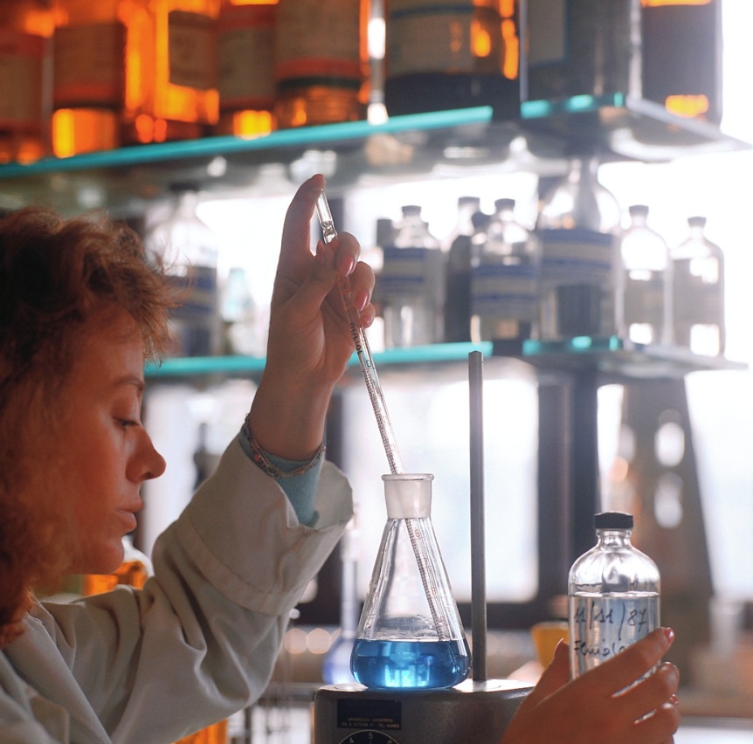
Chemical Safety
Read all labels twice before removing
a chemical from the container
Only use the type and
amount of chemical
instructed to use
Never touch, taste, or
smell a chemical unless instructed by the teacher
Never mix chemicals
unless instructed to do so

Slide 14

Chemical Safety
Transfer chemicals carefully!
Keep lids on chemical containers when not in use
When diluting an acid, pour the
acid into water
Consider all chemicals dangerous

Slide 15
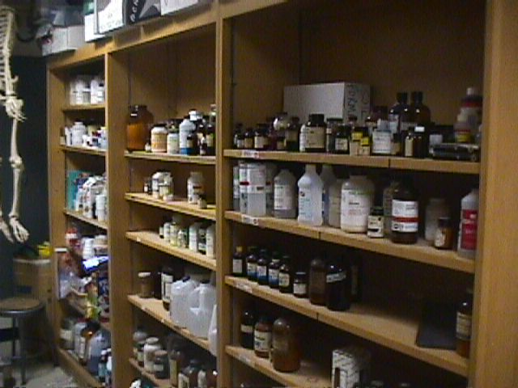
You Should Never…
Enter store room unless given permission
Take any chemicals from lab or store room
Touch any equipment, chemicals, or other materials until instructed to do so

Slide 16
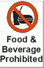

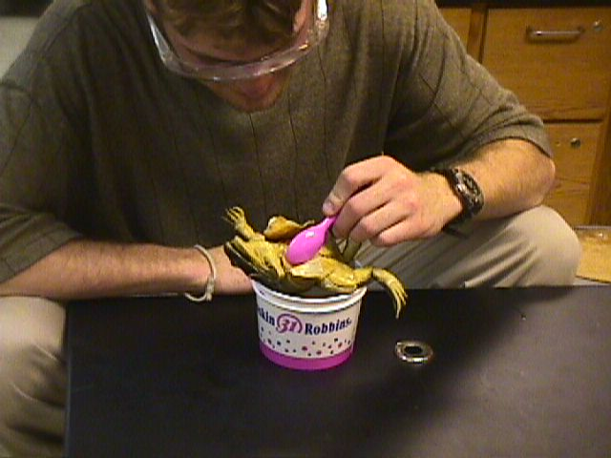
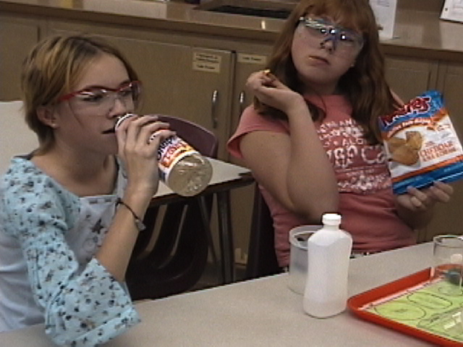
You Should Never…
Eat or drink in the lab
Use lab glass-ware to eat or drink out of

Slide 17
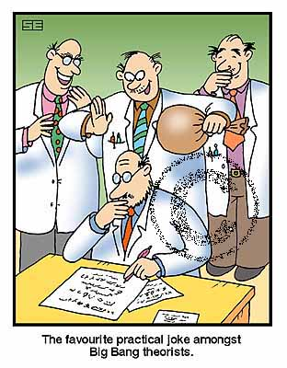
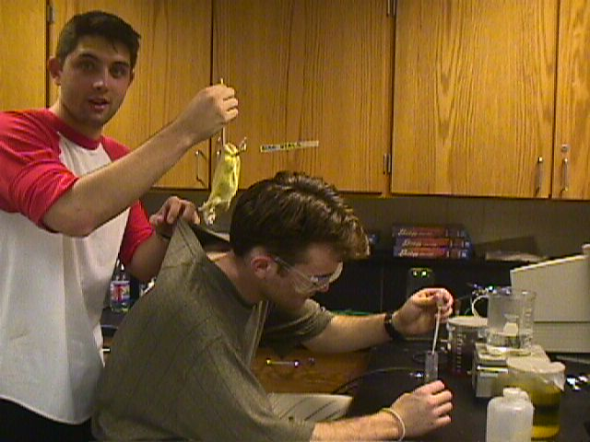
You Should Never…
Engage in….
  practical jokes
  horse play
  rough house

Slide 18


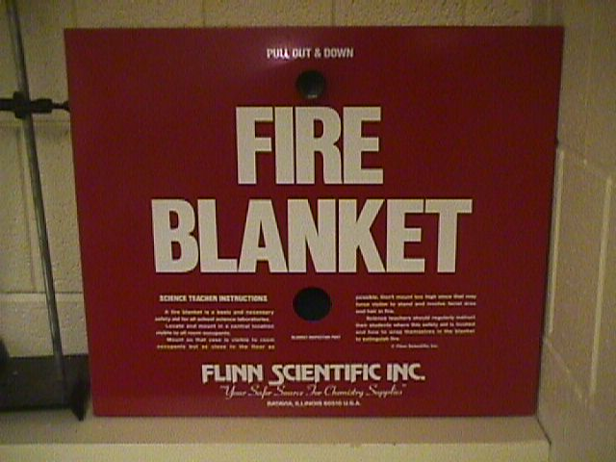

In case of an emergency…
Know the locations of:
  fire extinguisher
  fire blanket
  body shower
  eyewash
  station
  first aid kit
If you spill a harmful chemical on yourself or in your eyes, start rinsing immediately and send your partner to get teacher’s help

Slide 19

Remember to…
Stay at your work station
Maintain a clean work area
Read and follow all directions
Report any spills, accidents,
or injury to the teacher immediately
Clean and put away all equipment at the end of the
lab period
Dispose of waste products according to instruction

Slide 20
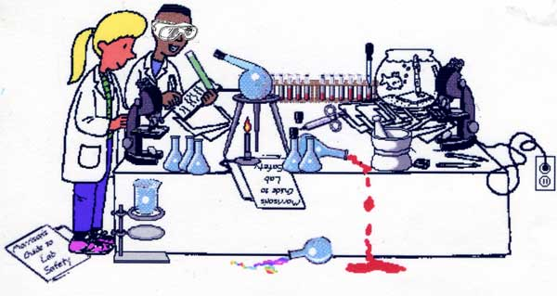

So Do It Right!

