Slide 1
Medical Microbiology
Asst. Prof. Dr. Dalya Basil Hanna

Slide 2
Chlamydiae
Chlamydiae that infect humans are divided into three species, Chlamydia trachomatis, Chlamydia (Chlamydophila) pneumoniae, and Chlamydia (Chlamydophila) psittaci, on the basis of antigenic composition, intracellular inclusions, sulfonamide susceptibility, and disease production.
Chlamydiae possess shared genus-specific antigens. These are heat-stable lipopolysaccharides with 2-keto-3-deoxyoctanoic acid. Antibody to these genus-specific antigens can be detected by immunofluorescence.
All chlamydiae exhibit similar morphologic features and multiply in the cytoplasm of their host cells by a distinctive developmental cycle. The chlamydiae can be viewed as gram-negative bacteria that lack mechanisms for the production of metabolic energy and cannot synthesize ATP. This restricts them to an intracellular existence. Thus, chlamydiae are obligate intracellular parasites.

Slide 3
Developmental Cycle
All chlamydiae have a common reproductive cycle. The environmentally stable infectious particle is a small cell called the elementary body or EB (0.3 µm) in diameter. The EBs have a high affinity for host epithelial cells and rapidly enter them through Heparan sulfate-like proteoglycans on the surface of C trachomatis mediates the initial interaction between EBs and host cells, or through other potential adhesins outer membrane protein and other surface proteins. EBs then subsequently engulfed by the host cell.

Slide 4
Developmental Cycle
Shortly after entry into the host cell, the disulfide bonds of the EB membrane proteins are no longer cross-linked and the EB is reorganized into a larger structure called a reticulate body or RB measuring about 0.5-1 µm. Within the membrane-bound vacuole, the RB grows in size and divides repeatedly by binary fission. Eventually, the entire vacuole becomes filled with elementary bodies derived from the reticulate bodies to form a cytoplasmic inclusion. The newly formed EBs may be liberated from the host cell to infect new cells. The developmental cycle takes 24–48 hours.

Slide 5
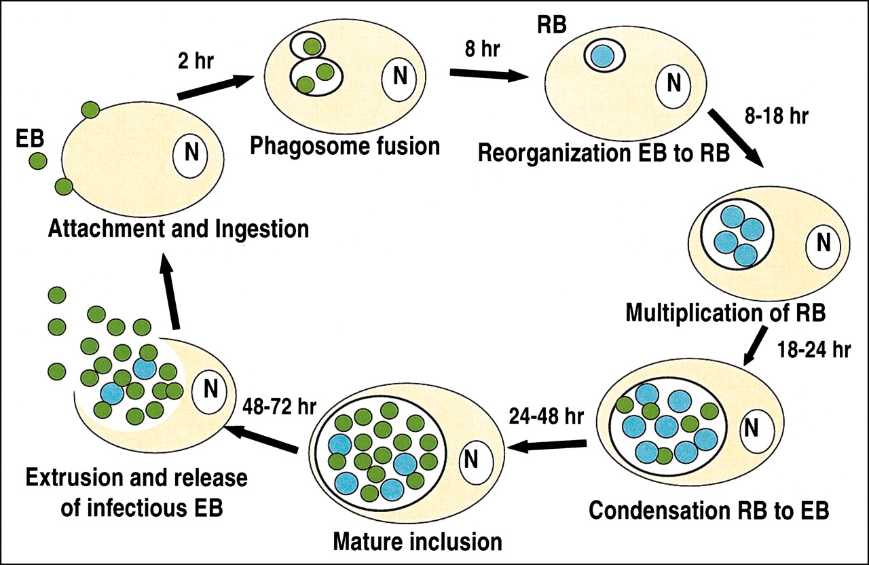

Slide 6
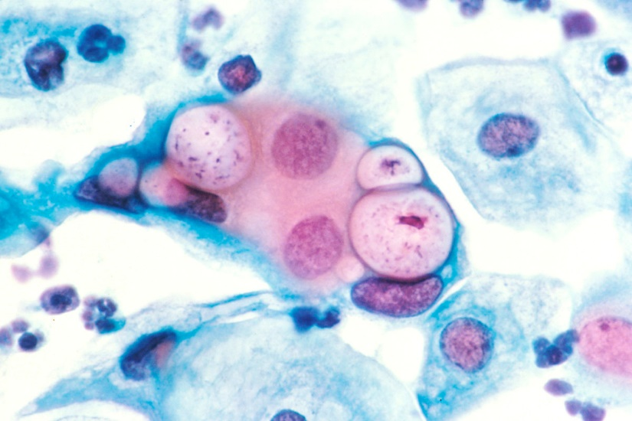
Staining Properties
Chlamydiae have distinctive staining properties. Elementary bodies stain purple with Giemsa's stain—in contrast to the blue of host cell cytoplasm. The larger, noninfective reticulate bodies stain blue with Giemsa's stain. The Gram reaction of chlamydiae is negative or variable and is not useful in identification of the agents.

Slide 7
Chlamydia trachomatis Ocular Infections
Humans are the natural host for C trachomatis. Intracytoplasmic replication results in the formation of compact inclusions with a glycogen matrix in which elementary bodies are embedded.
Trachoma is an ancient eye disease, it is a chronic keratoconjunctivitis that begins with acute inflammatory changes in the conjunctiva and cornea and progresses to scarring and blindness. The C trachomatis serovars A, B, and C are associated with clinical trachoma.

Slide 8
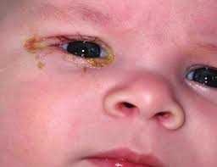
Clinical Findings
The incubation period for chlamydial conjunctival infection is 3–10 days.
The earliest symptoms of trachoma are lacrimation, mucopurulent discharge, conjunctival hyperemia. Microscopic examination of the cornea reveals epithelial keratitis, subepithelial infiltrates, and extension of vessels into the cornea (pannus). As the pannus extends downward across the cornea, there is scarring of the conjunctiva, eyelid deformities. With secondary bacterial infection, loss of vision progresses over a period of years.

Slide 9
Treatment, Prevention and Control
Clinical trials, in an endemic trachoma, using azithromycin treatment show that infection and clinical disease are greatly decreased at 6 and 12 months post therapy. Topical therapy is of little value.
The WHO has initiated the S-A-F-E program to eliminate blinding trachoma and at least markedly reduce clinically active disease.
The S-A-F-E program is as follows: Surgery for deformed eyelids; periodic Azithromycin therapy; Face washing and hygiene; and, Environmental improvement such as decreasing the number of flies that feed on conjunctival exudates. It is clear that improved socioeconomic conditions enhance the disappearance of endemic trachoma.

Slide 10
Chlamydia trachomatis Genital Infections
C trachomatis serovars D–K cause sexually transmitted diseases and may also produce infection of the eye.
In sexually active men, C trachomatis causes nongonococcal urethritis and, occasionally, epididymitis.
In women, C trachomatis causes urethritis, cervicitis, and pelvic inflammatory disease, which can lead to sterility and predispose to ectopic pregnancy.
The newborn acquires the infection during passage through an infected birth canal. Probably 20–60% of infants of infected mothers acquire the infection.

Slide 11
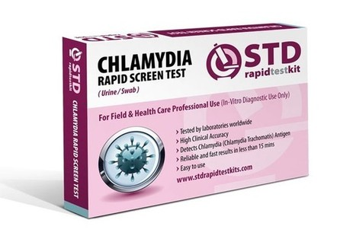
Chlamydia trachomatis Genital Infections
Laboratory Diagnosis
1- Specimen Collection: Proper specimen collection is the key to the laboratory diagnosis of chlamydia infection. Because the chlamydiae are obligate intracellular bacteria, it is important that the specimens contain infected human cells as well as the extracellular material where they might also be present. Collect endocervical specimens following removal of discharge and secretions from the cervix. A swab or cytology brush is used to scrape epithelial cells from 1 to 2 cm deep into the endocervix.

Slide 12
Chlamydia trachomatis Genital Infections
2- Nucleic Acid Detection: Nucleic acid amplification tests are the tests of choice to diagnose genital C trachomatis infections, e.g. the PCR technique.
3- Culture: Culture is generally much less sensitive than the nucleic acid detection assays.
4- Serology: Because of the relatively great antigenic mass of chlamydiae in genital tract infections, serum antibodies occur much more commonly than in trachoma and are of higher titer. A titer rise occurs during and after acute chlamydial infection.
Treatment: Azithromycin is effective and can be given to pregnant women. Tetracyclines (eg, doxycycline) are commonly used in non gonococcal urethritis and in non pregnant infected females.

Slide 13
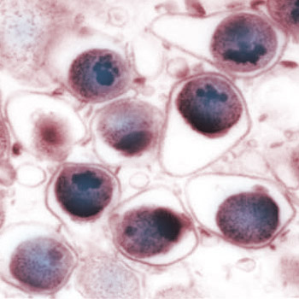
Chlamydophila pneumoniae & Respiratory Infections
C pneumoniae has been established as a new species that causes respiratory disease. Humans are the only known host.
Most infections with C pneumoniae are asymptomatic or associated with mild illness, but severe disease has been reported. There are no signs or symptoms that specifically differentiate C pneumoniae infections from those caused by many other agents. Both upper and lower airway diseases occur. Pharyngitis is common. Sinusitis and otitis media may occur and be accompanied by lower airway disease.

Slide 14
Laboratory Diagnosis and treatment
Smears: Direct detection of elementary bodies in clinical specimens using fluorescent antibody techniques is insensitive.
Culture: Swab specimens of the pharynx should be put into a chlamydiae transport medium and placed at 4°C; C pneumoniae is rapidly inactivated at room temperature. It grows poorly in cell culture, forming inclusions smaller than those formed by the other chlamydiae. C pneumoniae Growth is better at 35°C than 37°C.
Serology: Primary infection yields IgM antibody after about 3 weeks followed by IgG antibody at 6–8 weeks. In reinfection, the IgM response may be absent or minimal and the IgG response occurs in 1–2 weeks.
Treatment: C pneumoniae is susceptible to the macrolides and tetracyclines and to some fluoroquinolones.

Slide 15
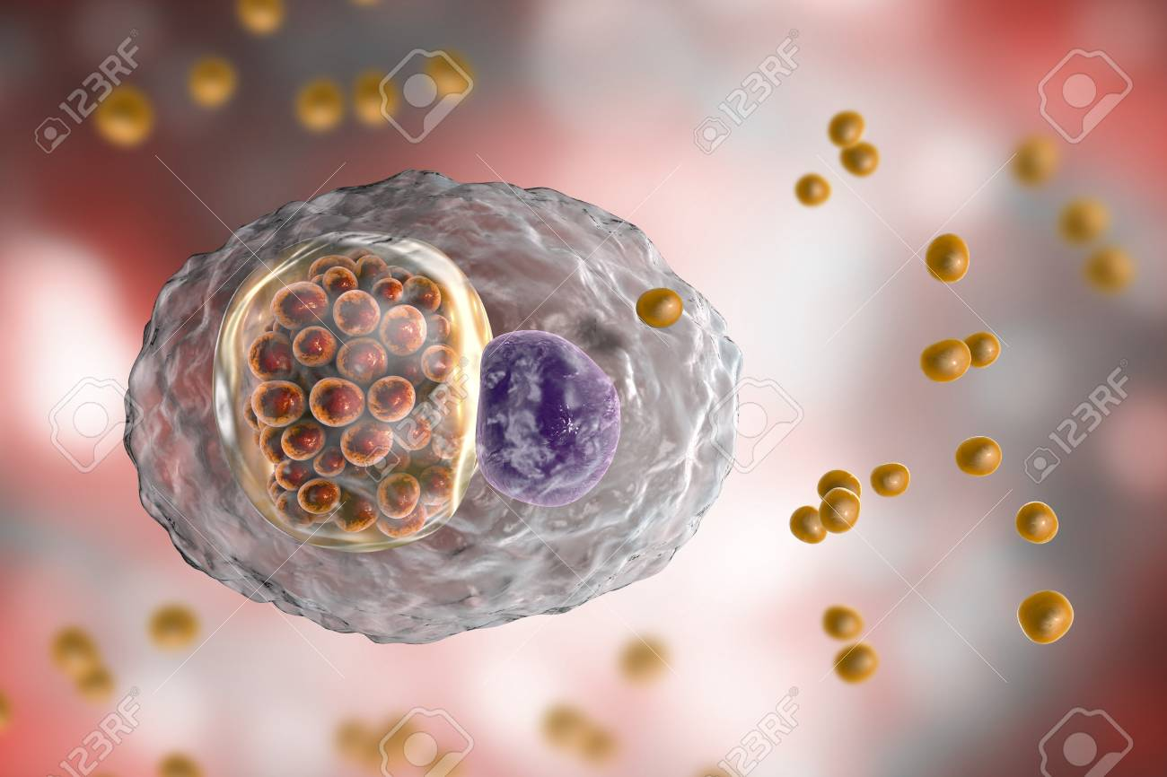
Chlamydia psittaci & Psittacosis
The term "psittacosis" is applied to the human C psittaci disease acquired from contact with birds and also the infection of psittacine birds especially parrots.
In humans, C psittaci produces a spectrum of clinical manifestations ranging from severe pneumonia and sepsis with a high mortality rate to a mild inapparent infection.

Slide 16
Pathogenesis & Pathology of Chlamydia psittaci
The agent enters through the respiratory tract, is found in the blood during the first 2 weeks of the disease, and may be found in the sputum at the time the lung is involved.
Psittacosis causes a patchy inflammation of the lungs in which consolidated areas are sharply demarcated. The exudates are predominantly mononuclear. Only minor changes occur in the large bronchioles and bronchi. Liver, spleen, heart, and kidney are often enlarged and congested.
The mortality rate may be as high as 20% in untreated cases, especially in the elderly.

Slide 17
Laboratory Diagnosis and treatment
Culture: Culture of C psittaci can be dangerous, and detection of the organism using immunoassays or PCR is preferred. If necessary, C psittaci can be cultured from blood or sputum or from lung tissue by culture in tissue culture cells, or embryonated eggs.
Because of the difficulty in obtaining laboratory confirmation of C psittaci infection, most infections are treated based only on the clinical diagnosis. Information on therapeutic efficacy comes from several clinical trials. Azithromycin, clarithromycin, and erythromycin (and doxycycline in adults) clear most, but not all, respiratory C psittaci infections. All the patients improve clinically, even those with persistent infection.

Slide 18


