Slide 1
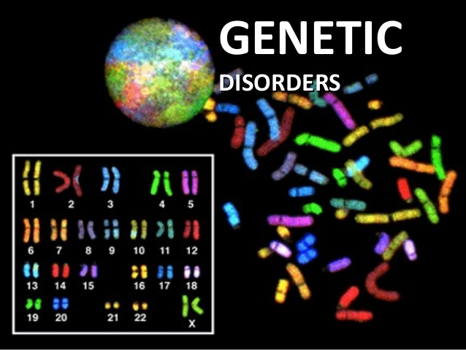

Slide 2
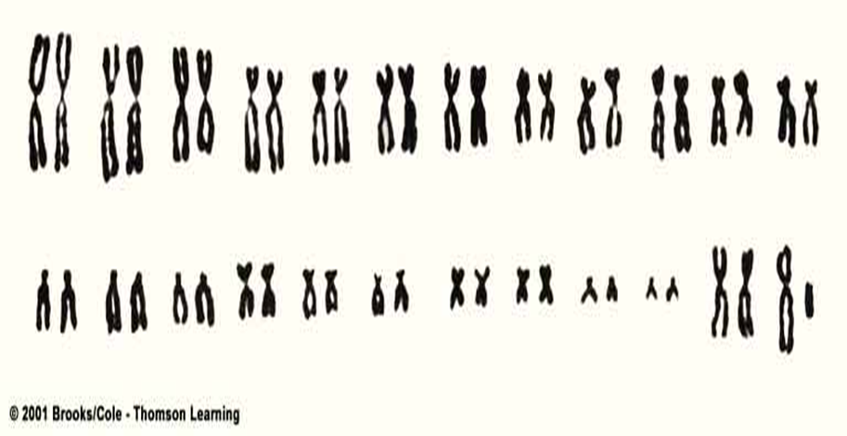

Slide 3
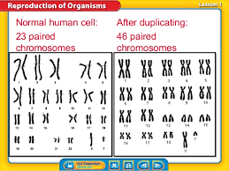

Slide 4
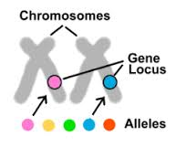
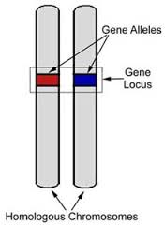
l

Slide 5
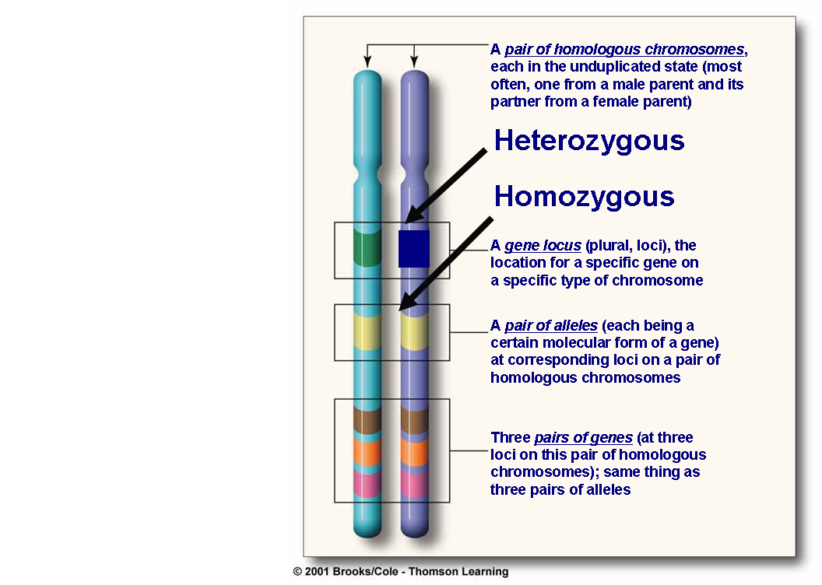
VISUAL REPRESENTATION
Pair of Chromosomes
Homologous chromosomes
Gene
Exon
Introns
Locus (loci)
Alleles
Heterozygous alleles
Homozygous alleles

Slide 6

Genetic Pathology
Genetic pathology deals with the diseases that have genetic origin. It is estimated that
50% of spontaneous abortion during early months of gestation has a chromosomal abnormality.
About 1% of all newborn infants possess a gross chromosomal abnormality.
20% of pediatric in patients have genetic diseases.
5% of individuals under age 25 develop a serious disease with a significant genetic component.

Slide 7
Chromosome: structure that contain DNA genetic material
Gene: nucleotide sequence that codes for polypeptide chain.
2% of the DNA codes directly for information (coding sequence) called exons.
The remaining 98%: 24% is non coding sequence inside the gene and 74% is non coding sequence out side the gene.
The non coding sequences called introns.

Slide 8
Gene Locus: location of the gene on the specific chromosome
Alleles: different molecular forms for the same genes
Homozygus alleles: the same allele will present in the homologous chromosomes
Heterozygout alleles: different alleles inherited for the same gene in the homologous chromosomes

Slide 9
Classification of genetic disorders:
I-Classical genetic diseases
a-Chromosomal disorders
b-Single gene disorder (Mendelian disorders)
c-Multifactorial disorders.
II-Non classical genetic diseases (single gene disorders with atypical pattern of inheritance)
a-Diseases caused by mutation in the mitochondrial genes.
b-Triplet repeat mutation
c-Uniparental disomy/genomic imprinting
d-Gonadal mosaicism

Slide 10
I//Classical genetic disorders:

Slide 11
1-chromosomal disorders:
man somatic cells contain 46 chromosomes; these comprise 22 homologous pairs of autosomes and two sex chromosomes, XX in the female and XY in the male. The study of chromosomes—karyotyping—is the basic tool of the cytogenetics.
Chromosomal disorders include alterations that affect autosoms or sex chromosomes that could be:
1- Numerical
2- Structural

Slide 12
A-Numerical: defined as gain or loss of a whole chromosome whether autosomal or sex chromosome. The half number of chromosomes (n) is called haploid. The normal person has 2n, one set from paternal side and the other from maternal side. The normal chromosomal count is 46 ie 2n=46 this is called euploid. Any number that is not exact multiple of haploid is called aneuploidy.

Slide 13
A gain of chromosome is a state known as polyploidy. Gain of one extrachromosome called trisomy, gaining two called tetrasomy ……
Example of trisomy of autosomal chromosomes: chromosome 21 called downs syndrome. Trisomy of 18 called Edwards syndrome, and trisomy of 13 called patau syndrome.
Trisomy of sex chromosome is exemplified by klienfelter syndrome xxy in male and xxx in female.
Loss of chromosome is a state known as monosomy. Monosomy of autosomal chromosome is usually non compatible with life. Monosomy of sex chromosome is called turner syndrome (xo) .

Slide 14
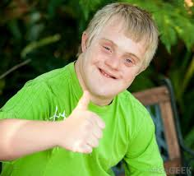
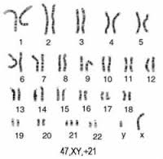

Slide 15
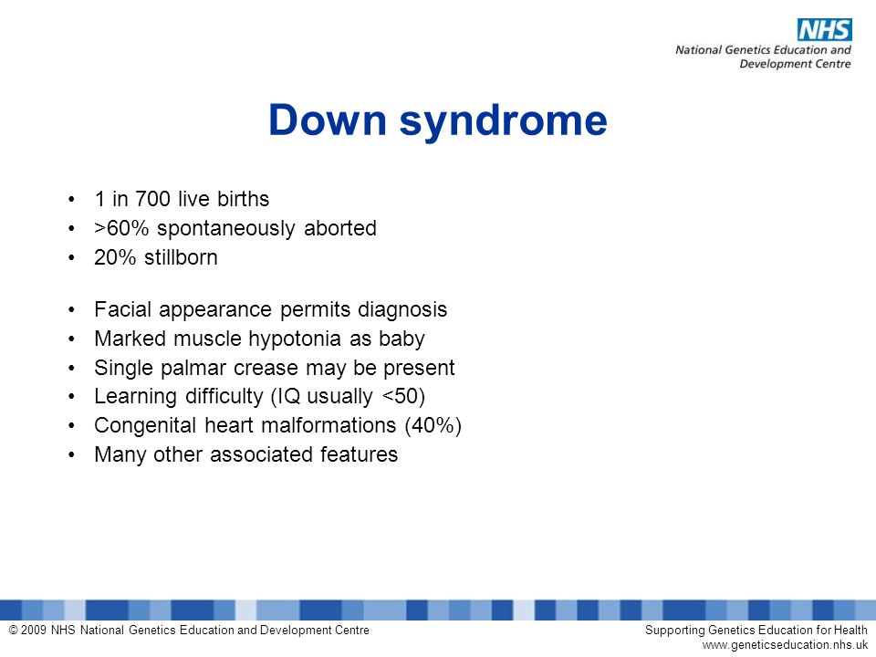

Slide 16
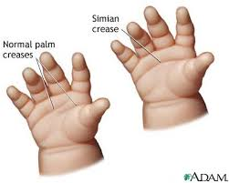

Slide 17
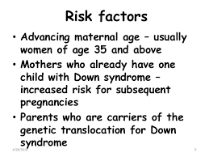

Slide 18
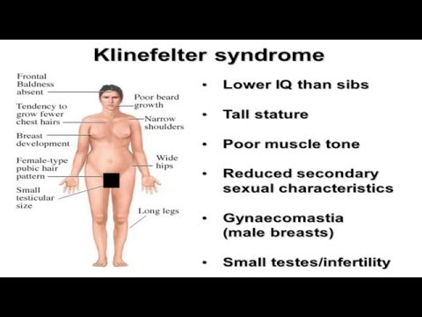
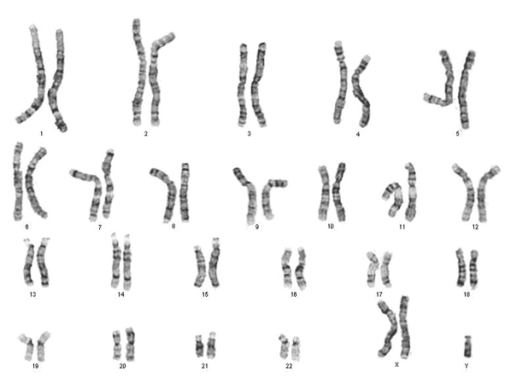

Slide 19
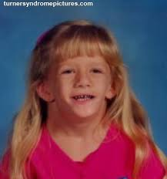
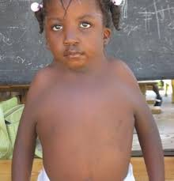
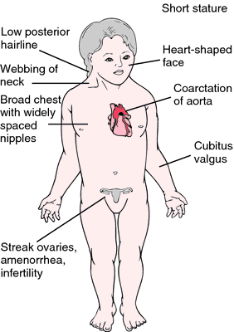
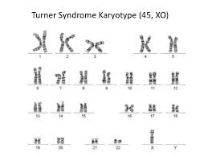

Slide 20
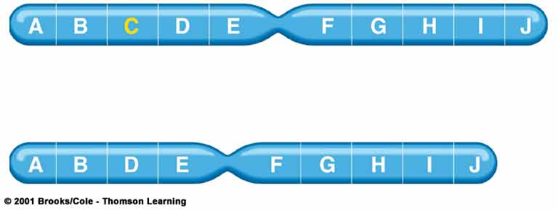
B-Structural abnormalities:
1-Deletion: Loss of some segment of a chromosome. Most are lethal or cause serious disorder because the lost piece could be carrying important genes and the disorder related to the loss of gene product.

Slide 21
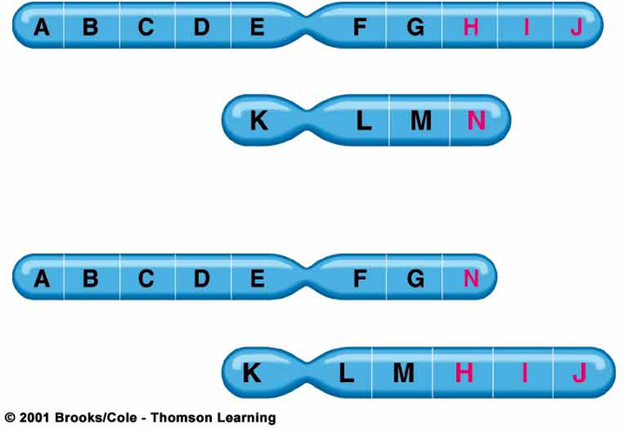
2-Translocation: an exchange of segments of chromosomes between non homologous chromosomes.

Slide 22
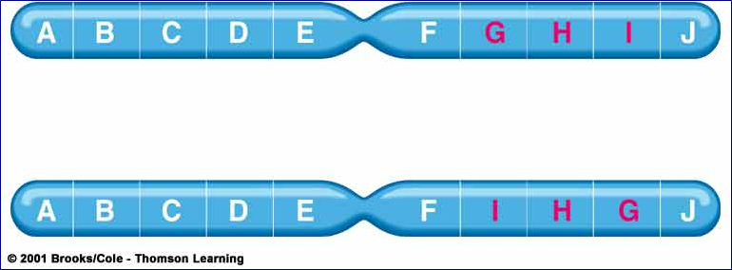
3-Inversion: result from two breaks in the chromosome and the piece between the two breaks will rotate 180 degree and fixed again.

Slide 23
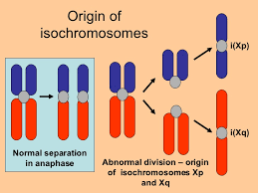
4-Isochromosome: horizontal rather than perpendicular centromere division.

Slide 24
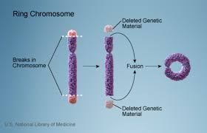
5-Ring chromosome: result from deletion of both ends of a chromosome and the ends, because the adhesive nature of the exposed DNA, will stick together forming a ring or a circle.

Slide 25
2- defects of single genes with large effect (mendelian disorders MD):
Mutation is a disturbance in the sequence of the nucleotide arrangement in the DNA molecule; simply it is a permanent change in the DNA. Mutations affecting the germ cells are transmitted to the progeny and may give rise to inherited disorders. Those occurring in the somatic cells are not transmitted to the progeny but are important in the causation of cancers and some congenital malformation.

Slide 26
A gene is that part of DNA that code for polypeptide chain. Only about 2% of the DNA codes directly for information called exons ie coding sequence, 98% of DNA not code for information (non coding sequence), 24% of these are present between the coding sequence of the gene called introns and 74% present out of the gene.

Slide 27
MENDELIAN inheritance patterns
• AUTOSOMAL DOMINANT
• AUTOSOMAL RECESSIVE
• SEX-LINKED involving “X” chromosome

Slide 28
AUTOSOMAL DOMINANT
•Disease is in HETEROZYGOTES ie if one allele affected the disease occur.
•NEITHER parent may have the disease (NEW mutation)
•REDUCED PENETRANCE: low rate of transmission
•VARIABLE EXPRESSIVITY
•May have a DELAYED ONSET (later in life)
•Usually result in a REDUCED PRODUCTION or PRODUCTION OF INACTIVE protein

Slide 29
AUTOSOMAL RECESSIVE
Disease is in HOMOZYGOTES
More UNIFORM expression than AD
Often COMPLETE PENETRANCE
Onset usually EARLY in life
NEW mutations rarely detected clinically
Proteins show LOSS of FUNCTION
Include ALL inborn errors of metabolism
MUCH more common than autosomal dominant

Slide 30
SEX (“X”) LINKED
• MALES ONLY
• HIS SONS are not affected.
• ALL his DAUGHTERS are CARRIERS
3- Multifactorial inheritance: it is the additive effect of many genes of small effect PLUS a suitable environment causes such disorders.

Slide 31
II// Non classical genetic disorders (single gene defect with atypical pattern of inheritance)

Slide 32
a- mitochondrial gene disorder (mtDNA): mtDNA differ from other nuclear DNA in that the former is associated with maternal inheritance (from mother only) and random segregation of mtDNA to the daughter cell. So any mutation in mtDNA cannot be predicted.
b- Triplet repeat mutation: it is characterized by a long repeating sequence of three nucleotides (pathological expansion of trinucleotide). (eg fragile x syndrome)

Slide 33
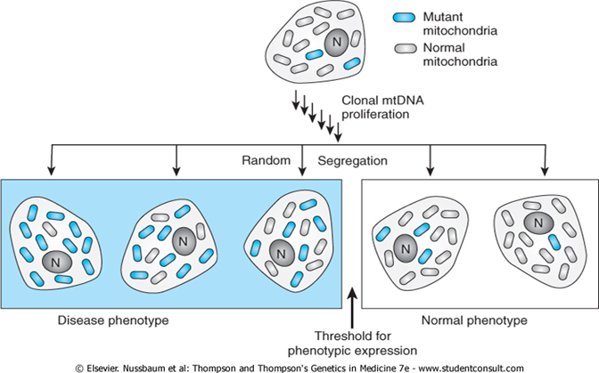

Slide 34
c- uniparental disomy/genomic imprinting: it has been established that there is a functional differences exist between the maternally or paternally derived genes( either the maternal or the paternal gene will be functioning and expressed). Genetic disorder occur when the mutation affect the functioning gene only.

Slide 35
e-Gonadal mosaicism: mutation not occur in the germ cell of either parent during gametogenesis (sperm or ovum formation)but in an undifferentiated cells of the post fertilization zygote. So there are two sets of cell clusters one carrying the mutation and the other not. If it happens that this mutated cell would form the future testis or ovary of the growing embryo, a state of mosaicism is formed.
This mutation is usually an autosomal dominant mutation without previous family history.

Slide 36


