Slide 1
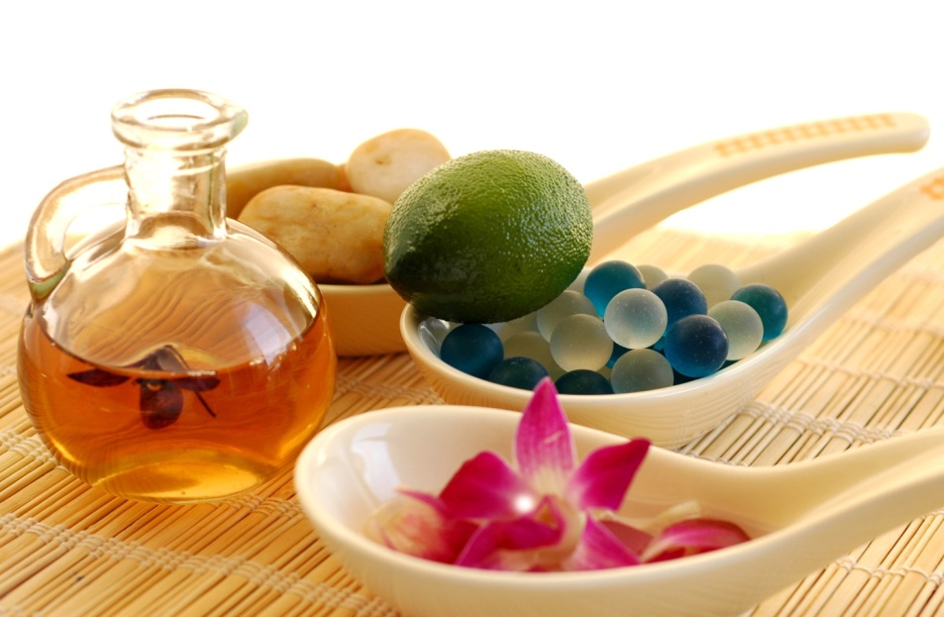
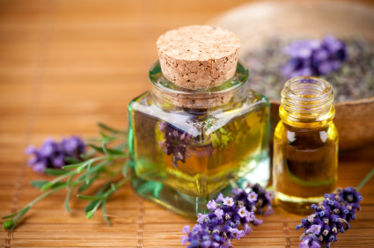
VOLATILE OILS
Pharmacognosy
3rd Class, 1st Semester
Lab.9

Slide 2
Introduction
Volatile oils are products which are generally complex in composition, consisting of the volatile principles contained in plants.
Because they evaporate when exposed to the air room temperatures, they are called volatile oils, they are also called essential oils or ethereal oils.
Volatile oils are colorless as a rule, particularly when they are fresh, but on long standing they are may oxidize and resinify, thus darkening in color to prevent this darkening, they should be stored in a cool, dry place in tightly stoppered, preferably full, amber glass containers.

Slide 3
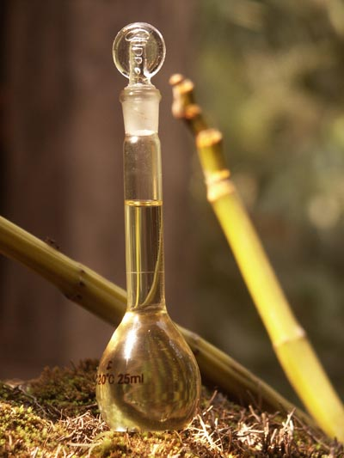
Cont…
As a rule volatile oils are immiscible with water or Slightly soluble in water just give it a characteristic odour & taste, but they are soluble in ether, alcohol and most organic solvents.
Chemically and physically different from fixed oils (Sunflower oil is the fixed oil obtained from the seed of the sunflower ) :-
  Not glyceryl esters of fatty acids.
  Do not leaves permanent grease spot in paper.
  Not saponified with alkali.
  Not become rancid but on exposure to air and light becomes oxidized and resinify.

Slide 4
Cont…
All official volatile oils are of vegetable origin normally pre-exist in the plant – stored in a special secretary tissue ,oil glands, oil cells, glandular hairs.
EXCEPTION: Oil of bitter almond–formed by hydrolysis of the glycosides.

Slide 5
Uses Of Volatile Oils
Therapeutically administered by:-
Inhalation (Eucalyptus oil).
Orally (Peppermint oil).
Gargle and mouthwash (Thymol oil).
Transdermal (Lavender, Rosemary).
Flavouring (Oil of Lemon)
Perfumery (Oil of Rose)
Starting materials to synthesize other compounds .
Anti-septic due to high phenols (Oil of Thyme). Also as a preservative.
Anti-spasmodic (Ginger, Rosemary, Peppermint).
Aromatherapy is the treatment or prevention of disease by use of essential oils and other uses include pain and anxiety reduction, enhancement of energy and short-term memory, relaxation, hair loss prevention.

Slide 6
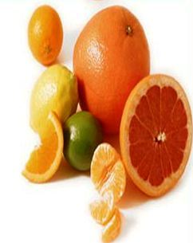
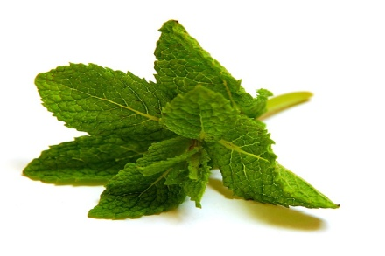
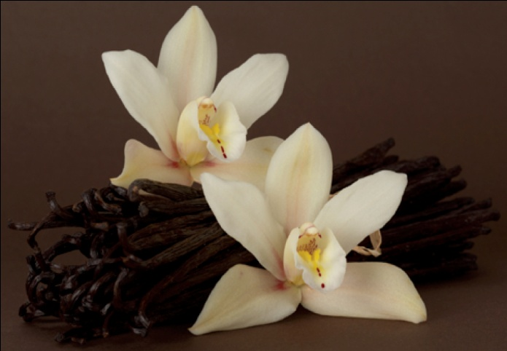
Chemical Composition
Terpene derivatives (terpenes are natural products whose structures may be divided into isoprene units formed via the acetate mevalonic acid pathway) for ex: Limonene and Menthol.
Aromatic compounds (formed via the shikimic acid-phenylpropanoid route) for ex: Vanillin.
Many volatile oils are largely monoterpenoids and others phenylterpenoids.
Constituents are responsible for their characteristic odor, taste, flavor and therapeutic properties.

Slide 7
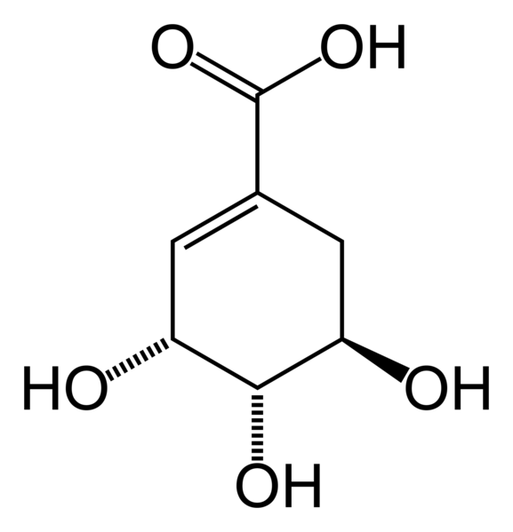
Cont…
Note:
Shikimic acid more commonly known as its anionic form shikimate.
It is an important biochemical metabolite in plants and microorganisms.
Its name comes from the Japanese flower shikimi.

Slide 8
Cont…
Generally volatile oils containing drugs are divided into the following classes:-
Hydrocarbons
Alcohols
Aldehydes
Ketones
Phenols
Phenolic ethers
Oxides
Esters

Slide 9
Methods of obtaining volatile oils
1. Steam Distillation: This method is applied to fresh plants for ex: peppermint.
2. Expression: Mostly the citrus oil is obtained by this method.
3. Enfleurage method: This method is especially used for those volatile oils, which are present in such a part which is very small and also liable to decomposition on distillation.
4. Enzymatic hydrolysis: Glycosidic volatile oils like bitter almond, mustard oil is obtained by enzymatic hydrolysis of glycosides.
5. Solvent extraction: This is very costly method and is mostly used in perfume industry. The parts containing volatile oil are extracted directly by one of the organic solvents and they are then separated.

Slide 10
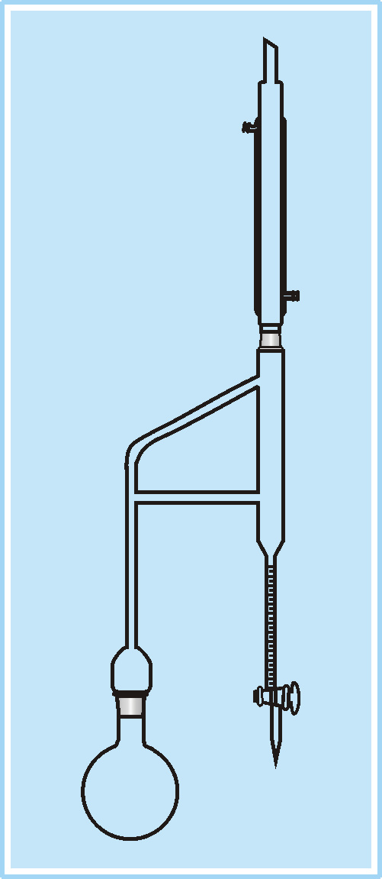
Determination of the volatile content of crude drugs by steam distillation method
Apparatus: - Clevenger apparatus is used to determine the volatile oil content in a given sample. The oil layer settles on top of the aqueous layer.

Slide 11
Cont…
Procedure:-
Weight out 20gm of the plant material (coarse powder)and place into a distilling flask.
Add few pieces of porous earthenware to prevent pumping.
Add 200ml distilled water to the flask and shake well.
Connect the distilling flask with the still head of the apparatus.
Heat the distilling flask until the boiling starts.
Record the time of the beginning of distillation and continue the distillation for one hour.
Switch off heating allow the graduated receiver to cool read off the volume of the volatile oil(count all small divisions in the receiver of the layer of oil).
Calculate the %v/w of the volatile oil content of the drug.

Slide 12
TLC Technique in the identification of Volatile Oil
Peppermint oil
Stationary phase=silica gel G
Mobile phase= chloroform :benzene (1:1)
Spray reagent =dinitrophenyl hydrazine.
Standard reagent=peppermint oil
Measure Rf Value

Slide 13
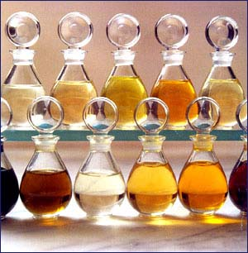
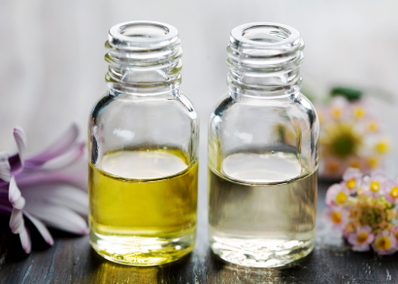
THANK YOU

