Slide 1
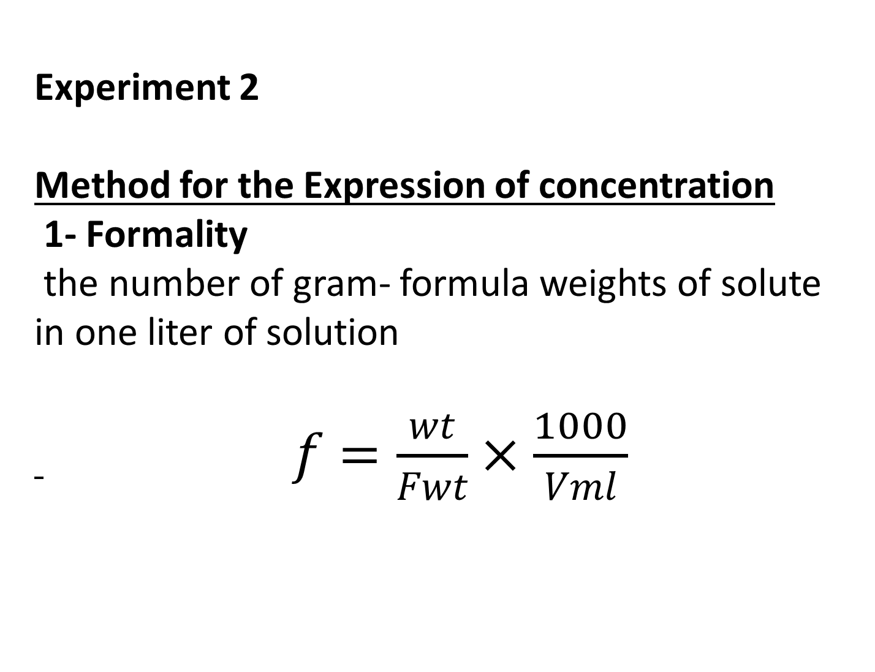
Experiment 2
Method for the Expression of concentration
1- Formality
the number of gram- formula weights of solute in one liter of solution
$f=\frac{wt}{Fwt}×\frac{1000}{Vml}$

Slide 2
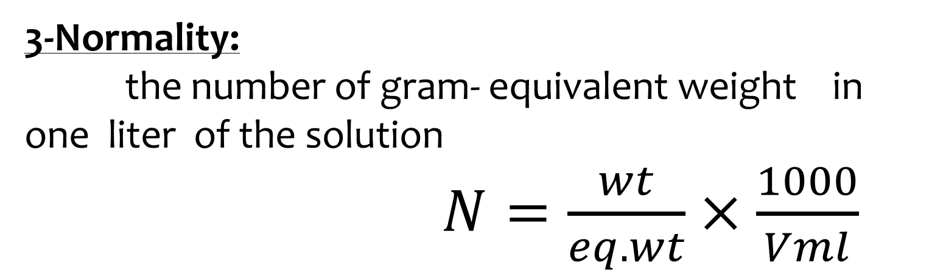
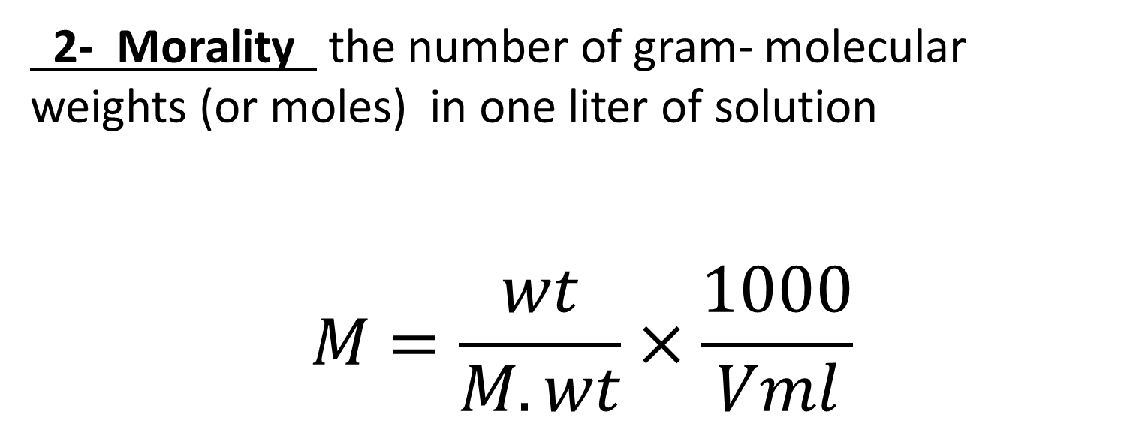
2- Morality the number of gram- molecular weights (or moles) in one liter of solution
$$M=\frac{wt}{M.wt}×\frac{1000}{Vml}$$
3-Normality:
the number of gram- equivalent weight in one liter of the solution
$N=\frac{wt}{eq.wt}×\frac{1000}{Vml}$

Slide 3
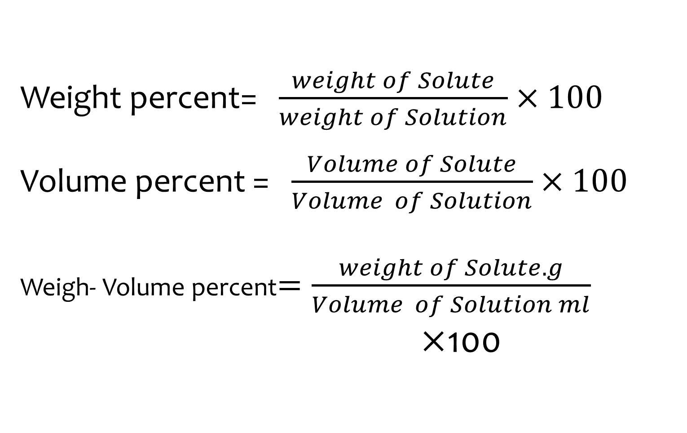
Percent Concentration
Weight percent= $\frac{weight of Solute}{weight of Solution}×100$
Volume percent = $\frac{Volume of Solute}{Volume of Solution}×100$
Weigh- Volume percent$=\frac{weight of Solute.g}{Volume of Solution ml}$
$×$100

Slide 4
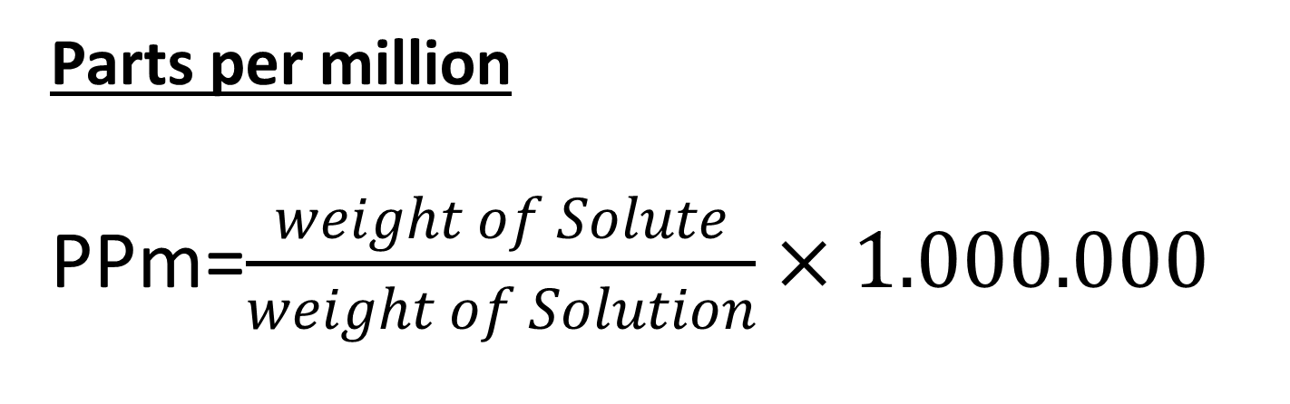
Parts per million
PPm=$\frac{weight of Solute}{weight of Solution}×1.000.000$
The Dilution
before dilution = after dilution
C₁V₁ = C₂V ₂

Slide 5
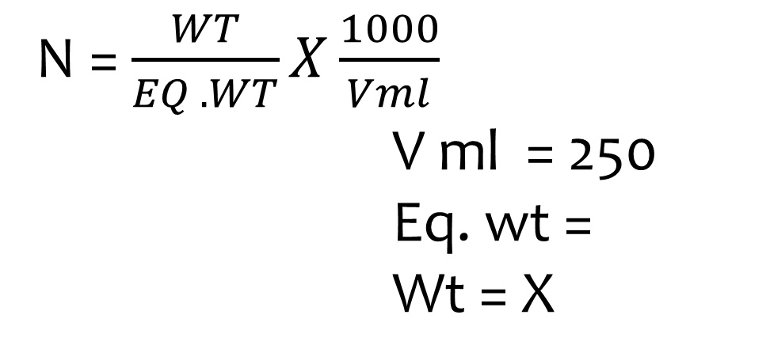
1-Solids
a- Preparation (0.1N)of NaOH in250 ml
N = $\frac{WT}{EQ .WT}X\frac{1000}{Vml}$
            V ml = 250
            Eq. wt =
            Wt = X

Slide 6
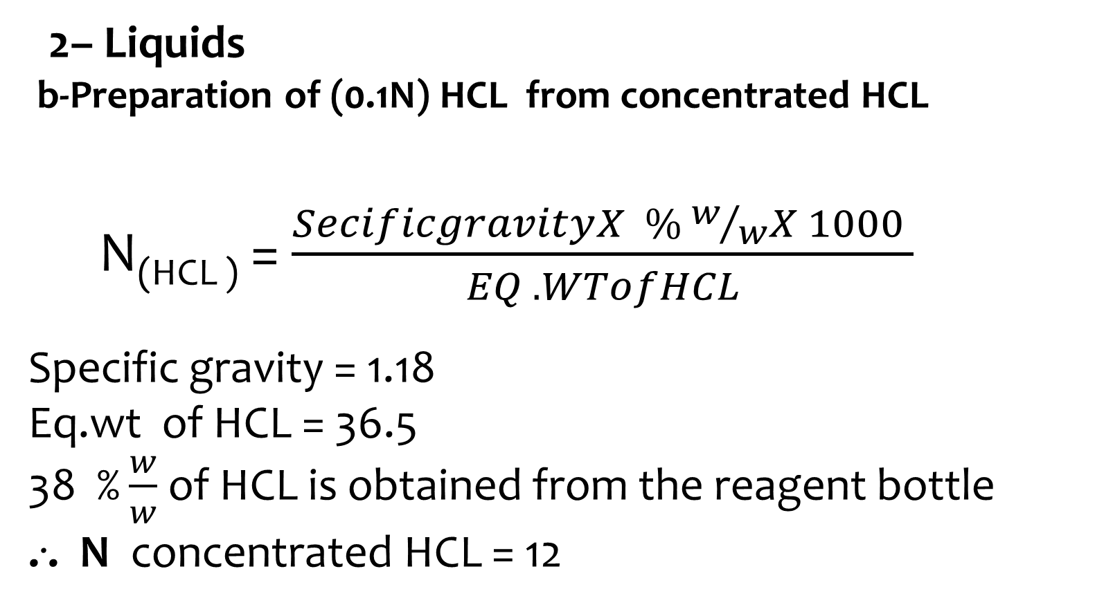
2– Liquids
b-Preparation of (0.1N) HCL from concentrated HCL
N_{(HCL )} = $\frac{SecificgravityX \% w/wX 1000 }{EQ .WTofHCL}$
Specific gravity = 1.18
Eq.wt of HCL = 36.5
38 % $\frac{w}{w}$ of HCL is obtained from the reagent bottle
... N concentrated HCL = 12

Slide 7
To calculate the volume of concentrated HCL that should be taken to prepare 250 ml of (0.1N) HCL .
Conc.HCL = diluted HCL
N₁ V₁ = N₂ V₂
12 X V₁ = 0.1 X 250
V₁ = ?

