Slide 1
Pediatric Care Practice

Slide 2
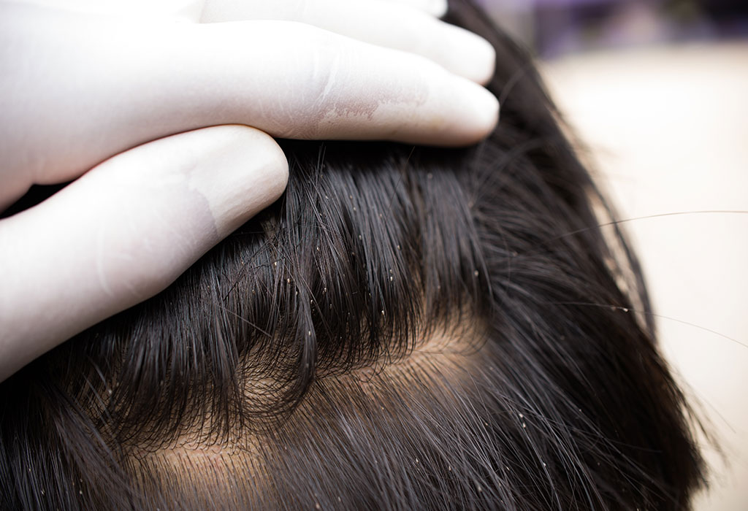
Head Lice
Commonly found in children,
especially around the age of
4-11 years old
Infection is spread by direct
head-to-head contact
Girls showing higher incidence
than boys

Slide 3
Patient Assessment

Slide 4
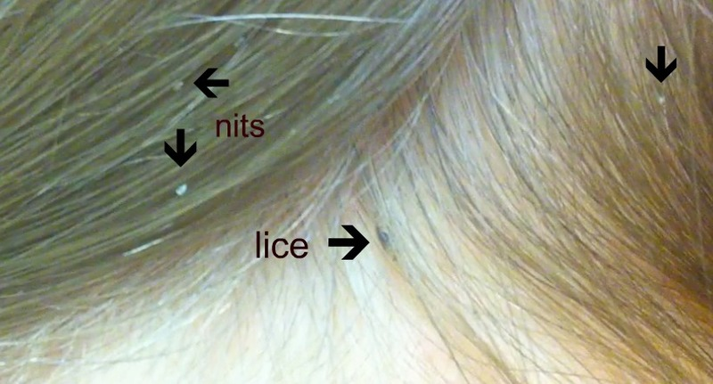
Have live lice been seen?

Slide 5
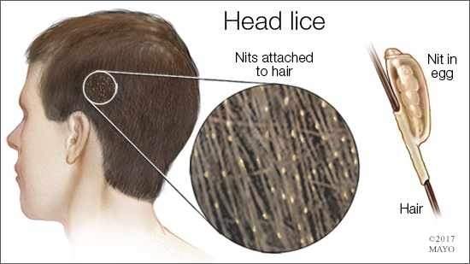
Presence of empty egg shells (nits)

Slide 6
Presence of itching
Previous infection
Medication

Slide 7
Management
Preventative Measures:
1-Avoid direct contact with infected patients.
2-Do not share articles such as combs, brushes, hats and towels
3-Use hot water to wash hairbrushes and combs of patient for 10 minutes.
4-Use hot water to wash clothes, bedding, and towels of patient.

Slide 8
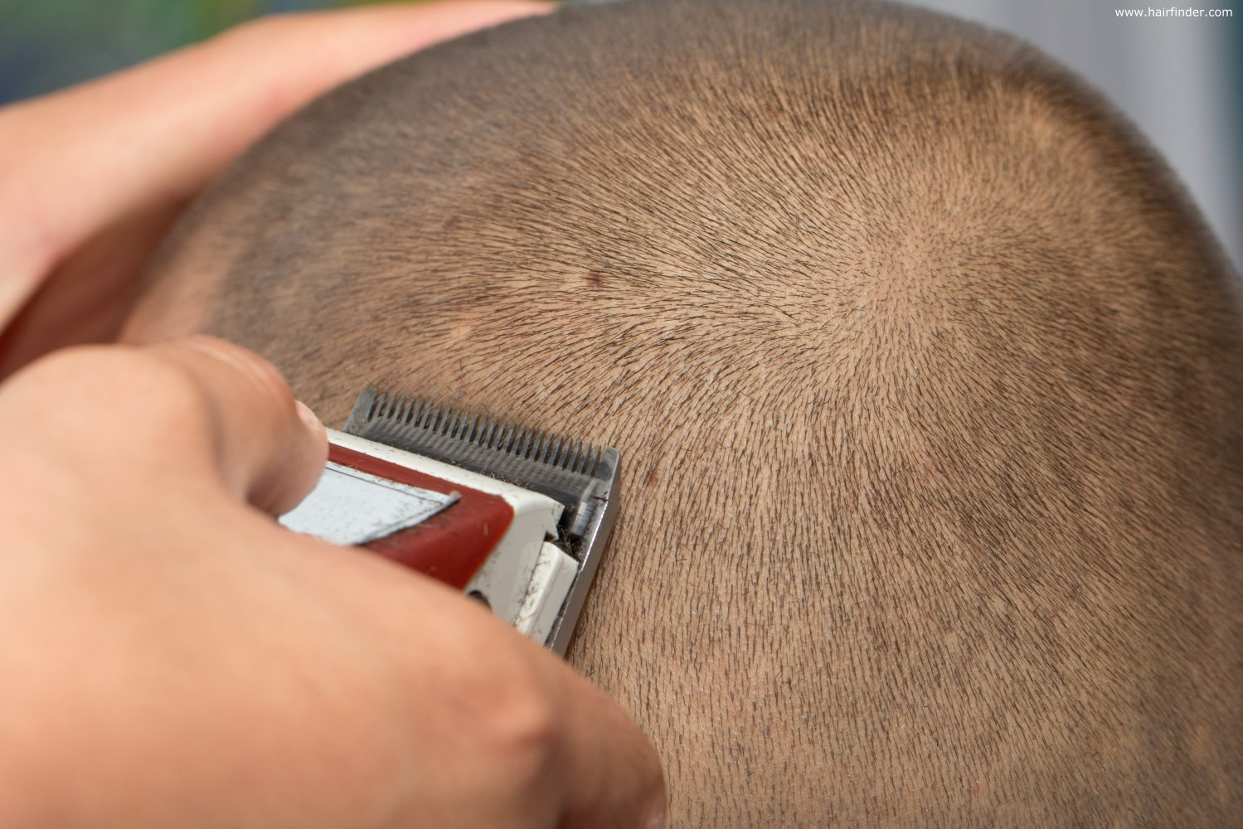
Shaving the head is not an effective treatment because lice can cling to as little as 1 mm of hair.

Slide 9
Treatment
A-Insecticides: permethrin, lindane (gama benzene hexachloride), and malathion, cure rates of 70-80 %
B-Dimeticone and isopropyl myristate (physical insecticides), cure rates 70 %
C-Wet-combing, cure rates 50-60 %

Slide 10
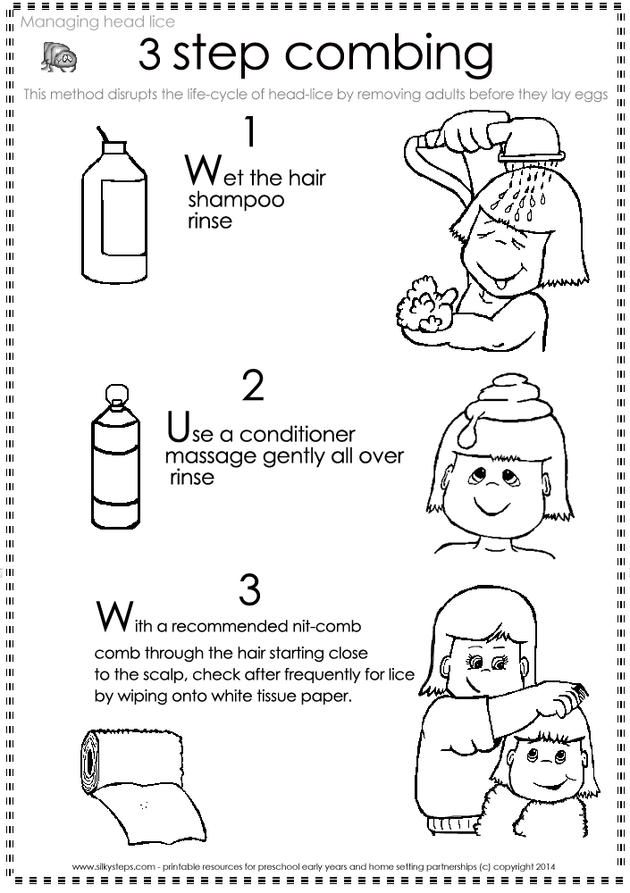
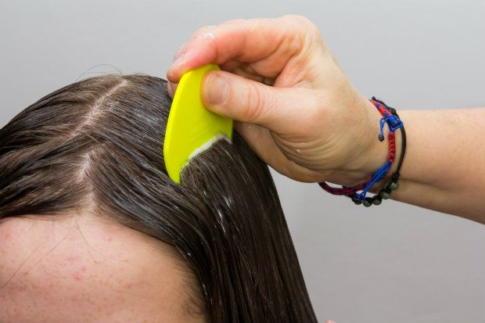
Wet-combing method

Slide 11
Napkin rash
Contributing factors includes:
1-Contact of urine and faeces with the skin.
2-Wetness of the skin due to infrequent nappy changes and inadequate skin care.

Slide 12
Patient Assessment
Location
Severity
Duration

Slide 13
Management
A-Skin care
B-Skin protectants (barrier preparation, emollient)
C-Antifungal

Slide 14
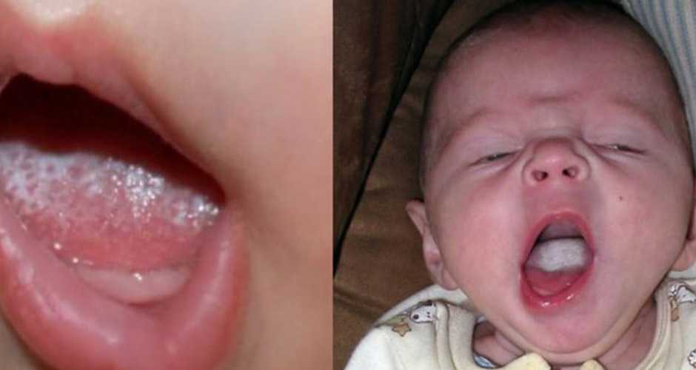
Oral Thrush
Oral thrush is most common in babies, particularly in the first few weeks of life

Slide 15
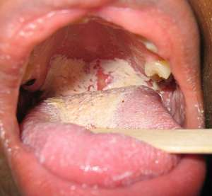
Oral thrush in adult… referal

Slide 16
When to refer
Recurrent infection
All except babies
Failed medication

Slide 17
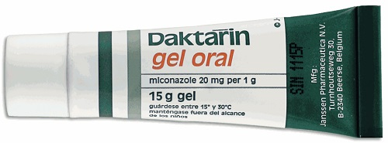
Treatment timescale Oral thrush should respond to treatment quickly. If the symptoms have not cleared up within 1 week, patients should see their doctor.
Management
Antifungal agents
Miconazole

Slide 18
Threadworms (pinworms)
Clinical features
Other family members
Recent travel abroad
Medication

Slide 19
When to refer
Infection other than the threadworm suspected
Recent travel abroad
Medication failure

Slide 20
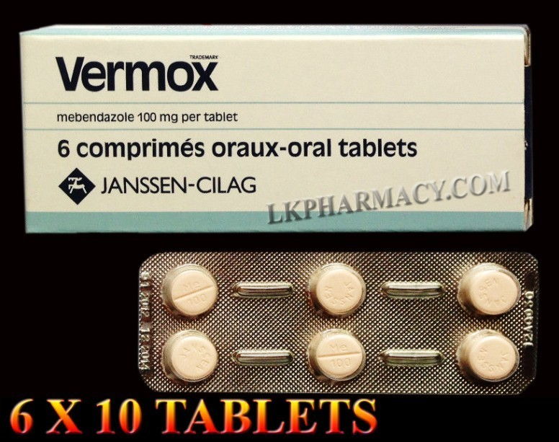
Management
Mebendazole
Piperazine

