Slide 2
Common Cold
The common cold comprises a mixture of viral upper respiratory tract infections.
It is self-limiting.
over-the-counter (OTC) medicines for symptomatic relief.

Slide 3
Questions to be asked
Age
Duration
Symptoms…
Previous history
Present medication

Slide 4
Symptoms
Runny/blocked nose
Summer colds
Sneezing/coughing
Aches and pains/ headach
High temperature
Sore throat
Earache
Facial pain/frontal headache

Slide 5
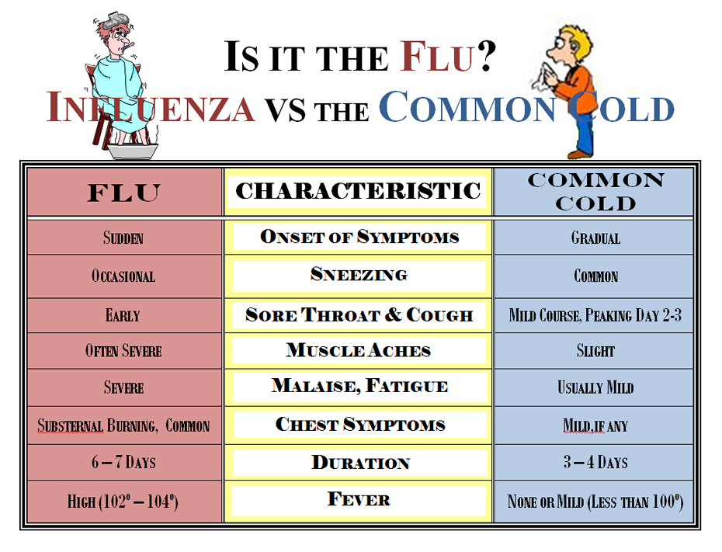
Differentiating between colds and flu
Flu often starts abruptly
Fever..temperature is 38◦ C or higher.
one or more respiratory symptom – cough, sore throat, nasal congestion or rhinorrhoea – is present; or
One or more constitutional symptom – headache, malaise, myalgia, sweats/chills, prostration – is present.

Slide 6
Asthma
Asthmatic attacks can be triggered by respiratory viral infections.
Most asthma sufferers learn to start or increase their usual medication to prevent such an occurrence.

Slide 7
When to refer
Earache not settling with analgesic
In the very young
In the very old
In those with heart or lung disease, e.g. COPD, kidney disease, diabetes, compromised immune system
With persisting fever and productive cough
With delirium
With pleuritic-type chest pain
Asthma

Slide 8
Treatment timescale (in 10–14 days)
Decongestants, Sympathomimetics
Antihistamines
Zinc
Vitamin C
Cough remedies
Analgesics
Products for sore throats

Slide 9
Prevention of flu
Vaccinations.
Antiviral drugs: may help reduce the duration of flu symptoms, Three antiviral products are licensed for use: oseltamivir, zanamivir And amantadine.
Antibiotics:

Slide 10
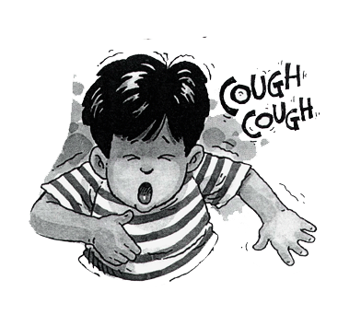

Slide 11
Cough
Coughing is a protective reflex action
Caused when the airway is being irritated or obstructed.
Its purpose is to clear the airway so that breathing can continue normally.
Often be associated with other symptoms of a cold.

Slide 12
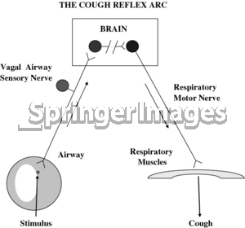

Slide 13
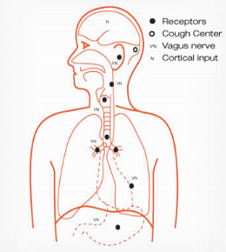

Slide 14
Questions to be Asked
Age
Duration
Nature of cough….
Associated symptoms…
Present medication (ACEI)

Slide 15
Nature of cough
Unproductive (dry, tickly or tight)
Productive (chesty or loose)
Tuberculosis (TB)
Croup (acute laryngotracheitis)
Whooping cough (pertussis)

Slide 16
Previous History
Chronic bronchitis
Asthma
Cardiovascular
Gastro-oesophageal
Smoking habit

Slide 17
When to refer
Cough lasting 2 weeks or more and not improving
Sputum (yellow, green, rusty or blood-stained)
Chest pain
Shortness of breath
Wheezing
Whooping cough or croup
Recurrent nocturnal cough
Suspected adverse drug reaction
Failed medication

Slide 18
Treatment timescale
Cough suppressants
Expectorants
Antihistamines
Sympathomimetics
Theophylline

