Slide 1
Medical Microbiology
Asst. Prof. Dr. Dalya Basil Hanna

Slide 2
Yersinia & Pasturella

Slide 3
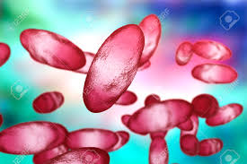
Yersinia
Pleomorphic gram-negative rods that can exhibit bipolar staining. They are catalase-positive, oxidase-negative, and microaerophilic or facultatively anaerobic. Most have animals as their natural hosts, but they can produce serious disease in humans.
The genus Yersinia includes Yersinia pestis, the cause of plague; Yersinia pseudotuberculosis and Yersinia enterocolitica, important causes of human diarrheal diseases; and several others considered nonpathogenic for humans.

Slide 4
Yersinia pestis & Plague
Plague is an infection of wild rodents, transmitted from one rodent to another and occasionally from rodents to humans by the bites of fleas. Serious infection often results, which in previous centuries produced pandemics of "black death" with millions of fatalities. The ability of this organism to be transmitted by aerosol, and the severity and high mortality associated with pneumonic plague, make Y pestis a potential biological weapon.

Slide 5
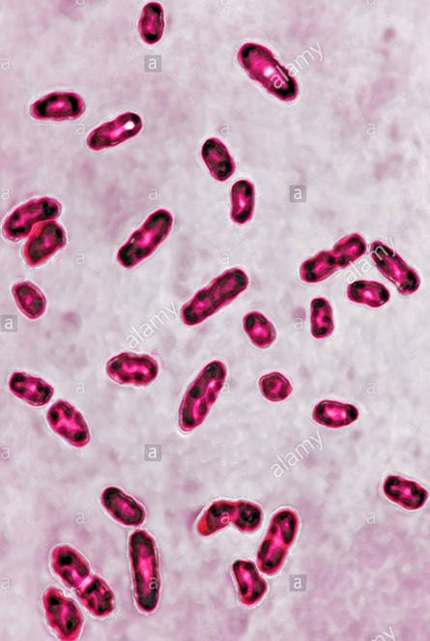
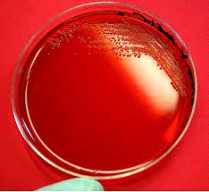
Morphology & Identification
Y pestis is a gram-negative rod that exhibits striking bipolar staining with special stains. It is nonmotile. It grows as a facultative anaerobe on many bacteriologic media. Growth is more rapid in media containing blood or tissue fluids and fastest at 30°C. In cultures on blood agar at 37°C, colonies may be very small at 24 hours.

Slide 6
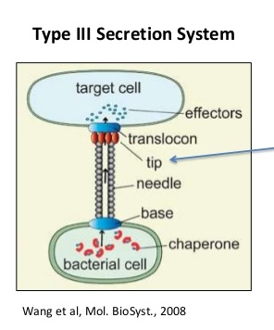
Antigenic Structure/ Virulence factors
All yersiniae possess lipopolysaccharides that have endotoxic activity. The three pathogenic species produce antigens and toxins that act as virulence factors. They have type III secretion systems that consist of a membrane-spanning complex that allows the bacteria to inject proteins directly into cytoplasm of the host cells. The virulent yersiniae produce V and W antigens, which are encoded by genes on a plasmid of approximately 70 kb. This is essential for virulence; the V and W antigens yield the requirement for calcium for growth at 37°C.

Slide 7
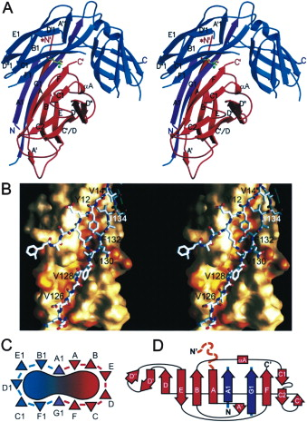
Antigenic Structure/ Virulence factors
Y pestis has gained additional plasmids. pPst is a 9.5 kb plasmid that contains genes that yield plasminogen-activating protease that has temperature-dependent coagulase activity (20–28°C, the temperature of the flea) and fibrinolytic activity (35–37°C, the temperature of the host). This factor is involved in dissemination of the organism from the flea bite injection site. The pFra/pMT plasmid (80–101 kb) encodes the capsular protein (fraction F1) that is produced mainly at 37°C and confers antiphagocytic properties. In addition, this plasmid contains genes that encode phospholipase D, which is required for organism survival in the flea midgut.

Slide 8
Pathogenesis & Pathology
When a flea feeds on a rodent infected with Y pestis, the ingested organisms multiply in the gut of the flea and, helped by the coagulase, block its proventriculus so that no food can pass through.
Subsequently, the "blocked" and hungry flea bites ferociously and the aspirated blood, contaminated with Y pestis from the flea, is regurgitated into the bite wound. The inoculated organisms may be phagocytosed by polymorphonuclear cells and macrophages. The Y pestis organisms are killed by the polymorphonuclear cells but multiply in the macrophages; because the bacteria are multiplying at 37°C, they produce the antiphagocytic protein and subsequently are able to resist phagocytosis.

Slide 9
Pathogenesis & Pathology
The pathogens rapidly reach the lymphatics and an intense hemorrhagic inflammation develops in the enlarged lymph nodes, which may undergo necrosis. While the invasion may stop there, Y pestis organisms often reach the bloodstream and become widely disseminated. Hemorrhagic and necrotic lesions may develop in all organs; meningitis, pneumonia, and serosanguineous pleuropericarditis are prominent features.
Primary pneumonic plague results from inhalation of infective droplets (usually from a coughing patient), with hemorrhagic consolidation, sepsis, and death.

Slide 11
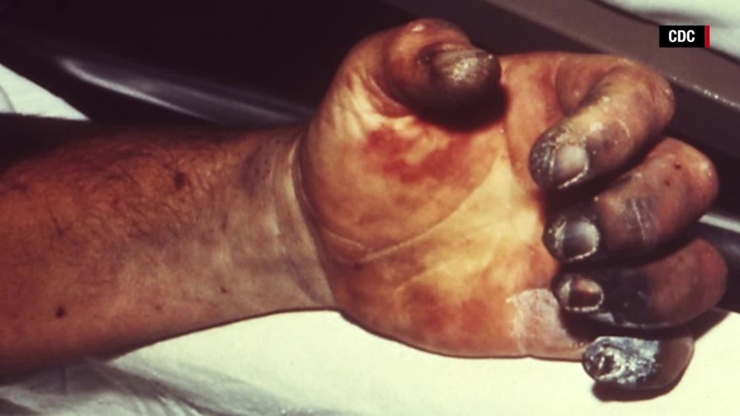
Clinical Findings
After an incubation period of 2–7 days, there is high fever and painful lymphadenopathy, commonly with greatly enlarged, tender nodes (buboes) in the groin or axillae. Vomiting and diarrhea may develop with early sepsis. Later, disseminated intravascular coagulation leads to hypotension, altered mental status, and renal and cardiac failure. Terminally, signs of pneumonia and meningitis can appear, and Y pestis multiplies intravascularly and can be seen in blood smears.

Slide 13
Diagnostic Laboratory Tests
Specimens
Blood is taken for culture and aspirates of enlarged lymph nodes for smear and culture. In pneumonia, sputum is cultured. In possible meningitis, cerebrospinal fluid is taken for smear and culture.
Smears
Y pestis are small gram-negative bacilli that appear as single cells or as pairs or short chains in clinical material. Wright's, Giemsa's, or Wayson's stains may be more useful because of the striking bipolar appearance of the organism using these stains that is not evident on a direct Gram stain. More specific direct staining methods (possibly available through reference laboratories) include the use of fluorescent antibody stains targeting the capsular F1 antigen.

Slide 14
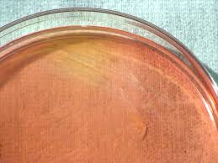
Culture
All materials are cultured on blood agar, chocolate, and MacConkey agar plates and in brain-heart infusion broth. Growth on solid media may be slow, requiring more than 48 hours, but blood cultures are often positive in 24 hours. Cultures can be tentatively identified by biochemical reactions. Y pestis produces nonlactose-fermenting colonies on MacConkey agar, and it grows better at 28°C than at 37°C. The organism is catalase positive; indole, oxidase, urease negative; and nonmotile.
All cultures are highly infectious and must be handled with extreme caution inside a biological safety cabinet.

Slide 15
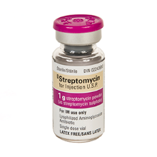
Serology & Treatment
In patients who have not been previously vaccinated, a serum antibody titer of 1:16 or greater is presumptive evidence of Y pestis infection. A titer rise in two sequential specimens confirms the serologic diagnosis.
Unless promptly treated, plague may have a mortality rate of nearly 50%; pneumonic plague, nearly 100%. The drug of choice is streptomycin, but the more readily available aminoglycoside gentamicin has been shown to be as effective. Doxycycline is an alternative drug and is sometimes given in combination with streptomycin. Drug resistance has been noted in Y pestis.

Slide 16
Yersinia enterocolitica & Yersinia pseudotuberculosis
These are non lactose-fermenting gram-negative rods that are urease-positive and oxidase-negative. They grow best at 25°C and are motile at 25°C but nonmotile at 37°C. They are found in the intestinal tract of a variety of animals, in which they may cause disease, and are transmissible to humans,
Y enterocolitica exists in more than 50 serotypes; most isolates from human disease belong to serotypes O:3, O:8, and O:9. Y enterocolitica can produce a heat-stable enterotoxin, but the role of this toxin in diarrhea associated with infection is not well defined.
Y pseudotuberculosis exists in at least six serotypes, but serotype O:1 accounts for most human infections.

Slide 17
Pathogenesis
An inoculum of 10⁸–10⁹ yersiniae must enter the alimentary tract to produce infection. Y enterocolitica has been isolated from rodents and domestic animals (eg, sheep, cattle, swine, dogs, and cats) and waters contaminated by them. Transmission to humans probably occurs by contamination of food, drink, or fomites.
During the incubation period of 4–7 days, yersiniae multiply in the gut mucosa, particularly the ileum. This leads to inflammation and ulceration, and leukocytes appear in feces. The process may extend to mesenteric lymph nodes and, rarely, to bacteremia.

Slide 18
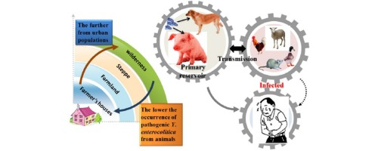
Clinical Findings
Early symptoms include fever, abdominal pain, and diarrhea. Diarrhea ranges from watery to bloody and may be due to an enterotoxin or to invasion of the mucosa. At times, the abdominal pain is severe and located in the right lower quadrant, suggesting appendicitis. Very rarely, Yersinia infection produces pneumonia, meningitis, or sepsis; in most cases, it is self-limited.

Slide 19
Diagnostic Laboratory Tests
Specimens
Specimens may be stool, blood, Stained smears are not contributory.
Culture
The number of yersiniae in stool may be small and can be increased by "cold enrichment": a small amount of feces or a rectal swab is placed in buffered saline, pH 7.6, and kept at 4°C for 2–4 weeks; many fecal organisms do not survive, but Y enterocolitica will multiply. Subcultures made at intervals on MacConkey agar may yield yersiniae.

Slide 20
Treatment
Most Yersinia infections with diarrhea are self-limited, Y enterocolitica is generally susceptible to aminoglycosides, chloramphenicol, tetracycline, trimethoprim sulfamethoxazole, piperacillin, third-generation cephalosporins, and fluoroquinolones; it is typically resistant to ampicillin and to first-generation cephalosporins. Proved Yersinia sepsis or meningitis has a high mortality rate, but deaths occur mainly in immunocompromised patients. Yersinia sepsis can be successfully treated with third-generation cephalosporins (possibly in combination with an aminoglycoside) or a fluoroquinolone (possibly in combination with another antimicrobial).

Slide 21
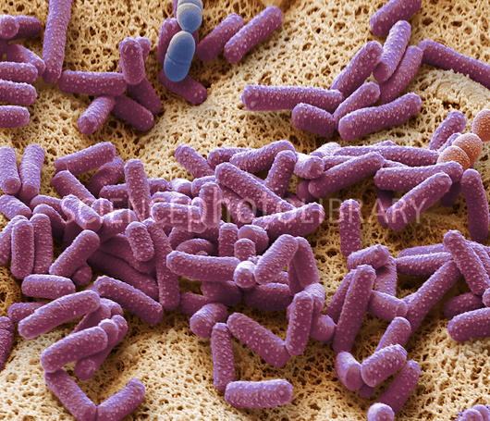
Pasteurella
Pasteurella species are primarily animal pathogens, but they
can produce a range of human diseases.
Pasteurellae are non motile gram-negative coccobacilli with a bipolar appearance on stained smears. They are aerobes or facultative anaerobes that grow readily on ordinary bacteriologic media at 37°C. They are all oxidase-positive and catalase-positive but diverge in other biochemical reactions.
Pasteurella multocida occurs worldwide in the respiratory and gastrointestinal tracts of many domestic and wild animals. It is perhaps the most common organism in human wounds inflicted by bites from cats and dogs. It can also produce human infections in many systems and may at times be part of normal human flora.

Slide 22
Pasteurella
Pasteurella bettyae has been recovered from infections of the human genital tract and of newborns.
Pasteurella pneumotropica is a normal inhabitant of the respiratory tract and gut of mice and rats. A few human infections have followed animal bites.
Pasteurella ureae has rarely been found in animals but occurs as part of a mixed flora in human chronic respiratory disease or other suppurative infections.

Slide 23
Clinical Findings & Treatment
The most common presentation is a history of animal bite followed within hours by an acute onset of redness, swelling, and pain. Regional lymphadenopathy is variable, and fever is often low grade. Pasteurella species infections sometimes present as bacteremia or chronic respiratory infection without an evident connection with animals.
P multocida is susceptible to most antibiotics. Penicillin G is considered the drug of choice for P multocida infections resulting from animal bites. Tetracyclines and fluoroquinolones are alternative drugs.

Slide 24
Thank You

