Slide 1
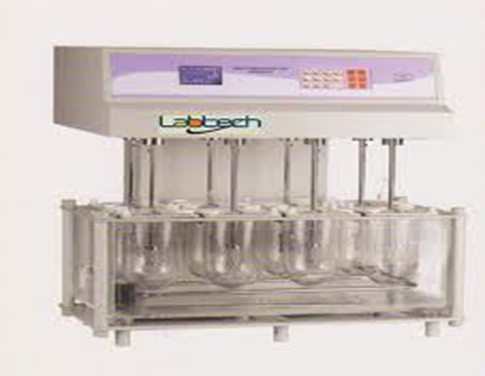
Biopharmaceuitcs lab 6
In vitro dissolution study of per – oral tablet

Slide 2
Introduction :
Dissolution is a process of going into
solution form .
A basic principle of drug absorption is that absorption takes place only after a drug is in solution .this means that drug given orally in solid dosage form must dissolve in GIT fluid before absorption occurs

Slide 3
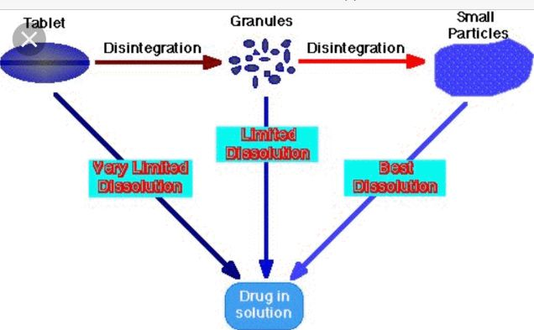
The following process occurs before absorption of solid dosage forms
Notes :
Pero- oral means taken orally
Oral means work on oral cavity

Slide 4
Dissolution and Absorption
When drug is slightly soluble the rate limiting factor for absorption is dissolution
While for highly soluble drug the rate limiting factor is absorption

Slide 5
Factors affecting dissolution rate
Agitation intensity
Drug solubility
Surface area exposed to dissolution medium

Slide 6
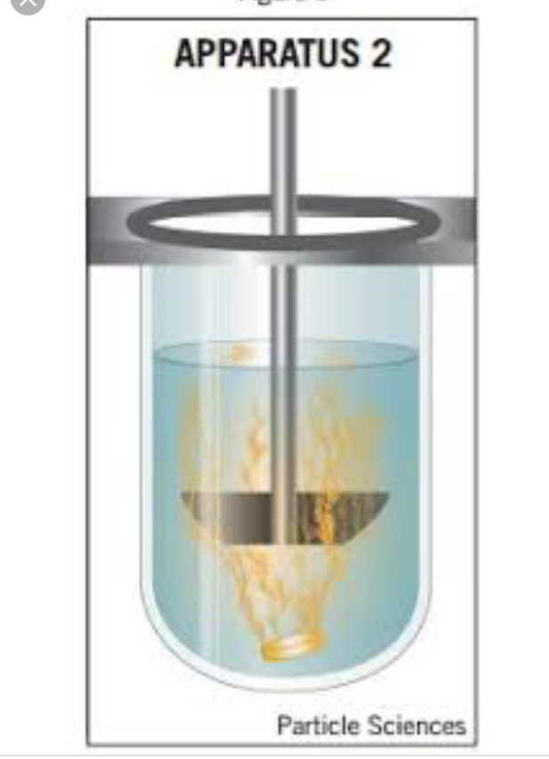
Method :
By using dissolution apparatus (karl kolb)
(apparatus 2 paddle type )
The conditions of the experiment are made so that they simulate body conditions .
A temperature 37 º C and a rotation speed of 50 r.p.m
The dissolution medium is artificial gastric juice or artificial intestinal juice .

Slide 7
Dissolution testing is a key quality control test
• Dissolution tests can be conducted in simple buffer solutions or in more bio-relevant dissolution media
• Dissolution tests are normally performed under sink conditions
• There are four types of compendial dissolution apparatus: the basket apparatus (USP I), the paddle apparatus(USPII) , the reciprocating cylinder and the flow-through cell
•A dissolution test is said to be performed under sink conditions if the concentration of the drug in the bulk of the dissolution medium does not exceed 10% of the solubility of the drug.

Slide 8
Under sink conditions, the concentration gradient between the diffusion layer surrounding the solid drug particles and the concentration in the dissolution medium is assumed to be constant

Slide 11
Sampling point USP/NF – midway from top of basket or paddle to top of fluid and no closer than 1 cm to side of flask BP – halfway between basket and side at middle of basket

Slide 12
Procedure ( Dissolution study of nitrofurantoin tablets)
Fill the jars with 1 L of dissolution fluid (artificial gastric juice)
Put the jars in a thermostatically controlled water bath at 37 (switch water bath on)
Place 1 tablet of nitrofurantoin in the basket of apparatus, and start the instrument immediately
Set the speed on 50 r.p.m
With draw 5 ml each 10 min for 1.5 hr

Slide 13
Notes
stop apparatus for withdrawal.
Substitute for the volume withdrawn each time interval using a fresh (artificial gastric juice) previously maintained at 37º C
After withdrawal and replacement start instrument again
Analyze samples of nitrofurantoin by reading the absorbance on a spectronic -20 at 369 nm ~370 nm immediately because nitrofurantoin solution discolored by exposure to light
Use the following stright line equation to obtain the concentartion of y= c+bx , y= AB, X= conc.(mg/100ml), c=0.01, b=0.4

Slide 14
Collection time (min) | Ab | Conc.(mg/ml) | Percent drug release
10
20
30
40
50
60
75
90

Slide 15
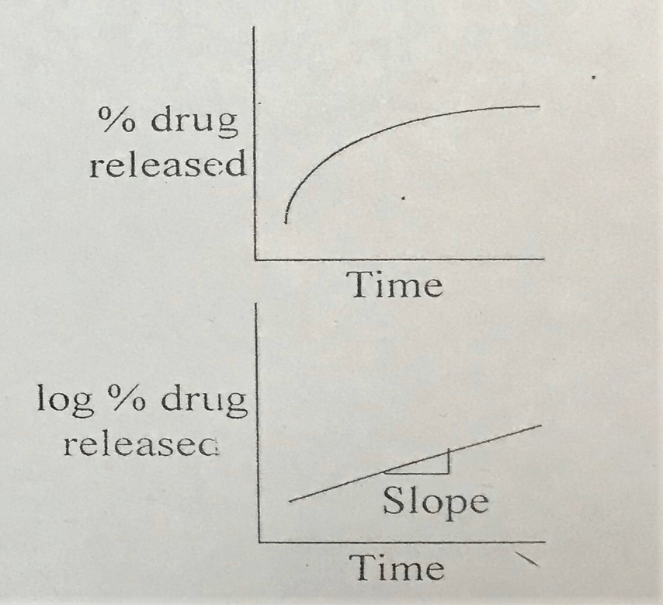
To obtain percent drug release:
Con.(mg/ml)X vol. of dissolution media =mg amount of drug released into the dissolution media
% of drug released = amount of drug release /amount of drug in the tablet *100
Plot the following graphs :
1. drug release % versus time in (min)
2. log % drug released versus time in (min)
Find dissolution rate K from
the slope
K= slope * 2.303
Note : amount of drug is
equal to 100 mg in each tab

Slide 16
Working example using EXCEL SHEET

Slide 17
Switch the sheet direction so that the first column is on right side

Slide 18
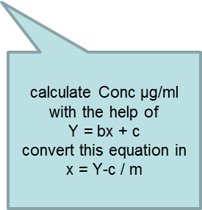
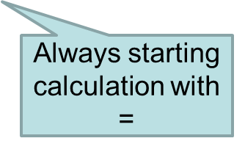
Note units of x are given in u/ml in this example

Slide 19
After completing calculation press ENTER
Then DRAG

Slide 20
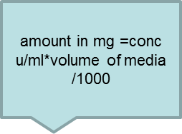

Slide 21
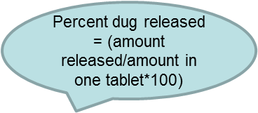

Slide 22
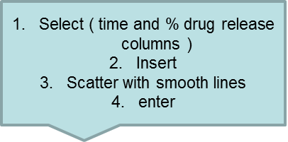

Slide 23
To add titles

Slide 25
Thank you

