Slide 1
Medical Microbiology
Asst. Prof. Dr. Dalya Basil Hanna

Slide 2
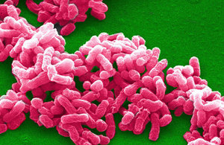
The Brucellae
The brucellae are obligate parasites of animals and humans and are characteristically located intracellularly.
The disease in humans, brucellosis (undulant fever, Malta fever), is characterized by an acute bacteremic phase followed by a chronic stage that may extend over many years and may involve many tissues.
Four species, B melitensis, B abortus, B suis, and B canis, have been described as zoonotic pathogens in humans

Slide 3
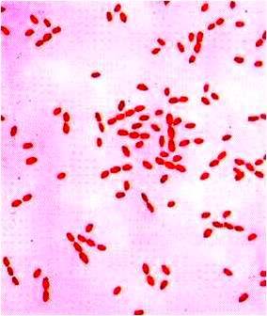
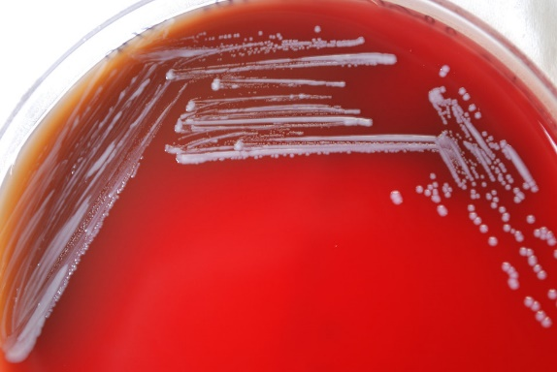
Morphology & Identification
Typical Organisms
The appearance in young cultures varies from cocci to rod 1.2 µm in length, with short coccobacillary forms predominating. They are gram-negative, and they are aerobic, non-motile, and non-spore forming.
Culture
Small, convex, smooth colonies appear on enriched media in 2–5 days.

Slide 4
Growth Characteristics
Brucellae are adapted to an intracellular habitat, and their nutritional requirements are complex. Some strains have been cultivated on defined media containing amino acids, vitamins, salts, and glucose. Fresh specimens from animal or human sources are usually inoculated on trypticase-soy agar or blood culture media.
B abortus requires 5–10% CO₂ for growth, whereas the other three species grow in air.
Brucellae utilize carbohydrates but produce neither acid nor gas. Catalase and oxidase are produced by the four species that infect humans. Hydrogen sulfide is produced by many strains, and nitrates are reduced to nitrites.
Brucellae are moderately sensitive to heat and acidity. They are killed in milk by pasteurization.

Slide 5
Variation & Antigenic Structure
The typical virulent organism forms a smooth, transparent colony; upon culture, it tends to change to the rough form, which is avirulent.
The serum of susceptible animals contains a globulin and a lipoprotein that suppress growth of non smooth, avirulent types and favor the growth of virulent types. Resistant animal species lack these factors, so that rapid mutation to avirulence can occur.
Differentiation among Brucella species is made possible by their characteristic sensitivity to dyes and their production of H₂S. Few laboratories have maintained the procedures for these tests, and the brucellae are seldom placed into the traditional species. Because brucellae are hazardous in the laboratory, tests to classify them should be performed only in reference public health laboratories using appropriate biosafety precautions.

Slide 6
The common routes of infection in humans are the intestinal tract (ingestion of infected milk), mucous membranes (droplets), and skin (contact with infected tissues of animals). Cheese made from unpasteurized goats' milk is a particularly common vehicle. The organisms progress from the portal of entry, via lymphatic channels and regional lymph nodes, to the thoracic duct and the bloodstream, which distributes them to the parenchymatous organs.

Slide 7
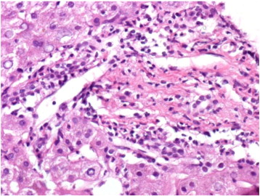
Granulomatous nodules that may develop into abscesses form in lymphatic tissue, liver, spleen, bone marrow, and other parts of the reticuloendothelial system. In such lesions, the brucellae are principally intracellular. Osteomyelitis, meningitis, or cholecystitis also occasionally occurs. The main histologic reaction in brucellosis consists of proliferation of mononuclear cells, exudation of fibrin, coagulation necrosis, and fibrosis. The granulomas consist of epithelioid and giant cells, with central necrosis and peripheral fibrosis.

Slide 8
Pathogenesis & Pathology
The brucellae that infect humans have apparent differences in pathogenicity. B abortus usually causes mild disease without suppurative complications; noncaseating granulomas of the reticuloendothelial system are found. B canis also causes mild disease. B suis infection tends to be chronic with suppurative lesions; caseating granulomas may be present. B melitensis infection is more acute and severe.
Placentas and fetal membranes of cattle, swine, sheep, and goats contain erythritol, a growth factor for brucellae. The proliferation of organisms in pregnant animals leads to placentitis and abortion in these species. There is no erythritol in human placentas, and abortion is not part of Brucella infection of humans.

Slide 9
Clinical Findings
The incubation period is 1–6 weeks. The onset is insidious, with malaise, fever, weakness, and sweats. The fever usually rises in the afternoon; its fall during the night is accompanied by drenching sweat. There may be gastrointestinal and nervous symptoms. Lymph nodes enlarge, and the spleen becomes palpable. Hepatitis may be accompanied by jaundice. Deep pain and disturbances of motion, suggest osteomyelitis. These symptoms of generalized Brucella infection generally subside in weeks or months, although localized lesions and symptoms may continue.

Slide 10
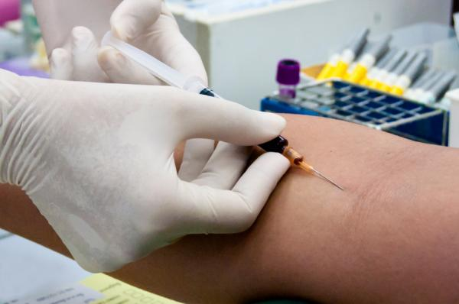
Diagnostic Laboratory Tests
Specimens
Blood should be taken for culture, biopsy material for culture (lymph nodes, bone, etc), and serum for serologic tests.

Slide 11
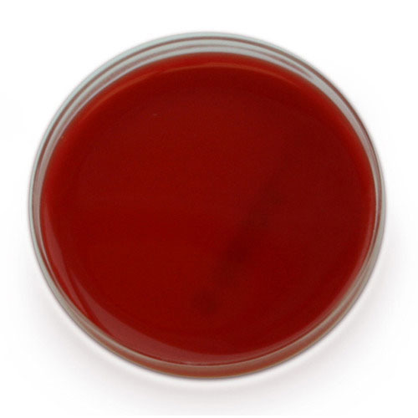
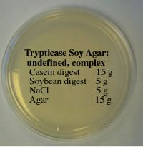
Culture
Brucella agar was specifically designed to culture Brucella species bacteria. The Brucella species bacteria will grow on commonly used media, including trypticase-soy medium with or without 5% sheep blood, brain heart infusion medium, and chocolate agar.
Negative cultures for Brucella do not exclude the disease because brucellae can be cultivated from patients only during the acute phase of the illness or during recurrence of activity.

Slide 12
Serology
IgM antibody levels rise during the first week of acute illness, peak at 3 months, and may persist during chronic disease. Even with appropriate antibiotic therapy, high IgM levels may persist for up to 2 years in a small percentage of patients. IgG antibody levels rise about 3 weeks after onset of acute disease, peak at 6–8 weeks, and remain high during chronic disease.

Slide 13
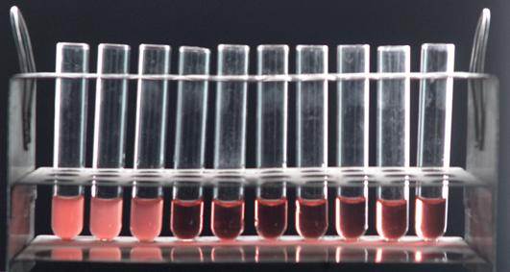
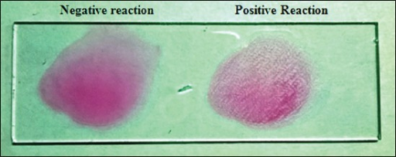
Serology
1. Agglutination test: To be reliable, serum agglutination tests must be performed with standardized heat-killed, phenolized, smooth Brucella antigens. IgG agglutinin titers above 1:80 indicate active infection. Brucellosis agglutinins are cross-reactive with tularemia agglutinins, and tests for both diseases should be done on positive sera; usually, the titer for one disease will be much higher than that for the other.

Slide 14
Serology
2. Blocking antibodies—These are IgA antibodies that interfere with agglutination by IgG and IgM and cause a serologic test to be negative in low serum dilutions (prozone) although positive in higher dilutions. These antibodies appear during the subacute stage of infection, tend to persist for many years independently of activity of infection, and are detected by the Coombs antiglobulin method.
3. ELISA assays—IgG, IgA, and IgM antibodies may be detected using ELISA assays, which use cytoplasmic proteins as antigens. These assays tend to be more sensitive and specific than the agglutination test.

Slide 15
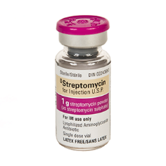
Treatment
Brucellae may be susceptible to tetracyclines or ampicillin. Symptomatic relief may occur within a few days after treatment with these drugs is begun. However, because of their intracellular location, the organisms are not readily eradicated completely from the host. For best results, treatment must be prolonged. Combined treatment with a tetracycline (such as doxycycline) and either streptomycin for 2–3 weeks or rifampin for 6 weeks is recommended.

Slide 16
Epidemiology, Prevention, & Control
Brucellae are animal pathogens transmitted to humans by accidental contact with infected animal feces, urine, milk, and tissues. The common sources of infection for humans are unpasteurized milk, milk products, and cheese, and occupational contact (eg, farmers, veterinarians, and slaughterhouse workers) with infected animals.
Cheese made from unpasteurized goat's milk is a particularly common vehicle for transmission of brucellosis. Occasionally the airborne route may be important. Because of occupational contact, Brucella infection is much more frequent in men. The majority of infections remain asymptomatic (latent).

Slide 17
Epidemiology, Prevention, & Control
Infection rates vary greatly with different animals and in different countries. Eradication of brucellosis in cattle can be attempted by test and slaughter, active immunization of heifers with avirulent live strain 19, or combined testing, segregation, and immunization. Cattle are examined by means of agglutination tests.
Active immunization of humans against Brucella infection is experimental. Control rests on limitation of spread and possible eradication of animal infection, pasteurization of milk and milk products, and reduction of occupational hazards wherever possible.

Slide 18
Thank You

