Slide 1
Solubility product constant for slightly soluble salt
Assistant Lecturer Hiba Sabah
Assistant Lecturer Sura Zuhair
Assistant Lecturer Zeina Dawoad

Slide 2

Introduction
When slightly soluble electrolyte is dissolved to form saturated solution, the solubility is described by special constant known as solubility product constant Ksp.
The aim of this experiment is to determine the Ksp for KHT (potassium acid tartrate).
silver chloride (Agcl) is an example of such slightly soluble salt. It is the excess solid in equilibrium with the ion in saturated solution at specific temperature

Slide 3
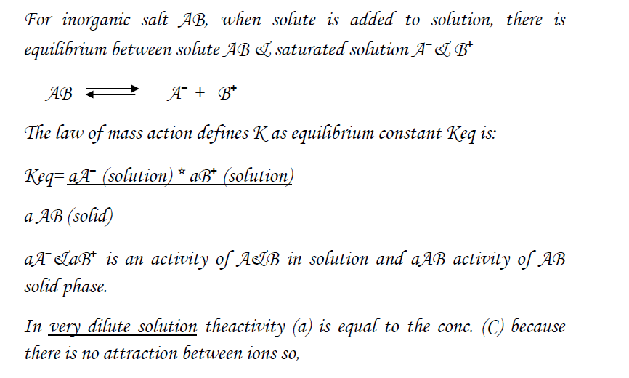

Slide 4
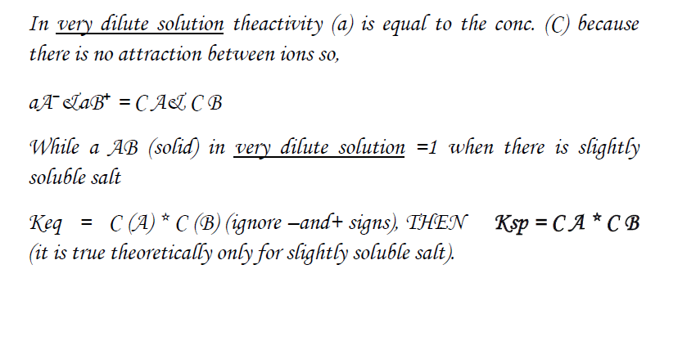

Slide 5
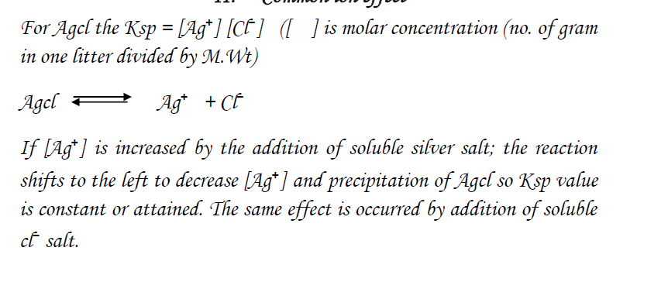

Slide 6
Factors affecting Ksp
1-Temperature: - Ksp is increased with increasing the temperature.
2- Common ion: - increasing the concentration of any ion in solution is leading to decrease the solubility (except if the ion forms soluble complex with the salt).

Slide 7
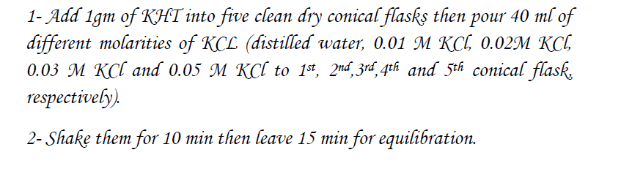
Experimental work

Slide 8
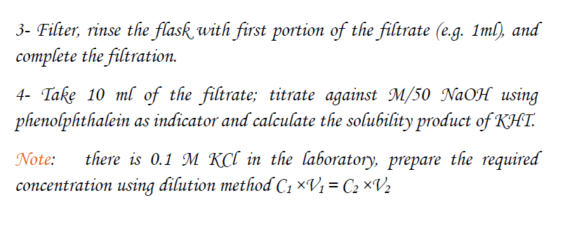

Slide 9
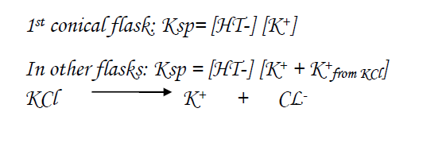
Calculation

Slide 10
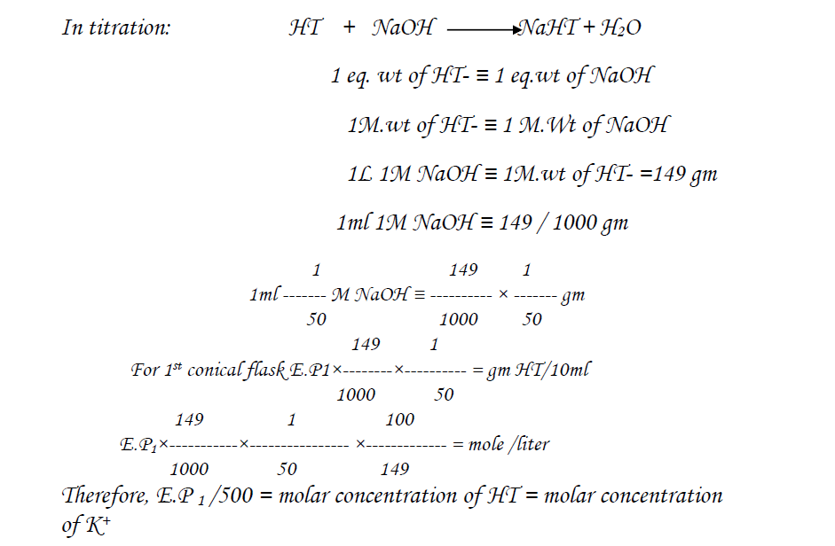

Slide 11
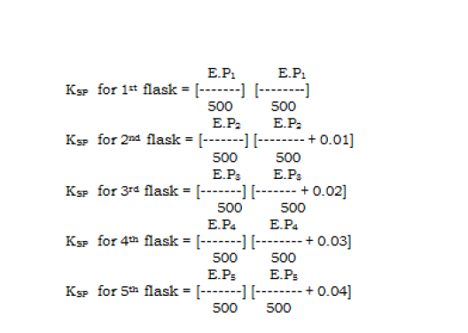

Slide 12
We saw that the K_{sp} for Ca₃(PO₄)₂ is 2.07 × 10⁻³³ at 25°C. Calculate the aqueous solubility of Ca₃(PO₄)₂ in terms of the following:
the molarity of ions produced in solution
Ca₃(PO₄)₂(s) ⇌ 3Ca²⁺(aq) + 2PO₄³⁻(aq)
Ca3(PO4)2 | [Ca2+] | [PO₄³⁻]
initial | pure solid | 0 | 0
change | — | +3x | +2x
final | pure solid | 3x | 2x
Answer: [PO₄³⁻] = 2.28 × 10⁻⁷ and [Ca²⁺] = 3.42 × 10⁻⁷.

Slide 13
The solubility product of silver carbonate (Ag₂CO₃) is 8.46 × 10⁻¹² at 25°C. Calculate the following:
A- the molarity of a saturated solution
B- the mass of silver carbonate that will dissolve in 100 mL of water at this temperature
Answer:
A- 1.28 × 10⁻⁴ M
B- 3.54 mg

