Slide 1
GIT problems II

Slide 2
Hemorrhoids
also known as piles.
abnormally dilated, swollen, bulging of hemorrhoidal vessels and the overlying skin in the anorectal region.

Slide 3
Etiology
Anatomical (degeneration of elastic tissue),
Physiological (increased anal canal pressure),
Mechanical (increase pressure inside abdomen).
Exacerbated Factors:
Constipation, inadequate dietary fiber or fluid intake.
Pregnancy is believed to precipitate hemorrhoids in susceptible women.

Slide 4
Types of hemorrhoids

Slide 5
Internal Haemorrhoid
Grade I, do not prolapse out of the anal canal;
Grade II, prolapse on defecation but reduce spontaneously;
Grade III, require manual reduction; and
Grade IV, cannot be reduced.

Slide 6
Patient Assessment (Specific questions to ask)
Duration and previous history
Pain (not continuous)
Itching (perianal area)
Bleeding (with stool or not)
Constipation
Associated symptoms (pain, vomiting, loss of appetite, tenesmus (desire to defecate when there is no stool), seepage (involuntary passage of fecal material).

Slide 7
When to Refer
Duration of longer than 3 weeks.
Presence of blood in the stools.
Change in bowel habit (persisting alteration from normal bowel habit).
Suspected drug-induced constipation.
Associated abdominal pain/vomiting.
If symptoms have not improved with OTC medication after 1 week.

Slide 8
Management
Non-pharmacological Advices
Increase the amount of fiber and fluid in the diet.
Avoid lifting heavy object.
Avoid delaying the urge to defecate.
Avoid prolonged sitting in the toilet to reduce straining and pressure on the hemorrhoids vessels.
Wash the perianal area with warm water after each bowel movement. In addition many patients find that warm bath soothes their discomfort.

Slide 9
Pharmacological Therapy

Slide 10
The OTC local products for hemorrhoids
Type | Example(s) | Purpose (and mechanism)
Anesthetics | Lidocaine, benzocaine | Reduce pain and itching
Astringents | Bismuth, zinc | Precipitate the surface protein producing coat over hemorrhoids to reduce itching, irritation,..
Anti-inflammatory | Hydrocortisone (the only OTC) | Reduce inflammation and swelling to relief Pain and itching.
Protectants | Zinc oxide, AL-hydroxide, calamine, shark liver oil | Form a barrier on skin to prevent irritation, itching, and loss of moisture.
Antiseptics | resorcinol | Antiseptic.
Counter-irritants | menthol | Give tingling sensation to overcome pain and itching.
Vasoconstrictor | Phenylphrine, ephedrine… | Reduce swelling to relief pain and itching.

Slide 11
Laxatives
The short-term use of a laxative to relieve constipation might be considered.
A stimulant laxative (e.g. senna) could be supplied for 1 or 2 days.
dietary fiber and fluids are being increased.
For patients who cannot or choose not to adapt their diet, bulk laxatives may be used long term.

Slide 13
Heartburn
Gastro-esophageal reflux disease (GERD) = Reflux Esophagitis = Heartburn.
Reflux of gastric contents, particularly acid, into the esophagus.
Typically a burning discomfort/pain felt in the stomach
Unlike the stomach lining, the esophageal mucosa has no protection against gastric acid and readily irritated by acid.

Slide 14
Patient assessment with GERD
Age
Symptoms
Severity of pain
Difficulty in swallowing and regurgitation
Pregnancy

Slide 15
Precipitating or aggravating factors…
Bending or lying down.
Overweight.
After large meal.
Pregnancy (mechanical and hormonal influence).
It can be aggravated or even caused by belching.

Slide 16
Medication
What had been tried to treat the condition.
Some drugs may cause GERD and may also lead to an increase in existing GERD symptoms and signs:
Reduction in lower esophageal sphincter pressure (LESP) (anticholinergics, tricyclic antidepressants).
Delayed gastric emptying (calcium channel blockers).
Damage or inflammation in the esophageal (NSAID).

Slide 17
When to refer
Failure to respond to antacids
Pain radiating to arms
Difficulty in swallowing
Regurgitation
Long duration
Increasing severity
Children

Slide 18
Treatment Timescale (1 week)
Non-pharmacological advices
Eat small and frequent meals
Avoid lying down within 3 hours of a meal.
Wear loose fitting clothing
Avoid smoking and foods that exacerbate symptoms of GERD.
Weight reduction should be advised.

Slide 19
Pharmacological Treatment
Antacids
Alginates
H2 antagonists (Cimetidine, Nizatidine, Famotidine and Ranitidine)
Proton pump inhibitors (Omeprazole, Lansoprazole and Esomeprazole)

Slide 22
Indigestion
Many patients use the terms indigestion and heartburn interchangeably.
The discomfort of dyspepsia is variably described as a pain, distension, or feeling of fullness, but is generally not burning in nature.

Slide 23
Patient Assessment
Age
Symptoms (upper to lower abdominal discomfort)
Diet & Smoking
Details of pain/ associated symptoms
Medication

Slide 24
Interrelated Symptoms

Slide 25
Duodenal Ulcer
Pain is localised to the upper abdomen, slightly to the right of the midline.
It is often possible to point to the site of pain with a single finger.
The pain is dull and is most likely to occur when the stomach is empty, especially at night.
It is relieved by food (although it may be aggravated by fatty foods) and antacids.
Gastric Ulcer
It is often aggravated by food and may be associated with nausea and vomiting.
Appetite is usually reduced and the symptoms are persistent and severe.
same site of pain.

Slide 26
Gallstones
Stones can become temporarily stuck in the opening to the bile duct as the gall bladder contracts.
This causes severe pain (biliary colic) in the upper abdomen.
Confused with that of a duodenal ulcer.
Biliary colic may be precipitated by a fatty meal.

Slide 27
Gastro-oesophageal Reflux The symptoms are typically described as heartburn arising in the upper abdomen passing upwards behind the breastbone. It is often precipitated by a large meal or by bending and lying down.
Irritable bowel syndrome
Pain is often occur in the lower abdominal but it may be upper abdominal and therefore confused with indigestion.
There is usually an alteration in bowel habit (alternating constipation and diarrhoea).

Slide 28
Atypical angina Angina is usually experienced as a tight, painful constricting band across the middle of the chest. Atypical angina pain may be felt in the lower chest or upper abdomen. It is likely to be precipitated by exercise or exertion.
Appendicitis
Starts centrally and radiates to right iliac fossa after some time.
More serious disorders
Persisting upper abdominal pain with anorexia and unexplained weight loss.
Ulcers start bleeding, which may present with blood in the vomit (haematemesis) or in the stool (melaena).

Slide 29
When to refer
Age over 45 years if symptoms develop for first time
Symptoms are persistent (longer than 5 days) or recurrent
Pain is severe
Blood in vomit or stool
Pain worsens on effort
Persistent vomiting
Treatment has failed
Adverse drug reaction is suspected
Associated weight loss
Children

Slide 30
Treatment timescale 5 days
Antacids
H2 antagonists
Dimeticone
Domperidone

Slide 31
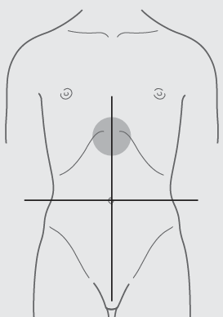
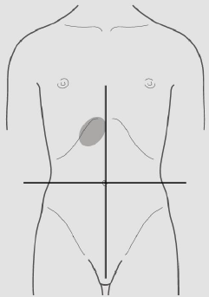
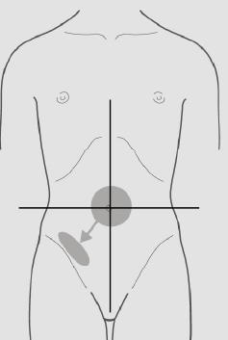
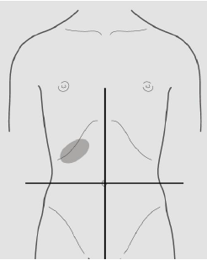
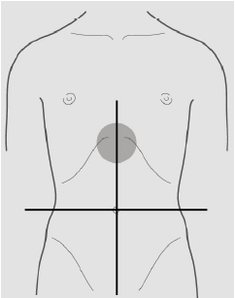
The position of pain in appendicitis
The position of pain in ulcers
The position of pain in GERD
The position of pain in gallstone
The position of pain in dyspepsia

