Slide 2
Skin Conditions II

Slide 3
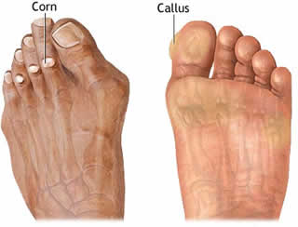
Corn and Calluses

Slide 4
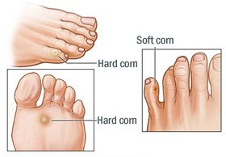
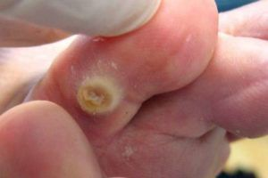
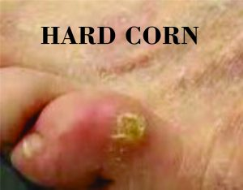

Slide 6
Treatment
Non-pharmacologic Therapy
A-Selection of the properly fitted footwear.
B-Epidermabrasion.
Pharmacologic Therapy
Salicylic acid

Slide 9
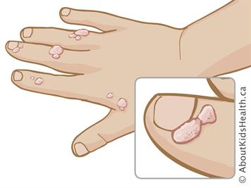
Warts and Verrucae
Bening growth of the skin caused by Human Papilloma Virus (HPV)

Slide 10
Common Warts grow most often on the hands

Slide 11
Plantar Warts/ Verrucae grow on the soles of the feet

Slide 12
Anogenital Warts caused by another Strain of the HPV REFERAL

Slide 13
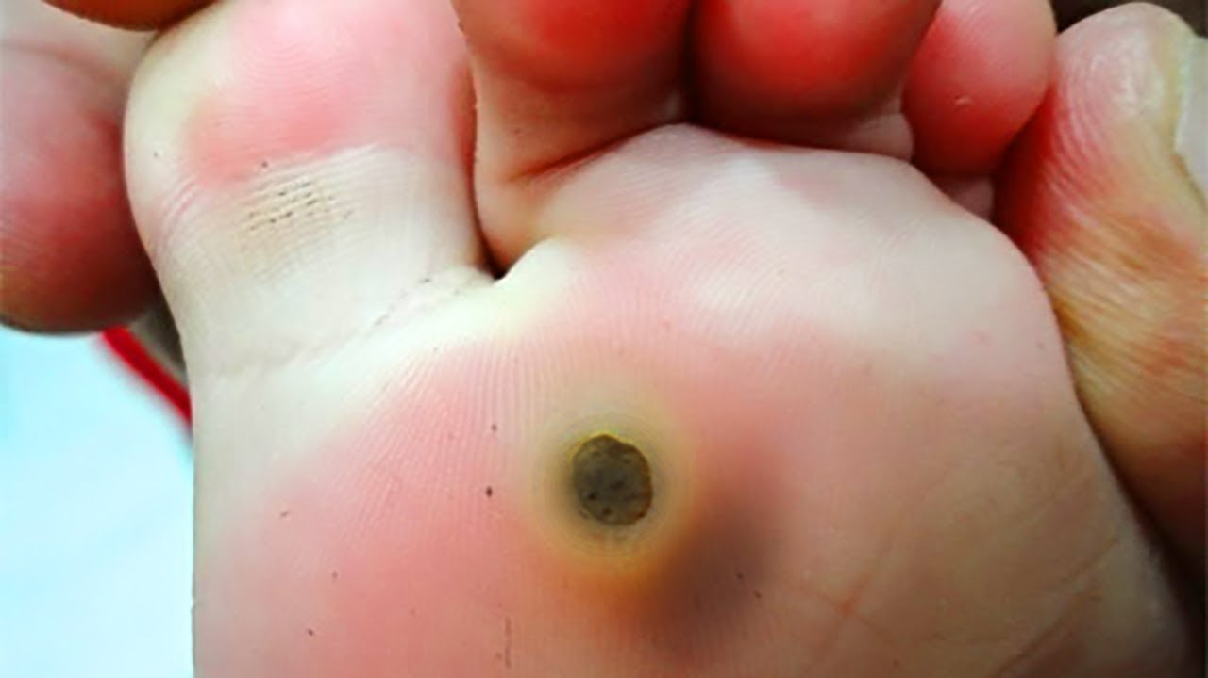
Plantar warts vs Callus

Slide 14
Patient Assessment
Age
Appearance
Location
Duration and history
Medical & Medication History

Slide 15
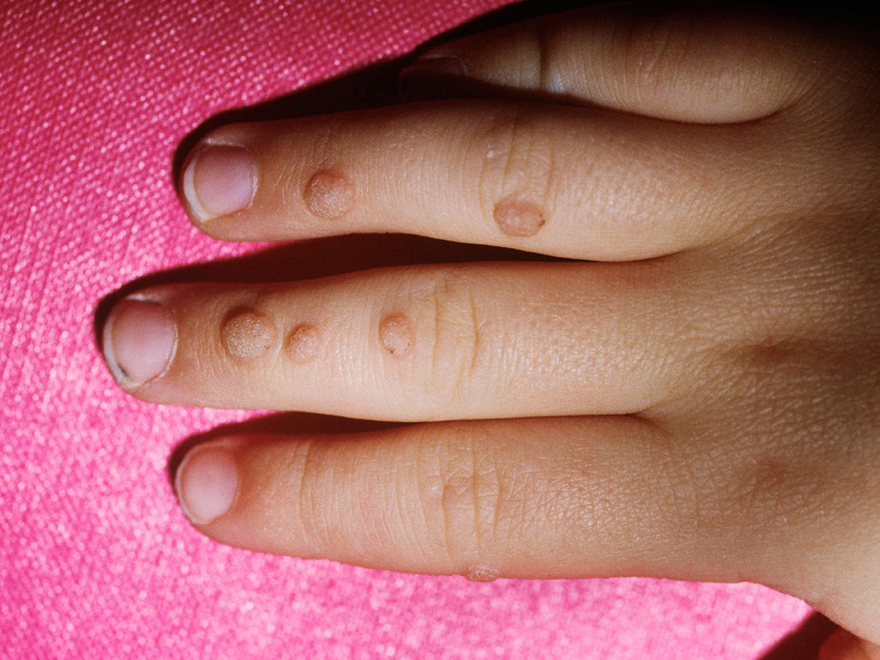
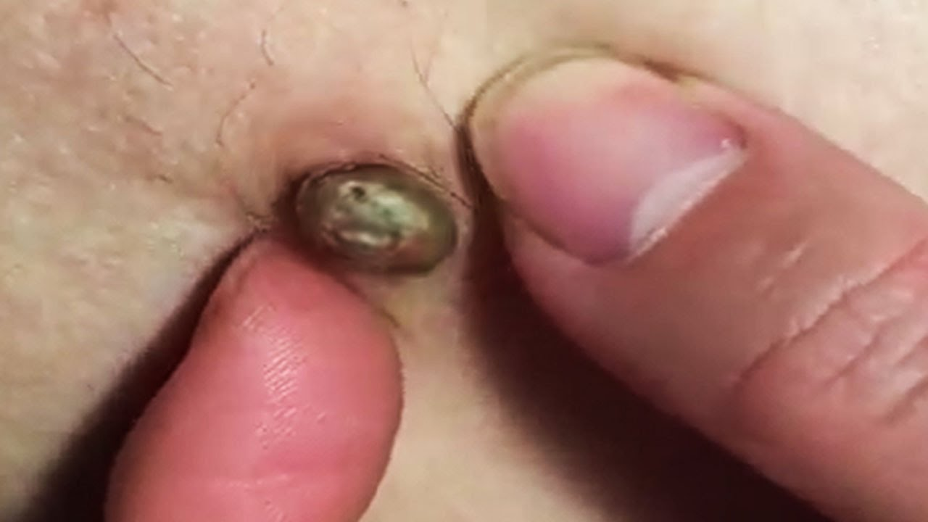
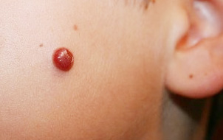
When to refer
Children
Facial warts
Changed appearance/ Bleeding

Slide 16
Diabetic and Immunocompromised Patients…REFERAL

Slide 17
Treatment timescale 3 months on OTC
A- Aim 1: for warts, to reduce the size of the lesion by gradual destruction of the skin.
Salicylic acid
Cryotherapy
Formaldehyde & Glutaraldehyde

Slide 18
B- Aim 2: for genital warts act as immune response modifier
Aldara (imiquimod)
Molutrex
C- Drug act by preventing the wart cells from dividing and multiplying
Podophyllin (podophyllotoxin)

Slide 19
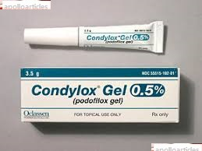
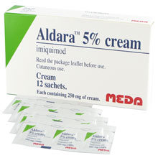

Slide 20
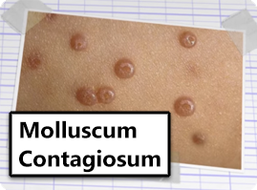
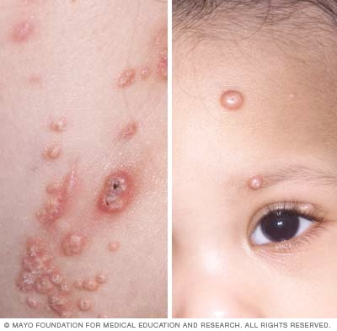
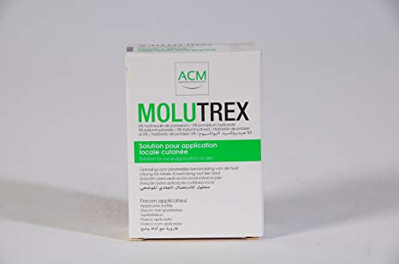

Slide 21
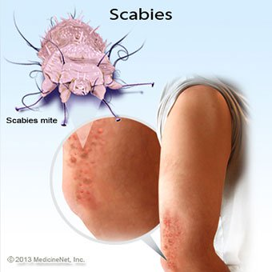
Scabies
pruritic skin condition
direct physical contact
Long Inocubation period

Slide 22
Patient Assessment
Age
Symptoms
Signs of infection
Medication History

Slide 24
When to refer
Babies and children under 2 years
Infected skin
Treatment failure
Unclear diagnosis

Slide 25
Management
Permethrin (5% cream)
Malathion
Benzyl benzoate (25% in an emulsion basis)
Crotamiton (Eurax®)

Slide 26
Psoriasis

Slide 27
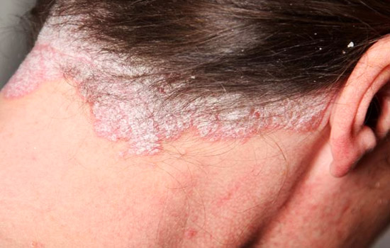
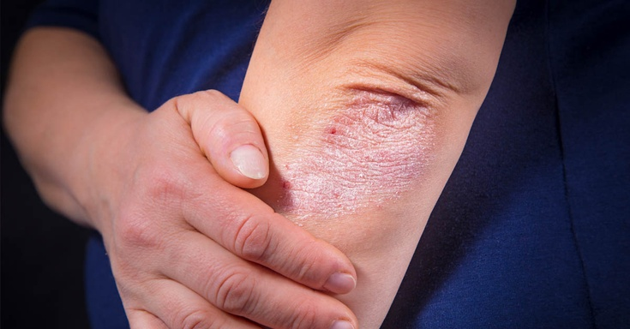
Appearance & Location

Slide 28
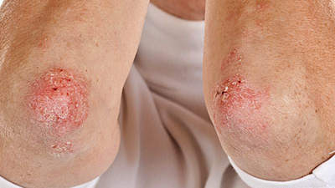
Symmetrical patches

Slide 29
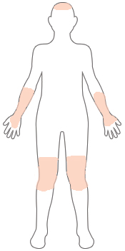
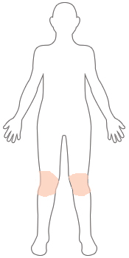
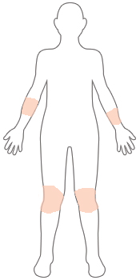
Severity
MILD
Mild psoriasis covers less than 3 percent of the body.
MODERATE
Moderate psoriasis covers between 3 and 10 percent of the body.
SEVERE
If psoriasis covers more than 10 percent of your body, it is severe.

Slide 30
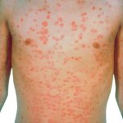
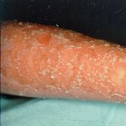
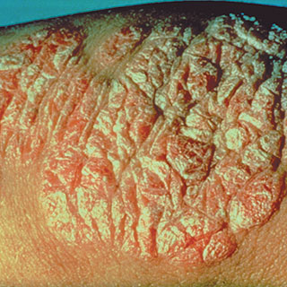
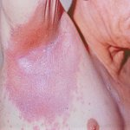
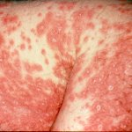
Types of Psoriasis
Guttate
Pustular
Plaque
Inverse
Erythrodermic

Slide 31
Topical treatments
Calcipotriol or Tacalcitol
Topical steroids
Dithranol
Second-line treatment.. Phototherapy, Methotrexate

