Slide 1
Skin Conditions I

Slide 2
Fungal Skin Infection/ Athlete’s foot
Site | Name
Scalp | Tinea capitis
Feet | Tinea pedis
Groin | Tinea cruris
Body | Tinea corporis
Nails | Tinea unguium (onychomycosis)

Slide 3
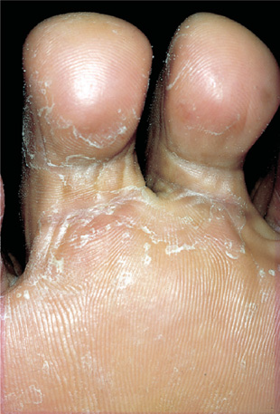
The fungus that causes the disease thrives in warm, moist conditions.
The problem is more common in men than in women and responds well to OTC treatment.

Slide 4
Patient Assessment
Appearance
Severity
Location
Previous history
Medication

Slide 5
When to Refer
Severe, affecting other parts of the foot
Signs of bacterial infection
Unresponsive to appropriate treatment
Diabetic patients
Involvement of toenails

Slide 6
Management 2 weeks
Pharmacists should instruct patients on how to use the treatment correctly to prevent recurrence.
Clean and dry your feet.
treatment must be continued for 1–2 weeks after the disappearance of all signs of infection to ensure eradication of the fungus

Slide 7
Azoles (Miconazole, clotrimazole, ketconazole) Terbinafine Griseofulvin Tolnaftate Undecenoates (e.g. zinc undecenoate) Hydrocortisone
Topical Anti-fungal

Slide 8
Eczema/dermatitis
Skin conditions characterized by dryness, erythema, and itch of the skin, often with weeping and crusting.
Contact dermatitis (irritation or allergy).
Atopic eczema (with endogenous cause ).

Slide 9
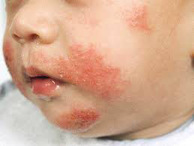
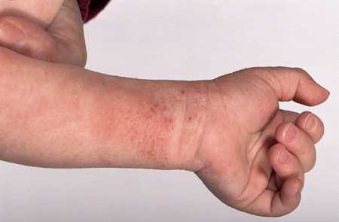
Contact dermatitis & Atopic eczema
Typical eczema dermatitis rash
Atopic eczema.

Slide 10
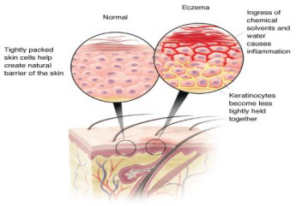

Slide 11
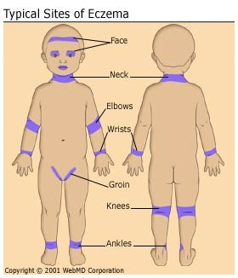

Slide 12
Patient assessment
Age/distribution
Occupation/contact
History of hay fever/asthma
Severity…

Slide 13
Aggravating Factors
hay-fever season.
house dust or animal danders.
soaps or detergents and cold wind (dry the skin ).
Certain clothing such as woollen material can irritate the skin.
Cow’s milk, eggs and some food colouring.
Emotional factors, stress and worry.
Antiseptic solutions applied directly to the skin or added to the bathwater.

Slide 14
Medication
Contact dermatitis may be caused or made worse by sensitisation to topical medicaments.
Topically applied local anaesthetics, antihistamines, antibiotics and antiseptics can all provoke allergic dermatitis. Some preservatives may cause sensitisation.
Failed medication need referral.

Slide 15
When to refer
Evidence of infection (weeping, crusting, spreading)
Severe condition: badly fissured/cracked skin, bleeding
Failed medication
No identifiable cause (unless previously diagnosed as eczema)
Duration of longer than 2 weeks

Slide 16
Treatment Timescale (1 week)
Non-pharmacological advices
Managing the itch
Avoiding the irritant (e.g.: wearing gloves to protect the skin).
Maintaining the skin integrity.

Slide 17
Pharmacological Treatment
Emollients
Topical corticosteroids
Antipruritics

Slide 18
Acne
Acne vulgaris is a common condition in young people.
It is not usually serious and resolves in most patients by the age of 25.
Peak incidence of acne is 14–17 years in females and 16–19 years in males.
The condition normally resolves in the majority of patients within 10 years of onset.

Slide 20
Etiology
The hormonal changes especially the production of androgens.
Increased keratin and sebum production during adolescence leads to blockages of the follicles and the formation of microcomedones.
A microcomedone can develop into a non-inflammatory lesion (comedone), which may be open (blackhead) or closed (whitehead), or into an inflammatory lesion (papule, pustule or nodule).
Excess sebum encourages the growth of bacteria, particularly Propionibacterium acnes, which are involved in the development of inflammatory lesions.

Slide 21
Patient Assessment
Age
Severity…
Affected areas
Medication

Slide 22
Severity
Mild acne: Patients with predominately open and closed comedones with few inflammatory (papulopustular) lesions mainly confined to the face. Mild acne is therefore characterized by the presence of a few to several papules and pustules the, but not nodules
Moderate acne: A patient with moderate acne has many inflammatory lesions that are not confined to the face. Lesions are often painful and there is a possibility of mild scaring.
Severe acne: A patient with severe acne has all the characteristics of moderate acne plus the development of cysts. Lesions are often widespread involving the upper back and chest. Scarring will usually result.

Slide 23
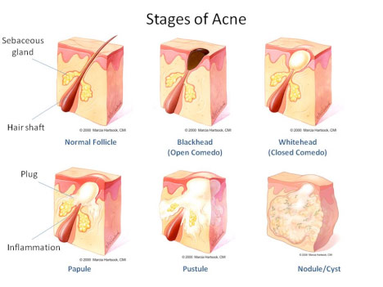

Slide 24
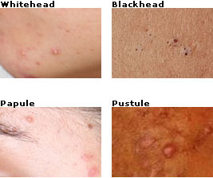

Slide 25
When to refer
Moderate and Severe acne
Failed medication
Suspected drug-induced acne

Slide 26
Management
Benzoyl peroxide (2.5%, 5%, and 10% gels, lotion, cream)
Antibacterials
Topical Retinoids (Adapalene/ Differin Gel 0.1%)

Slide 27
Practical points
Diet
Continuous treatment
Skin hygiene
Topical hydrocortisone and acne

Slide 28
Treatment timescale improved within 8 weeks
Only mild acne can be managed by the pharmacist using OTC products, moderate and severe acne should be referred.

Slide 29
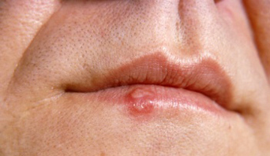
Cold Sore
The virus responsible is the herpes simplex virus (HSV) of which there are two major types: HSV1 and HSV2.

Slide 30
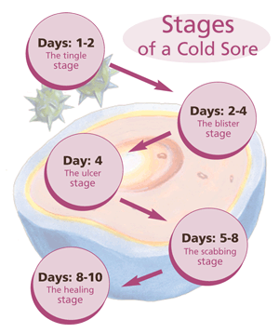

Slide 31
Patient Assessment
Age and Duration
Symptoms and appearance
Location
Precipitating factors
Previous history (help in diagnosis)
Medication

Slide 32
When to refer
Babies and young children
Failure of an established sore to resolve
Severe or worsening sore (widespread)
History of frequent cold sores
Sore lasting longer than 2 weeks
Painless sore (like in oral cancer)
Patients with atopic eczema
Eye affected
Uncertain diagnosis
Immunocompromised patient

Slide 33
Management
Aciclovir and Penciclovir cream
Bland creams (e.g. cetrimide/ celavex cream)
Hydrocolloid patch

Slide 34
Advices to preventing cross-infection

