Slide 1
Clinical pharmacy lab (first course) 4th stage students skin part 1
Assistant lecturers zahraa abdulGhani lubab Tareq Nafea MSc in clinical pharmacy

Slide 2
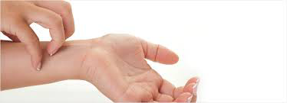
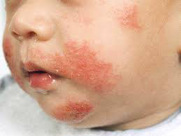

Slide 3
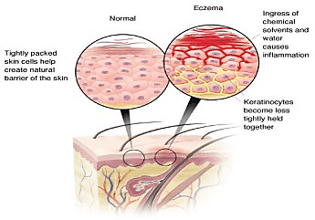

Slide 5
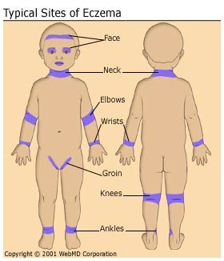

Slide 6
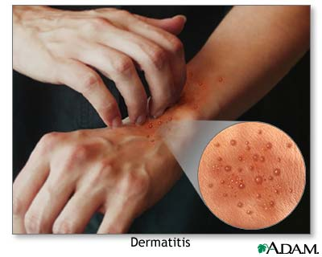
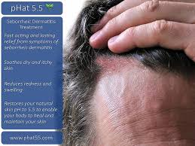
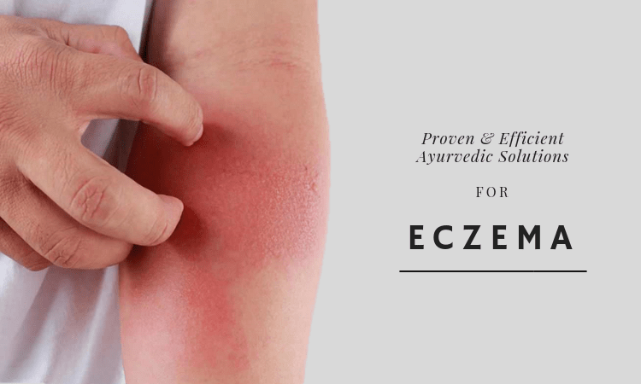
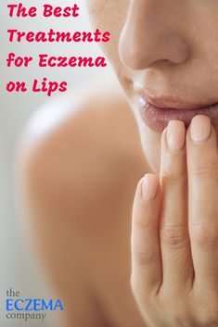
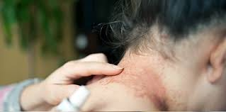
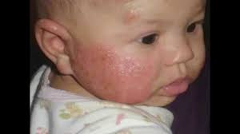
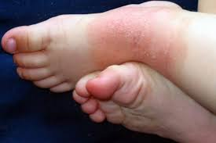
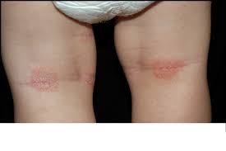

Slide 7
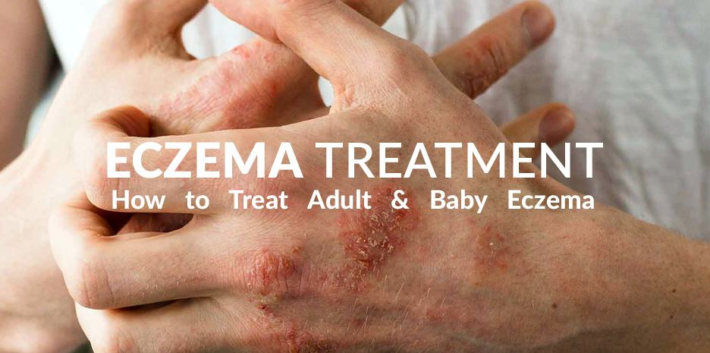
1- Emollient 2- Topical Corticosteroid 3- Antipruritics
Treatment

Slide 8
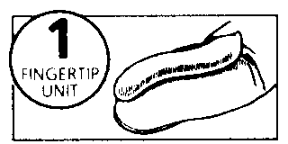
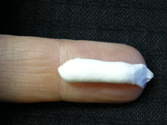
Topical CS

Slide 9
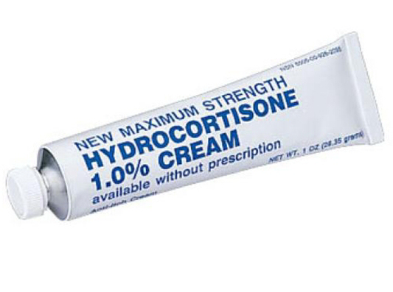

Slide 10
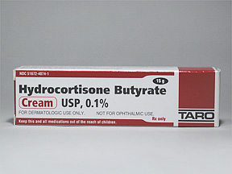

Slide 11
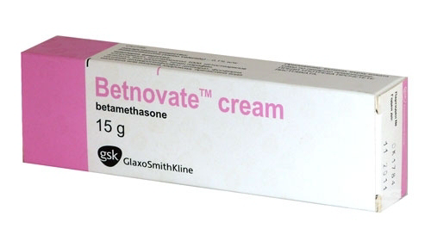
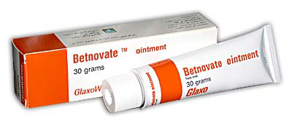

Slide 12
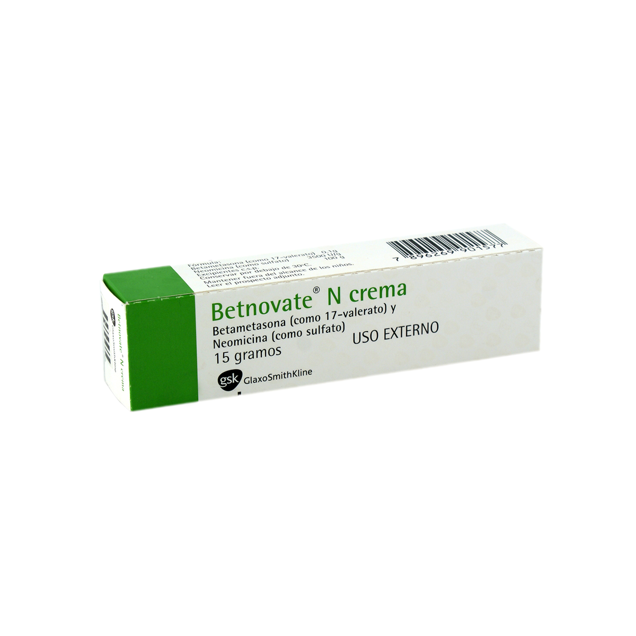
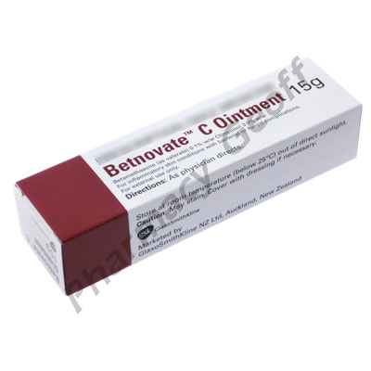

Slide 13
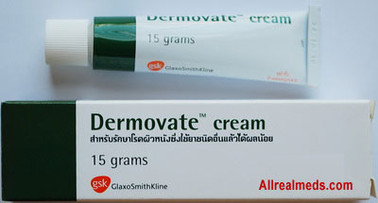
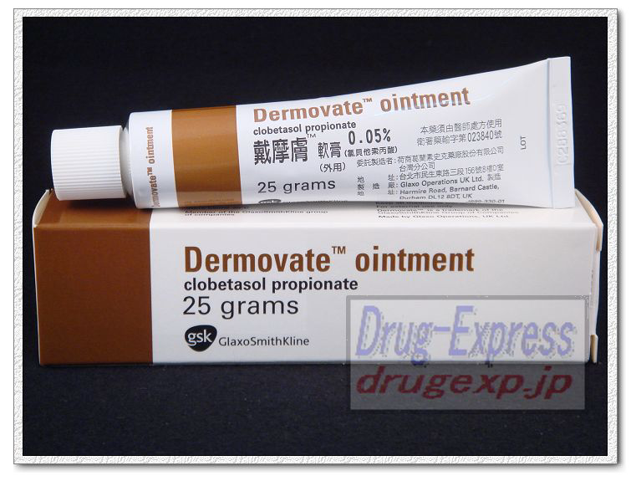

Slide 14
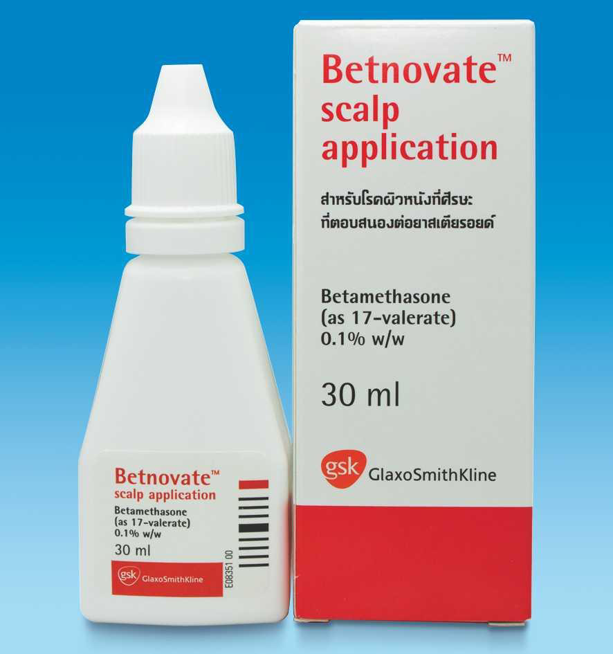
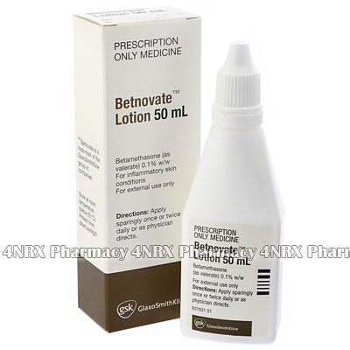

Slide 15
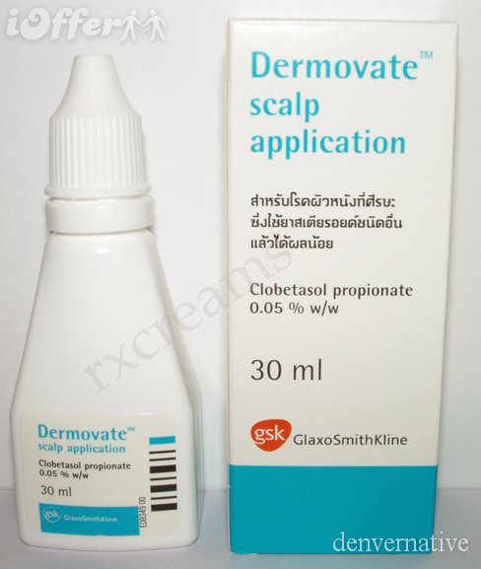

Slide 16
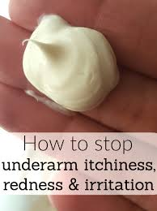
Anti-pruritis

Slide 17
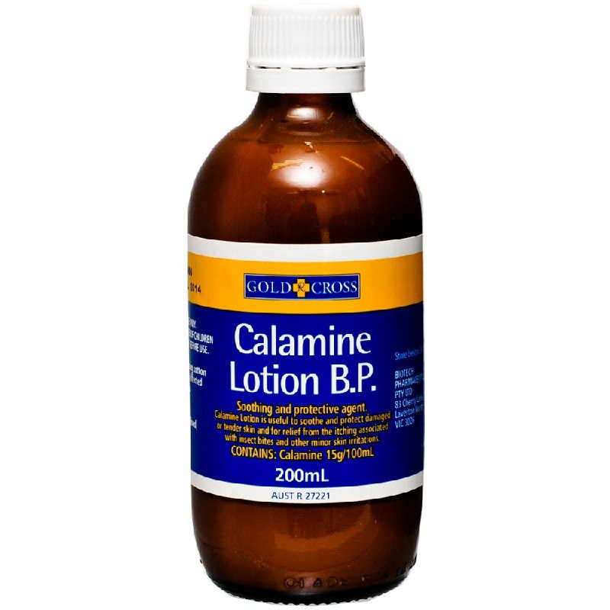

Slide 18
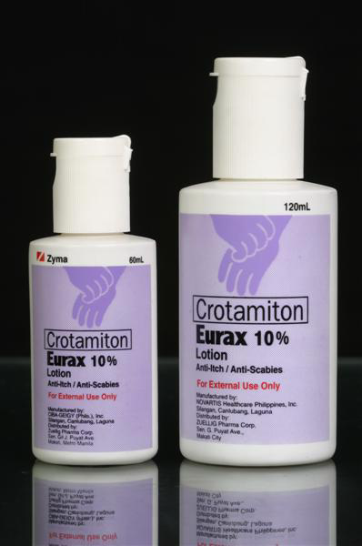
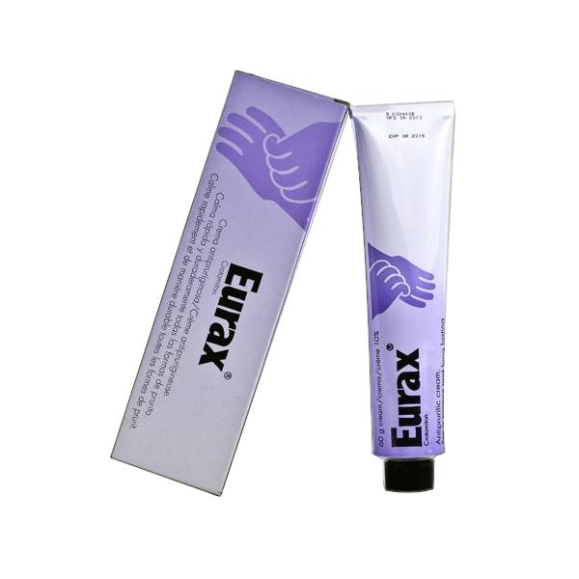

Slide 19
Dandruff

Slide 20
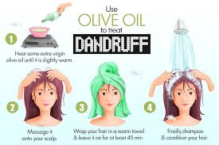
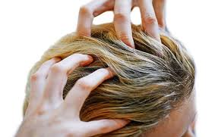
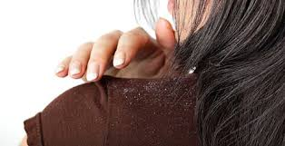
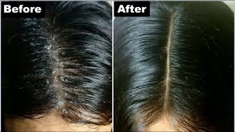
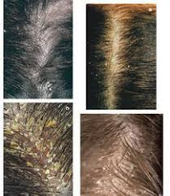

Slide 21
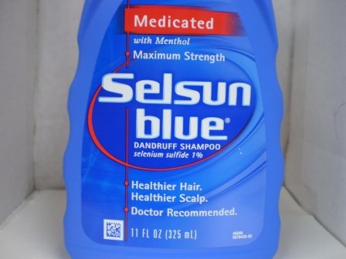
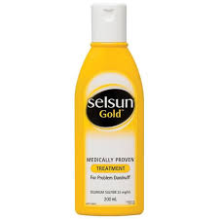
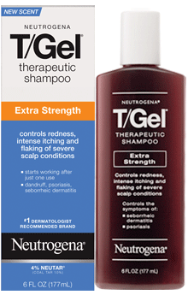
Anti- Dandruff

Slide 22
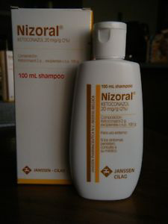

Slide 23
Hair Loss

Slide 24
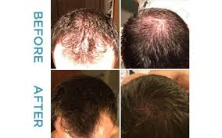
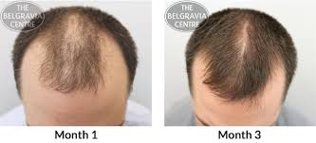

Slide 25
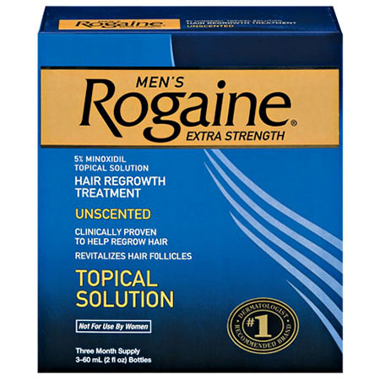
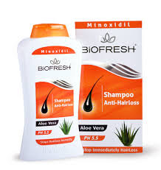
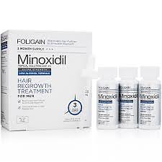
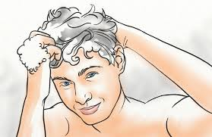
Hair Loss

Slide 26
Acne

Slide 28
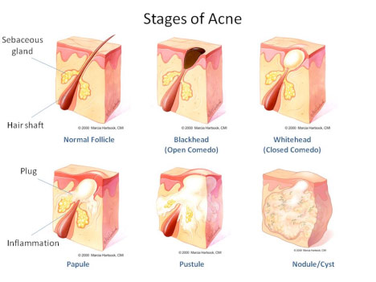

Slide 29
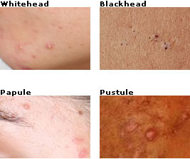

Slide 30
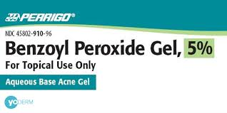
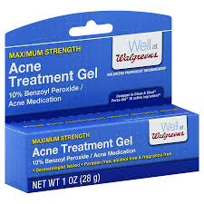
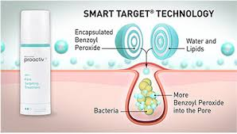

Slide 35
CHILDHOOD CONDITIONS

Slide 37
Thrush(candidosis) is a fungal infection caused by Candida albicans which occurs commonly in the mouth (oral thrush).It may also occurs in the nappy area in the babies and in the vagina.
patient assessment with oral thrush:
1-Age:
oral thrush is most common in babies .
In older children and adults it is rarer.-------it may be a sign of immunosuppressant and referral to the Dr. is advisable.
2-Affected area:
oral thrush can occurs anywhere in oral cavity (mainly on the surface of the tongue and insides of the cheeks).
3-Appeareance:
oral thrush occurs as a creamy white soft elevated patches which resemble milk curds( but oral thrush differ from milk curds in that it is not so easily removed and when it is scraped , a sore and reddened area will be seen).
4-Previous history:
patients who experience recurrent infections should be referred for further investigations.
5-Medications:
A- Broad –spectrum antibiotics can predispose to oral thrush .
B-Immunosuppressive Agents: like cytotoxic and steroids( oral or inhaled) can predispose to oral thrush .
Note: Rinsing the mouth with water after the use of inhaled steroid may be helpful.
Treatment timescale
If symptoms are not cleared within a week -------patient should see a Dr.

Slide 39
Management
Miconazole Oral Gel:
It the only (till now)products available as an OTC to treat oral thrush and its appear to have superior cure rate than the POM Nystatin.
Dose for infants and children under 2 years is:
2.5 ml of the gel twice daily after food.
Duration of treatment: for 2 clear days after the symptoms have apparently gone.
Practical points
1- Patients should be advised to hold the gel in the mouth for as long as possible.
2-For young babies , the gel can be applied directly to lesion using a cotton bud or the handle of a teaspoon.
3-treatment may be enhanced by cleaning the white plug off with a cotton bud prior to the application of the gel.
4- The pharmacist should check whether nappy rash is also presents
(in the napkin area , candidal infection present as red papules on the outer edge of the area of napkin rash (satellite papules), another feature is that the skin in the skin folds is nearly always affected).
In this case an antifungal cream containing miconazole or clotrimazole can be used for the nappy area--------see napkin rash later.
5-Where the mother is Breast feeding, a small amount of miconazole gel applied to the nipple will eradicated any fungus present.

Slide 41
Napkin Rash
(diaper dermatitis, nappy rash)

Slide 42
Napkin rash refer to the erythematous rash that appear on the buttock area during infancy.
Contributing factors includes:
1-contact of urine and faeces with the skin.
2-wetness of the skin due to infrequent nappy changes and inadequate skin care.
Patient assessment with napkin rash.
1-location:
napkin rash affect the diaper region(buttock, lower abdomen, and the inner thighs)----------napkin rash that has spread outside the diaper area required referral.
2-severity:
A-in general , if the skin is unbroken and there are no signs of bacterial infection--------treatment may be considered.
B-If signs of bacterial infection is present(weeping, yellow crusting, oozing blood or pus)----------referral.
C-secondary fungal infection is common( characterized by the presence of satellite papules(small red lesions near the perimeter of the affected area)-------recommend one of the OTC azole antifungal (see antifungal later).
3-Duration:
napkin rash of longer than 2 weeks duration may be referred.
4-previous history:
to identify the identity and effectiveness of any products used for the current or previous episodes.
Treatment timescale:
One week.( but see the antifungal later)

Slide 43
Management:
1-Skin care:
a-nappies should be changed as frequently as possible.
b-nappies should be left off wherever possible so that air is able to circulate around the skin and helping in drying the skin.
c-at each nappy changes the skin should be cleansed thoroughly with warm water and then dried carefully. the use of talc powder may be helpful , but the clumping of the powder can lead sometimes to further irritation. Talc powder should be applied to dry skin and dusted lightly over the nappy area.
Note: powder is poured into the hands then gently rubbed onto the skin but keep away from the face of the child to prevent inhalation of the powder which may lead to breathing problems.
2-skin protectants ( Barrier preparation, Emollient ):
(examples: Zinc oxide, castor oil, talc powder, white petrolatum, calamine, cetrimide( celavex® cream: which has antibacterial property also),…….)
They absorb moisture or prevent moisture from coming in contact with the skin (act as a barrier between the skin and outside). Also they serve as a lubricant in area of the skin in which skin-to-skin friction could aggravate diaper rash.
****they are applied at each nappy changes , after cleansing the skin.
****they may be also used regularly as a prophylactic to protect the skin but it may be discontinued periodically (e.g. every other week or four 3-4 days ) to determine whether further use is still necessary .

Slide 44
3-Antifungal:
Secondary fungal infection is common --------if so, recommend one of the topical OTC azole antifungal (miconazole , clotrimazole (Fugidin®))-----apply twice daily:
a-if no improvement after 5 days ------refer to the Dr.
b- if improvement achieved--------continued for 5 days after the disappearance of the symptoms.
c-a protectant cream or ointment can still be applied over the antifungal product.
4-Topical steroid:
Topical steroid especially the most potent: clobetasol(dermodin®), triamcinolone(present in Nystacort®) are commonly misused in Iraq to treat napkin rash (and they are used for long time, and usually applied in large quantity each time) but:
A-potent steroid (clobetasol, betamethasone(betnosam®),triamcinolone,… )are preferably avoided (even by prescription) in infants and children.
B-only the mild steroid(hydrocortisone 1%) and the moderately potent (clobetasone)(not clobetasol) are OTC[[[ for patients aged >10 years in case of hydrocortisone and > 12 years in case of clobetasone)]]].and for short course only.
****However, short course of topical steroid are effective treatment for napkin rash-------therefore when they are prescribed by the Dr., the pharmacist can give the advices about the proper use especially that regarding the amount of the ointment or cream applied each time where:
[[[one fingertip unit-------is sufficient to cover an area that is twice that of the flat adult hand]]].

Slide 45
Management of Napkin rash

