Slide 1
  Drugs in gynecology
  College of medicine
  Gynecological department
  Al Mustansiriyah university

Slide 2
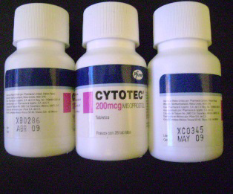
cytotec.
Synthetic prostaglandin E1analoge
Uterotonic drug
Uses:
It is utero tonic drug
1. Used for ripening of cervix in induction of labour
2.Medical management of miscarriage/ IUD
3. termination of pregnancy
4. in prevention & treatment of PPH (800mcg PR/PV)

Slide 3
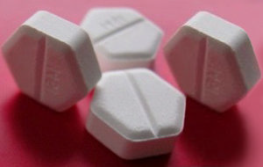
Contraindications?
1. Uterine scar
2. uterine over distenstion
3. Risk of hyperstimulation & rupture uterus
Side effect 1.Nausea
2.vomiting
3.diarrhea
4.fever
5.abdominal pain

Slide 4

Mifepristone(RU 486)
Anti-progestational agents( It is a progesterone receptor antagonist)
Uses:
1. medical termination of intrauterine pregnancies
2. Labor induction in fetal death in utero
3. Treatment of uterine fibroids (decrease fibroid size)
It induced amenorrhea
Side effects:
1. Hyperplasia
2. abdominal pain

Slide 5
3. uterine cramping
4. vaginal bleeding or spotting for an average of 9–16 days
5. Other less common side effects included nausea, vomiting, diarrhea, dizziness, fatigue, and fever.
Contraindications:
1. ectopic pregnancy
2. hemorrhagic disorders
3. anticoagulant or long-term corticosteroid therapy

Slide 6
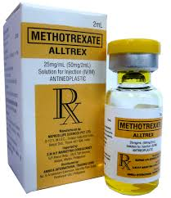
Methotrexate
Chemotherapy ,antimetabolite.
Uses
1. for treatment of persistent trophoblastic disease
2. : Medical management of ectopic pregnancy(Criteria- adenexal mass, non viable pregnancy hCG< 3000U, haemoperitonuem < 150ml)
Dose 50mg per kg/m2
3.early pregnancy termination
4.sever psoriasis.
Side effect:
Dry cough, diarrhea, vomiting ,fever

Slide 7
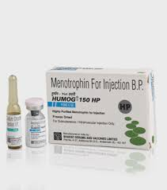
Human menopausal gonadotrophin
:
1. Act by ovarian stimulation to cause multiple follicle development.
2. Used in treatment of infertility. Side effect:
1. multiple pregnancy
2. ovarian hyper stimulation syndrome

Slide 8
Gonadotropin-releasing hormone agonist
Mechanism- Initial stimulation then down regulation of GnRH receptors reducing the release of gonadotrophins and in-turn release of estrogen
& androgen production
E.g Prostap, Zoladex & Buserelin spray
Maximum treatment no more than 6 months
These medications can be administered intranasally, by injection, or by implant, Injectables have been formulated for daily and monthly, and implants can last from 1 to 12 months.

Slide 9
Uses :
1.Endometriosis
2.Chronic pelvic pain
3.Prior to myomectomy- size & bleeding
4.Prior to hysterectomy for fibroids
5.Infertility- pituitary desensitisation before induction of ovulation by gonadotrophin for IVF
6.Menorrhagia in perimenopausal women
7.Precocious puberty
Side effects: these medications cause menopausal like symptoms( hot flushes, night sweats and osteoporosis especially with long term continuous use).

Slide 10
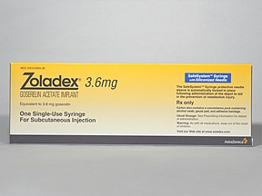
gosereline (Zoladex)
Its GnRH analouge,given by S.C injection in the abdominal area every 28day

Slide 11
Side effect:
Back pain, breast tenderness, hot flush ,headache ,depression ,decreased libido.
Used in treatment of endometriosis, breast cancer, its also used to help thinning of the lining of the uterus before surgery.

Slide 12
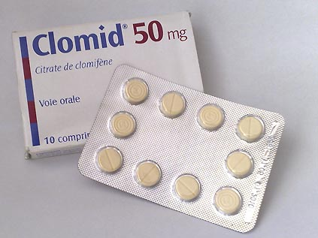
Clomifene citrate
It is a selective estrogen receptor modulator (SERM) that increases production of gonadotropins by inhibiting negative feedback on the hypothalamus.
Administered during follicular phase of menstrual cycle. It act by increasing gonadotrophin release from the pituitary, leading to enhanced follicular recruitment & growth.
. It is effective in inducing ovulation in 85% of women & the current recommendation is for 6 cycles of treatment

Slide 13
It is recommended that tretment are monitered with serial U/S scans to minimize the risk of multiple pregnancy & risk of OHSS.
Adverse effects
1. multiple pregnancy 5-12%
2. OHSS-ovarian hyperstimulation syndrome.
3. hot flushing
4. Headache
5. abdominal discomfort
6. visual blurring
7. Rarely cause reversible alopecia

Slide 14
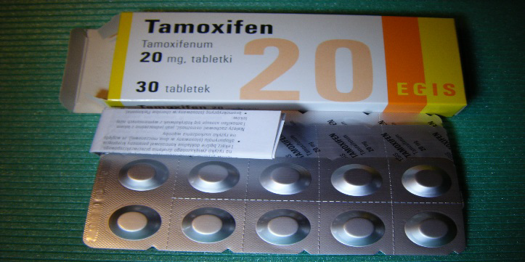
Tamoxifen
Estrogenic and antiestrogenic effects
Estrogen receptor antagonist in breast tissue, treat breast cancer in receptor + patients
Adverse effects
nausea
2. Vomiting
3. hot flashes
4. vaginal bleeding
5. menstrual irregularities

Slide 15
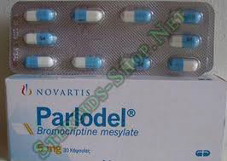
parlodel
Medical treatment of hyperprolactenemia Nonspecific dopamine receptor agonist, bromocriptine (Parlodel) The dopamine receptor type 2 agonist, cabergoline (Dostinex).
Most patients can tolerate bromocriptine if started at a low dose—½ tablet or 0.125 mg—each night to minimize associated nausea and dizziness. This dose can be slowly increased to three times

Slide 16
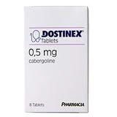
side effects
1. Nausea
2. Vomiting
3. nasal congestion
.Alternative is gabrgoline (dostinex):
Cabergoline has a longer half-life than bromocriptine, allowing once- or twice-weekly dosing compared with the multiple daily doses that may be required for bromocriptine

Slide 17
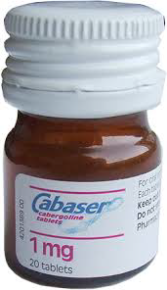
Typical initial cabergoline dosages are 0.25 mg orally twice weekly. Cabergoline has been found to be more effective than bromocriptine in normalizing PRL levels but, cabergoline is expensive Reliable measurement of post treatment serum prolactin levels can be obtained 1 month following a steady medication dose

Slide 18
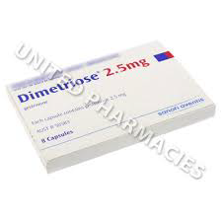
Gestrinone
is a synthetic derivative of 19 nor testosterone with antioestrogenic, antiprogestinic& some androgenic activity
Dose :2.5 mg twice weekly.
Uses: as a treatment for endometriosis. It also has been used to shrink uterine fibroids and to reduce menorrhagia.
Side effects : signs of increased androgen activity such as acne, oily skin, fluid retention, weight gain, hirsutism and voice change.
Contraindications: The drug is contraindicated in pregnancy, during lactation, and in patients with severe cardiac, renal or hepatic insufficiency.

Slide 19
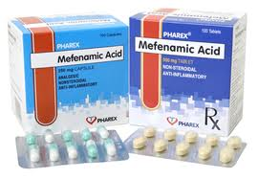
Mefenamic acid:
- NSAID, reduces bleeding by 25%
- Dose: 250-500mg x TDS D1-3 of cycle or PRN
- Side effects: Gastro-intestinal discomfort nausea, diarrhoea, bleeding/ulceration

Slide 20
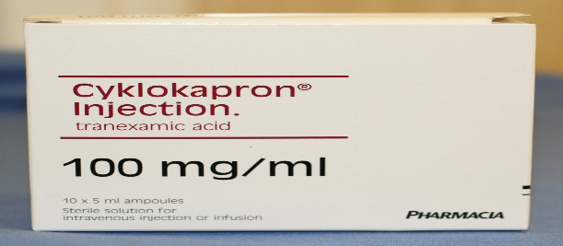
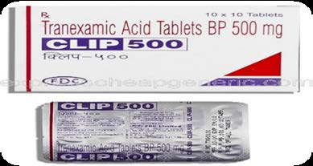
Tranxamic acid :antifibrinlytic agent
Tranexamic acid:
- Antifibrinolytic,reduces bleeding by 50%
- Dose: 1g TDS/QDS D1-4 of cycle
- Contraindication: thromboembolic disease
- Side effects: nausea,vomiting,diarrhoea, thrombo embolic event

Slide 21
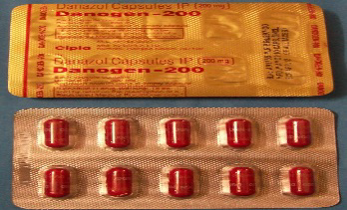
Danazol
Mechanism: Inhibits pituitary gonadotrophin
-antioestrogenic & antiprogestogenic
- androgenic activity
Dose : 200-800mg 4 divided dose for 3-6 month
Clinical use:
- Endometriosis
- Benign fibrocystic disease(breast tenderness)
Side effects: Nausea, headache,dizziness, weight gain, libido changes, androgenic side effects ( acne, oily skin, hair loss,voice changes)

Slide 22


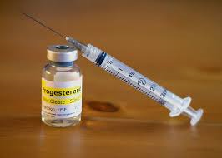
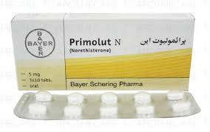
progestogen
Dysfunctional uterine bleeding/menorrhagia-Norethisterone 5mg TDS D5-25 (3ks on/1wk off)
Endometriosis- same dose contin. 9 months
Menorrhagia- Depoprovera, Mirena

Slide 23
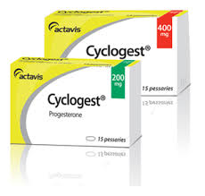
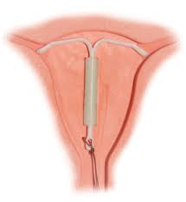
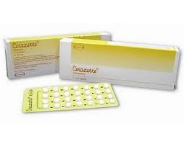
Contraception- Mini pill, Mirena
Induce withdrawal bleeding eg. PCOS ( 10 days Rx)
Endometrial hyperplasia ( except atypical variety)- Depo provera, Mirena
HRT
Women with previous preterm labours -cyclogest pessary 200mg PV/PR daily till 36 weeks
Following IVF/ICSI- Gestone inj + cyclogest pessary

Slide 24
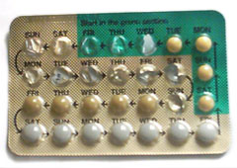
MICROGYNON® 30
MICROGYNON 30 is a combined oral contraceptive
These are levonorgestrel (a progestogen) and ethinyloestradiol (an oestrogen).
Because of the small amount of hormones, MICROGYNON 30 is considered to
be a low-dose combined oral contraceptive preparation.

Slide 25
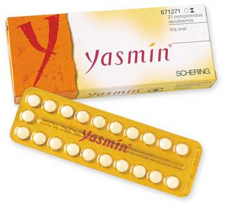
Yasmin
Contain progestagen, drosperinone, that has an anti-androgen effect through:Inhibition of ovarian androgen production. Blockage of androgen receptors.

Slide 26
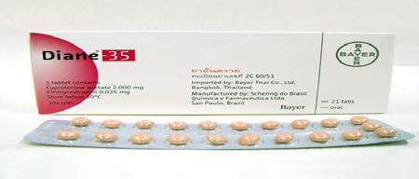
Dianne 35
35 MICROGRAMS Ethinyl estrodial +2 MG cyproterone acetate
Used in treatment of
1. PCO.
2. regulate cycle
3. treat hairsutism

Slide 27
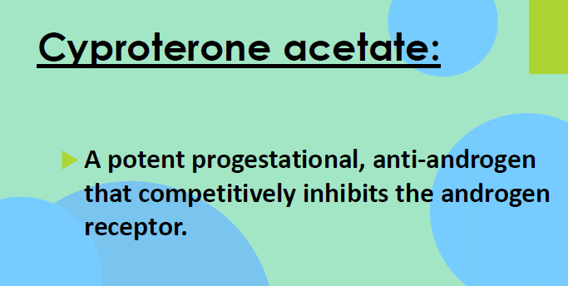

Slide 28
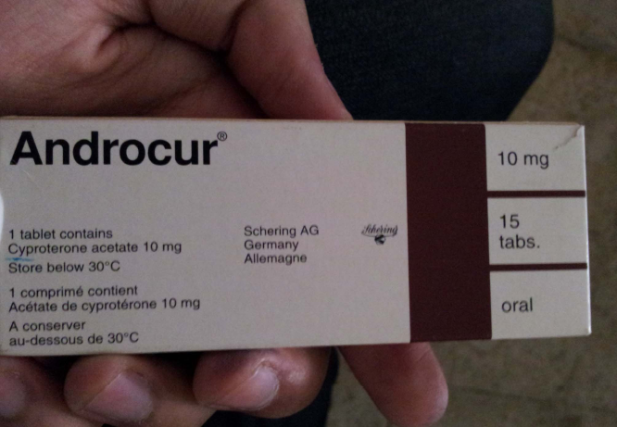

Slide 29

HRT
Benefits:
Systemic therapy- improves vasomotor symp.
- prevents osteoporosis
- Vaginal cream/ pessary - atrophic vaginitis/ urinary symptoms
Risk of HRT:
- Breast Ca
- Ovarian Ca
Endometrial Ca(unopposed E2)
VTE
Stroke
Coronary heart disease

Slide 30
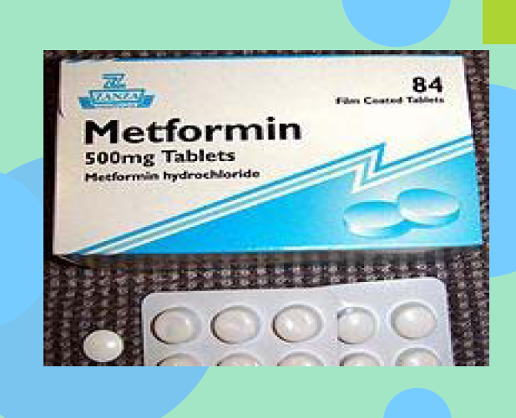

Slide 31


Slide 32


Thank you

