Slide 1
Study of the action of Drugs on Human Eyes
Lab-6
LABORATORY OF PHARMACOLOGY,
UNIVERSITY OF AL-MUSTANSYRIA
2018-2019

Slide 2
Eye
is specialized sensory organ that mediate vision. The eye focuses images from external environment onto retina & convert them into electrical signals which then recognized by the brain.

Slide 3
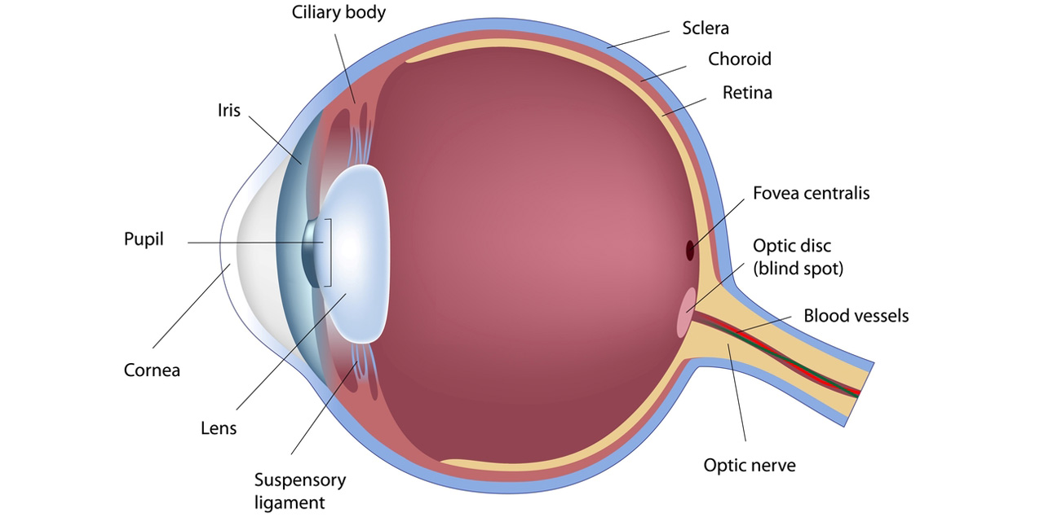
Anatomy & Physiology of the Eye
Figure 1: The composition of the human eye

Slide 4
The main compartments of the human eye (as shown in figure 1)
1- Iris: That involves: Circular muscle (Muscarinic receptors) and Radial muscle (Alpha-receptors).
2- Lens: Attached to the ciliary body by ligaments.
3- Ciliary body: that involves
Ciliary epithelium (B₂ receptors): responsible for secretion of aqueous humor.
Ciliary muscle (M receptors): responsible for near or far vision
4- The cornea is the transparent front part of the eye that cover the iris, pupil, and anterior chamber.
5- The anterior chamber: is the fluid-filled space inside the eye between the iris and the cornea. Aqueous humor is the clear fluid that fills the anterior chamber.

Slide 5
Pupil Diameter
The pupil is the hole in the center of iris. The diameter of the pupil (pupil size) & hence the amount of light entering the eye is regulated by two anatomically innervated set of smooth muscles:
1- radial muscles which innervated by adrenergic fibers (containing alpha1-receptors).
2- circular muscles which innervated by cholinergic fibers (containing M3-receptors).
Notes: Miosis: is due to either contraction of circular muscle or relaxation of radial muscle.
Mydriasis: is due to either contraction of radial muscle or relaxation of circular muscle

Slide 6
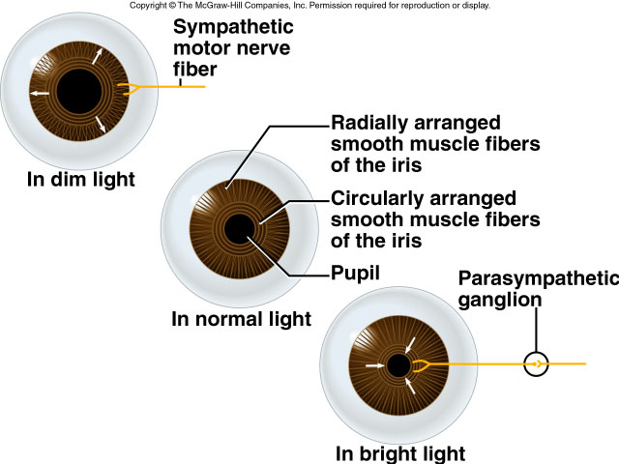
Human eye anatomy
Mydriasis
Miosis
Figure 2:Regulation of the amount of the light

Slide 7
Accummodation for Near & Far Vision
Ciliary body involves ciliary muscle and ciliary epithelium
Ciliary muscle (M receptors): responsible for near or far vision.
M-agonist → Ciliary M. Contraction → Lens contraction → near vision
Anti-Muscarinic → Ciliary M. Relaxation → Lens relaxation → far vision
Contraction of ciliary muscle in response to cholinergic activation (M3 receptors) causes these suspensory ligaments to relax allowing the lens to become more convex & thus improving the focus for closer objects. .
relaxation of the ciliary muscle (e.g. by antimuscarinic agents) the suspensory ligaments will be stretch allowing the lens to become more flat so that improving the focus for farther objects. .
Drugs that antagonized accummodation for near vision termed cycloplegics, they are exclusively muscarinic antagonists. sympatholytic agents do not alter accummodation for near vision since there are no adrenergic receptors in the ciliary muscle.

Slide 8
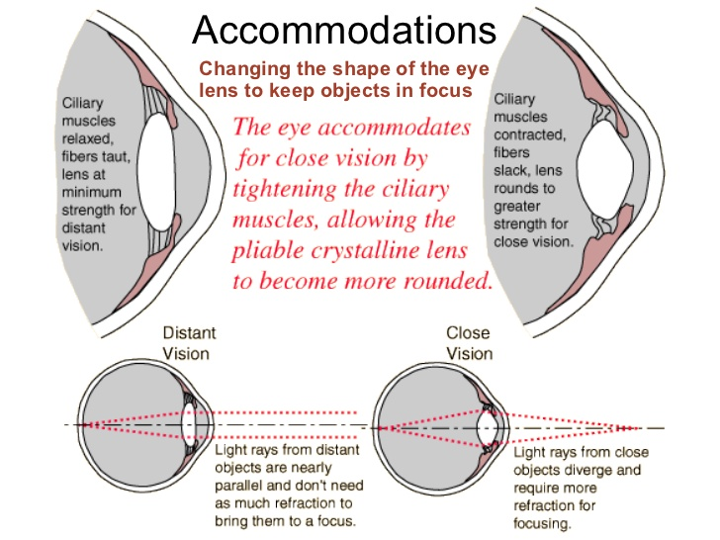
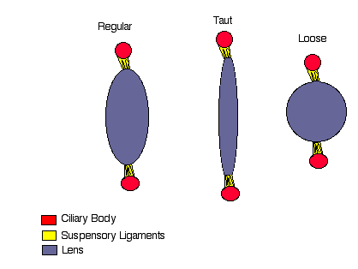
Human eyes accommodation
Figure 3: The contraction and relaxation of the lens

Slide 9
Drugs and human eye
Topical administration
Eye drops
  Principally absorbed through the cornea
  Short drug-eye contact time
Eye ointments
  Allow a prolonged contact time
Eye lotions
  Used for irrigation
Local injections and systemic treatment
Physiological barriers limit systemically administered drug penetration to the eye
Ex. acetazolamide for severely raised intraocular pressure

Slide 10
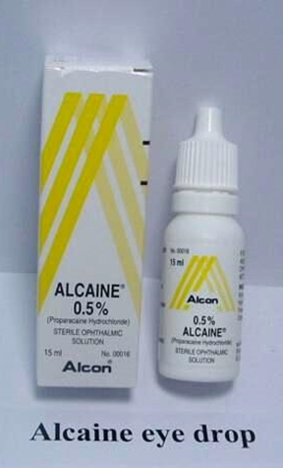
Drugs and human eye
Ophthalmic anesthetics
Ophthalmic anesthetics are agents that act locally to block pain signals at the nerve endings in the eyes
Anaesthetic drops:
  Initial assessment of minor trauma
  Removal of conjunctival and corneal foreign bodies
  In surgery
Example:
  Propracaine Hydrochloride 0.5% (Alcaine)
  Tetracaine 0.5%
Side effects:
  Allergy: local or systemic

Slide 11
Drugs and human eye
Dilating Drops (mydriatic medications)
Mydriatics are used to enlarge the pupil for eye examinations
Used in diagnosis and surgery
1- Parasympathetic antagonists (parasympatholytics)
  Paralyzing the iris sphincter muscle
  Make the pupil larger and paralyze the muscle involved in focusing of the lens (accommodation)
  Blurry eyes especially for up close (reading, near play)
  Tropicamide: (Mydriacyl) 0.5% and 1%. Action up to 6 hours
  Cyclopentolate: (Cyclogyl) 0.5%, 1% and 2%. Action up to 24 hours
  Homatropine: 2% and 5%. Action: 2-3 days.
  Atropine: (Atropisol) Drops 0.5% or 1%, ointment 1%. Action: 1-2 weeks
2- Sympathetic agonists (sympathomimetics)
  Stimulate the iris dilator muscle.
  Phenylephrine: 2.5% and 10%. Action 3-6 hours.

Slide 12
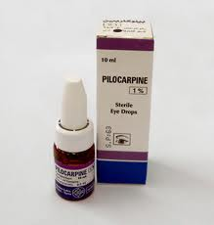
Drugs and human eye
Miotic agents
Dapiprazole (α1-antagonist)
Pilocarpine (M3 agonist)

Slide 13
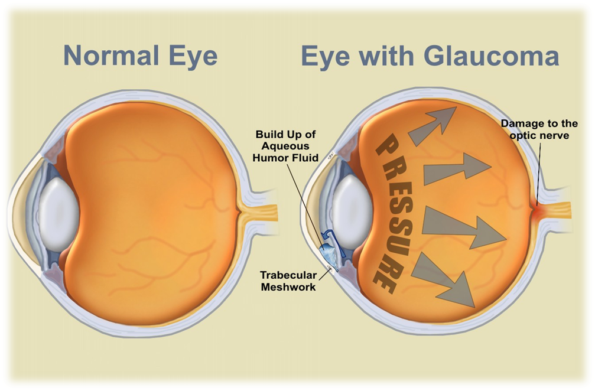
GLAUCOMA
Disease of the eye in which fluid pressure within the eye rises
May lead to vision lose
Affects both eyes
Symptoms :Loss of peripheral vision Sensitivity to light and glare
Problems with night vision ,and Blurred vision
Characterized chiefly by an increase in IOP above 21 mmHg & may be as high as 70 or 80 mmHg during the attack

Slide 14
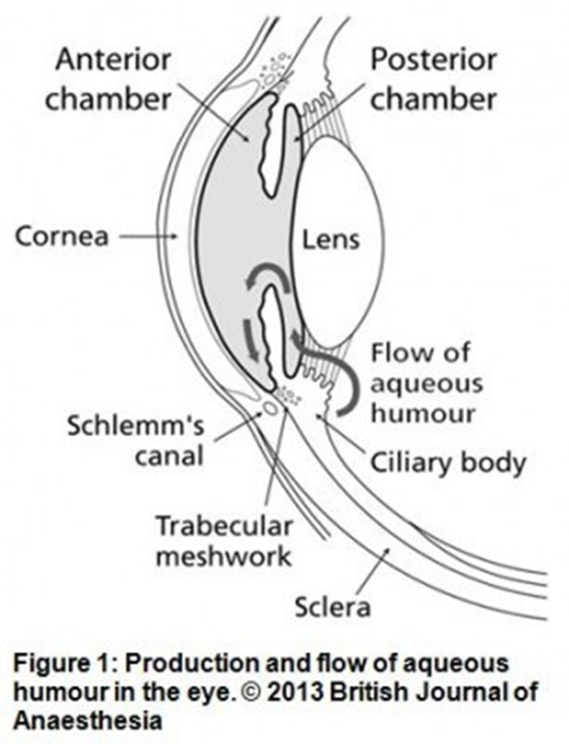
Pathphysiology of Glaucoma
The aqueous humor is a transparent, gelatinous fluid. It is secreted from the ciliary epithelium.
In glaucoma, aqueous humor builds up and increases pressure within the eye
Ciliary Epithelium (B2-Receptors) Responsible for secretion of aqueous humor.
Ciliary muscle contraction(M3 agonist) → Increases flow → Decreases IOP.
Ciliary muscle Relaxation → Decreases flow → Increases IOP (Glaucoma).

Slide 15
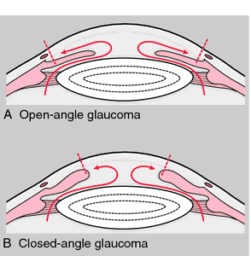
glaucoma
Types of Glaucoma
Open-Angle Glaucoma
  The most common form of glaucoma, 90% of all glaucoma cases
  Caused by the slow clogging of the drainage canals, increased IOP
  Develops slowly
  “Open-angle” means that the angle where the iris meets the cornea is as wide and open as it should be
Angle-Closure Glaucoma
  Caused by blocked drainage canals, sudden rise in IOP
  Has a closed or narrow angle between the iris and cornea

Slide 16
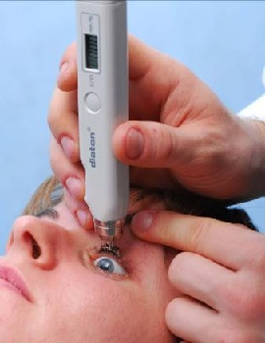
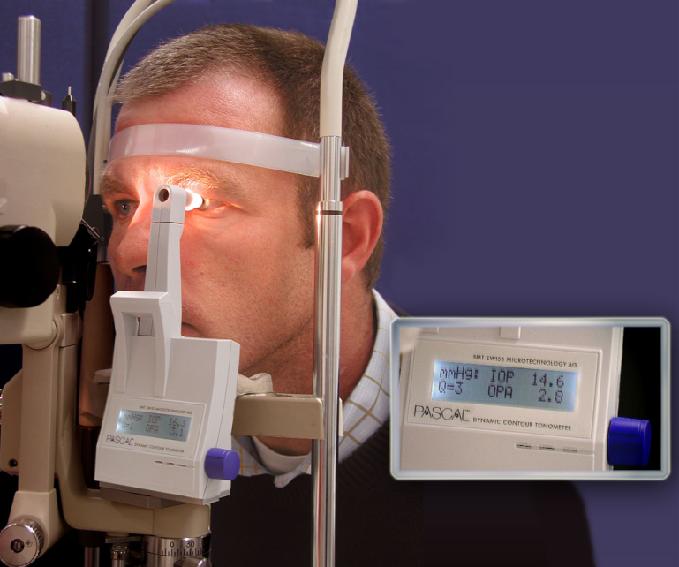
glaucoma
Diagnosis
Tonometry: eyeball pressure is measured. High Intraocular pressure (IOP) may suggest glaucoma
Optic Nerve Examination: check for damage
Visual Field Examination: a patient's visual field (area in front) will be mapped to check for visual loss
IOP is the pressure caused by the fluid inside the eye that helps maintain the shape of the eye
IOP ranges from 10 - 21 mm Hg

Slide 17
glaucoma
Treatment
There is no cure for glaucoma and if the optic nerve is damaged, it cannot be fixed
The progression of glaucoma can be controlled, by lowering IOP
  Increase the drainage
  Decrease production
Drugs that reduce the production of aqueous humor: beta-blockers, alpha-adrenergic agents, carbonic anhydrase inhibitors.
Drugs that increase the outflow of aqueous humor: prostaglandins, prostamides.
Surgery to improve the outflow of aqueous humor.
Implantation of a device to help drain fluid within eyes.

Slide 18
OBJECTIVES
At the end of the practical class the student shall be able to:
1. Instill drugs carefully into the volunteer eye by the pouch method without injuring the cornea.
2. Study the effects of drugs on the eyes

Slide 19
Methods
Place one drop of the agents in the following table into on eye and check for the parameters mentioned in the following table:
Parameter | Pupil Size | Accommodation | Light Reflex | Blanching | Blinking | IOP
Agent
Phenylphrine
Pilocarpine
Tropicamide
proparacaine
placeabo

