Slide 1
  Drugs in obstetric & gynecology
  College of medicine
  Department of obstetrics
  Al Mustansiriyah university

Slide 2
oxytocin
The word oxytocin was derived from Greek meaning "quick birth"
Oxytocin is a peptide of nine amino acids (a nonapeptide
Strong rhythmical contraction of myometrium
Large doses- sustained contraction(↓ placental blood flow & fetal hypoxia/death)
Clinical use:
1- IOL (IV infusion 3U syntocinon+50 ml of saline)
2- Augment slow labour (IV infusion same as above)
3-3rd stage of labour- 5 U IM for HTN ,cardiac disease
- IV infusion 40 U in 500ml saline ( PPH)
4-Surgical termination of preg./ERPC- 5U slow IV

Slide 3
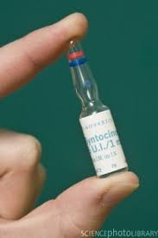
Oxytocin
10 IU/1ml/amp, in 500ml N/S, 20 mU/ml
Moad of action :Uterine stimulant, by increasing intracellular concentrations of calcium in uterine myometrial tissue
OXYTOCIN also has pressor and antidiuretic activity which may be exhibited with high doses
Antidiuresis appears to be initiated by the direct action of oxytocin on the kidney. The action of the drug stimulates renal tubular absorption of free water.

Slide 4
SE:
Cardiovascular:
- The cardiovascular effects of oxytocin used postpartum consist of HYPOTENSION followed by a period of HYPERTENSION
- arrhythmias
- peripheral arteriospasm
- myocardial infarction: coronary artery spasm(?)→ maybe related to supine hypotension, epidural anesthesia, ephedrine, cigarette smoking, intravenous oxytocin

Slide 5
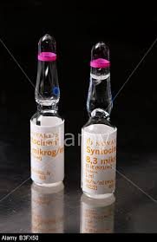
Others: Nausea and vomiting, uterine hypertonia or rupture uterus, flushing

Slide 6
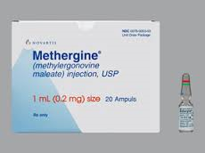
Ergometrine
0.2mg/1ml/amp : is an ergot derivative with direct uterine and vascular smooth muscle contractile properties
Dose :give IV only in emergency because of potential for HTN & CVA.
Give over >1 min & monitor BP.
Side effects: hypertension, thrombophlebitis, leg cramps,
ruptured uterus. – Nausea, vomiting, abdominal pain, chest pain, palpitation, Stroke & MI

Slide 7
Clinical use:
1- Management of 3rd stage of labour
0.2 milligram after delivery of the anterior shoulder, after delivery of the placenta, or during the puerperium, which may be repeated every 2 to 4 hours as needed
This drug should not be routinely administered intravenously because of the possibility of inducing sudden hypertensive and cerebrovascular accidents

Slide 8
If intravenous administration is considered essential as a life-saving measure, Methergine should be given slowly over a period of no less than 60 seconds, with careful monitoring of blood pressure
2 - Management of PPH - 2nd dose give. Alternatively IV ergometrine can be given (works with in 40 sec)

Slide 9
Contraindications: hypertension and cardiac disease.
It is usually combined with oxytocin as syntometrine.
Syntometrine IM:
5U syntocinon(rhythmic contraction in 2min) +
500µg ergometrine(sustained contraction in 7 min)

Slide 10
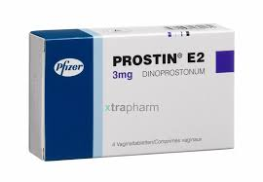
Dinoprostone ( prostin E2)
Vaginal pessary/gel
Clinical use: IOL – 3mg 6hrs apart ( no more than 2 pessaries in 24hrs and max. 3 doses)
Side effect: Nausea ,vomiting, diarrhoea, fever,
Uterine hyperstimulation , HTN, bronchospasm
Advantages :
- Mobile patient
-Reduce need for syntocinon

Slide 11
Carboprost ( Hemabate)
Dose ; 250µg deep IM repeated every 15 min max 8 doses.
(OR Intra-myometrial use at C/S)
Side effects: Nausea ,vomiting, diarrhoea, fever, bronchospasm, dyspnoea, pulmonary oedema,
HTN, cardiovascular collapse
Clinical use: Postpartum haemorrhage

Slide 12
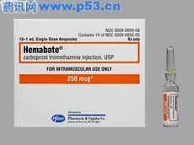
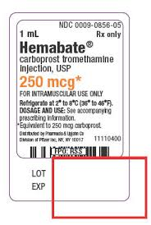

Slide 13
Antihypertension
Methyldopa
It is a centrally acting α₂-adrenergic agonist
Dose: The usual starting dosage of Methyldopa tablet is 250 mg two or three times a day in the first 48 hours then the Maintenance dose is 500 mg to 2 g in two to four doses.
Indications: gestational hypertension (or pregnancy induced hypertension) and pre-eclampsia.
Side effects : it is relatively safe in pregnancy compared to many other antihypertensive which may affect the fetus , however it is produce a number of side effect include:
SE :Headache,dizziness,dry mouth , postural hypotension,nightmares, mild psychosis, depression,hepatitis & jaundice

Slide 14
Important to stop drug in postnatal period
Labetolol 100-200mg BD/TDS PO max 2.4g/24hr
ACE inhibitors are contraindicated in pregnancy

Slide 15
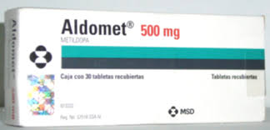

Slide 16
hydralazine
It is a direct-acting smooth muscle relaxant.
Dose: Dilute hydralazine 1 mL(20 mg) with normal saline, the initial dose is 5-10 mg as ordered given by slow intravenous injection over 2 minutes. Blood pressure is taken at 5 minute intervals for at least 20 minutes following each bolus. After 15 minutes, depending upon response, a second dose of 5 mg may be given. Note that the maximal effect occurs 15-20 minutes after each bolus if still no benefit give maintenance dose.
Indications: Intravenous hydralazine is used for the acute control of blood pressure in pre-eclampsia and eclampsia.
Side effects: Facial flushing and headache, tachycardia, nausea, vomiting, dizziness, anxiety and tremor.

Slide 17
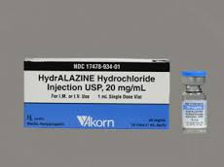

Slide 18
  steroid
  Use between 32-34 weeks arguable- may no benefit RDS but may benefit IVH up to 34 weeks
  Regimens:
  -Betamethasone 12 mg IM, 2 doses, q 24 hr
  -Dexamethasone 6 mg IM, 4 doses, q 12 hr

Slide 19
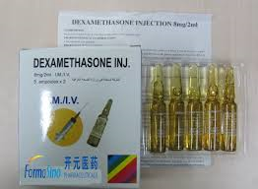
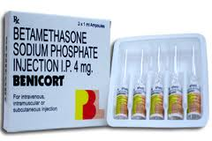
Maternal Adverse Effects
  Short term: glucose control, pulmonary edema, infection
  Long term: no adverse effects
Fetal Adverse Effects
  No long term effects of single course
  Multiple course associated w/ infection, abnormal development

Slide 20
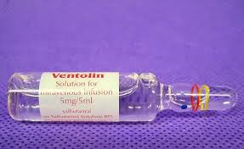
Tocolytic drug
Beta-mimetics
Function:
  Stimulate beta₂ receptors in uterus and lung, decrease contractility
Salbutamol inhaler- 100 mcg x 2 puffs stat
Terbutaline- 250 mcg subcutaneous
Clinical use: both drugs are used for short term.
(i) relaxing uterus at C/S
(ii) ECV procedure

Slide 21
  Side effect:
  Tremor, nervousness, N/V, anxiety, SOB, palpitations, chest pain
  Hyperglycemia, electrolyte abnormalities
  Fluid retention,
  Hypotension, pulmonary oedema Headache, tachycardia, MI ,arrhythmias, hypotension & collapse

Slide 22
  Contra indications
  Absolute:
    Maternal cardiac disease, eclampsia, severe pre-eclampsia, hemorrhage, uncontrolled hyperthyroid, diabetes
  Relative:
    Diabetes, hypertension, migraines, sepsis

Slide 23

nifidipin
Calcium Channel blocker
Clinical use:
Mild to moderate hypertension- 5-20 mg TDS/PO
Severe HTN- 10 mg Retard/PO
Tocolytic- Incremental doses every 20 min until contraction stop, then 20 mg TDS/PO
Side effects: Headache,dizziness,palpitation, tachycardia, hypotension,sweating & syncope.

Slide 24
Magnesium sulphate
Clinical use: Prevention & treatment of seizure in eclampsia / severe pre eclampsia
Dose: 4g IV stat then 1g/hr to be continued 24hr after last seizure
Side effects: nausea,vomiting,flushing, drowsiness,confusion,loss of tendon reflexes, hypotension, decrease U/O, respiratory depression, arrhythmias,cardiac arrest
Because of toxicity, Mg levels monitored

Slide 25
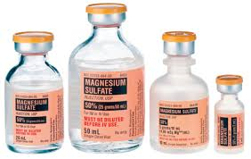
Magnesium sulphate
Crosses placenta, no adverse fetal effects (may have less reactivity)
Contraindications:
  Myasthenia Gravis, renal failure, hypocalcemia
Exam:
  Fluid I/O, UOP, VS, mental status hourly
  Pulm exam
  Reflexes (loss when level >8)
  Therapeutic level: 5.5-7.5 mg/dl, toxic >15
  Antidote: calcium gluconate

Slide 26
Oral Iron
  Ferrous Sulfate (Feosol) – 300 mg tid
  Side Effects are extremely mild:
    Nausea, upper abdominal pain, constipation or diarrhea.
  Cheapest form of Iron and one of the most widely used
Parenteral
  Iron Dextran (Imferon) – IM or IV
  Indicated for patients who cannot tolerate or absorb oral iron or where oral iron is insufficient to treat the condition ie. Malabsorption syndrome, prolonged salicylate therapy, dialysis patients

Slide 27
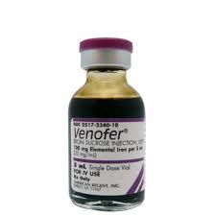
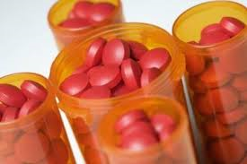

Slide 28
Folic acid
Source in food – yeast, egg yolk, liver and leafy vegetables
Folic Acid (F.A.) is absorbed in the small intestines.
F.A. is converted to tetrahydrofolate by dihydrofolate reductase.
Folic Acid deficiency (F.A. Deficiency) is also called Will’s Disease.
Deficiency may produce megaloblastic anemia; neural tube defect in fetus.
Used for treatment of megaloblastic anemia due to folic acid deffecinecy,used to prevent neural tube defect.
Given preconception and throughout the pregnancy

Slide 29
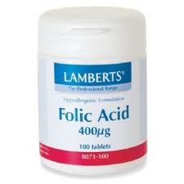

Slide 30
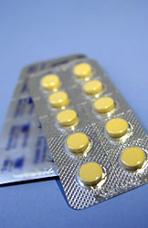
Folic acid
Folic acid is a vitamin B
Dose: as prophylactic 0.4 mg one tablet per day
as therapeutic 5mg one tablet per day
Indications: as prophylactic start taking folic acid tablets before becoming pregnant and Continue to take folic acid tablets for the first 12 weeks of pregnancy.
as therapeutic indicated in:
1-previously affected pregnancy.
2- mother has family history of spinal cord defect
3-mother takes medication for epilepsy.
4-obese women- especially if the Body Mass Index (BMI) is 30 or more
5-women have celiac disease, diabetes, sickle cell anemia, or thalassaemia.

Slide 31
Anti-D (Rho) Immunoglobulin
available as 250, 500 and 2500 IU vials, for intramuscular use only
Indications
Miscarriage, ectopic pregnancy or termination of pregnancy

Slide 32
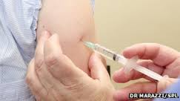

Slide 33
250 IU anti-D Ig is given up to 19⁺⁶ weeks of gestation and 500 IU thereafter. A test for the size of feto-maternal haemorrhage (FMH) should be performed when anti-D Ig is given at or after 20⁺⁰ weeks of gestation:
Anti-D Ig is not required for spontaneous miscarriage before 12⁺⁰ weeks of gestation, unless there is instrumentation or medical evacuation of the uterus. It should be considered in women if there is heavy, repeated bleeding with abdominal pain as she approaches 12⁺⁰ weeks of gestation.

Slide 34
Anti-D Ig is not required for spontaneous miscarriage before 12⁺⁰ weeks of gestation, unless there is instrumentation or medical evacuation of the uterus. It should be considered in women if there is heavy, repeated bleeding with abdominal pain as she approaches 12⁺⁰ weeks of gestation.

