Slide 1
ORGANIC PHARMACEUTICAL CHEMISTRY IV
Dr. Mohammed Al-Ameedee
amiedy5@yahoo.com

Slide 2
Prodrugs to improve membrane permeability
A carboxylic acid functional group may have an important role to play in binding a drug to its binding site via ionic or hydrogen bonding
However, the very fact that it is an ionizable group may prevent it from crossing a fatty cell membrane
The answer is to protect the acid function as an ester
The less polar ester can cross fatty cell membranes and, once it is in the bloodstream, it is hydrolysed back to the free acid by esterases in the blood

Slide 3
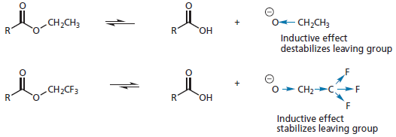
Ester prodrugs
It is possible to make esters more susceptible to hydrolysis by introducing electron-withdrawing groups to the alcohol moiety (e.g. OCH₂CF₃, OCH₂CO₂R, OCONR₂, OAr)
The inductive effect of these groups aids the hydrolytic mechanism by stabilizing the alkoxide leaving group

Slide 4
Ester prodrugs
The protease inhibitor candoxatrilat has to be given intravenously because it is too polar to be absorbed from the gastro intestinal tract
Different esters were tried as prodrugs to get round this problem
It was found that an ethyl ester was absorbed but was inefficiently hydrolysed
A more activated ester was required and a 5-indanyl ester proved to be the best
The 5-indanol released on hydrolysis is non-toxic

Slide 5
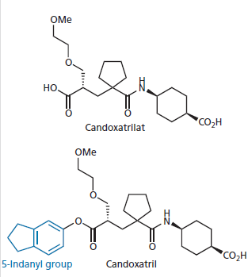
Ester prodrugs

Slide 6
Ester prodrugs
Another way round the problem of membrane permeability is to design a prodrug which can take advantage of transport proteins in the cell membrane, such as the ones responsible for carrying amino acids into a cell
Levodopa is a prodrug for the neurotransmitter dopamine and has been used in the treatment of Parkinson’s disease—a condition due primarily to a deficiency of that neurotransmitter in the brain
Dopamine itself cannot be used as it is too polar to cross the blood–brain barrier

Slide 7
Ester prodrugs
Levodopa is even more polar and seems an unlikely prodrug, but it is also an amino acid, and so it is recognized by the transport proteins for amino acids which carry it across the cell membrane
Once in the brain, a decarboxylase enzyme removes the acid group and generates dopamine

Slide 8
Prodrugs to prolong drug activity
prodrugs are also designed to be converted slowly to the active drug, thus prolonging a drug’s activity
6-mercaptopurine suppresses the body’s immune response and is, therefore, useful in protecting donor grafts
Unfortunately, the drug tends to be eliminated from the body too quickly
The prodrug azathioprine has the advantage that it is slowly converted to 6-mercaptopurine by being attacked by glutathione allowing a more sustained activity.

Slide 9
Prodrugs to prolong drug activity

Slide 10
Prodrugs to prolong drug activity
Another approach to maintaining a sustained level of drug over long periods is to deliberately associate a very lipophilic group to the drug
This means that most of the drug is stored in fat tissue from where it is steadily and slowly released into the bloodstream
The antimalarial agent cycloguanil pamoate is one such agent
The active drug is bound ionically to an anion containing a large lipophilic group and is only released into the blood supply following slow dissociation of the ion complex

Slide 11
Prodrugs masking drug toxicity and side effects
Prodrugs can be used to mask the side effects and toxicity of drugs
LDZ is an example of a diazepam prodrug which avoids the drowsiness side effects associated with diazepam
These side effects are associated with the high initial plasma levels of diazepam following administration
The use of a prodrug avoids this problem. An aminopeptidase enzyme hydrolyses the prodrug to release a non-toxic lysine moiety, and the resulting amine spontaneously cyclizes to the diazepam

Slide 12
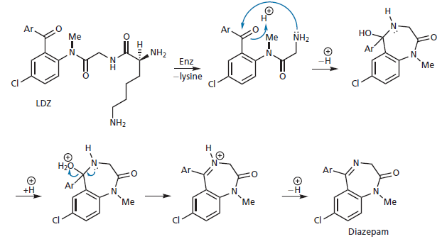
Prodrugs masking drug toxicity and side effects

Slide 13
Prodrugs to improve water solubility
Polar prodrugs have been used to improve the absorption of non-polar drugs from the gut
Drugs have to have some water solubility if they are to be absorbed, otherwise they dissolve in fatty globules and fail to interact effectively with the gut wall
The steroid estrone is one such drug. By using a lysine ester prodrug, water solubility and absorption is increased
Hydrolysis of the prodrug releases the active drug and the amino acid lysine as a non-toxic by-product

Slide 14
Prodrugs to improve water solubility

Slide 15
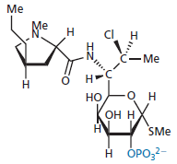
Prodrugs to improve water solubility
Prodrugs designed to increase water solubility have proved useful in preventing the pain associated with some injections, which is caused by the poor solubility of the drug at the site of injection
The antibacterial agent clindamycin is painful when injected, but this is avoided by using a phosphate ester prodrug which has much better solubility because of the ionic phosphate group

Slide 16
Prodrugs to increase chemical stability
The antibacterial agent ampicillin decomposes in concentrated aqueous solution as a result of intramolecular attack of the side chain amino group on the lactam ring
Hetacillin is a prodrug which locks up the off ending nitrogen in a ring and prevents this reaction. Once the prodrug has been administered, hetacillin slowly decomposes to release ampicillin and acetone

Slide 17
Photodynamic therapy
A variation of the prodrug approach is the concept of a sleeping agent
This is an inactive compound which is converted to the active drug by some form of external influence
The best example of this approach is the use of photosensitizing agents such as porphyrins or chlorins in cancer treatment—photodynamic therapy (PDT)
Porphyrins occur naturally in chlorophyll in plants and haemoglobin in red blood cells
They usually complex a metal ion in the centre of the molecule(magnesium in chlorophyll and iron in haemoglobin)

Slide 18
Photodynamic therapy
In this form, they are non-toxic but if they lack the central ion, they have the potential to do great damage
Given intravenously, these agents accumulate within cells and have some selectivity for tumour cells
By themselves, the agents have little effect, but if the cancer cells are irradiated with red light or a red laser, the porphyrins are converted to an excited state and react with molecular oxygen to produce highly toxic singlet oxygen
Singlet oxygen can then attack proteins and unsaturated lipids in the cell membrane leading to the formation of hydroxyl radicals which further react with DNA leading to cell destruction

Slide 19
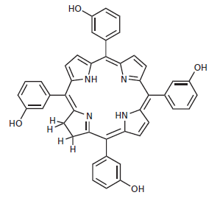
Photodynamic therapy
Temoporfin is an example of a chlorin photosensitizing agent which is used to treat advanced head and neck tumours that do not respond to other treatments

Slide 20
Getting the drug into the market
There are various issues that need to be tackled before a promising-looking drug candidate reaches the clinic and goes into full-scale production
Th is final phase is significantly more expensive in terms of time and money than either lead discovery or drug design, and many drugs will fall by the wayside.
On average, for every 10,000 structures synthesized during drug design, 500 will reach animal testing, 10 will reach phase I clinical trials, and only 1 will reach the market place
The average overall development cost of a new drug was recently estimated as $800 million

Slide 21
Preclinical testing
Toxicity testing
One of the first priorities for a new drug is to test if it has any toxicity
This often starts with in vitro tests on genetically engineered cell cultures and/or in vivo testing on transgenic mice to examine any effects on cell reproduction and to identify potential carcinogens
Any signs of carcinogenicity would prevent the drug being taken any further

Slide 22
Drug metabolism studies
The body has an arsenal of metabolic enzymes that can modify foreign chemicals in such a way that they are rapidly excreted
The structures formed from these reactions are called drug metabolites, and it is important to find out what metabolites are formed from any new drug
The structure and stereochemistry of each metabolite has to be determined and the metabolite tested to see what sort of biological activity it might have

Slide 23
Pharmacology, formulation, and stability tests
It is usually necessary to carry out more tests to see whether the drug has activity at targets other than the intended one, and to gain a better insight into the drug’s mechanism of action
These studies also determine a dose–response relationship and define the drug’s duration of action
Formulation studies involve developing a preparation of the drug which is both stable and acceptable to the patient
For orally taken drugs, this usually involves incorporating the drug into a tablet or a capsule

Slide 24
Pharmacology, formulation, and stability tests
Pre-formulation involves the characterization of a drug’s physical, chemical, and mechanical properties in order to choose what other ingredients should be used in the preparation
Formulation studies then consider such factors as particle size, salt forms, crystal polymorphism, solvates, pH, and solubility, as all of these can influence bioavailability and, hence, the activity of a drug
The drug must be combined with inactive additives by a method which ensures that the quantity of drug present is consistent in each dosage unit
The dosage should have a uniform appearance, with an acceptable taste, tablet hardness, or capsule disintegration.

Slide 25
Clinical trials
Phase I studies
Phase I studies take about a year and involve 100–200 volunteers
They are carried out on healthy human volunteers to provide a preliminary evaluation of the drug’s safety, its pharmacokinetics, and the dose levels that can be administered, but they are not intended to demonstrate whether the drug is effective or not
In situations where the drug is potentially toxic and is to be used for a life threatening disease, such as AIDS or cancer, volunteer patients are used for phase I studies rather than healthy volunteers

Slide 26
Clinical trials
Phase II studies
Phase II studies generally last about two years and may start before phase I studies are complete
They are carried out on patients to establish whether the drug has the therapeutic property claimed, to study the pharmacokinetics and short-term safety of the drug, and to define the best dose regimen
Most phase II trials require 20–80 patients per dose group to demonstrate efficacy

Slide 27
Clinical trials
Phase III studies
Phase III studies normally take about three years
These studies may begin before phase II studies are completed
The drug is tested in the same way as in phase II, but on a much larger sample of patients
Patients taking the drug are compared with patients taking a placebo or another available treatment
Comparative studies of this sort must be carried out without bias and this is achieved by randomly selecting the patients—those who will receive the new drug and those who will receive the alternative treatment or Placebo

Slide 28
Clinical trials
Serious side effects observed during phase III may result in early termination of the clinical trials and the stopping of further development
For example, the development of Pfizer’s torcetrapib (a cholesterol-lowering agent) was terminated in 2006 when it was discovered that there was a statistically increased risk of death associated with its use
The drug had been developed over a period of 16 years at a cost of $800 million and represented one of the costliest failures in pharmaceutical history

Slide 29
Clinical trials
Phase IV studies
Th e drug is now placed on the market and can be prescribed, but it is still monitored for effectiveness and for any rare or unexpected side effects
In a sense, this phase is a never-ending process as unexpected side effects may arise many years after the introduction of the drug
The β-blocker practolol had to be withdrawn after several years of use because some patients suffered blindness and even death

Slide 30
Clinical trials
Rofecoxib (VIOXX) was used to treat rheumatoid arthritis for five years before a clinical trial carried out after its release showed that it was associated with increased risks of heart attack and stroke
The drug was withdrawn voluntarily by Merck in 2004, but in the 5 years it had been on the market, rofecoxib had been prescribed to 1.3 million patients in the USA and to 700,000 patients in 80 other countries
Annual profi ts from the drug had reached $1.2 billion, which represented 18% of Merck’s net income

Slide 31
Clinical trials
Th e loss of this income was so serious that the company’s share price dropped 27% in value in a single day
Not only that the company was faced with a lengthy litigation battle as thousands of patients sought compensation for claimed personal injuries resulting from the use of the drug

Slide 32
Patenting
Having spent enormous amounts of time and money on research and development, a pharmaceutical company wants to get the benefit of all its hard work
It needs to have the exclusive rights to sell and manufacture its products for a reasonable period of time, and at a price which will not only recover its costs, but that will generate sufficient profits for further research and development
Without such rights, a competitor could synthesize the same product without suffering the expense involved in designing and developing it

Slide 33
Patenting
Patents in most countries run for 20 years after the date of filing
This sounds a reasonable time span, but it has to be remembered that the protection period starts from the time of filing, not from when the drug comes onto the market
A significant period of patent protection is lost because of the time required for preclinical tests, clinical trials, and regulatory approval which involves a period of 6–10 years
The income obtained from a successful drug is so important to a company’s financial viability that pay-for delay deals have become a growing trend in the pharmaceutical sector for drugs that are nearing the end of their patent lifetime

Slide 34
Patenting
These involve a pharmaceutical company making a deal with a manufacturer that specializes in producing generic drugs
The generic manufacturer receives a huge amount of money if it agrees to delay manufacturing the generic version for an agreed time period (typically a year), allowing the inventor to gain several months of additional income

Slide 35
The regulatory process
Before clinical trials can begin, the company has to submit the results of its scientific and preclinical studies to the relevant regulatory authority (FDA for USA)
The FDA assesses this information and then decides whether clinical trials can begin
Dialogue then continues between the FDA and the company throughout the clinical trials
Any adverse results must be reported to the FDA, who will discuss with the company whether the trials should be stopped

Slide 36
Regulatory proces
If the clinical trials proceed smoothly, the company applies to the regulatory authority for marketing approval
In the USA, this involves the submission of a New Drug Application (NDA) to the FDA
An NDA is typically 400–700 volumes in size, with each volume
containing 400 pages
The application has to state what the drug is intended to do, along with scientific and clinical evidence for its efficacy and safety

Slide 37
Regulatory process
It should also give details of the chemistry and manufacture of the drug, as well as the controls and analysis which will be in place to ensure that the drug has a consistent quality
Any advertising and marketing material must be submitted to ensure that it makes accurate claims and that the drug is being promoted for its intended use
The labelling of a drug preparation must also be approved to ensure that it instructs physicians about the mechanism of action of the drug, the medical situations for which it should be used, and the correct dosing levels and frequency
Possible side effects, toxicity, or addictive effects should be detailed, as well as special precautions which might need to be taken

Slide 38
Analysis of cost versus benefit
The last barrier for the drug to reach the market is the cost versus benefit analysis by the government authority
the UK’s National Institute for Health and Clinical Excellence (NICE) determines whether novel drugs should be used by the National
Health Service (NHS) and have rejected several approved anticancer drugs, such as lapatinib, dasatinib, sorafenib, nilotinib, bevacizumab, and temsirolimus
Th e decisions of NICE have a significant economic impact on world-wide pharmaceutical sales, as more than 60 other countries adopt the NICE guidelines

