Slide 1

Hydrolysis of Acetyl Salicylic Acid Solution in Sorenson Phosphate Buffer at pH 8
LAB 4
BIOPHARMACEUTICS
LAB 4

Slide 2

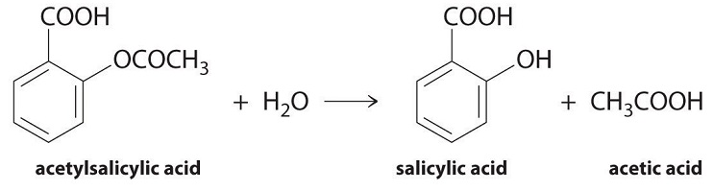
Introduction
Aspirin is a weak acid .it is soluble at 20 C°in 300 parts of water .
It is unstable in aqueous solutions degrading to salicylic acid and acetic acid
Aspirin also degrades in solid dosage forms when exposed to moisture and therefore , should be stored in tightly closed containers and kept in a dry environment .

Slide 3

Aim of Experiment
To study the effect of temperature on the hydrolysis of aspirin (S.P.B), and to calculate the shelf life of aspirin .
Shelf life of any drug :it is the time required for the drug to lose 10% of its effectiveness

Slide 4
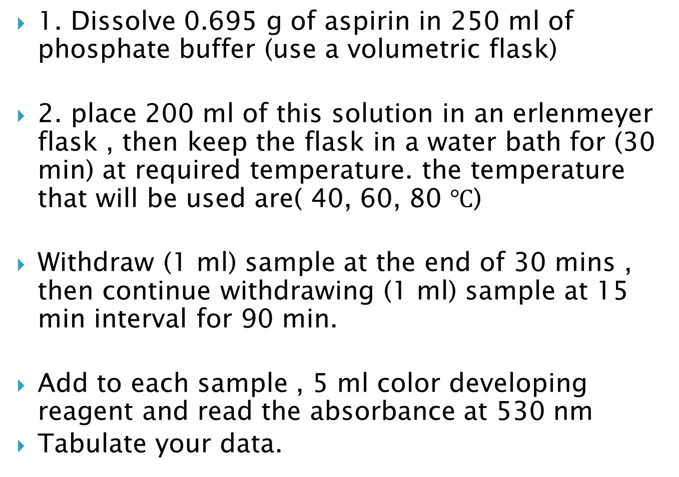
Procedure :
1. Dissolve 0.695 g of aspirin in 250 ml of phosphate buffer (use a volumetric flask)
2. place 200 ml of this solution in an erlenmeyer flask , then keep the flask in a water bath for (30 min) at required temperature. the temperature that will be used are( 40, 60, 80 $℃$)
Withdraw (1 ml) sample at the end of 30 mins , then continue withdrawing (1 ml) sample at 15 min interval for 90 min.
Add to each sample , 5 ml color developing reagent and read the absorbance at 530 nm
Tabulate your data.

Slide 5
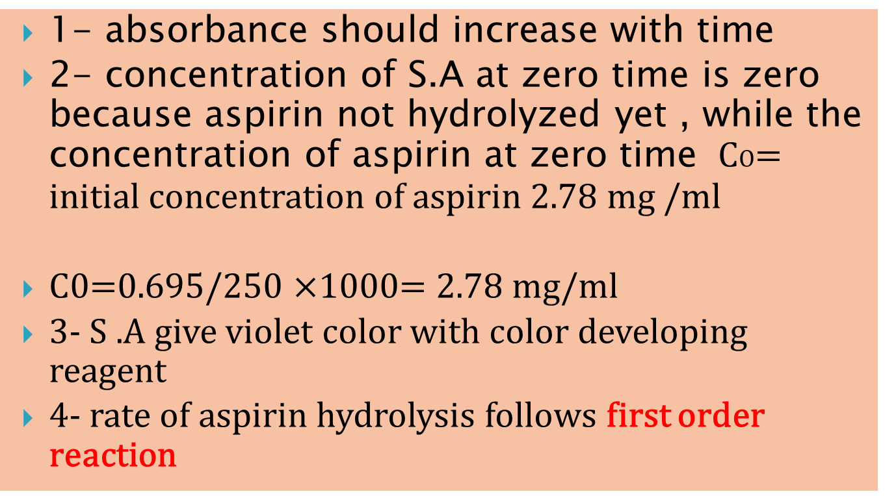
Notes:
1- absorbance should increase with time
2- concentration of S.A at zero time is zero because aspirin not hydrolyzed yet , while the concentration of aspirin at zero time CO= initial concentration of aspirin 2.78 mg /ml
C0=0.695/250 $×$1000= 2.78 mg/ml
3- S .A give violet color with color developing reagent
4- rate of aspirin hydrolysis follows first order reaction

Slide 6
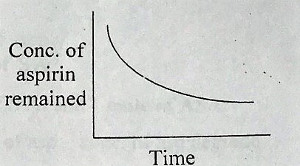

$\frac{dc}{dt}$ ∝ C
- $\frac{dc}{dt}$ $∝$ C (since conc. Of aspirin decrease with time as hydrolyzed)
- $\frac{dc}{dt}$ $=KC$

Slide 7
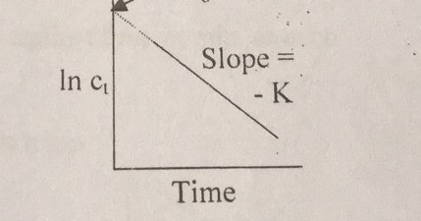
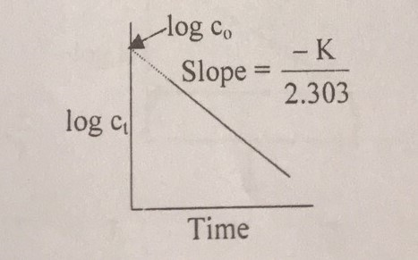

$\int_{c0}^{ct}{\frac{dc}{c}=−k \int_{0}^{t}{dt}}$
-(ln Ct- ln Co) =kt(t-0)
Ln Ct –ln Co = - kt
Ln Ct = ln Co –kt
Since ln = log $×$ 2.303
Log Ct *2.303=log Co* 2.303-kt
Log Ct = log Co –kt/2.303

Slide 8
5- Sorenson phosphate buffer (pH 8)
Consist of two solutions
A-1/15 M Monopotasium phosphate KH2PO4
B- 1/15 M Disodium phosphate Na2HPO4.2H2O
Time | Absorbance | Conc. Of S.A | Conc. Of aspirin hydrolyzed | Conc.of aspirin remained
0 |  | Y= c+bx | *180/138 | 2.7- Ch
30
45
60

Slide 9
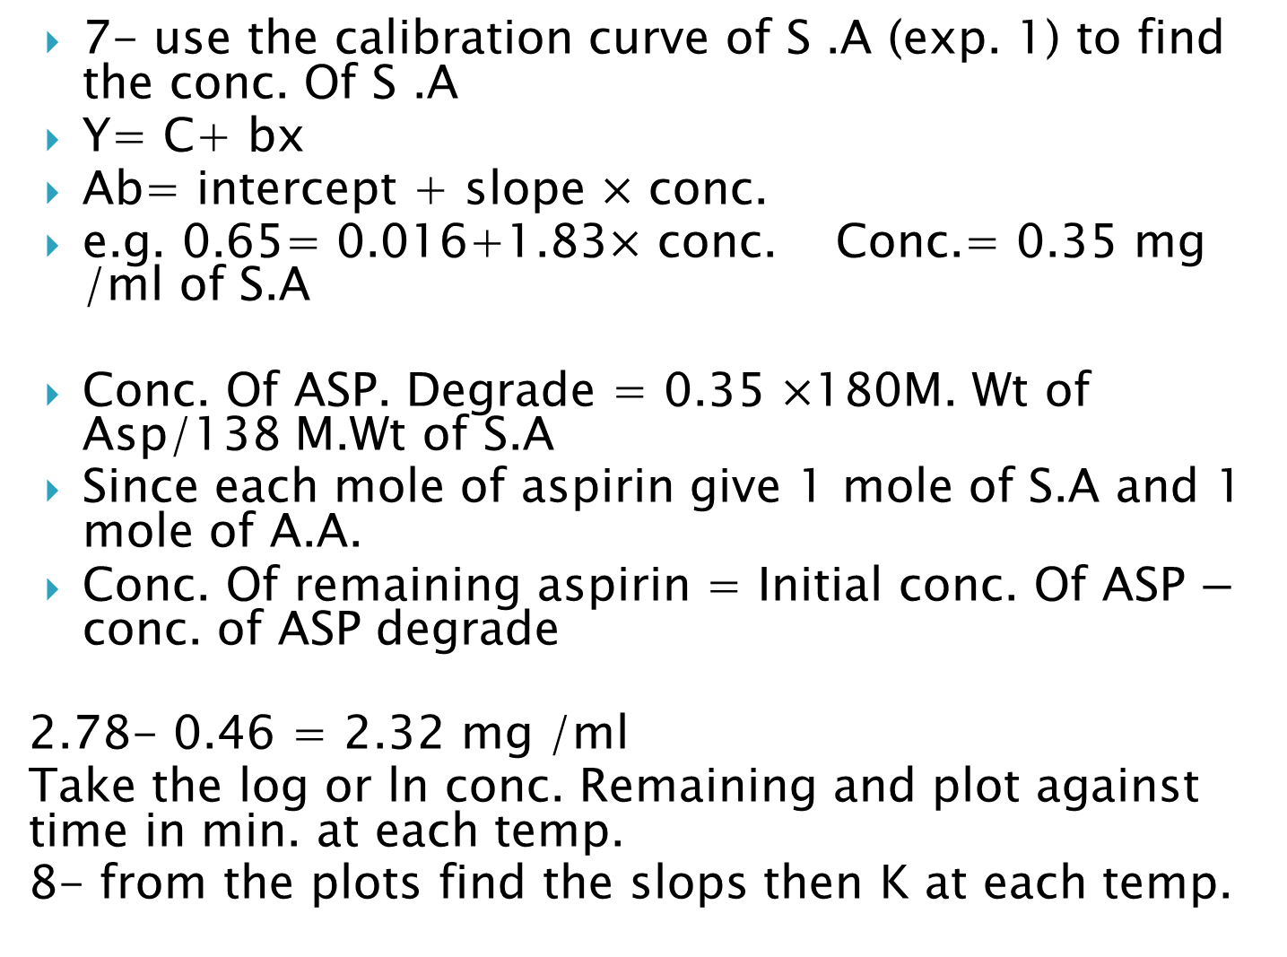
7- use the calibration curve of S .A (exp. 1) to find the conc. Of S .A
Y= C+ bx
Ab= intercept + slope $×$ conc.
e.g. 0.65= 0.016+1.83$×$ conc. Conc.= 0.35 mg /ml of S.A
Conc. Of ASP. Degrade = 0.35 $×$180M. Wt of Asp/138 M.Wt of S.A
Since each mole of aspirin give 1 mole of S.A and 1 mole of A.A.
Conc. Of remaining aspirin = Initial conc. Of ASP $−$ conc. of ASP degrade
2.78- 0.46 = 2.32 mg /ml
Take the log or ln conc. Remaining and plot against time in min. at each temp.
8- from the plots find the slops then K at each temp.

Slide 10
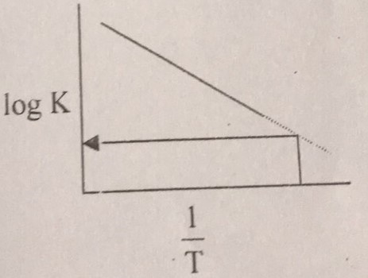
9- take log K and plot 1/𝑇
(draw Arrhenius plot ) to find K at 25 ℃.
Arrhenious equation :
Log K= log A - (𝐸𝑎 )/(2.303 𝑅) *1/𝑇
Where A= frequency factor ,Ea = energy of activation ,T= absolute temp.
R= gas constant .
t10%= 0.105/ K25℃

Slide 11
THANK YOU

