Slide 1
The Aldol Condensation Reaction Preparation of Benzalacetophenon (Chalcones)

Slide 2
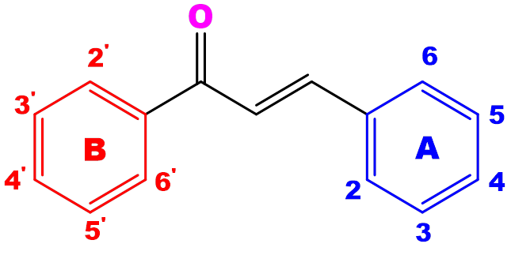
Chalcones
Are(enone ) or α, β unsaturated aromatic ketones containing the reactive keto ethylene group –CO– CH=CH-. Many of the chalcones are highly biological active which have medicinal and pharmaceutical applications

Slide 3
The alternative name given to chalcone are phenyl styryl ketone, benzalacetophenone, β-phenylacrylophenone, ɣ-oxo-α,ɣ-diphenyl-α-propylene and α-phenyl-β-benzoylethylene.
Chalcones and their derivatives demonstrate wide range of biological activities such as anti-diabetic, anti-neoplastic, anti-hypertensive, anti-retroviral, anti-inflammatory, anti-parasital, anti-histaminic, anti-malarial, anti-oxidant, anti-fungal.

Slide 4
anti-obesity, anti-platelet, anti-tubercular, immunosuppressant, anti-arrhythmic, hypnotic, anti-gout, anxiolytic, anti-spasmodic, anti-nociceptive, hypolipidemic, anti-filarial, anti-angiogenic, antiprotozoal, anti-bacterial, anti-steroidal

Slide 5
Aldol condensation: is the reaction of two carbonyl compounds to form a new β-hydroxy carbonyl compound. This reaction can be performed under acidic or basic conditions.

Slide 6
One of the reacting species must contain a protonated α-carbon adjacent to the carbonyl centre.
Crossed aldol condensation of this type proceed in a high yield, because benzaldehyde cannot with itself by an aldol condensation reaction because it has no α-hydrogen. likewise, ketones do not react easily with themselves in aqueous base. Therefore, the only possibility is for a ketone to react with benzaldehyde.

Slide 7
Benzalacetophenones (Chalcones) are prepared by the reaction of a substituted benzaldehyde with acetophenone in aqueous base.
Chemicals Required:
Benzaldehyde , acetophenone , Sodium hydroxide solution (20%, )ethanol.

Slide 9
Procedure:
1-Place 1.06 ml of benzaldehyde in 50ml flask and add 1.18ml of acetophenone.
Add 1 ml of 95% ethanol .
2-stir the mixture (you may need to warm the mixture on a hot plate to dissolve the solids ).
3-Cool the solution to room temperature.
4-Add 10ml of sodium hydroxide solution(20%) to the mixture ,stir the mixture until it solidifies or until it become very cloudy.
5-Add 2ml ice water to the mixture and neutralize with 2N HCL.
6-Transfer the mixture to a small beaker with 3ml of ice water, stir the precipitate to break it up and then collect the solid on a Buchner funnel .
7-Wash the product with cold water.

Slide 10
Recrystallization:
The product may be recrystallize by dissolving it in a hot ethanol (95%) and filter the hot solution. Cool it and collect the crystals by filtration.

