Slide 1
Lab 3
IN VITRO EVALUATION OF BULK FORMING LAXATIVES

Slide 2
Introduction
A laxative is a medicine that loosen the bowel contents and encourages evacuation.
Laxatives taken regularly tend to deprive the colon of its natural muscle tone .
Simple constipation is usually relieved by increasing the intake of dietary fiber.

Slide 3
Laxatives should be generally avoided except where:
Straining exacerbates a condition such as angina or increases the risk of rectal bleeding as in hemorrhoids.
Laxatives are also of value in drug induced constipation.
For the repulsion of parasites after anthelmintic treatment.
To clear the alimentary tract before surgery and radiological procedures.

Slide 4
Laxatives have been divided into four main groups:
Stimulant laxatives (irritant)
Fecal softeners(emollients or wetting)
Osmotic laxatives
Bulk forming laxatives

Slide 5
Stimulant laxatives (irritants):These act by increasing intestinal motility . The most commonly used stimulant laxatives are :castor oil, cascara and senna .
Fecal softeners(emollient or wetting):They act by lubricating the feces. For example liquid paraffin or by softening the feces for example sodium dioctyl sodium sulfosuccinate . This may cause a sufficient rectal stimulation to promote a bowel action . These drugs are useful in management of hemorrhoids and anal fissure.
Osmotic laxatives: These act by maintaining the volume of fluid in the bowel by osmosis .e.g. magnesium carbonate , magnesium hydroxide and magnesium sulfate.

Slide 6
Bulk forming laxatives: These relieve constipation by increasing fecal mass which stimulate peristalsis .
These include various natural and semi synthetic polysaccharides and cellulose derivatives that dissolve or swell in water to form an emollient gel or viscous solution that maintain the feces soft and hydrated. In addition ,this indigestible residue may stimulate peristalsis reflexly .

Slide 7
The laxative effect of the bulk forming agent is usually apparent within 12-24 hours ,but their full effect may not be achieved until the 2nd or 3rd day of medication .
Adequate fluid intake may be maintained to avoid intestinal obstruction. The efficiency of the bulk forming agent depends on its water –retaining properties( whether it is good or poor).

Slide 8
Indications of bulk forming agents:
Constipation caused by inadequate fiber intake.
Anal fissure
Hemorrhoids

Slide 9
Cautions
Adequate fluid intake should be maintained
Caution in ulcerative colitis(inflammation of colon)

Slide 10
Contraindications :
Intestinal obstruction
colonic atony ” absence or lack of normal tone”

Slide 11
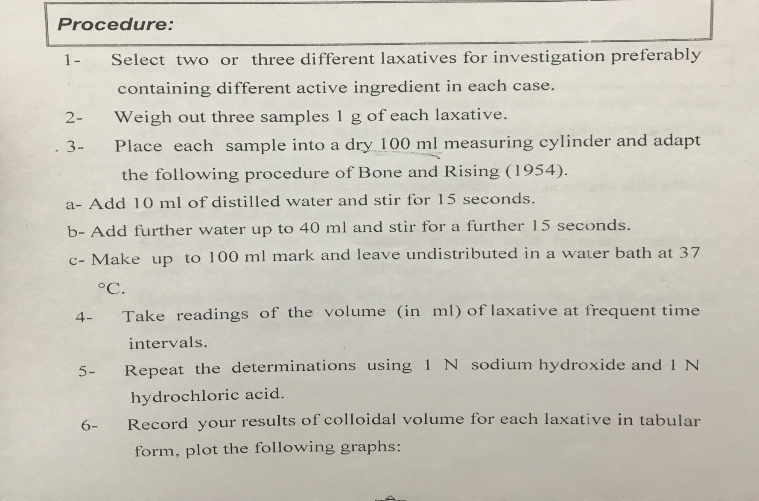

Slide 12
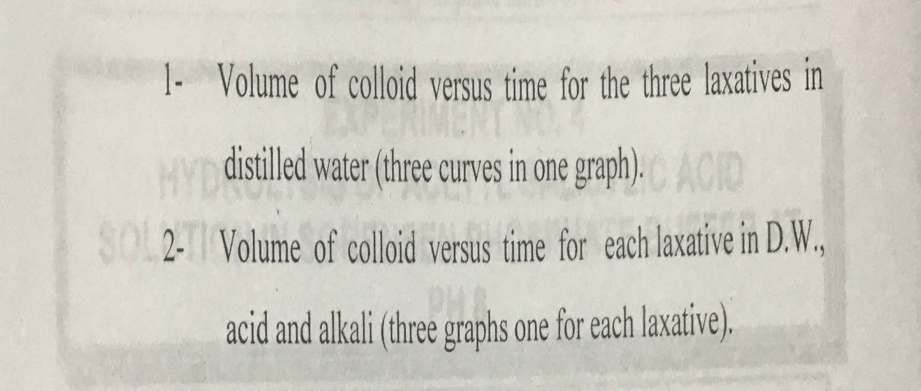

Slide 13
Questions :
Why is an evaluation carried out in neutral ,acidic and alkaline media ?
What are the ideal swelling properties of bulk forming laxatives?

