Slide 1
ORGANIC PHARMACEUTICAL CHEMISTRY IV
Dr. Mohammed Al-Ameedee
amiedy5@yahoo.com

Slide 2
Optimizing access to target
The compound with the best binding interactions is not necessarily the best drug to use in medicine
The drug needs to overcome many barriers if it is to reach its target in the body
There are design strategies which can be used to counter such barriers, and which involve modification of the drug itself
The aim is to design drugs that will be absorbed into the blood supply, will reach their target efficiently, be stable enough to survive the journey, and will be eliminated in a reasonable period of time.
This all comes under the category of drug pharmacokinetics

Slide 3
Optimizing hydrophilic/hydrophobic properties
The relative hydrophilic/hydrophobic properties of a drug are crucial in influencing its solubility, absorption, distribution, metabolism, and excretion (ADME)
Drugs which are too polar or too hydrophilic do not cross the cell membranes of the gut wall easily. One way round this is to inject them, but they cannot be used against intracellular targets as they will not cross cell membranes
The hydrophobic character of a drug can be measured experimentally by testing the drug’s relative distribution in an n-octanol/water mixture

Slide 4
Adding or removing polar functional groups to vary polarity
A polar functional group could be added to a drug to increase its polarity
The antifungal agent tioconazole is only used for skin infections because it is non-polar and poorly soluble in blood
Introducing a polar hydroxyl group and more polar heterocyclic rings led to the orally active antifungal agent fluconazole, with improved solubility and enhanced activity against systemic infection

Slide 5
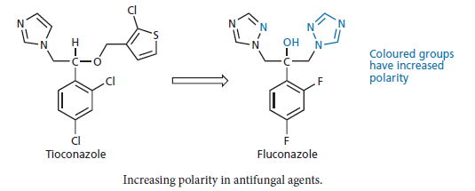
Adding or removing polar functional groups to vary polarity

Slide 6
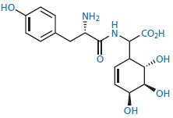
Adding or removing polar functional groups to vary polarity
Th e polarity of an excessively polar drug can be lowered by removing polar functional groups
It is important not to remove functional groups which are important to the drug’s binding interactions with its target
In some cases, a drug may have too many essential polar groups as in the example below which has good in vitro activity but poor in vivo activity, because of the large number of polar groups
Some of these groups can be removed or masked but most of them are required for activity
As a result, the drug cannot be used clinically

Slide 7
Variation of N-alkyl substituents to vary pKa
Drugs with a pKa outside the range 6–9 tend to be too strongly ionized and are poorly absorbed through cell membranes
The pKa can often be altered to bring it into the preferred range
This can be done by varying any N -alkyl substituents that are present
Extra N –alkyl groups or larger N -alkyl groups have an increased electron-
donating effect which should increase basicity, but increasing the size or number of alkyl groups increases the steric bulk around the nitrogen atom
This hinders water molecules from solvating the ionized form of the base and prevents stabilization of the ion
This, in turn, decreases the basicity of the amine

Slide 8
Variation of N-alkyl substituents to vary pKa
Therefore, there are two different effects acting against each other
A variation of this tactic is to include a basic nitrogen within a ring
For example, the benzamidine structure I has anti-thrombotic activity, but the amidine group present is too basic for effective absorption
Incorporating the group into an isoquinoline ring system (PRO 3112) reduced basicity and increased absorption

Slide 9
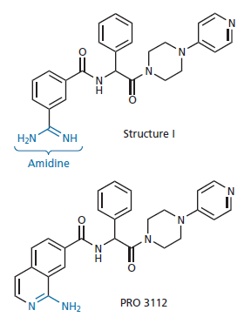
Variation of N-alkyl substituents to vary pKa

Slide 10
Bioisosteres for polar groups
Bioisosteres have been used as substitutes for important functional groups which suffer from pharmacokinetic problems
For example, a carboxylic acid is a highly polar group which can ionize and hinder absorption of any drug containing it
An important strategy is to replace it with a bioisostere which has similar physicochemical properties, but which offers some advantage over the original carboxylic acid
Several bioisosteres have been used for carboxylic acids, but among the most popular is a 5-substituted tetrazole ring

Slide 11
Bioisosteres for polar groups
Like carboxylic acids, tetrazoles contain an acidic proton and are ionized at pH 7.4
They are also planar in structure. However, they have an advantage in that the tetrazole anion is 10 times more lipophilic than a carboxylate anion and drug absorption is enhanced as a result
The biphenyl structure (Structure I) inhibits the receptor for angiotensin II and had potential as an antihypertensive agent
However, the drug had to be injected as it showed poor absorption through the gut wall
Replacing the carboxylic acid with a tetrazole ring led to losartan, which was launched in 1994

Slide 12
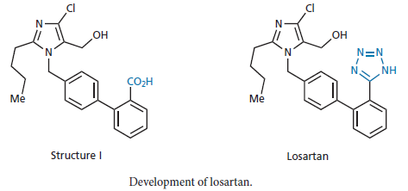
Bioisosteres for polar groups

Slide 13
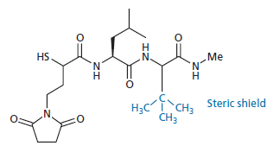
Making drugs more resistant to chemical and enzymatic degradation
A common strategy to protect degradation susceptible functional groups such as esters and amides is to add steric shields designed to hinder the approach of a nucleophile or an enzyme to the susceptible group
the t –butyl group in the anti-rheumatic agent D 1927 serves as a steric shield and blocks hydrolysis of the terminal peptide bond

Slide 14
Electronic effects of bioisosteres
Another strategy to protect against degradation is to stabilize the group electronically using a bioisostere
Replacing the methyl group of an ethanoate ester with NH 2 results in a urethane functional group which is more stable than the original ester
The NH₂ group is the same valency and size as the methyl group and, therefore, has no steric effect, but it has totally different electronic properties as it can feed electrons into the carboxyl group and stabilize it from hydrolysis

Slide 15
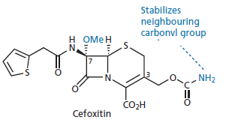
Electronic effects of bioisosteres
Cefoxitin shows good metabolic stability to esterases owing to the presence of the urethane group at position 3, rather than an ester

Slide 16
Steric and electronic modifications
Steric hindrance and electronic stabilization have often been used together to stabilize labile groups.
Procaine is a good, but short-lasting, local anaesthetic because its ester group is quickly hydrolysed
Changing the ester group to the less reactive amide group reduces susceptibility to chemical hydrolysis
The presence of two ortho -methyl groups on the aromatic ring helps to shield the carbonyl group from attack by nucleophiles or enzymes This results in the longer-acting local anaesthetic lidocaine

Slide 17
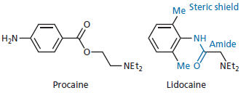
Steric and electronic modifications

Slide 18
Metabolic blockers
A popular method of protecting aromatic rings from metabolism at the para –position is to introduce a fluoro substituent
CGP 52411 is an enzyme inhibitor which acts on the kinase-active site of the epidermal growth factor receptor
It went forward for clinical trials as an anticancer agent and was found to undergo oxidative metabolism at the para-position of the aromatic rings
Fluoro substituents were successfully added in the analogue CGP 53353 to block this metabolism
This tactic was also applied successfully in the design of gefitinib

Slide 19
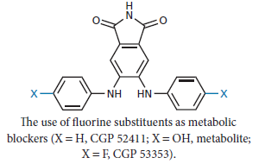
Metabolic blockers

Slide 20
Group shifts
Removing or replacing a metabolically sensitive group is possible if the group concerned is not involved in important binding interactions with the binding site
If the group is important, then we have to use a different strategy
We can try shifting the vulnerable group within the molecular skeleton which was successful in the development of salbutamol
Salbutamol is an analogue of the neurotransmitter noradrenaline —a catechol structure containing two ortho -phenolic groups

Slide 21
Group shifts
One of the problems faced by catechol compounds is metabolic methylation of one of the phenolic groups
As both phenol groups are involved in hydrogen bonds to the receptor, methylation of one of the phenol groups disrupts the hydrogen bonding and makes the compound inactive
The noradrenaline analogue (structure I) has useful anti-asthmatic activity, but the effect is of short duration because the compound is rapidly metabolized to the inactive methyl ether (structure II)
Removing the OH or replacing it with CH₃ prevents metabolism, but also prevents the important hydrogen bonding interactions with the binding site

Slide 22
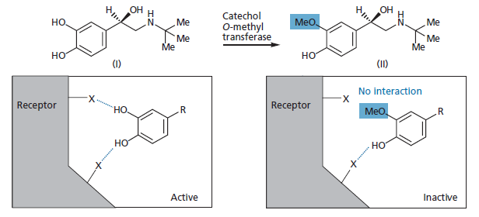
Group shifts

Slide 23
Group shifts
This problem was solved by moving the vulnerable hydroxyl group out from the ring by one carbon unit
This was enough to make the compound unrecognizable to the metabolic enzyme, but not to the receptor binding site
Fortunately, the receptor appears to be quite flexible over the position of this hydrogen bonding group and a hydroxyethyl group is also acceptable
Beyond that, activity is lost because the OH group is out of range or the substituent is too large to fit

Slide 24
Ring variation and ring substituents
In some cases, introducing a nitrogen atom into the aromatic/heteroaromatic ring can be useful, as lowering the electron density in the ring also helps to make the methyl substituent more resistant to metabolism
F13640 underwent phase II clinical trials as an analgesic
The methyl substituent on the pyridine ring is susceptible to oxidation and is converted to a carboxylic acid, which is inactive
The methyl group plays an important binding role and has to be present
Therefore, the pyridine ring was changed to a pyrimidine ring resulting in a compound (F15599) that has increased metabolic stability without affecting binding affinity

Slide 25
Ring variation and ring substituents

Slide 26
Making drugs less resistant to drug metabolism
If a drug that is extremely stable to metabolism and is very slowly excreted can pose just as many problems as one that is susceptible to metabolism
It is usually recommended to have a drug that does its action, then stops doing it within a reasonable time
If not, the effects of the drug could last too long and cause toxicity and prolonged side effects
Therefore, designing drugs with decreased chemical and metabolic stability can sometimes be useful

Slide 27
Introducing metabolically susceptible groups
Introducing groups that are susceptible to metabolism is a good way of shortening the lifetime of a drug
For example, a methyl group was introduced to the anti-arthritic agent L 787257 to shorten its lifetime
The methyl group of the resulting compound ( L 791456 ) was metabolically oxidized to a polar alcohol, as well as to a carboxylic acid

Slide 28
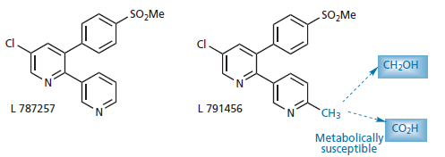
Introducing metabolically susceptible groups

Slide 29
Self destruct drugs
A self-destruct drug is one which is chemically stable under one set of conditions, but becomes unstable and degrades spontaneously under another set of conditions
The advantage of a self-destruct drug is that inactivation does not depend on the activity of metabolic enzymes, which could vary from patient to patient
Th e best example of a self-destruct drug is the neuromuscular blocking agent atracurium , which is stable at acid pH but self destructs when it meets the slightly alkaline conditions of the blood

Slide 30
Self destruct drugs
Th is means that the drug has a short duration of action, allowing anaesthetists to control its blood levels during surgery by providing it as a continuous, intravenous drip
Th e rapid breakdown is due to a self-destruct mechanism
At the slightly alkaline pH of blood (pH = 7.4), the molecule can undergo a Hofmann elimination
Once this happens, the compound is inactivated because the positive charge on the nitrogen is lost and the molecule is split in two
It is a clever example of drug design in that the same element responsible for the molecule’s biological activity promotes its deactivation

Slide 31
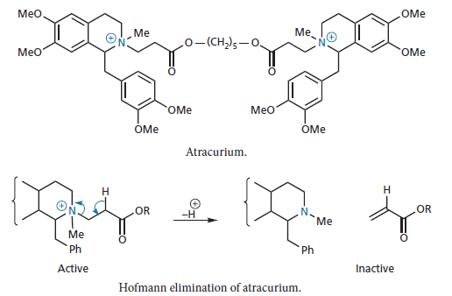
Self destruct drugs

Slide 32
Drug targeting
A major goal in cancer chemotherapy is to target drugs efficiently against tumour cells rather than normal cells
One of targeting approaches is to attach the active drug to monoclonal antibodies which can recognize antigens unique to the tumour cell. Once the antibody binds to the antigen, the drug or poison is released to kill the cell.
The difficulties in this approach include the identification of suitable antigens and the production of antibodies in significant quantity. The approach has great promise for the future
Another tactic which has been used to target anticancer drugs is to administer an enzyme–antibody conjugate where the enzyme serves to activate an anticancer prodrug, and the antibody directs the enzyme to the tumour
This is a strategy known as Antibody directed enzyme prodrug therapy (ADEPT)

