Slide 1
Cell Wall Inhibitors

Slide 2
Some antimicrobial drugs selectively interfere with
synthesis of the bacterial cell wall—a structure that
mammalian cells do not possess. The cell wall is
composed of a polymer called peptidoglycan that
consists of glycan units joined to each other by
peptide cross-links.
Inhibitors of cell wall synthesis require actively
proliferating microorganisms. They have little or no
effect on bacteria that are not growing and dividing.

Slide 3
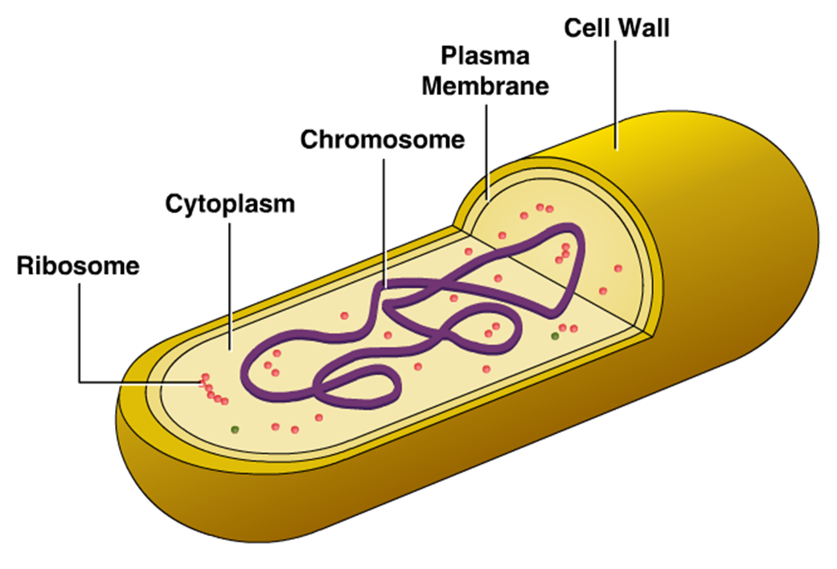

Slide 4
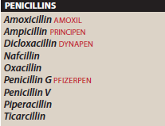
The most important members of this group of
drugs are the β-lactam antibiotics, vancomycin, and daptomycin.

Slide 5
PENICILLINS
The penicillins are among the most widely
effective and the least toxic drugs known.
Members of this family differ from one another in
the R substituent attached to the 6-aminopenicillanic
acid residue .The nature of this side chain affects
the antimicrobial spectrum, stability to stomach
acid, cross hypersensitivity, and susceptibility to
bacterial degradative enzymes (β-lactamases).

Slide 6
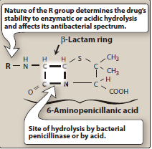

Slide 7
Mechanism of action
The penicillins interfere with the last step of bacterial cell
wall Synthesis (transpeptidation or cross-linkage), resulting
in exposure of the osmotically less stable membrane. Cell
lysis can then occur, either through osmotic pressure or
through the activation of autolysins. These drugs are
bactericidal and work in a time-dependent fashion.
Penicillins are only effective against rapidly growing
organisms that synthesize a Peptidoglycan cell wall.
Consequently, they are inactive against organisms devoid
of this structure, such as mycobacteria, protozoa, fungi,
and viruses.

Slide 8
Penicillin-binding proteins:
Penicillins also inactivate numerous proteins on
the bacterial cell membrane. These penicillin-
Binding proteins (PBPs) are bacterial enzymes
involved in the synthesis of the cell wall and in the
maintenance of the morphologic features of
the bacterium. Exposure to these antibiotics can
therefore not only prevent cell wall synthesis but
also lead to morphologic changes or lysis of susceptible bacteria.

Slide 9
The number of PBPs varies with the type of
organism. Alterations in some of these PBPs
Provide the organism with resistance to the
penicillins. ((Note: Methicillin resistant
Staphylococcus aureus (MRSA))

Slide 10
2. Inhibition of transpeptidase:
Some PBPs catalyze formation of
the cross-linkages between peptidoglycan
chains .Penicillins inhibit this transpeptidase-
catalyzed reaction, thus hindering
the formation of cross-links essential for cell
wall integrity.

Slide 11
3. Production of autolysins:
Many bacteria, particularly the gram positive
cocci, produce degradative enzymes (autolysins) that
participate in the normal remodeling of the bacterial
cell wall. In the presence of a penicillin, the degradative
action of the autolysins proceeds in the absence of cell
wall synthesis. Thus, the antibacterial effect of a
penicillin is the result of both inhibition of cell wall
synthesis and destruction of the existing cell wall by
autolysins.

Slide 12
B. Antibacterial spectrum
The antibacterial spectrum of the various penicillins is
determined, in part, by their ability to cross the bacterial
peptidoglycan cell wall to reach the PBPs in the periplasmic
space. Factors that determine the susceptibility of PBPs to
these antibiotics include the size, charge, and
hydrophobicity of the particular β-lactam antibiotic. In
general, gram-positive microorganisms have cell walls
that are easily traversed by penicillins, and, therefore, in
the absence of resistance, they are susceptible to these
drugs.

Slide 13
Gram-negative microorganisms have an outer
lipopolysaccharide membrane surrounding the
Cell wall that presents a barrier to the water-
soluble penicillins. However, gram-negative
bacteria have proteins inserted in the
Lipopolysaccharide layer that act as water-filled
channels (called porins) to permit
transmembrane entry.

Slide 14
1. Natural penicillins: Natural penicillins (penicillin G and penicillinV). Semisynthetic penicillins, such as amoxicillin and ampicillin (also known as aminopenicillins). Penicillin G (benzyl-penicillin) is the cornerstone of therapy for infections caused by a number of gram positive and gram-negative cocci, gram-positive bacilli, and spirochetes .

Slide 15
Penicillins are susceptible to inactivation
by β-lactamases (penicillinases) that are
produced by the resistant bacteria. Penicillin V
has a similar spectrum to that of penicillin G,
but Penicillin V is more acid stable than
penicillin G and is often employed orally in the
treatment of infections.

Slide 16
2. Antistaphylococcal penicillins:
Methicillin,nafcillin,oxacillin are β-lactamase
(penicillinase)-resistant penicillins. Their use is
restricted to the treatment of infections caused
by penicillinase-producing
staphylococci, including methicillin sensitive
Staphylococcus aureus (MSSA). The
penicillinase-resistant penicillins have minimal
to no activity against gram-negative infections.

Slide 17
3. Extended-spectrum penicillins: Ampicillin and amoxicillin have an
antibacterial spectrum similar to that of penicillin G but are more
effective against gram negative bacilli . Ampicillin (with or without the
addition of gentamicin) is the drug of choice for the gram-positive
bacillus Listeria monocytogenes and susceptible enterococcal
species. These extended-spectrum agents are also widely used
in the treatment of respiratory infections, and amoxicillin is
employed prophylactically by dentist in high-risk patients for the
prevention of bacterial endocarditis. Resistance to these antibiotics
is now a major clinical problem because of inactivation
by plasmid-mediated penicillinases. Formulation
with a β-lactamase inhibitor, such as clavulanic acid or sulbactam,
protects amoxicillin or ampicillin, respectively, from enzymatic
hydrolysis and extends their antimicrobial spectra.

Slide 18
4. Antipseudomonal penicillins: (have activity against
Pseudomonas aeruginosa) Piperacillin and
ticarcillin. These agents are available in parenteral
Formulations only. They are effective against many
gram-negative bacilli, but not against Klebsiella
because of its constitutive penicillinase. Formulation
Of ticarcillin or piperacillin with clavulanic acid or
tazobactam, respectively, extends the antimicrobial
spectrum of these antibiotics to include penicillinase-producing organisms

Slide 19
Resistance
Natural resistance to the penicillins occurs
in organisms that either lack a peptidoglycan
cell wall. Acquired resistance to the
penicillins has become a significant clinical
problem

Slide 20
β-Lactamase activity: This family of enzymes
hydrolyzes the cyclic amide bond of the β-
lactam ring, which results in loss of bactericidal
activity .They are the major cause of resistance
to the penicillins and are an increasing
problem.
2. Decreased permeability to the drug
3. Altered PBPs: modified PBPs have a lower affinity for β-lactam antibiotics.

Slide 21
Pharmacokinetics
Administration: The route of administration of a β-lactam antibiotic
is determined by the stability of the drug to gastric acid and by
the severity of the infection.
The combination of ampicillin with sulbactam, ticarcillin with clavulanic
acid, and piperacillin with tazobactam, and the antistaphylococcal
penicillins nafcillin and oxacillin must be administered intravenously (IV)
or intramuscularly (IM).
Penicillin V, amoxicillin are available only as oral preparations. Others
are effective by the oral, IV, or IM routes
Depot forms: Procaine penicillin G and benzathine penicillin G
are administered IM and serve as depot forms. They are slowly
absorbed into the circulation and persist at low levels over a
long time period.

Slide 22
Absorption: most of the penicillins are
incompletely absorbed after oral administration.
Food decreases the absorption of all the
penicillinase-resistant penicillins because as
gastric emptying time increases, the drugs are
destroyed by stomach acid. Therefore, they should
be taken on an empty stomach.

Slide 23
Distribution: The β-lactam antibiotics distribute well
Throughout the body. All the penicillins cross the placental
barrier, but none have been shown to have teratogenic
effects. However, Penetration into bone or cerebrospinal
fluid (CSF) is insufficient for therapy unless these sites are
inflamed .[Note:Inflamed meninges are more permeable to
the penicillins, resulting in an increased ratio of the drug in
the CSF compared to the serum.] Penicillin levels in the
prostate are insufficient to be effective against infections.
Metabolism: Host metabolism of the β-lactam antibiotics is
usually insignificant.

Slide 24
Excretion: The primary route of excretion is through the
Organic acid (tubular) secretory system of the kidney as
well as by glomerular filtration. Patients with impaired
renal function must have dosage regimens adjusted.
Nafcillin and oxacillin are exceptions to the rule. They are
primarily metabolized in the liver and do not
require dose adjustment for renal insufficiency.
Probenecid inhibits the secretion of penicillins by
competing for active tubular secretion via the organic acid
transporter and, thus, can increase blood
levels. The penicillins are also excreted in breast milk.

Slide 25
Adverse reactions
Penicillins are among the safest drugs, and
blood levels are not monitored. However,
adverse reactions may occur:
1. Hypersensitivity: Approximately 5% of patients have some kind of reaction, ranging from rashes to angioedema (marked
swelling of the lips, tongue, and periorbital area) and anaphylaxis.
Cross-allergic reactions occur among the β-lactam antibiotics.

Slide 26
2. Diarrhea
3. Nephritis: Penicillins, particularly methicillin, have the
potential to cause acute interstitial nephritis. [Note: Methicillin
is therefore no longer used clinically.]
4. Neurotoxicity: The penicillins are irritating to neuronal tissue,
and they can provoke seizures if injected intrathecally or if very
High blood levels are reached. Epileptic patients are particularly
at risk due to the ability of penicillins to cause GABAergic
inhibition.
5. Hematologic toxicities: Decreased coagulation may be
observed with high doses of piperacillin, ticarcillin, and nafcillin
(and, to some extent, with penicillin G).

