Slide 2
Cholinergic
Antagonists

Slide 3
Cholinergic antagonist is a general term for agents
that bind to cholinoceptors (muscarinic or nicotinic)
and prevent the effects of acetylcholine (ACh) and
other cholinergic agonists. The most clinically
useful of these agents are selective blockers of
muscarinic receptors.
They are commonly known as anticholinergic
agents ,antimuscarinic agents or
parasympatholytics.

Slide 4
A second group of drugs, the ganglionic
blockers, shows a preference for the nicotinic receptors
of the sympathetic and parasympathetic ganglia. Clinically,
they are the least important of the cholinergic antagonists.
A third family of compounds, the neuromuscular-blocking
agents (mostly nicotinic antagonists),
interfere with transmission of efferent impulses to skeletal
muscles. These agents are used as skeletal muscle relaxant
adjuvants in anesthesia during surgery, intubation, and
various orthopedic procedures.

Slide 5
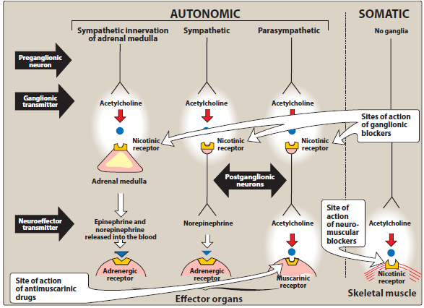
Sites of actions of cholinergic antagonists

Slide 6
ANTIMUSCARINIC AGENTS
block muscarinic receptors, causing inhibition of
muscarinic functions.
block the few exceptional sympathetic neurons that are cholinergic, such as those innervating the salivary and sweat glands.
Because they do not block nicotinic receptors, they have little or no action at skeletal neuromuscular junctions (NMJs) or autonomic ganglia.

Slide 7
A. Atropine
Atropine is a tertiary amine belladonna alkaloid with a high affinity for muscarinic receptors.
It binds competitively and prevents ACh from binding to those sites.
Atropine acts both centrally and peripherally.
Its general actions last about 4 hours, except when placed topically in the eye, where the action may last for days.
The greatest inhibitory effects are on bronchial tissue and the secretion of sweat and saliva.

Slide 8
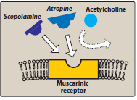

Slide 9
Actions:
Eye:
Atropine blocks muscarinic activity in the eye, resulting
in mydriasis (dilation of the pupil), unresponsiveness to
light, and cycloplegia (inability to focus for near vision).
In patients with angle-closure glaucoma, IOP may rise
dangerously.
b. Gastrointestinal (GI):
Atropine can be used as an antispasmodic to reduce
activity of the GI tract. Atropine and scopolamine are
probably the most potent antispasmodic drugs available.

Slide 10
Although gastric motility is reduced, hydrochloric acid
production is not significantly affected. Thus, atropine is
not effective for the treatment of peptic ulcer.
[Note: Pirenzepine, an M1 muscarinic antagonist, does
reduce gastric acid secretion at doses that do not
antagonize other systems.]
Doses of atropine that reduce spasms also reduce saliva
secretion, ocular accommodation, and urination. These
effects decrease compliance with atropine.

Slide 11
C. Cardiovascular: Atropine produces divergent
effects on the cardiovascular system, depending on
the dose. At low doses, the predominant effect is a
slight decrease in heart rate. This effect results from
blockade of the M1 receptors on the
inhibitory prejunctional (or presynaptic) neurons,
thus permitting increased ACh release. Higher
doses of atropine cause a progressive increase in
heart rate by blocking the M2 receptors
on the sinoatrial node.

Slide 12
d. Secretions: Atropine blocks muscarinic receptors in the salivary glands, producing dryness of the mouth (xerostomia). The
salivary glands are sensitive to atropine. Sweat and lacrimal glands are similarly affected. [Note: Inhibition of secretions
by sweat glands can cause elevated body temperature, which can be dangerous in children and the elderly.]

Slide 13
Therapeutic uses:
Ophthalmic: Topical atropine exerts both
mydriatic and cycloplegic effects.
Shorter-acting antimuscarinics (cyclopentolate
and tropicamide) have largely replaced atropine
due to Prolonged mydriasis observed with
atropine (7 to 14 days vs. 6 to 24 hours with
other agents).

Slide 14
2. Antispasmodic: Atropine is used as an antispasmodic agent to relax the GI tract.
3. Cardiovascular: The drug is used to treat bradycardia of varying etiologies.
4. Antisecretory: Atropine is sometimes used as an antisecretory agent to block secretions in the upper and lower respiratory tracts prior to surgery.

Slide 15
5. Antidote for cholinergic agonists: Atropine is used for
treatment of organophosphate (insecticides, nerve gases)
poisoning, of overdose of clinically used
anticholinesterases such as physostigmine, and in some
types of mushroom poisoning (certain mushrooms
contain cholinergic substances that block
cholinesterases). Massive doses of atropine may be
required over a long period of time to counteract the
poisons. The ability of atropine to enter the central
nervous system (CNS) is of particular importance in
treating central toxic effects of anticholinesterases.

Slide 16
Pharmacokinetics: Atropine is readily absorbed, partially
metabolized by the liver, and eliminated primarily in urine. It has
a half-life of about 4 hours.
Adverse effects: Depending on the dose, atropine may cause
dry mouth, blurred vision, “sandy eyes,” tachycardia, urinary
retention, and constipation. Effects on the CNS include restlessness,
confusion, hallucinations, and delirium, which may progress
to depression, collapse of the circulatory and respiratory
systems, and death. Low doses of cholinesterase inhibitors,
such as physostigmine, may be used to overcome atropine toxicity.
The drug may be dangerous in children, because they are sensitive to
Its effects, particularly to rapid increases in body temperature.

Slide 17
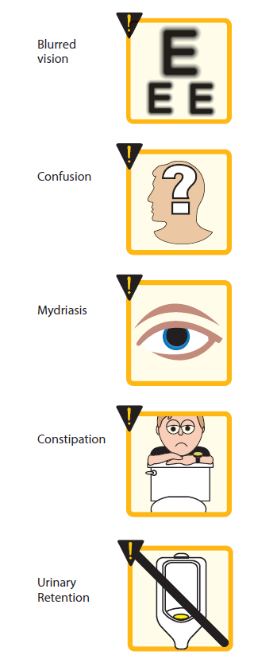
Adverse effects of muscarinic antagonists

Slide 18
B. Scopolamine
Is tertiary amine plant alkaloid,
produces peripheral effects similar to those of
atropine. However, scopolamine has greater action
on the CNS (unlike atropine, CNS effects are
observed at therapeutic doses) and a longer duration
of action as compared to atropine.
Actions: Scopolamine is one of the most effective
anti–motion sickness drugs available.

Slide 19
Therapeutic uses:
prevention of motion sickness and postoperative nausea and vomiting.
For motion sickness, it is available as a
topical patch that provides effects for up to 3
days. [Note: As with all drugs used for
motion sickness, it is much more effective
prophylactically than for treating motion
sickness once it occurs.]
Pharmacokinetics and adverse effects: similar to those of atropine.

Slide 20
C. Ipratropium and tiotropium:
are quaternary derivatives of atropine. These agents are
approved as bronchodilators for maintenance treatment of
bronchospasm associated with chronic obstructive
pulmonary Disease (COPD).
Ipratropium is also used in the acute management of
bronchospasm in asthma. Both agents are delivered via
inhalation. Because of their positive charges, these drugs do
not enter the systemic circulation or the CNS, isolating their
effects to the pulmonary system. Tiotropium is administered
once daily, a major advantage over ipratropium, which
requires dosing up to four times daily.

Slide 21
D. Tropicamide and cyclopentolate
used as ophthalmic solutions for mydriasis and cycloplegia.
Their duration of action is shorter than that of
atropine.
Tropicamide produces mydriasis for 6 hours and
cyclopentolate for 24 hours.
E. Benztropine and trihexyphenidyl
useful as adjuncts with other antiparkinsonian agents to treat parkinson’s disease.

Slide 22
F. Darifenacin, fesoterodine, oxybutynin, solifenacin, tolterodine,and trospium chloride
These synthetic atropine-like drugs are used to treat
overactive bladder. By blocking muscarinic receptors
in the bladder, bladder capacity is increased, and the
frequency of bladder contractions is reduced.
Side effects include dry mouth, constipation,
and blurred vision.
Oxybutynin is available as a transdermal patch,
which is better tolerated because it causes less dry
mouth than oral formulations.

Slide 23
GANGLIONIC BLOCKERS
specifically act on the nicotinic receptors of both
parasympathetic and sympathetic autonomic ganglia.
Therefore, ganglionic blockade is rarely used therapeutically, but often serves as a tool in experimental pharmacology.

Slide 24
A. Nicotine
A component of cigarette smoke, is a poison with
many undesirable actions.
It is without therapeutic benefit and is deleterious to
health. Depending on the dose, nicotine depolarizes
autonomic ganglia, resulting first in stimulation and
then in paralysis of all ganglia. The stimulatory effects
are complex and result from increased release of
neurotransmitters , due to effects on both
sympathetic and parasympathetic ganglia.

Slide 25
These include increased blood pressure and cardiac rate (due to release of transmitter from adrenergic terminals and from the adrenal medulla) and increased peristalsis and secretions. At higher doses, the blood pressure falls because of ganglionic blockade, and activity in both the GI tract and bladder musculature ceases.

Slide 26
NEUROMUSCULAR-BLOCKING AGENTS
These drugs block cholinergic transmission between motor nerve endings and the nicotinic receptors on the skeletal muscle. Neuromuscular blockers are clinically useful during surgery to facilitate tracheal intubation and provide complete muscle relaxation at lower anesthetic doses, allowing for more rapid recovery from anesthesia and reducing postoperative respiratory depression.

Slide 27
A. Nondepolarizing (competitive) blockers
The first drug known to block the skeletal NMJ was
curare.
The development of the drug tubocurarine followed,
but it has been replaced by other agents with fewer
adverse effects, such as cisatracurium, pancuronium,
rocuronium, and vecuronium. The neuromuscular-
blocking agents have significantly increased the safety
of anesthesia, because less anesthetic is required to
produce muscle relaxation, allowing
patients to recover quickly and completely after
surgery.

Slide 28
Mechanism of action:
a. At low doses: Nondepolarizing agents competitively block
ACh at the nicotinic receptors. That is, they
compete with ACh at the receptor without stimulating it.
Thus, these drugs prevent depolarization of the muscle cell
membrane and inhibit muscular contraction. Their
competitive action can be overcome by administration of
cholinesterase inhibitors, such as neostigmine and
edrophonium, which increase the concentration of ACh in the
neuromuscular junction. This strategy used in anesthesia to
shorten the duration of the neuromuscular blockade.

Slide 29
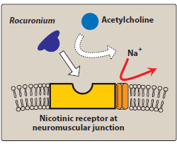
Mechanism of action of competitive neuromuscular blocking agents

Slide 30
b. At high doses: Nondepolarizing agents can
block the ion channels of the motor endplate.
This leads to further weakening of
neuromuscular transmission, thereby reducing
the ability of cholinesterase inhibitors to reverse
the actions of the nondepolarizing
blockers.

Slide 31
Actions: Not all muscles are equally sensitive to
blockade by competitive agents. Small, rapidly
contracting muscles of the face and eye are most
susceptible and are paralyzed first, followed by
the fingers, limbs, neck, and trunk muscles. Next,
the intercostal muscles are affected and, lastly, the
diaphragm. The muscles recover in the reverse
manner.

Slide 32
Pharmacokinetics: All neuromuscular-blocking agents are
injected intravenously or occasionally intramuscularly since
they are not effective orally. These agents possess two or
more quaternary amines in their bulky ring structure that
prevent their absorption from the gut. They penetrate
membranes very poorly and do not enter cells or cross the
blood–brain barrier. Many of the drugs are
not metabolized, and their actions are terminated by
redistribution. For example, pancuronium is excreted
unchanged in urine. Cisatracurium is degraded spontaneously
in plasma and by ester hydrolysis.

Slide 33
[Note: Atracurium has been replaced by its isomer,
cisatracurium. Atracurium releases histamine and is
metabolized to laudanosine, which can provoke seizures.
Cisatracurium, which has the same pharmacokinetic
properties as atracurium, is less likely to have these effects.]
Vecuronium and rocuronium are deacetylated in the liver,
and their clearance may be prolonged in patients with
hepatic disease.
These drugs are also excreted unchanged in bile. The choice
of an agent depends on the desired onset and duration of
the muscle relaxation.
Adverse effects: In general, these agents are
safe with minimal side effects.

Slide 34
Drug interactions:
1. Cholinesterase inhibitors: Drugs such as
neostigmine, physostigmine, pyridostigmine, and
edrophonium can overcome the action of
nondepolarizing neuromuscular blockers.

Slide 35
2. Halogenated hydrocarbon anesthetics:
Drugs such as desflurane act to enhance
neuromuscular blockade by exerting a stabilizing
action at the NMJ. These agents sensitize the NMJ
to the effects of neuromuscular blockers.
3. Aminoglycoside antibiotics: Drugs such as
gentamicin and tobramycin inhibit ACh release
from cholinergic nerves
4. Calcium channel blockers: These agents may
increase the neuromuscular blockade of
competitive blockers.

Slide 36
B. Depolarizing agents
Depolarizing blocking agents work by depolarizing
the plasma membrane of the muscle fiber, similar
to the action of ACh. However, these agents are
more resistant to degradation by
acetylcholinesterase (AChE) and can thus have
more persistent depolarize effect on the muscle
fibers.
Succinylcholine is the only depolaorizing
muscle relaxant in use today.

Slide 37
Mechanism of action:
Succinylcholine attaches to the nicotinic
receptor and acts like ACh to depolarize the
junction.
It persists at high conc. in the synaptic cleft,
remaining attached to the receptor for a relatively
longer time and providing constant stimulation of
the receptor.

Slide 38
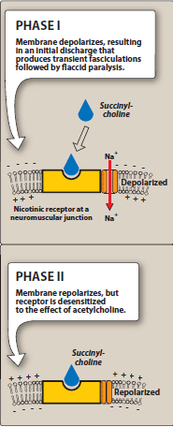


Slide 39
The depolarizing agent first causes the opening of the
sodium channel associated with the nicotinic
receptors, which results in depolarization of the
receptor (Phase I). This leads to a transient twitching of
the muscle (fasciculations). Continued binding of the
depolarizing agent renders the receptor
incapable of transmitting further impulses. With time,
continuous depolarization gives way to gradual
repolarization as the sodium channel closes. This
causes a resistance to depolarization
(Phase II) and flaccid paralysis.

Slide 40
Actions: Normally, the duration of action of
succinylcholine is extremely short, due to rapid
Hydrolysis by plasma pseudocholinesterase.
However, succinylcholine that gets to the NMJ is not
metabolized by AChE, allowing the
agent to bind to nicotinic receptors, and
redistribution to plasma is necessary for metabolism

Slide 41
Therapeutic uses:
Because of its rapid onset of action, succinylcholine
is useful when rapid endotracheal intubation is
required during the induction of anesthesia (a
rapid action is essential if aspiration of gastric
contents is to be avoided during intubation). It is
also used during electroconvulsive shock
treatment.

Slide 42
Pharmacokinetics: Succinylcholine is injected
I.V., Its brief duration of action results
from redistribution and rapid hydrolysis
by plasma pseudocholinesterase. Therefore, it is
sometimes given by continuous infusion to
maintain a longer duration of effect.
Drug effects rapidly disappear upon
discontinuation.

Slide 43
Adverse effects:
Hyperthermia: Succinylcholine can potentially induce
malignant hyperthermia in susceptible patients.
b. Apnea: Administration of succinylcholine to a patient who
is deficient in plasma cholinesterase or who has an atypical
form of the enzyme can lead to prolonged apnea due to
paralysis of the diaphragm. The rapid release of potassium
may also contribute to prolonged apnea in patients with
electrolyte imbalances who receive this drug. In patients with
electrolyte imbalances who are also receiving digoxin or
diuretics (such as heart failure patients) succinylcholine
should be used with caution or not at all.

Slide 44
c. Hyperkalemia: Succinylcholine increases
potassium release from intracellular stores. This
may be particularly dangerous in burn patients and
patients with massive tissue damage in which
potassium has been rapidly lost from within cells.

