Slide 1
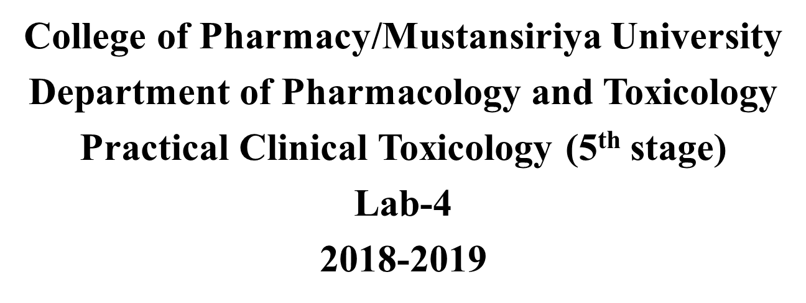
Acetaminophen & Salicylates Toxicity

Slide 2
Acetaminophen
( N -acetyl- p -aminophenol [APAP])
Most commonly used OTC analgesic and antipyratic drug
It has weak anti inflammatory and antiplatelet properties
Antipyresis and analgesia are predominantly mediated by the central indirect COX-2 inhibition where as anti inflammatory and antiplatelets effect due to mild, peripheral inhibition of COX-2 and minimal COX-1 inhibition.

Slide 3
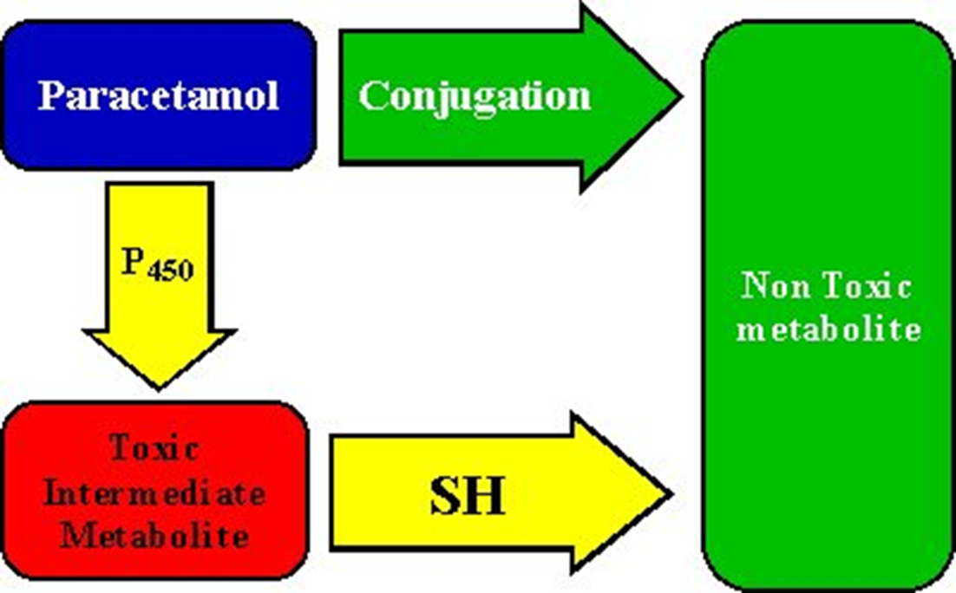
Acetaminophen metabolism
60% glucuronide conjugates
30% to sulfate conjugates
4% is metabolized by the cytochrome P450 mixed-function oxidase system (CYP 2E1 ) to the potentially toxic reactive intermediate N-acetyl-p-benzoquinoneimine (NAPQI).
LIVER
conjugated with glutathione to form nontoxic cysteine and mercapturic acid conjugates

Slide 4
Mechanism of toxicity
Nontoxic sulfation metabolism of APAP may become saturated,and the amount of N -acetyl- p benzoquinoneimine (NAPQI) (toxic metabolite) formed is increased by CYP2E1 and outstrip the supplying of (glutathion)GSH, resulting in free NAPQI rapidly binding to hepatocyte constituents lead to centrilubular necrosis.
Hepatic toxicity becomes evident only when hepatic GSH falls to 30% of baseline

Slide 6
**Factors that may predispose patients to hepatotoxicity:
Increased frequency and duration of acetaminophen dosing
Increased capacity for CYP2E1 activation to NAPQI for example: Long-term treatment with CYP 450 inductors (e.g., carbamazepine, rifampicin) and long term administeration of alcohol.
Decreased GSH availability by:
people with acute or chronic starvation
Eating disorders (e.g., anorexia or bulimia)
Patients with chronic debilitating illnesses (e.g., cystic fibrosis, AIDS, alcoholism, or hepatitis C)
Decreased capacity for glucuronidation and sulfation
Children

Slide 7
Concentrations of acetaminophen and their interpretation

Slide 8
Clinical Manifestations
Stage II toxicity
24 to 72hours, right upper quadrant abdominal pain, anorexia, N/V,
Tachycardia and hypotension , Raised liver function test
Stage III toxicity
72 to 96 hours, N/V/abdominal pain, Maximal liver injury (jaundice, coagulopathy,
hypoglycemia, and hepatic encephalopathy), Acute renal failure,
Death from multiorgan failure
Stage IV toxicity
The recovery phase, Patients who survive stage III

Slide 9
Monitoring and Testing
Laboratory tests
*Serum acetaminophen levels
Management is dependent on the serum acetaminophen level and the time of ingestion
Rumack/Matthew nomogram or acetaminophen nomogram is an acetaminophen toxicity nomogram plotting serum concentration of acetaminophen against the time since ingestion in an attempt to prognosticate possible liver toxicity as well as allowing a clinician to decide whether to proceed with N-Acetylcysteine (NAC) treatment or not.
Paracetamol concentrations taken between 4 and 24 hours after ingestion.
Generally, a serum plasma concentration (APAP) of 140–150 microgram/mL (or milligrams/L) at 4 hours post ingestion, indicates the need for NAC treatment.

Slide 11
Cont…
Liver function tests
alanine aminotransferase [ALT]
aspartate aminotransferase [AST]
bilirubin [total and fractionated]
alkaline phosphatase
Prothrombin time (PT) with international normalized ratio (INR)
Glucose
Renal function studies (electrolytes, BUN, creatinine)

Slide 12
Treatment of Acetaminophen Overdose
Gastric emptying
Activated charcol
NAC (N-acetylcysteine),antidote given orally, from 4-8 hrs from ingestion. It is a sulfhydryl
donor, replenishes glutathione stores
Loading dose of 140 mg/kg then 70 mg/kg given every 4 hours
Total treatment duration of 72 hours
It causes vomiting when given by mouth or nausea when given intravenously
Asthma, this treated by interrupting the acetylcysteine infusion and providing symptomatic relief with an antihistamine such as chlorpheniramine and nebulized salbutamol.
Liver transplantation, for patients with severe hepatotoxicity and potential to progress to hepatic failure,Metabolic acidosis,Renal failure, Coagulopathy and Encephalopathy

Slide 13
Case study
A 16-year-old female patient arrives in the ED by ambulance after being found by a parent in what appeared to be an intoxicated state with empty pill bottles scattered about her room. The parent reports the patient was despondent recently after breaking up with her boyfriend. The patient is tearful and reports abdominal pain and admits to drinking alcohol and taking over-the-counter (OTC) pills in an apparent suicide attempt. The estimated time of ingestion is six hours prior to arrival in the ED. The patient does not use prescription, OTC medications, or dietary supplements and is not known to have a history of regular consumption of alcoholic beverages or use illicit drugs.
On physical examination the vital signs were blood pressure 118/80 mm Hg, pulse 88/min and regular, respiratory rate 18/min, and temperature 37.0°C. She was awake and oriented, responded to questions appropriately with slightly slurred speech. Other pertinent findings included normal bowel sounds with mild epigastric tenderness. The neurological examination was only significant for slightly slurred speech.
Routine clinical laboratory studies were ordered STAT (electrolytes, creatinine, BUN, glucose, complete blood count with differential, coagulation studies, urine analysis, and urine toxicology screen) and a plasma acetaminophen level. Chest and abdominal radiography were normal.
The patient was given 1.5 g/kg oral activated charcoal as a slurry in a sorbitol cathartic and placed in the intensive monitoring section of the ED while the laboratory tests were being performed. Forty minutes later, the laboratory results returned and showed a mildly increased white blood cell count, liver transaminase values were elevated at approximately three times the upper limit of normal, and an acetaminophen concentration was 308 ug/mL. She denied taking any other medications with the acetaminophen and alcohol.
Based on the Rumack–Mathew nomogram ,a plasma acetaminophen concentration of 308 ug/mL at approximately six hours after ingestion is well within the “probable hepatic toxicity” range, and therefore treatment with NAC was required. The patient received the first dose of IV NAC in the ED and was admitted to the medical ward to complete the treatment course of IV NAC. Transient increases of hepatic transaminases were measured over the ensuing two days of the hospitalization. The patient was seen by the Psychiatry Consultation service, which determined she was not actively suicidal; she was discharged from the hospital
two days after admission with scheduled psychiatric and medical follow-up appointments

Slide 14
Salicylates Toxicity
Aspirin is acetyl salicylic acid ,it has analgesics, anti inflammatory, antipyretic and antiplateletes effects.
Aspirin acts by inhibiting COX and thus inhibit generation of prostaglandin and thromboxane.
Its side effects incude GI ulceration,bleeding and interferance with platelets adherance
Concentrations higher than 30 mg/dL are associated with signs and symptoms of toxicity.
A toxic condition produced by the excessive intake of salicylates
called salicylism

Slide 15
Mechanism of Salicylate Toxicity
Salicylic acid acts to uncouple oxidative phosphorylation, leading to accumulation of lactic acid and pyruvic acid, causing a primary elevated anion gap metabolic acidosis.
Salicylic acid also directly stimulates the respiratory drive in the medulla, leading to a primary respiratory alkalosis.
Salicylic acid is a weak acid, exists mostly in charged/ionized state at physiologic pH. As pH decreases, shifts more towards uncharged/ non-ionzed state and can cross blood-brain barrier to worsen neurotoxicity.
Neuroglycopenia ,even at normal plasma glucose levels, salicylate toxicity causes decreased brain glucose due to uncoupling of oxidative phosphorylation and compensatory stimulation of brain glycolysis.

Slide 16
Clinical manifestation
Hyperthermia is an indication of severe toxicity
Acute intoxication
Gastric effects: N & V, Gastritis
CNS effects: N & V, tinnitus, confusion, hallucinations, seizures
Metabolic effects: Hyperventilation, Acid-base disturbance (respiratory alkalosis, metabolic acidosis), dehydration, electrolyte disturbances, fever
Chronic intoxication
More common in elderly
Lower GI symptoms & higher non-specific neuro symptoms
Confusion, delirium, dehydration, metabolic acidosis, cerebral oedema

Slide 17
Monitoring and Testing
Lab tests
Salicylate level
If enteric coated preparations, serial salicylate levels (2 hourly)
15-30 mg/dL: therapeutic level
Higher than 40-50 mg/dL: symptomatic
Above 100 mg/dL: life-threatening toxicity
Arterial blood gas (ABG)
Respiratory alkalosis
Metabolic acidosis
Electrolytes, BUN/creatinine, glucose
Anion-gap metabolic acidosis
Hypokalemia
Baseline renal function

Slide 18
Treatment of salicylism
ABC performance include maintaining of air ways and ventilation as well as circulation. Caution should be taken for airways maintaining with endotracheal intubation and assisted ventilation
MDAC with or without whole bowel irrigation solution such as poly ethylene glycol electrolyte solution(PEG-ELS) particularly for enteric coated aspirin.
I.V. fluid to correct dehydration (ex: Normal Saline)
I.V. Sod.bicarbonate infusion (Alkalinization will reduce the non-ionic fraction of salicylate thus reduce the penetration of BBB and CNS effect. Also it maintains the urine PH >7.5 thus enhance elimination).
Correction of hypokalemia by potassium supplement (if not, it will prevent urine alkalinization).

Slide 19
Hemodialysis indicated when
A- Alkalinisation and elimination with sod.bicarbonate not achieved.
B- Persistent altered mental status
C- Renal/hepatic/cardiac failure
D- Persistent acidemia
E- Acute salicylism with concentrations greater than
80 or 100 mg/dL.
F- In chronic salicylate toxicity, may require HD at
much lower levels.

