Slide 1
Biopharmacy
Biopharmaceutics and pharmacokinetics
Arranged by
Assistant professor Widad Kamal Ali
Edited by
Assiastant lecturer Amera Radhi
Assistant lecturer Nora Zawar
Assistant lecturer Ashti mohamed

Slide 2
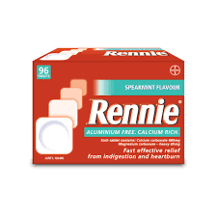
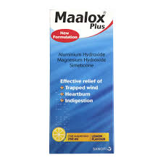
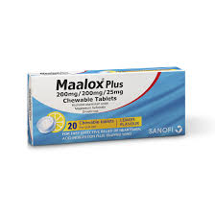
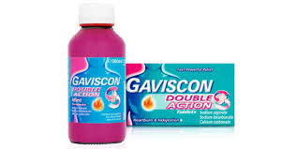
Lab 2.In vitro evaluation of antacids

Slide 3
Introduction
The Gastro-intestinal (GI) tract generates and maintains different pH environments along its length.
pH is very important for controlling activity of digestive enzymes.

Slide 4
ACIDITY IN THE STOMACH
Acidity in the stomach is normal, but excess acidity is potentially harmful.
It is unusual compared to other organs as its pH is as low as 1-2 due to production of hydrochloric acid from structures in lining of walls.
Acid environment kills bacteria that comes in with food, is optimum for activity of digestive enzymes

Slide 5

EXCESS ACID
Factors that cause excess production of gastric juice (acidic secretion)
 Excess alcohol
 Smoking
 Stress
 Some anti-inflammatory drugs

Slide 6
Acid indigestion or dyspepsia is an illness commonly treated by self-medication.
Antacids are drugs which on ingestion react with the hydrochloric acid of gastric content to lower the acidity.
Antacids are alkalis, such as aluminium hydroxide, magnesium salts (magnesium hydroxide and magnesium trisilicate),sodium bicarbonate, and calcium hydroxide.
The finished product must raise the pH of gastric secretions to 3.5 or greater within 10 minutes.

Slide 7
They are simple ,often effective treatment for many dyspepsia's (impairment of the power or function of digestion),and provide symptomatic relief in conditions such as peptic ulcer, gastritis (inflammation of the lining of the stomach) ,and esophageal reflux with heartburn.

Slide 8
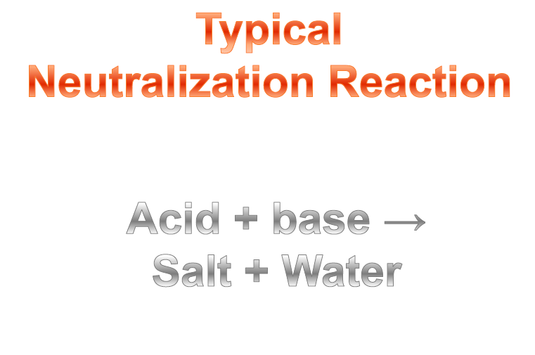

Slide 9
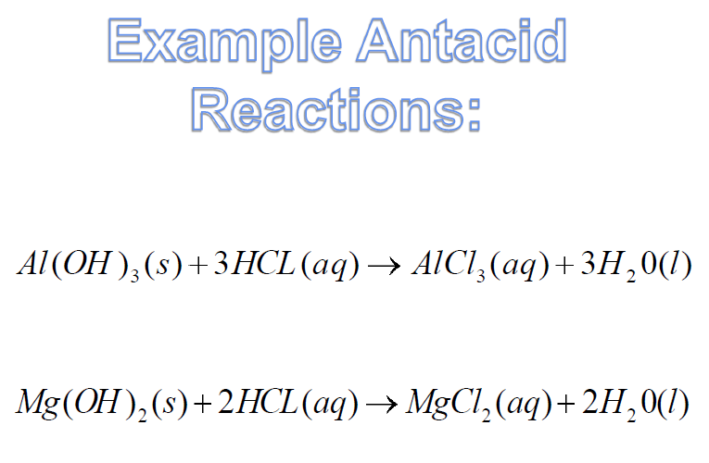

Slide 10
They are generally formulated in combinations ,for example:
magnesium hydroxide +aluminium hydroxide
Or with other components, such as:
Simeticone (activated dimeticone, an anti-foaming agent),
Alginates (anti-reflux agents).

Slide 11
Antacids may be divided into two main groups according to their water solubility:
Water insoluble and have slow prolonged action
e.g.aluminium hydroxide,magnesium carbonate,hydroxide and trisilicate.
Water soluble and act quickly but its effect is transient and prolonged use may cause systemic alkalosis and renal damage
e.g. sodium bicarbonate and sodium citrate

Slide 12
Antacids ,by altering gastric pH, may interfere with drug absorption in number of ways:
Altered drug ionization :e.g. carbenoxolone (an ulcer healing drug),its absorption is completely inhibited above pH 2 and therefore ,it should not be given with antacids.
Alteration of gastric emptying : The stomach empties more readily when pH increaeses.

Slide 13
Drug dissolution may be affected by pH changes.
Drug interaction: calcium , aluminium and magnesium decrease the gastric absorption of tetracyclines due to complex formation with it.
Systemic effect : Systemic antacids may accelerate the excretion of drugs(salicylates) and inhibit the urinary excretion of basic drugs ,e.g. amphetamines.
It seems advisable to administer other drugs at least one half to one hour before antacids ingestion in order to assure consistent absorption and effect.

Slide 14
Several factors must be considered when selecting an antacid product
Patient
Type of antacid
Neutralizing capacity
Dose and dose interval
Cost

Slide 15
The patient : Whether he has impaired renal function ,edema , high blood pressure , allergic to milk or milk products.
Type of antacid(systemic or nonsystemic ):A systemic antacid,such as sodium bicarbonate is soluble, readily absorbed,and capable of producing systemic electrolyte disturbance

Slide 16
Non systemic such as calcium carbonate or basic aluminum substances ,form compounds that are not appreciably absorbed and thus do not exert any systemic effect.

Slide 17
Neutralizing capacity
Antacids differ in their ability to neutralize gastric secretions
Dose and dose interval
An ideal antacid should be rapid in onset and provide a continuous buffering action

Slide 18
Mg (OH)2 and CaCo3 have rapid onset of action.
MgCO3 : Intermediate onset
Mg trisilicate and aluminium compounds have slow onset.

Slide 19
Aim of the experiment:
The objective of this experiment is to
evaluate in vitro , a number of antacid marketed products and compare their buffering capacity .

Slide 20
Principle
A simple procedure is used, to imitate the physiological conditions in the stomach . Techniques of alternate addition and removal of (0.1N HCI )solution are used to mimic the release of HCL from the oxyntic cells and the periodic emptying of the stomach.

Slide 21
Experimental
A quantity of 2gm of finely ground powder or its equivalent of formulations was added to 100ml of 0.1N HCI.
The pH of the mixture was determined after the intervals of 0.5, 2, 4, 6, 8 and 10 minutes.
A quantity of 20ml of the mixture was then removed by a pipette and replaced by 20ml fresh 0.1N HCI.

Slide 22
The process was repeated at 10 minutes interval until a pH below 2.75 was reached which shows that the buffering power of antacid was spent out.
the time at which pH falls below 2.75 was used as measure of buffering capacity

Slide 23
Enter your results in a table and plot a graph against time as you conduct the experiment.

Slide 24
PH of the mixture | Time in minutes
 | 0.5
 | 2
 | 4
 | 6
 | 8
 | 10
 | 20
 | 40
 | 50

