Slide 1
Community pharmacy lab fourth stage students
Cough
Assistant lecturers zahraa abdulGhani lubab Tareq Nafea
MSc in clinical pharmacy

Slide 2
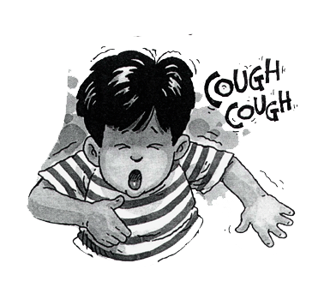

Slide 3

Coughing is a protective reflex action caused when the airway is being irritated or obstructed. Its purpose is to clear the airway so that breathing can continue normally.

Slide 4
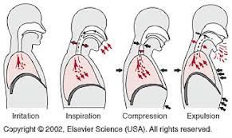

Slide 5
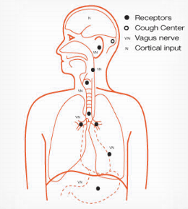

Slide 6
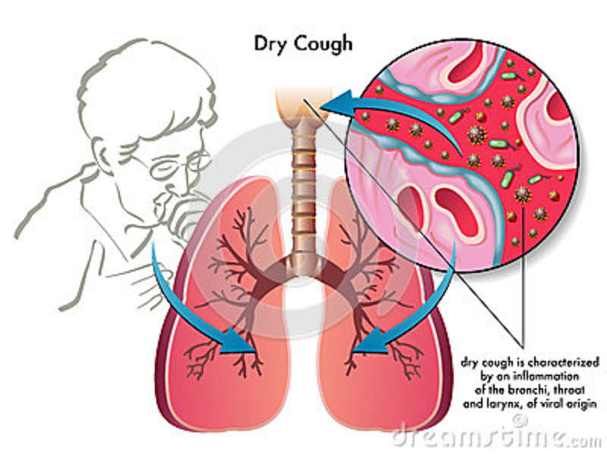

Slide 7

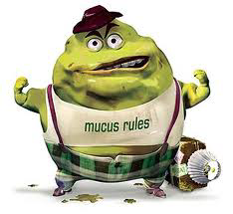

Slide 8
Types of cough
Unproductive (dry): no sputum is produced caused by viral infection and is self-limiting.
Productive (chesty or loose): sputum is normally produced but over secretion to coughing may be caused by irritation of the airways due to infection, allergy, etc., or when the cilia are not working properly (e.g. in smokers).
Non-coloured (clear or whitish) sputum is uninfected and known as mucoid.
Coloured sputum may indicate a bacterial chest infection such as bronchitis or pneumonia and require referral. In these situations the sputum is described as green, yellow or rust-coloured thick mucus and the patient is more unwell usually with a raised temperature, shivers and sweats. Sometimes blood may be present in the sputum (haemoptysis), with a colour ranging from pink to deep red. Haemoptysis is an indication for referral.

Slide 9
Significance of questions and answers
Age: the patient is – child or adult – will influence the choice of treatment.
Duration: most coughs are self-limiting and will be better within a few days with or without treatment. In general, a cough of longer than 2 weeks’ duration should be referred.
Nature of cough
A-Dry
B-Wet (i.e. there is sputum)
Associated symptoms: cold, sore throat and catarrh may be associated with a cough.
Postnasal drip: is a common cause of coughing and may be due to sinusitis.
Smoking habit: smoking will exacerbate a cough and can cause coughing since it is irritating to the lungs. On stopping, the cough may initially become worse as the cleaning action of the cilia is re-established during the first few days.

Slide 10
Referral conditions:
-Cough lasting 2 weeks or more and not improving, sputum (yellow, green, rusty or blood-stained),chest pain, shortness of breath, wheezing, recurrent nocturnal cough, suspected adverse drug reaction and failed medication requiring referral to a physician.
-Tuberculosis (TB),Chronic bronchitis{ Fever, night sweats, weight loss, and hemoptysis: may indicate TB (tuberculosis) ------------referral for further investigations} .
-Asthma: a recurrent night-time cough with or without wheezing may indicates Asthma---------------- referral for further investigations .(Especially if there is a family history of eczema, asthma, hay fever …) ,can indicate asthma, especially in children.
-Smoking: if cough is related to smoking, refer the patient to primary care provider; such cough should not be self-treated with cough suppressant and/or expectorant. (Patient who smokes is more prone to chronic recurrent cough. Over time this might be develops into chronic bronchitis or emphysema) .
-Postnasal Drip: It is a common cause of coughing and may be due to sinusitis--------- referral for further investigations.(Postnasal Drip is characterized by a nasal discharge that flows behind the nose and into the throat . Patient present with swallowing mucus or frequent clearing of the throat more than usual).

Slide 11
Croup : it usually occurs in infants. The cough has a harsh barking quality and paroxysmal (occurring in bouts) . It develops 1 day or so after the onset of cold-like symptoms, often associated with difficulty in breathing , stridor (noisy inspiration) or noise in throat on breathing in)----------- referral for further investigations.
-Whooping cough (pertussis):it starts with catarrhal symptoms. The bouts of coughing prevent normal breathing and the whoop represents the desperate attempt to get a breath.
-Cardiovascular: coughing can be a symptom of heart failure. If there is a history of heart disease, especially with a persisting cough, or cough with frothy sputum, breathlessness (especially in bed during the night) may indicate heart failure------------- referral for further investigations.
(Note: other symptom of heart failure may be swollen ankles).
( لذلك نسال المريض عن history of C.V. disease)
(if there is a history of heart disease especially with a persisting cough, then referral is advisable then referral is advisable.
-Gastro-oesophageal: can cause coughing. Sometimes such reflux is asymptomatic apart from coughing. Or Coughing during the recumbent (supine, lying down), with heartburn may indicate Gastro esophageal reflux disease(GERD) which may be improved by antacid or histamine-2 receptor antagonists(H2RA) .
-Others Chest pain, shortness of breath (SOB), wheezing, Whooping------------- referral for further investigations

Slide 12
Medication:
If one or more appropriate remedies have been tried without success (failed medication) ------------- referral for further investigations .
Effective product for similar previous cough: the pharmacist should consider patient's satisfaction or dissatisfaction with specific products i.e. patient's preferability .
Drug-induced cough: e.g.:
1-Angiotensin-converting enzyme (ACE) inhibitors: (e.g. captopril, lisinopril, Enalapril ……) can induce cough in about 10% of patients (especially women), the cough is usually nonproductive, occurs within the first few months of therapy-----------refer and suggest the alternative: Angiotensin –II receptor antagonists (valsartan, losartan, ….).
2-The antiarrythmic agent :amiodarone.

Slide 13
Treatment timescale:-
The patient should seek medical attention if the cough does not improve in 7-10 days. Or if the cough persists longer than 3 weeks even if it has respond to OTC drugs .
Management:
Non-drug measures:
*slowly dissolving hard candies or other lozenges in the mouth may sooth the irritated throat and decreases the dry cough.
(They don’t contain an active ingredient and considered to be safe in children and pregnant women) .If recommended they should be given 3-4 times daily .
*General advice to patient with cough and cold is to increase fluid intake to about 2Ls / day .(About 8 to 10 glasses daily).

Slide 14

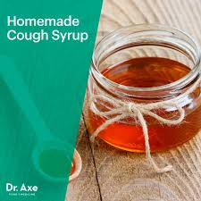
Non-pharmacological Treatment

Slide 15
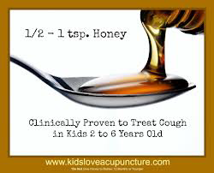

Slide 16
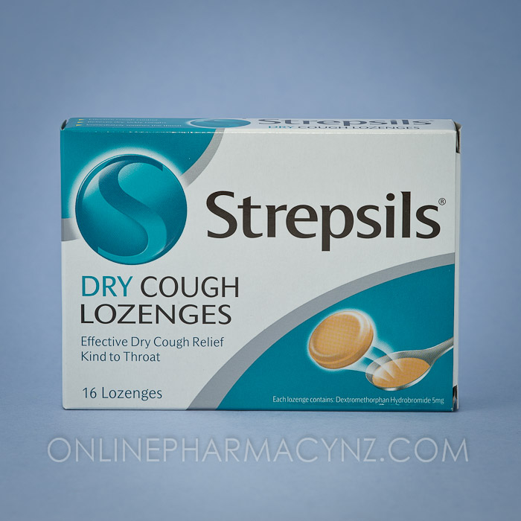
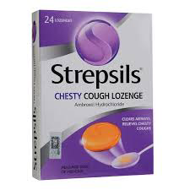

Slide 17
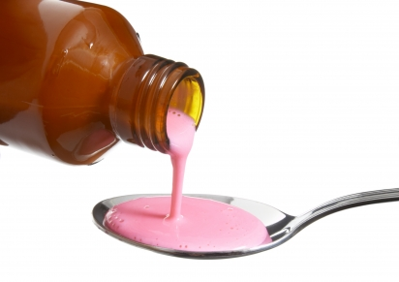
Cough Suppressant

Slide 18


Slide 19
Non-prescription medications:
A-Antitussive (cough suppressants): used for dry cough.
1-Codiene:
ملاحظة: إن هذا الدواء لا يتوفر حاليا في العراق منفردا ولكنه موجود ضمن الـ :
cough mixtures
e.g. of codeine containing cough mixtures available in Iraq are:
Tussiram® syrup, Pulmocodin® syrup…
S/Es: even at OTC doses codeine can cause constipation and at high doses, respiratory depression, therefore it is best avoided in patients with impaired respiratory function e.g. Asthma .
) ولكن وعلى الرغم من ذلك فان مصدر رقم 3 يذكر مايلي:
However, in practice this is very rarely observed and does not preclude the use of cough suppressant in asthmatic patients) .
(Note: Codiene is well known as a drug of abuse and sales must be refused because of knowledge or likelihood of abuse) .

Slide 20
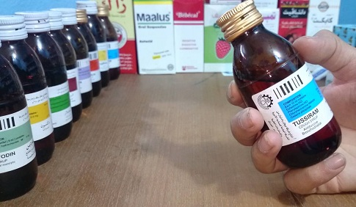

Slide 21

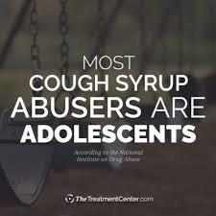
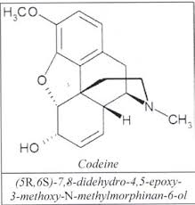
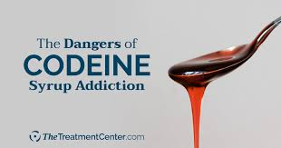

Slide 22
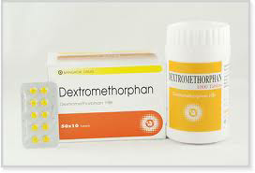
Dextromethorphan…

Slide 23
2-Dextromethorphan (Sedilar® tablet, drop,)
Generally it is considered non-sedating and has fewer side effects .
Dose :
dextromethorphanملاحظة: لكننا اخترنا الجرع اعلاه لسهولتها........
------------------------------------------------------------------------
3 -Diphenhydramine (Allermine®): Which is one of the sedating antihistamines.
The antitussive doses are :
1-5 years | 5 -12 years | Adults
2.5 mg four times daily | 7.5 mg four times daily | 15 mg four times daily
2-6 years | 6 -12 years | Adult
6.5 mg every 4hours (max. 37.5mg/day) | 12.5 mg every 4hours (max. 75mg/day) | 25 mg every 4hours (max. 150mg/day)

Slide 24
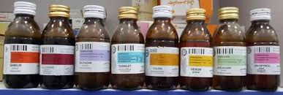
) للاطلاع) Pediatric Dextromethorphan doses:
كثيرا ماتوصف قطرات الـSedilar بجرع خاطئة وكبيرة لان اغلب المصادر لاتعطي جرعته تحت السنة وكما يلي فيرجى الانتباه لها رجاءا:
Equivalent no. of drops of (sedilar®drop:15mg/ml) | Dose | Age
About 1drop t.i.d | 0.5-1 mg t.i.d | 1-3 months
About 2drop t.i.d | 1-2 mg t.i.d | 3-6 months
About 3drop t.i.d | 2-4 mg t.i.d | 7months-1 year

Slide 25
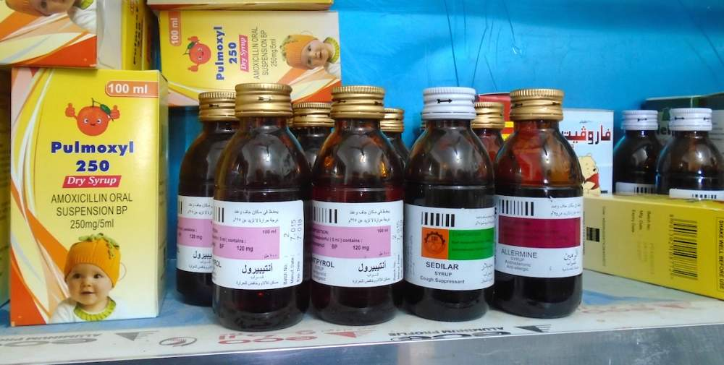
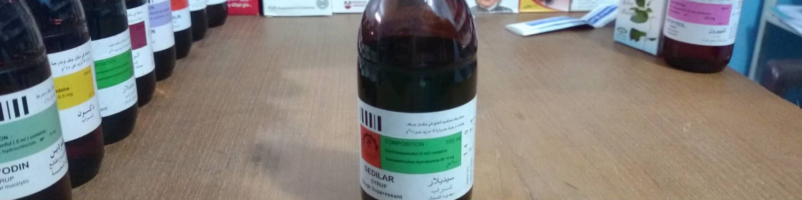

Slide 26
B-Expectorants and Mucolytics: which are used for wet cough.( But see the placebo effects of cough preparations later).
1-Glyceryl guaiacolate (also called Guaifenesin): Which is the only FDA approved OTC expectorant .
Doses :
ملاحظة: لكننا اخترنا الجرع اعلاه لسهولتها........
1-6 years | 6 -12 years | Adults
50 mg four times daily | 100 mg four times daily | 200 mg four times daily
2-Bromohexine (Solvodin® syrup, and tablet): which is one of the mucolytic drugs, used for wet cough.

Slide 27
C-Additional Constituents:
1-Theophylline: which is one of the bronchodilators, and it is available in some OTC products but it is best avoided because patients requiring medication to help with shortness of breath (SOB) or wheeze are best referred .
2-Sympathomimetics (e.g. Pseudoephedrine and Phenylphrine): these are commonly included in cough and cold remedies for their bronchodilator and decongestant actions .
They may be useful if the patient has blocked nose as well as cough, but they can increase the BP ,stimulate the heart, and alter the diabetic control therefore they are not recommended for patients with :
Coronary artery diseases (Angina, MI, ….), Hypertension, Diabetes mellitus, and Hyperthyroidism .
3-Sedating Antihistamine: like Diphenhydramine, and chlorpheniramine,…., which may be added to antitussives ( combination with expectorant is illogical) and they are effective especially if the dry cough is disturbing sleep.
S/Es: include sedation and drowsiness and anticholinergic S/Es (i.e. dry mouth, urinary retention, constipation, …..).
They are not recommended (or used with caution ) for patients with:
Glaucoma or prostate hypertrophy.

Slide 28
Further reading:
1-Placebo effects of cough preparations .
Antitussive probably have a limited role in the treatment of acute non-productive cough .patients should be encouraged to increase fluid intake and told that their symptoms will resolve in time on their own. If medication is required then any active ingredient could be recommended and the side effect profile and abuse tendency rather than clinical efficacy will drive choice. On this basis:
*Dextromethorphan: will be 1st line therapy.
*Codiene: will be 2nd line therapy (because of side effect profile and abuse tendency).
*Antihistamine: should not be used routinely, unless night-time sedation is perceived additional benefit to the patient sleep.
In addition, most products to treat productive cough are probably no more effective than placebos, however, if the patient has confidence in a product's efficacy then their use should not be discourage.
2-Diabetic patient and the sugar contents of cough medicines:
Current thinking is that in short –term acute conditions the amount of sugar in cough medicines is relatively unimportant .
(However sugar-free products are available and may be used for diabetic patients and by patients who wish to reduce sugar intake for themselves and their children as part of dental health) .

Slide 29
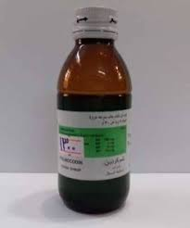
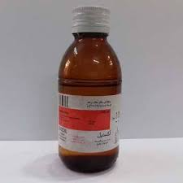
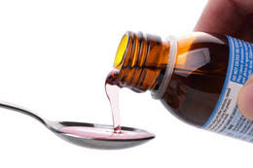

Slide 30
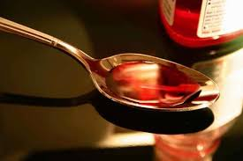
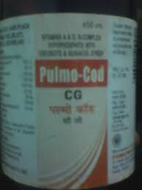
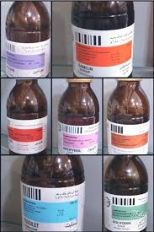

Slide 31
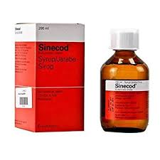
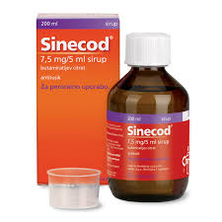
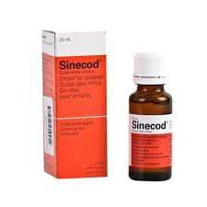
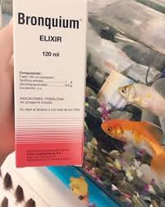

Slide 32
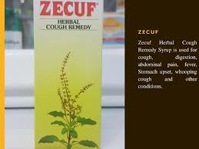
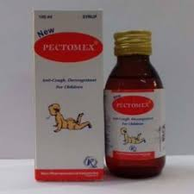

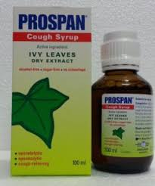


Slide 33
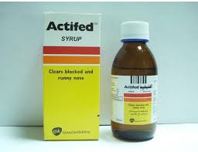
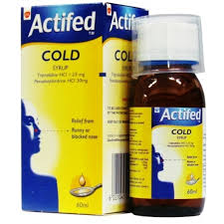
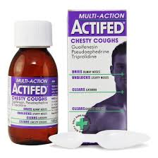
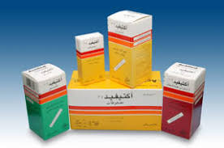


Slide 34

Thank you

