Slide 1
ORGANIC PHARMACEUTICAL CHEMISTRY IV
Dr. Mohammed Al-Ameedee
amiedy5@yahoo.com

Slide 2
Course Outline
Drug discovery, design and development
Choose a disease
Choose a drug target
Find a lead compound
Isolate and purify the lead compound
Identify the structure-activity relationships (SAR)
Identify the pharmacophore
Improve target interactions
Improve pharmacokinetic properties

Slide 3
Course Outline
Drug discovery, design and development
Patent the drug
Preclinical trials
Design a manufacturing process
Clinical trials
Register and market the drug
Make money

Slide 4
Choose a disease
A huge investment has to be made in the research and development of a new drug
research projects tend to focus on diseases that are important in the developed world because this is the market best able to afford new drugs
A great deal of research is carried out on ailments such as migraine, depression, ulcers, obesity, flu, cancer, and cardiovascular disease
Less research is carried out on the tropical diseases of the developing world
Science starts beyond this point

Slide 5
Choosing a drug target
Drugs exert their action through interaction with their targets
In the past targets were identified after discovery of their drugs, e.g. morphine.
Drug targets are receptors, enzymes or nucleic acids
Medicinal chemists should decide whether the desired effect is through the design of agonist or antagonist of receptor, or substrate or inhibitor for particular enzyme
Drug targets identification showed excellent progress after mapping of human genome project

Slide 6
Choosing a drug target
Target specificity and selectivity
Drug targets have different isoforms with different pharmacological actions
The desired drug should act on the specific isoform
Unwanted drug effects result often from the interaction of drug with other members of receptor or enzyme family
Selectivity is one of the main challenges of drug design

Slide 7
Choosing a drug target
In certain diseases, it is important to target different targets such as receptors, enzymes or ion channels
Treatment of hypertension requires drugs with different targets such as beta receptors, angiotensin converting enzyme, angiotensin II receptors
This is because cells have a highly complex system of signalling mechanisms, it is possible that the blockade of one part of that system could be overcome.

Slide 8
Choosing a drug target
This could be compared to blocking the main road into town to try and prevent congestion in the town centre.
The policy works, but, in a day or two, commuters discover alternative routes and congestion in the centre becomes as bad as ever

Slide 9
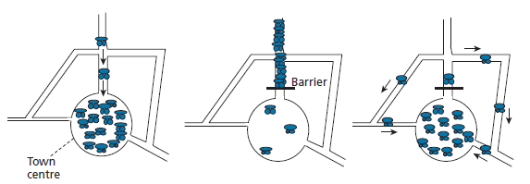

Slide 10
Finding a lead compound
The next stage of drug discovery project is finding a lead
Lead compound is a compound which shows the desired pharmacological activity
The level of activity may not be very great and there may be undesirable side effects, but the lead compound provides a start for the drug design and development process
There are different ways for finding a lead compound

Slide 11
Finding a lead compound
Screening of natural compound such as opioids (morphine, cocaine) and cholinergic drugs (tubocurarine, nicotine and muscarine)
One of the most extensively studied natural anticancer drug is taxol from the yew tree

Slide 12
Finding a lead compound
Screening of thousands of compounds synthesized by pharmaceutical companies are another source of lead compounds
The main disadvantage of this source is that these compounds often represent small modifications of a common nucleus
To overcome this, pharmaceutical companies try to diversify their range of structures by purchasing novel compounds prepared by research groups elsewhere—a useful source of revenue for university departments
Th ese compounds may never have been synthesized with medicinal chemistry in mind and may be intermediates in a purely synthetic research project, but there is always the chance that they may have useful biological activity.

Slide 13
Finding a lead compound
It can also be worth testing synthetic intermediates.
For example, a series of thiosemicarbazones was synthesized and tested as antitubercular agents in the 1950s. Th is included isonicotinaldehyde thiosemicarbazone, the synthesis of which involved the hydrazide structure isoniazid as a synthetic intermediate.
It was found subsequently that isoniazid had greater activity than the target structure. Similarly, a series of quinoline-3-carboxamide intermediates were found to have antiviral activity

Slide 14
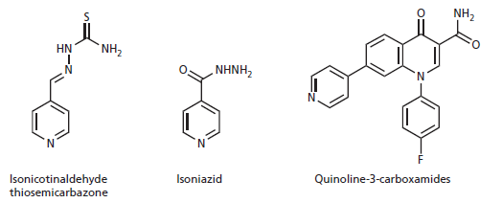
Finding a lead compound

Slide 15
Finding a lead compound
Lead compounds can be also obtained from existing drugs
Sulfonamides have been used as antibacterial agents.
Some sulfonamides with antibacterial activity could not be used clinically because they had convulsive side effects brought on by hypoglycaemia
This is an undesirable side effect for an antibacterial agent, but the ability to lower blood glucose levels would be useful in the treatment of diabetes.
Structural alterations were made to the sulfonamides concerned in order to eliminate the antibacterial activity and enhance antidiabetic activity

Slide 16
Finding a lead compound
This has led to the development of the antidiabetic sulfonamide tolbutamide
the anticoagulant warfarin is also a weak inhibitor of a viral enzyme that is important in the life cycle of HIV.
Warfarin was used as the lead compound in the development of an anti-HIV drug called tipranavir

Slide 17
Finding a lead compound

