Slide 1
ORGANIC PHARMACEUTICAL CHEMISTRY IV
Dr. Mohammed Al-Ameedee
amiedy5@yahoo.com

Slide 2
Natural ligands for receptors
The natural ligand of a receptor can also be used as the lead compound in the design of an antagonist
Histamine was used as the original lead compound in the development of the H 2 histamine antagonist cimetidine
Turning an agonist into an antagonist is frequently achieved by adding extra binding groups to the lead structure

Slide 3
Combinatorial synthesis
Th e growing number of potentially new drug targets means that there is an urgent need to find new lead compounds to interact with these targets
The traditional sources of lead compounds are not enough for this mission
Research groups have invested greatly in combinatorial and parallel synthesis in order to tackle this problem
Combinatorial synthesis is an automated solid-phase procedure aimed at producing as many different structures as possible in as short a time as possible
The reactions are carried out on very small scale, often in a way that will produce mixtures of compounds in each reaction vial

Slide 4
Computer-aided design of lead compounds
A detailed knowledge of a target binding site helps in the design of novel lead compounds intended to bind with that target.
In cases where enzymes or receptors can be crystallized, it is possible to determine the structure of the protein and its binding site by X-ray crystallography
Molecular modelling soft ware programs can then be used to study the binding site and to design molecules which will fi t and bind to the site— de novo drug design

Slide 5
Fragment-based lead discovery
the method sets out to find small molecules (epitopes), which will bind to specific, but different, regions of a protein’s binding site.
These molecules will have no activity in themselves as they only bind to one part of the binding site, but if a larger molecule is designed which links these epitopes together, then a lead compound may be created which is active and which binds to the whole of the binding site
Binding can be detected by observing a shift in any of the amide signals, which will not only show that binding is taking place, but will also reveal which part of the binding site is occupied

Slide 6
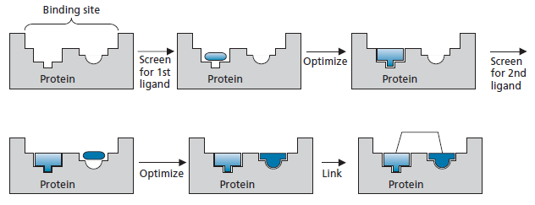
Fragment-based lead discovery
Once two ligands (or epitopes) have been identified, the structure of each can be optimized to find the best ligand for each of the binding regions
A molecule can be designed where the two ligands are linked together
This strategy is called the linking of fragments

Slide 7
Fragment-based lead discovery
Advantages
It is much easier to synthesize a series of small molecular weight compounds to optimize the interaction with specific parts of the binding site, than it is to synthesize a range of larger molecules to fit the overall binding site
A high level of diversity is also possible, as various combinations of fragments could be used
It is more likely to find epitopes that will bind to a particular region of a binding site, than to find a lead compound that will bind to the overall binding site

Slide 8
Fragment-based lead discovery
Fragments are more likely to be efficient binders, having a high binding energy per unit molecular mass
Some studies have demonstrated a ‘super-additivity’ effect where the binding affinity of the two linked fragments is much greater than one might have expected from the binding affinities of the two independent fragments

Slide 9
Fragment-based lead discovery
The second strategy is called fragment evolution
This involves the identification of a single fragment that binds to part of the binding site, then finding larger and larger molecules which contain that fragment, but which also bind to other parts of the binding site
The third strategy is called fragment self-assembly
Fragments are chosen that can bind to different regions of the binding site, then react with each other reversibly or irreversibly to form a linked molecule in situ (click chemistry in situ)

Slide 10
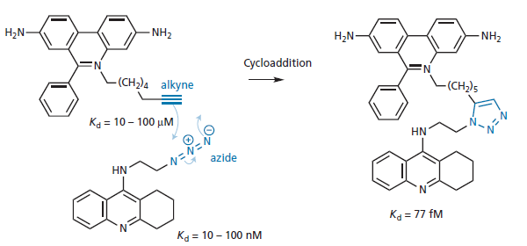
Fragment-based lead discovery

Slide 11
Properties of lead compound
If the aim of the research is to develop an orally active compound, certain properties of the lead compound should be taken into account
Most orally active drugs obey the rules laid down in Lipinski’s Rule of Five
A study of known orally active drugs and the lead compounds from which they were derived demonstrated that the equivalent rules for a lead compound should be more strict
This is because the structure of the lead compound almost certainly has to be modified and increased, both in terms of size and hydrophobicity

Slide 12
Properties of lead compound
The suggested properties for a lead compound are that it should have a molecular weight of 100–350 amu and a Clog P (a measure of hydrophobicity of compound) value of 1–3
There is an average increase in molecular weight of 80 amu and an increase of 1 in Clog P when going from a lead compound to the final drug
Studies also show that a lead compound generally has fewer aromatic rings and hydrogen bond acceptors compared with the final drug
Such considerations can be taken into account when deciding which lead compound to use for a research project if several such structures are available

Slide 13
Properties of lead compound
For fragment-based lead discovery, a rule of three has been suggested for the fragments used:
a molecular weight less than 300
no more than three hydrogen bond donors
no more than three hydrogen bond acceptors
cLog P = 3
no more than three rotatable bonds
a polar surface area = 60 A²

Slide 14
Isolation and Purification
If the lead compound (or active principle ) is present in
a mixture of compounds from a natural source or a combinatorial
synthesis, it has to be isolated and purified
The ease with which the active principle can be isolated and purified depends very much on the structure, stability, and quantity of the compound
The development of new experimental procedures for separation such as freeze drying and chromatography leads to more successful isolation and purification of lead compounds from natural sources

Slide 15
Structure determination
There is a great difference in the time needed for structure determination between the past and the present days
the microanalysis of cholesterol was carried out in 1888 to get its molecular formula, but its chemical structure was not fully established until an X-ray crystallographic study was carried out in 1932
In the past, structures had to be degraded to simpler compounds, which were further degraded to recognizable fragments

Slide 16
Structure determination
Today, structure determination is a relatively straightforward process
Th e most useful analytical techniques are X-ray crystallography and NMR spectroscopy.
The former technique comes closest to giving a ‘snapshot’ of the molecule, but requires a suitable crystal of the sample.
The latter technique is used more commonly, as it can be carried out on any sample, whether it be a solid, oil, or liquid
In cases where there is not enough sample for an NMR analysis, mass spectrometry can be helpful

Slide 17
Optimizing target interactions
Once the structure of a lead compound is known, the medicinal chemist moves on to study its structure–activity relationships (SAR)
Th e aim is to identify those parts of the molecule that are important to biological activity and those that are not
If it is possible to crystallize the target with the lead compound bound to the binding site, the crystal structure of the complex could be solved by X-ray crystallography, then studied with molecular modelling soft ware to identify important binding interactions

Slide 18
Structure Activity Relationships
if the target structure has not been identified or cannot be crystallized, it is then necessary to revert to the traditional method of synthesizing a selected number of compounds that vary slightly from the original structure, then studying what effect that has on the biological activity
Let us imagine that we have isolated glipine
There are a variety of functional groups present in the structure and the diagram shows the potential binding interactions that are possible with a target binding site

Slide 19
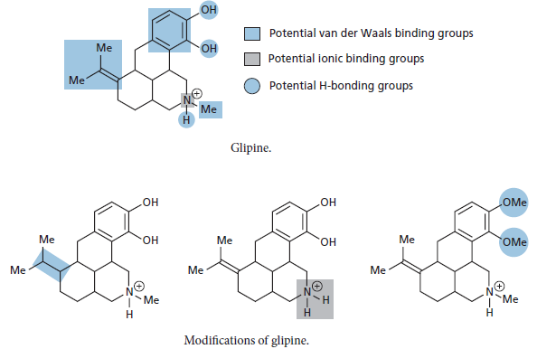
Structure Activity Relationships

Slide 20
Structure Activity Relationships
We have to identify which of these interactions take place actually
By synthesizing analogues where one particular functional group of the molecule is removed or altered, it is possible to find out which groups are essential and which are not
Th is involves testing all the analogues for biological activity and comparing them with the original compound
If an analogue shows a significantly lowered activity, then the group that has been modified must have been important
If the activity remains similar, then the group is not essential

Slide 21
Identification of a pharmacophore
Th e pharmacophore summarizes the important binding groups that are required for activity, and their relative positions in space
with respect to each other.
If we discover that the important binding groups for glipine are the two phenol groups, the aromatic ring, and the nitrogen atom, then the pharmacophore is as shown below
Structure I shows the two-dimensional (2D) pharmacophore and structure II shows the three-dimensional (3D) pharmacophore

Slide 22
Identification of a pharmacophore
Structure II specifies the relative positions of the important groups in space.
The nitrogen atom is 5.063 A from the centre of the phenolic ring and lies at an angle of 18° from the plane of the ring
An even more general type of 3D pharmacophore is the one shown as structure III
the bonding characteristics of each functional group are defined, rather than the group itself
This allows the comparison of molecules which may have the same pharmacophore and binding interactions, but which use different functional groups to achieve these interactions

Slide 23
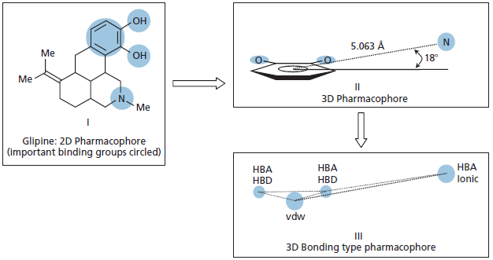
Identification of a pharmacophore

