Slide 1
Exercise 1
Work example

Slide 2
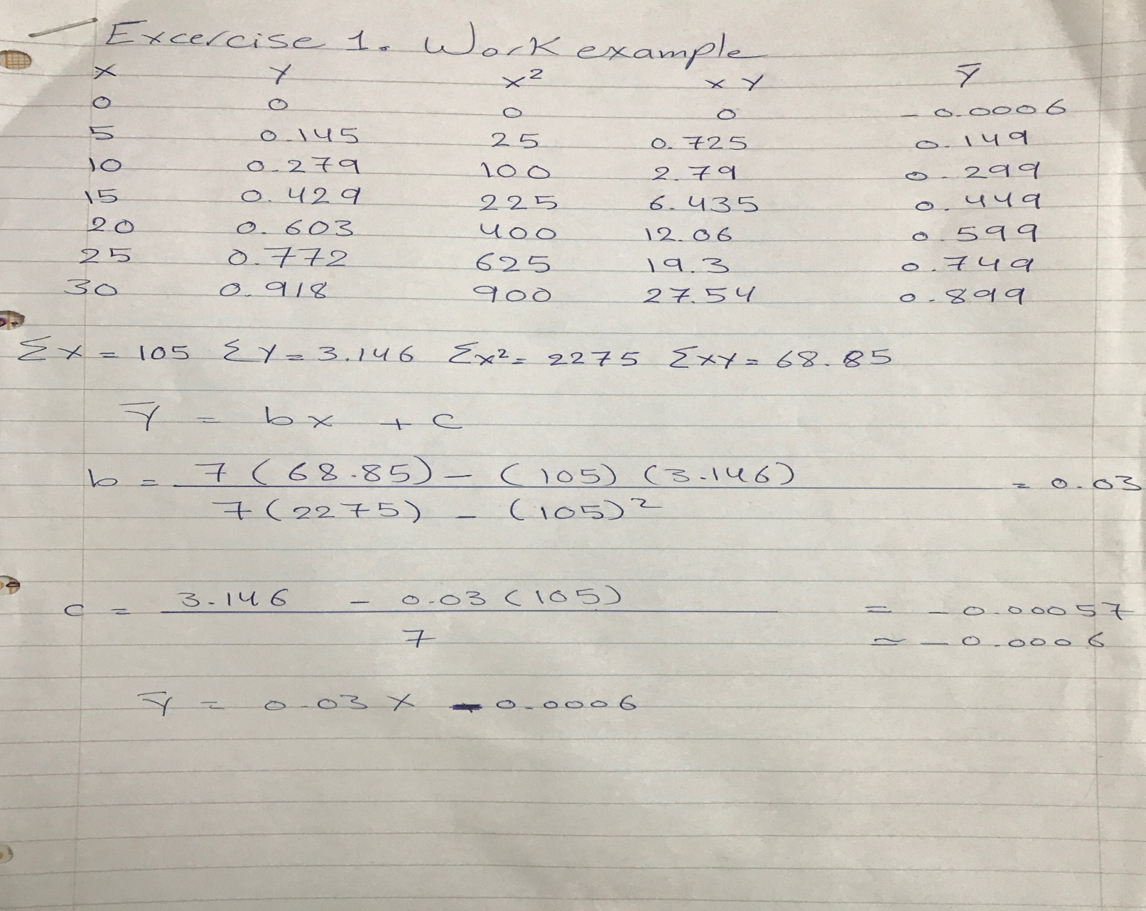

Slide 3
