Slide 1
Barbiturates
Thiopental Vs. phenobarbital and
Dose Calculations
Lab 2
Asst. Lec. Zakariya A. Mahdi , MSc
Department of Pharmacology and Toxicology
University of Al-Mustansiriyah
2018-2019

Slide 2
Overview:
General Anesthesia: Loss of consciousness in addition to loss
of sensation
• Analgesia: Loss of sensitivity to pain.
• Sedation: A state of mental calmness, decreased response to
environmental stimuli,
• Euthanasia: is the practice of intentionally ending a life to
relieve pain and suffering.

Slide 3
Barbiturate
Class of drugs that act as central nervous system depressants, and can therefore produce a wide spectrum of effects, from mild sedation to total anesthesia
  • Long acting bartiturates, ex. Phenobarbitone
  • Short acting barbiturates, ex. Butobarbitone and Pentobarbitone
  • Ultra short acting barbiturates, ex. Thiopentane
They are also effective as anxiolytics, hypnotics, and anticonvulsants
Barbiturates also have analgesic effects, however these effects are somewhat weak, preventing barbiturates from being used in surgery in the absence of other analgesics

Slide 4
Mechanism of action
Enhance binding of GABA with its receptors, prolonged opening of the Chloride channel (influx of Cl), hyperpolarization
Block the AMPA receptor, a subtype of glutamate receptor, Leading to decrease the activity of excitatory glutamate neurotransmitter

Slide 5
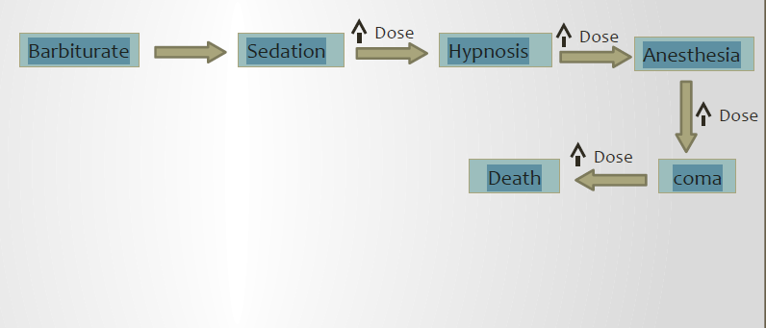
CNS depressant

Slide 6
Barbiturate
Advantages:
  Rapid anesthetic onset;
  Provides a prolonged duration of surgical anesthesia.
  Can be a sedative.
  Anesthetic agent or euthanasia agent depending on the dose
Disadvantages:
  Prolonged recovery time.
  inadequate analgesic properties.
  extremely expensive.
  narrow margin of safety.
  produces respiratory depression at higher dosages.
  Potent inducer for liver metabolizing enzymes.
  They have addiction potential, both physical and psychological.

Slide 7
Pharmacokinetics
High lipid solubility Cross blood brain barrier, rapid onset
Redistribution to other tissues Short duration of action

Slide 8
Experiment protocol
Six mice are injected with Thiopental ( three of them By Sc. route and other three by IP route.
Thiopental dosage form :1 gm vial
Thiopental dose in mice:
Thiopental 30-40 mg/kg IP or Sc.
Six mice are injected with Phenobarbital ( three of them By Sc. route and other three by IP route.
Phenobarbital dosage form: 200mg/1ml ampoule
Phenobarbital dose in mice:
Pentobarbital 50-90 mg/kg IP

Slide 9
Calculate Your Dose
The dose is the amount of drug taken at any one time
  • Weight of drug (e.g. 250 mg)
  • Volume of drug solution (e.g. 10 mL, 2 drops)
  • The number of dosage forms (e.g. 1 capsule, 1 suppository)
  • Other quantity (e.g. 2 puffs)
• The dosage regimen is the frequency at which the drug doses are given. Ex. 2.5 mL twice a day, one tablet three times a day…
• Accurate dosing is critical for the proper utilization of all pharmaceuticals
• First you need to know what volume you want to inject into the animal with each treatment being administered, then you need to know how much drug should be in that given volume

Slide 10
Calculate Your Dose
To calculate the correct dose of drug you need to know
  • The concentration of the drug
  • The weight of the animal
  • The recommended dose rate of the drug for each specific animal model
Concentration of the drug
  • mg/ml: Manufacturers usually provide concentrations of their product in milligrams (mg) of drug per (ml) of solvent
  • % : 10% solution of Drug A is 10gm/100ml, a 2% solution of Drug A is 2gm/100ml (20mg/ml)
  • IU/ml: International Units per ml of, like some of the fat soluble vitamins
  • powders: The mg of active drug in the vial. For example, Drug B comes in powdered form with 500mg per vial:
    • If you add 5ml of sterile water for injection to the vial thus providing 5ml of 100mg/ml drug
    • If you add 2.5ml of sterile water for injection, will make 2.5ml of a 200mg/ml solution

Slide 11
Calculate Your Dose
Weight of the animal
  • It is always best to use a scale and get an accurate weight
  • If you cannot weigh the animal prior to injection, you need to be experienced in estimating the weight
Dose rate of the drug
  • Always look up the drug dose for the species you are working with - it often varies

Slide 12
Calculate Your Dose
Practice
•For most applications the following formula is applicable:
    (C1)(V1) = (C2)(V2)
• Ex. You have 20 ml of a 10 mg/ml solution and you want to make 15 ml of a 2.5 mg/ml solution. Set up the math as follows:
  C1 = 10 mg/ml C2 = 2.5 mg/ml V1 = unknown V2 = 15 ml
  (10 mg/ml) (V1) = (2.5 mg/ml) (15 ml)
  V1 = 3.75 ml
So you dilute 3.75 ml of C1 to a final volume of 15 ml therefore you need to add 15 - 3.75 =11.25 ml of diluent
•How to administer xylazine at a dose rate of 10mg/kg to a 300 g rat?
You are using 2% xylazine.
  The proper dose for a 300g rat is: 10x0.3kg= 3mg of xylazine
  2% xylazine is 20 mg/ml
  3/20=0.15 ml of 2% xylazine

Slide 13
Experimental protocol
Parameters
  • General Activity
  • Characteristics of Breathing
  • Onset of Sleep (mins)
  • Duration of Sleep (mins)
Barbiturates are hypnotic drugs
  • Onset of action is the time required to loss the righting reflex
  • Duration of action in mice can be measured by the ‘sleeping time’ (i.e. the time from the loss of righting reflex to recovery of reflex)

Slide 14
Experimental protocol
The loss of righting reflex (LORR) assay was used to evaluate sedative/hypnotic effects
Righting reflex the ability to assume an optimal position when there has been a departure from it
The onset time of sleep was noted for all animals. After induction of sleep, mice were placed in the inverted position and when sedation was over, the mice came to normal posture and time was noted
Record:
  • LORR was recorded as the time at which the animal was unable to turn itself (onset of action)
  • The time to regain the righting reflex (duration of action)

Slide 15
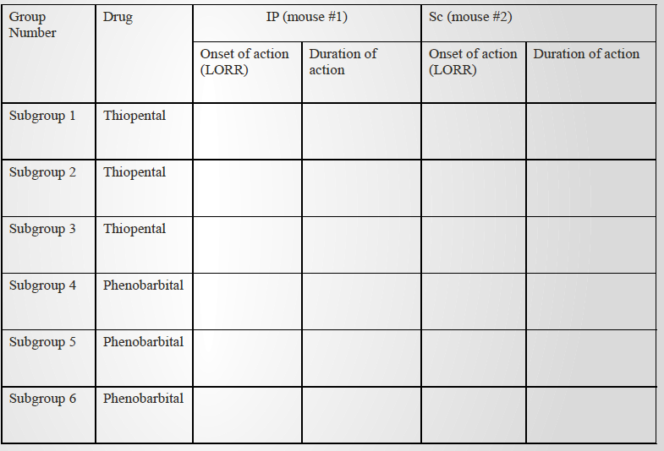
Results

Slide 16
Report
Discussion: mention and discuss your results, for example:
• From the results obtained, we noted that onset of
action was faster in IP than SC route. This is due
to…..etc.

