Slide 1
Variability in Drug Dosage
Requirements
Therapeutic Drug Monitoring
Lec. 3

Slide 2
Renal function
•
Most water-soluble drugs are eliminated
extent by the kidney.
unchanged to some
•
In addition, drug metabolites that were made more water
soluble via oxidation or conjugation are typically removed by
renal elimination.
•
Unbound drug molecules that are relatively small are ﬁltered
at the glomerulus.
•
Glomerular
ﬁltration
is
the
primary
elimination
route
for
many medications.

Slide 3
Renal function
•
When infants are born, renal function is not yet completely
developed in full-term neonates (~40 weeks gestational age(.
•
However, kidney development is complete and renal function
stabilizes 3–6 months after birth.
•
In premature infants (<35 weeks), kidney development may
take even longer during the postpartum period.
•
Kidney function, as measured by glomerular ﬁltration rate,
typically averages ~120–140 mL/min in young, healthy adults
between the ages of 18–22 years.

Slide 4
Renal function
•
As
humans aged,
there
is
a gradual
decline
in glomerular
function so that by 65 years of age, the average glomerular
filtration rate is ~50–60 mL/min.
•
The expected glomerular ﬁltration rate for otherwise healthy,
normal 80-year-old adults is ~30–40 mL/min.
•
A
glomerular
ﬁltration
rate
of 80-120
mL/min
is
usually
considered the normal range by most clinical laboratories.

Slide 5
Renal disease
Patients with acute kidney failure may get back their baseline
renal function after a period of supportive care and dialysis,
for example;
•
• Hypotension, shock, or hypovolemia
• Nephrotoxic drug therapy such as aminoglycoside or vancomycin

Slide 6
Renal disease
Patients with chronic renal failure sustain permanent loss of
functional nephrons due to irreversible damage and do not
recover the lost kidney function.
•

Slide 7
Measurement of creatinine clearance
•
Glomerular
ﬁltration
rate
can
be
determined
by
¹²⁵I-
administration of special test compounds such as inulin or
iothalamate;
this
is sometimes
done for
patients
when
precise determination of renal function is needed.
•
However, the method recommended by the Food and Drug
Administration (FDA) and others to estimate renal function for
the
purposes
of
drug
dosing
is
to
measure
or
estimate
creatinine clearance (CrCl(.

Slide 8
Measurement of creatinine clearance
•
Creatinine
is
a
by-product
of
muscle
metabolism
that
is
primarily eliminated by glomerular ﬁltration.
•
Because
of
this
property,
it
is used
as
a
surrogate
measurement of glomerular ﬁltration rate.

Slide 9
Measurement of creatinine clearance
Creatinine clearance rates can be measured by collecting urine for a specified period, and collecting a blood sample for determination of serum creatinine at the midpoint of the concurrent urine collection time
•
^{CrCl (ml/min) = (U}Cr ^{· V urine )/(S}Cr ^{· T(}
UCr: urine creatinine concentration (mg/dL(
V urine: volume of urine collected (ml(
SCr: serum creatinine collected at the midpoint of the urine collection (mg/dL(
T : time of the urine collection (minutes(

Slide 10
Measurement of creatinine clearance
Because creatinine renal secretion exhibits diurnal variation,
most nephrologists use a 24-hour urine collection period for
the determination of creatinine clearance.
•

Slide 11
Measurement of creatinine clearance
•
For example, a 24-hour
the following results:
urine
was
collected
for
a
patient
with
U_{Cr} = 55 mg/dL
V urine = 1000 mL
S_{Cr} = 1.0 mg/dL
T = 24 h × 60 min/h = 1440 min
CrCl (mL/min) = (UCr ⋅ Vurine) / (SCr ⋅ T)
= (55 mg/dL ⋅ 1000 mL) /(1.0 mg/dL ⋅ 1440 min)
= 38 mL/min.

Slide 12
Measurement of creatinine clearance
However, for the purpose of drug dosing, collection periods of 8–12 hours have been sufficient
•
If renal function is stable, the blood sample for determination of serum creatinine may not need to be collected at the precise midpoint of the urine collection.
•

Slide 13
Measurement of creatinine clearance
•
Routine measurement of creatinine clearances has been
associated with several problems:
•
•
Incomplete urine collections
Serum creatinine concentrations
times
Collection time errors
obtained at incorrect
•

Slide 14
Estimation of creatinine clearance
•
This realization has prompted investigators to derive methods
which estimate creatinine clearance from serum creatinine
values
and
other
patient
characteristics
in
various
populations.
•
The most widely used of these
years and older is the method
Gault:
formulas for adults aged 18
suggested by Cockcroft and

Slide 15
Estimation of creatinine clearance
•
For
males,
^{CrCl}est ^{= [(140 - age) BW] / (72 ⋅ SCr}
(
•
For
females,
CrClest = [0.85(140 - age)BW] /(72 ⋅ SCr)
•
The
0.85
correction factor
for
females
is
present
because
women have smaller muscle mass than men and, therefore,
produce less creatinine per day.
CrClest: estimated creatinine clearance (mL/min(
age (years(
BW: body weight (kg(
SCr: serum creatinine (mg/dL(

Slide 16
Estimation of creatinine clearance
•
The
Cockcroft-Gault method should only be used in patients:
▪
▪
▪
≥18 years old
Actual weight within 30% of their ideal body
Stable serum creatinine concentrations
weight
•
Ideal body weight
IBW_{males} (in kg) = 50 + 2.3(Ht − 60)
IBW_{females} (in kg) = 45 + 2.3(Ht − 60),
Ht: height in inches

Slide 17
Estimation of creatinine clearance
•
For example, A 55-year-old, 80-kg, 5-ft 11-in male has
1.9 mg/dL.
a
Scr
IBW males = 50 + 2.3 (Ht - 60) = 50 + 2.3(71 - 60) = 75
kg
So the patient is within 30% of his ideal body weight
the Cockcroft-Gault method can be used;
CrCl_{est} = [(140 −age)BW] / (72 ⋅ SCr)
= [(140 − 55 y)80 kg] / (72 ⋅ 1.9 mg/dL)
= 50 mL/min.

Slide 18
Estimation of creatinine clearance
•
Some patients have decreased muscle mass due to disease
states and conditions that affect muscle or prevent exercise.
•
Patients with spinal cord injury, cancer patients with muscle
wasting, HIV-infected patients
and
patients
with
poor
nutrition are examples of situations where muscle mass may
be very small resulting in low creatinine production.
•
In
these
cases,
serum
creatinine
concentrations
are
low
because of the low creatinine production rate and not due to
high renal clearance of creatinine.

Slide 19
Estimation of creatinine clearance
In these cases, investigators have suggested that if serum
creatinine values are <1.0 mg/dL for a patient, an arbitrary
value of 1 mg/dL be used in the Cockcroft-Gault formula to
estimate creatinine clearance.
It may be necessary to measure creatinine clearance in these types of patients if an accurate reﬂection of glomerular ﬁltration rate is needed
•
•

Slide 20
Estimation of creatinine clearance
•
If serum creatinine values are not stable, the Cockcroft-Gault
equation cannot be used to estimate creatinine clearance.
•
In
this
case,
an
alternate
method
must
be
used
which
is
Jelliffe and Jelliffe
The first step in this method is to estimate creatinine production:
Ess_{male} = IBW[29.3 − (0.203 ⋅ age)]
Ess_{female} = IBW[25.1 − (0.175 ⋅ age)]
Ess: excretion of creatinine
IBW: ideal body weight (kg(
Age (years(

Slide 21
Estimation of creatinine
clearance
The remainder of the equations correct creatinine production for renal function, and adjust the estimated creatinine clearance value according to whether the renal function is getting better or worse:
^{Ess}corrected
= Ess [1.035 − (0.0337 ⋅ Scr_{ave})]
[^{4IBW(Scr}2 ^{– Scr}1)]
E =
^{Ess}corrected
–
Δt
CrCl (in mL/min / 1.73m²) = E/(14.4 · Scrave
(
Scrave: average of the two serum creatinine determinations in (mg/dL(
Scr1: ﬁrst serum creatinine (mg/dL(
Scr2: second serum creatinine (mg/dL(
Δt: time that expired between the measurement of Scr1 and Scr2 (minutes(

Slide 22
Estimation of creatinine clearance
If patients are not within 30% of their ideal body weight, other methods to estimate creatinine clearance should be used.
It has been suggested that use of ideal body weight or adjusted body weight (ideal body weight plus 40% of obese weight) instead of actual body weight in the Cockcroft-Gault equation, gives an adequate estimate of creatinine clearance for obese individuals
•
•

Slide 23
Estimation of creatinine clearance
•
However, a speciﬁc method (Salazar and Corcoran) for
creatinine clearance for obese patients:
estimating
– 137) age)[(0.285 · Wt) + (12.1 · Ht²)]
CrClest (males) =
.51) Scr(
– 146) age)[(0.287 · Wt(
. 9.74) + Ht²)]
CrClest (females(
=
(60. Scr(
Wt: weight (kg (
Ht: height (m(
^{S}Cr^{: serum creatinine (mg/dL (}

Slide 24
Estimation of creatinine clearance
•
Methods to estimate creatinine clearance for
young adults are also available according to their
children
age:
and
age 0–1 year,
CrClest (in mL/min / 1.73 m2) = (0.45 ⋅ Ht) / SCr
age 1–20 years,
CrClest (in mL/min / 1.73 m2) = (0.55 ⋅ Ht)/SCr
Ht: height (cm(
SCr: serum creatinine (mg/dL(

Slide 25
Estimation of drug dosing using creatinine
clearance
It is common to base initial doses of drugs that are renally eliminated on creatinine clearance.
•
•
The basis for this is that renal clearance of the drug is smaller
in patients with a reduced glomerular ﬁltration rate.
•
However, clinicians should bear in mind that the suggested
doses for patients with renal impairment is an initial guideline
only, and doses may need to be increased in patients that
exhibit suboptimal drug response and decreased in patients
with adverse effects.

Slide 26
Estimation of drug dosing using creatinine
clearance
Generally, one should consider a possible,
•
▪
modest
decrease
in
drug
doses
when Clcr
<50−60 mL/min
▪
moderate
mL/min
substantial
decrease
in
drug
doses
when
Clcr
<25−30
▪
≤15 mL/min
decrease
in
drug
doses
when
Clcr

Slide 27
Estimation of drug dosing using creatinine
clearance
In order to modify doses for patients with renal impairment,
•
it
is
possible;
▪
Decrease the drug dose and retain the usual dosage
interval
▪
Retain the usual dose and increase the dosage interval
▪
Simultaneously decrease the dosage and prolong the
dosage interval

Slide 28
Estimation of drug dosing using creatinine
clearance
The approach of doses modification used depends on:
•
➢ Route of administration
➢ Dosage forms available
➢ Pharmacodynamic response to the drug

Slide 29
Estimation of drug dosing using creatinine
clearance
For example, if the drug is prescribed orally and only a limited number of solid dosage forms are available, one will usually administer the usual dose and increase the dosage interval.
•
•
If
the
drug
is
given parenterally,
a
smaller
dose can
be
administered,
and
it
is
more
likely
that
the
usual
dosage
interval will be retained.

Slide 30
Estimation of drug dosing using creatinine
clearance
•
For drugs with
narrow therapeutic ranges
(aminoglycoside
and vancomycin) both the dose and dosage interval can be
manipulated to achieve the targeted levels.
•
If the drug dose is reduced and the dosage interval remains unaltered in patients with decreased renal function, maximum drug concentrations are usually lower and minimum drug concentrations higher than that in patients
with normal renal function receiving the typical drug dose.
•
If
the
dosage interval
is
prolonged and the
drug
dosage
remains
the
same,
maximum
and
minimum
drug
concentrations are usually about the same as in patients with
good renal function receiving the usual drug dose.

Slide 31
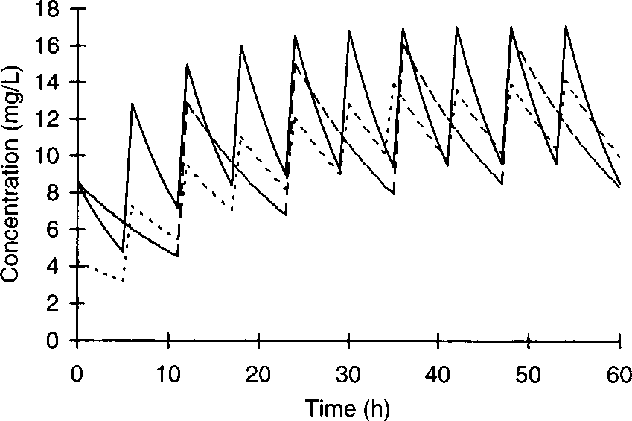

Slide 32
Estimation of drug dosing using creatinine
clearance
Serum concentration versus time profile for a patient with normal kidney function receiving a renally eliminated drug at the dose of 300 mg every 6 hours (solid line).
In a patient with renal dysfunction, it is possible to give the same dose and prolong the dosage interval (300 mg every 12 hours, dashed line), or a reduced dose at the same dosage interval (150 mg every 6 hours, dotted line).
Giving the same dose at a longer dosage interval in the patient with renal disease usually results in a concentration/time profile similar to that seen in a normal patient receiving the normal dose.
However, giving a smaller dose and keeping the dosage interval the same usually produces a concentration/time profile with a lower peak steady-state concentration and a higher trough steady-state concentration.
Note that since the total daily dose is the same for both renal disease dosage regimens (600 mg/d)

Slide 33
Estimation of drug dosing using creatinine
clearance
For drugs with narrow therapeutic indexes, Clcr may be used to estimate pharmacokinetic parameters for a patient based
•
on
prior
studies
conducted
in
other
patients
with
renal
dysfunction.
•
Estimated
pharmacokinetic
parameters
are then used in
pharmacokinetic dosing equations to compute initial doses for
patients.

Slide 34
Estimation of drug dosing using creatinine
clearance
Elimination rate constant (ke) can also be estimated using Clcr, but it is a dependent pharmacokinetic parameter whose result is reliant on the relative values of clearance and volume of distribution (ke = Cl/V).
Because of this, changes in elimination rate constant may not always be due to changes in the renal elimination of the drug.

Slide 35
Estimation of drug dosing using creatinine
clearance
The relationship between (ke) and Clcr is usually approximated by a straight line with a slope that is a function of renal elimination for the agent and an intercept that is related to the elimination of drug in functionally anephric patients (glomerular filtration rate ≈ 0)
Relationship between Clcr and aminoglycoside elimination rate constant (ke) used to estimate initial aminoglycoside elimination when no drug concentrations are available. The y-axis intercept (0.014 h–1) is non-renal elimination for aminoglycosides.

Slide 36
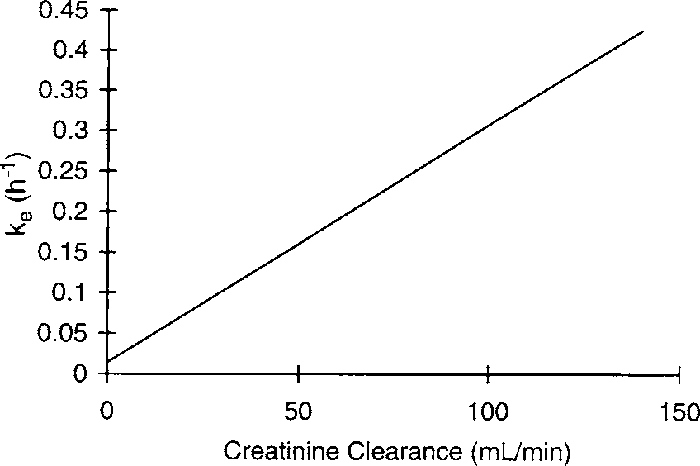
Estimation of drug dosing using creatinine
clearance
ke (in h−1) = 0.00293 ⋅ CrCl + 0.014.

Slide 37
Estimation of drug dosing using
clearance
creatinine
•
Volume
of
distribution
can
also
change
in
patients
with
decreased renal function.
•
Plasma protein binding displacement of drug by endogenous or exogenous substances that would normally be eliminated by the kidney but accumulate in the blood of patients with poor kidney function can increase the volume of distribution of other drugs.
•
Conversely, the volume of distribution of a drug can decrease
if compounds normally excreted by the kidney accumulate to
the extent that displacement of drug from tissue binding sites
occurs.

Slide 38
Estimation of drug dosing using
clearance
creatinine
•
Digoxin
volume
of
distribution
decreases
in
patients
with
decreased renal function;
V (L) = 226 + [(298 ⋅ CrCl)/(29.1 + CrCl)]
•
The
decline
in
volume of
distribution
presumably
occurs
because of displacement of tissue-bound digoxin.

Slide 39
Hepatic disease
•
Most lipid-soluble drugs are metabolized to some degree by
the liver.
•
Phase
I
type
reactions,
such
as
oxidation,
hydrolysis,
and
reduction,
are often
mediated
by
the
cytochrome P-450
enzyme system (CYP.(
•
Phase
II
type
reactions,
including
conjugation
to
form
glucuronides, acetates, or sulfates, may also be mediated in
the liver by cytosolic enzymes contained in hepatocytes.

Slide 40
Hepatic disease
•
Phase I and phase II drug metabolism generally results in
metabolites
that are
more
water
soluble
and
prone
to
elimination by the kidney.
•
Transport proteins, such as
drug molecules into the bile.
P-glycoprotein,
actively secrete
•
Liver blood ﬂow averages 1–1.5 L/min in adults.

Slide 41
Hepatic disease
•
Orally administered medications must pass through the liver
before
entering
the
the
systemic
liver, a
circulation,
so if
the
drug
is
be
metabolized
by
portion
of
the
dose may
inactivated by the hepatic ﬁrst-pass effect before having a
chance to exert a pharmacologic effect.
•
In addition to hepatic metabolism, drugs can be eliminated
unchanged by liver in the bile.

Slide 42
Hepatic disease
•
Hepatic metabolism of drugs is not completely
developed in
neonates
~40-)weeks gestational age,(
and
continues
to
increase so that by age 3–6 months it is stable.
•
In premature infants (<35 weeks), hepatic metabolism may
take even longer to develop in the postpartum period.
•
On a per kilogram basis, drug metabolism is more rapid in
children until puberty.

Slide 43
Hepatic disease
•
At
that point,
metabolic
rate
gradually
decreases
to
adult
values.
•
The effect of advanced age on hepatic
quite variable.
drug metabolism is
•
Patients over the age of 65 years may have decreased hepatic
clearance of some drugs, but oftentimes concurrent disease
states
and conditions that
effect drug
pharmacokinetics
obscure the inﬂuence of age in these older individuals.

Slide 44
Hepatic disease
•
Elderly individuals have decreased liver mass, and it appears
that hepatocytes which are still present have decreased ability
to metabolize drugs.
•
There
are
two major
types
of liver
disease:
hepatitis and
cirrhosis.
•
Patients with
acute
hepatitis
usually experience mild,
transient decreases in
drug metabolism that require no or
minor changes in drug dosing.

Slide 45
Hepatic disease
•
If
the
patient
develops
chronic
hepatitis, it
is
likely
that
irreversible hepatocyte damage will be more widespread, and
drug dosage changes will be required at some point.
•
In patients with hepatic cirrhosis, there is a permanent loss of
functional hepatocytes.
•
Drug
dosage
schedules
usually
need
to
be
modiﬁed
in
patients with severe cirrhosis.

Slide 46
Hepatic disease
•
When hepatocytes are damaged they are no longer able to
metabolize drugs efﬁciently, and intrinsic clearance decreases
which reduces the hepatic clearance of the drug.
•
If the drug experiences a hepatic ﬁrst-pass effect, less drug
will be lost by presystemic metabolism and bioavailability will
increase.
•
A simultaneous decrease in hepatic clearance and liver ﬁrst-
pass effect results in extremely large increases in steady-state
concentrations for orally administered drugs.

Slide 47
Hepatic disease
•
Liver
blood
ﬂow
also decreases
in
patients
with
cirrhosis
because
hepatocytes
are
replaced
by
nonfunctional
connective tissue which increases intraorgan pressure causing
portal vein hypertension and shunting of blood ﬂow around
the liver.
•
The decrease in liver blood ﬂow results in less drug delivery to
still-functioning
hepatocytes
and
depresses
hepatic
drug
clearance even further.

Slide 48
Hepatic disease
•
The liver produces albumin and α-1-acid glycoprotein, the two
major proteins that bind acidic and basic drugs, respectively, in the
blood.
•
In patients with cirrhosis, the production of these proteins decline.
•
When this is the case, the free fraction of drugs in the blood
increases because of a lack of binding proteins.
•
Additionally, high concentrations of endogenous substances in the
blood that are normally eliminated by the liver, such as bilirubin,
can displace drugs from plasma protein binding sites.

