Slide 1
Pharmaceultical dosage form design and drug delivery systems
Lecturer Dr Athmar Dhahir Habeeb
PhD in industrial pharmacy and pharmaceutical formulations

Slide 2
Drug and drug product stability
In preformulation work, evaluation of the physical and chemical stability of the drug substance is very important.
In these studies drug sample should be of known purity.
why?
Stability studies in preformulation phase include
Solid-state stability of the drug alone
Solution phase stability
Stability in presence of expected excipients.
Initial investigation begins with knowledge of the drug’s chemical structure.
Why?

Slide 3
Drug stability: Mechanism of Degradation
Chemically, drug substances are ……
Each with reactive chemical groups having different susceptibilities to chemical instability
Main Degradation pathways
Oxidation
Hydrolysis

Slide 4
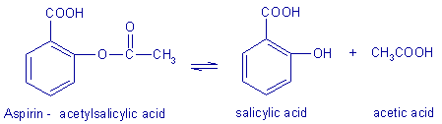
Hydrolysis
Hydrolysis is a solvolysis process
For example, aspirin, or acetylsalicylic acid, combines with a water molecule
Why Hydrolysis is the most important single cause of drug decomposition?

Slide 5
Oxidation
Oxidation destroys many drug types, including…….
Chemically
In inorganic chemistry
In organic chemistry
Oxidation frequently involves free chemical radicals
Many of the oxidative change in pharmaceutical preparation have a character of autoxidations.
Autoxidations occur spontaneously under initial influence of atmospheric oxygen and proceed slowly at first and then more rapidly.

Slide 6
Drug and product stability: kinetics and shelf life
Stability is the extent to which a product retains within specified limits and throughout its period of storage and use (i.e., its shelf life) the same properties and characteristics that it possessed at the time of its manufacture.

Slide 7
Types of stability
Five types of stability concern pharmacists:
1. Chemical:.
2. Physical:.
3. Microbiologic:.
4. Therapeutic:.
5. Toxicologic:.

Slide 8
Chemical stability is important for
selecting storage conditions
selecting the proper container for dispensing
anticipating interactions when mixing drugs and dosage forms.
Stability and expiration dating are based on reaction kinetics
It is the study of the rate of chemical change and the way this rate is influenced by concentration of reactants, products, and other chemical species and by factors such as solvent, pressure, and temperature.

Slide 9
In considering chemical stability of a pharmaceutical, one must know the reaction order and reaction rate.
The reaction order may be the overall order (the sum of the exponents of the concentration terms of the rate expression), or
the order with respect to each reactant (the
exponent of the individual concentration term in the rate expression).
The reaction rate is a description of the drug concentration with respect to time.
Most commonly, zero-order and first-order reactions are encountered in pharmacy.

Slide 10
Q10 Method of Shelf Life Estimation
The Q10 method of shelf life estimation lets the pharmacist estimate shelf life for a product that has been stored or is going to be stored under a different set of conditions.

Slide 11
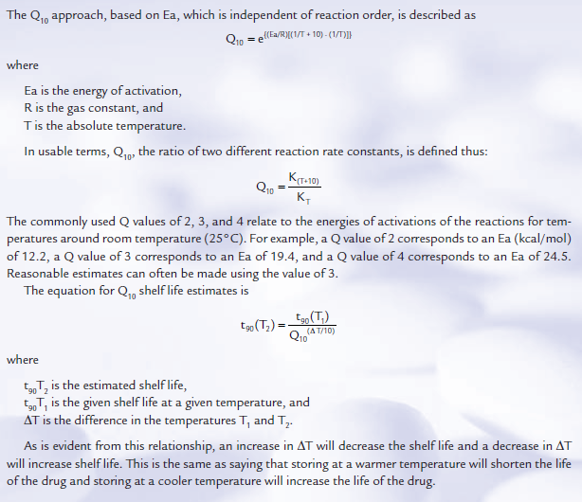

Slide 12
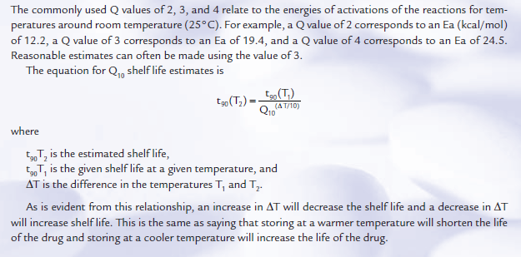

Slide 13
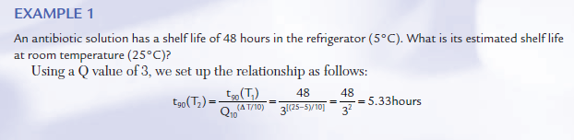

Slide 14
Enhancing Stability of Drug Products
Many pharmaceutical ingredients may be used to prepare the desired dosage form of a drug substance.
substances may be used to increase the stability of the drug substance, particularly against hydrolysis and oxidation.
In each instance, the added pharmaceutical ingredient must be compatible with and must not detract from the stability of the drug substance.

Slide 15
There are several approaches to the stabilization of pharmaceutical preparations containing drugs subject to hydrolysis.
Perhaps the most obvious is the reduction or elimination of water from the pharmaceutical system.
solid dosage forms containing water-labile drugs must be protected from humidity in the atmosphere.
In liquid preparations water reduced or replaced
In certain injectable products, anhydrous vegetable oils may be used as the drug’s solvent

Slide 16
in other liquid drugs by suspending them in a nonaqueous vehicle rather than dissolving them in an aqueous solvent.
unstable antibiotic
What are the main constituents of a dry powder for reconstitution
Together with temperature, pH is a major determinant of the stability of a drug prone to hydrolytic decomposition.
For most hydrolysable drugs, optimum stability is on the acid side, somewhere between pH 5 and 6.
use of buffering agents

Slide 17
oxidation
Pharmaceutically, oxidation of a susceptible drug substance is most likely to occur when
it is not kept dry in the presence of oxygen
it is exposed to light
combined with other chemical agents without proper regard to their influence on oxidation.
Oxidation of a chemical in pharmaceutical preparation is usually accompanied by
an alteration in the color of that preparation.
It may also result in precipitation
a change in odor.

Slide 18
The oxidative process is diverted and the stability of the drug is preserved by agents called antioxidants
How antioxidants work
Various antioxidants are employed in pharmacy.
1- Among those most frequently used in aqueous preparations are
sodium sulfite (Na₂SO₃),
sodium bisulfite (NaHSO₃),
sodium metabisulfite (Na₂S₂O₅),
hypophosphorous acid (H₃PO₂), and ascorbic acid.
2- In oleaginous (oily or unctuous) preparations, alpha-tocopherol, butyl hydroxy anisole, and ascorbyl palmitate find application.

Slide 19
In June 1987, U.S. FDA labeling regulations went into effect requiring a warning about possible allergic-type reactions, including anaphylaxis, in the package insert for prescription drugs to whose final dosage form sulfites have been added.
Some but not all epinephrine injections contain sulfites
In certain instances, other pharmaceutical additives can inactivate a given antioxidant.
In other cases, certain antioxidants can react chemically with the drugs they were intended to stabilize without a noticeable change in the appearance of the preparation.

Slide 20
Because oxygen may adversely affect their stability, certain pharmaceuticals require an oxygen-free atmosphere during preparation and storage.
pharmaceutical liquids
To avoid these exposures, oxygen-sensitive drugs may be prepared in the dry state and packaged in sealed containers
vials and ampoules of easily oxidizable preparations

Slide 21
Trace metals
The rate of formation of color in epinephrine solutions, for instance, is greatly increased by the presence of ferric, ferrous, cupric, and chromic ions.
Great care must be taken to eliminate these trace metals from labile preparations by
thorough purification of the source of the contaminant
by chemically complexing or binding the metal through the use of specialized agents that make it chemically unavailable for participation in the oxidative process.

Slide 22
Light can also act as a catalyst to oxidation reactions
As a precaution against acceleration of oxidation, sensitive preparations are packaged in light-resistant or opaque containers.
Temperature
pH
In some instances, the specific agent to employ as a stabilizer is mentioned in the monograph, and in others the term “suitable stabilizer” is used.

Slide 23
Polymerization, chemical decarboxylation, and deamination
Destructive processes
Polymerization is a reaction between two or more identical molecules that forms a new and generally larger molecule.
Formaldehyde In solution it may polymerize to paraformaldehyde (CH₂O)_{n}
The official formaldehyde solution contains approximately 37% formaldehyde and according to the USP, should be stored at temperatures not below 15°C (59°F).

Slide 24
Other organic drug molecules may be degraded through processes in which one or more of their active chemical groups are removed.
Decarboxylation, and deamination are examples of such processes
For example, insulin, a protein.
most preparations of insulin are neutralized to reduce the rate of decomposition.

Slide 25
Stability Teting
Drug and drug product stability testing during every stage of development is critical to the quality of the product.
Drug stability is important during preclinical testing and in clinical (human) trials why
For a marketed drug product, assurance of stability is vital why

Slide 26
The FDA-required demonstration of drug stability is necessarily different for each stage of drug development,
EX: for a 2-week preclinical study,
an early Phase I study,
a limited Phase II trial,
a pivotal Phase III clinical study,
for a new drug application.

Slide 27
Before approval for marketing, a product’s stability must be assessed with regard to its formulation;
the inﬂuence of its pharmaceutical ingredients;
the inﬂuence of the container and closure;
the manufacturing and processing conditions (e.g., heat);
packaging components;
conditions of storage;
anticipated conditions of shipping, temperature, light, and humidity; and
anticipated duration and conditions of pharmacy shelf life and patient use.

Slide 28
Product containers, closures, and other packaging features must be considered in stability testing.
Sterile products must meet sterility test standards to ensure protection against microbial contamination. All preservatives must be tested for effectiveness in the ﬁnished product.
How to detect product instability
Physical appearance
Chemical changes

Slide 29
Obviously, the rate at which a drug product degrades is of prime importance.
The study of the rate of chemical change and the way it is inﬂuenced by such factors as the concentration of the drug or reactant, the solvent, temperature and pressure, and other chemical agents in the formulation is reaction kinetics.
In general, a kinetic study begins by measuring the concentration of the drug at given intervals under a speciﬁc set of conditions
From this starting point, each of the original conditions may be varied to determine the inﬂuence of such changes on the drug’s stability.

Slide 30
From the experimental data, the reaction rate may be determined and a rate constant and half-life calculated.
The use of exaggerated conditions of temperature, humidity, light, and others to test the stability of drug formulations is termed accelerated stability testing.
conducted for 6 months at 40°C with 75% relative humidity.
If a signiﬁcant change in the product occurs
Short-term accelerated studies are used to determine the most stable of the proposed formulations for a drug product.

Slide 31
In addition to the accelerated stability studies, drug products are subjected to long-term stability studies under the usual conditions of transport and storage expected during product distribution.
Geographic regions are deﬁned by zones: zone I, temperate; zone II, subtropical; zone III, hot and dry; and zone IV, hot and humid.
In general, however, the long-term (12 months minimum) testing of new drug entities is conducted at 25°C ± 2°C and at a relative humidity of 60% ± 5%.

Slide 32
Samples maintained under these conditions may be retained for 5 years or longer
These studies, considered with the accelerated stability studies previously performed, lead to a more precise determination of drug product stability, actual shelf life, and the possible extension of expiration dating.

Slide 33
In addition, signs of degradation of the speciﬁc dosage forms must be observed and reported. For the various dosage forms, this includes the following (1):
Tablets:
Capsules:
Oral solutions and suspensions:
Oral powders:
Metered-dose inhalation aerosols:
Topical nonmetered aerosols:
Topical creams, ointments, lotions, solutions, and gels

Slide 34
Ophthalmic and nasal and oral inhalation preparations:
Small-volume parenterals:
Large-volume parenterals:
Suppositories:
Emulsions:
Controlled-release membrane drug delivery systems:

Slide 35
Under usual circumstances, most manufactured products must have a shelf life of 2 or more years to ensure stability at the time of consumption.
Commercial products must bear an appropriate expiration date that sets out the time during which the product may be expected to maintain its potency and remain stable under the designated storage conditions.
The expiration date limits the time during which the product may be dispensed by the pharmacist or used by the patient.

Slide 36
Prescriptions requiring extemporaneous compounding by the pharmacist do not require the extended shelf life that commercially manufactured and distributed products do because they are intended to be used immediately on receipt by the patient and used only during the immediate course of the prescribed treatment.
However, these compounded prescriptions must remain stable and efficacious during the course of use, and the compounding pharmacist must employ formulative components and techniques that will result in a stable product

